Slide 1


Spatial Computation
Computing without General-Purpose Processors
Mihai Budiu
Microsoft Research – Silicon Valley
joint work with
Girish Venkataramani, Tiberiu Chelcea, Seth Copen Goldstein
Carnegie Mellon University
May 10, 2005
Notes:
Note: this presentation contains several images harvested from the web. They contain explicit attributions in the notes, but may have copyright restrictions. I hope that my use of these images falls under “fair use”. I will immediately remove any infringing material brought to my knowledge.

Slide 2
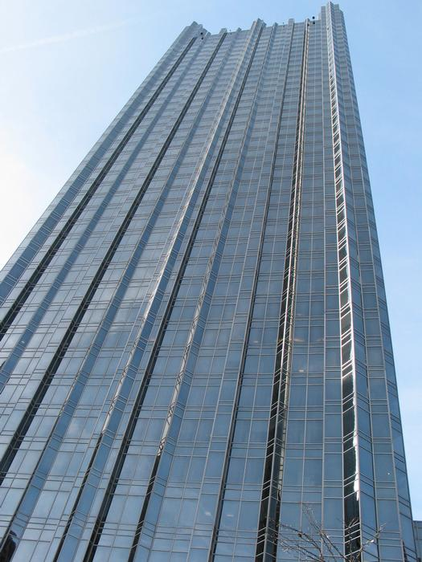
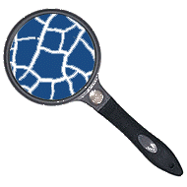
Outline
Intro: Problems of current architectures
Compiling Application-Specific Hardware
ASH Evaluation
Conclusions
1000
100
Performance
10
1
1980
1982
1984
1986
1988
1990
1992
1994
1996
1998
2000
Notes:
Now we will describe a compiler which automatically generates application-specific hardware from high-level language programs.
Image of cash from http://members.hebusx.com/webmasters.php.

Slide 3
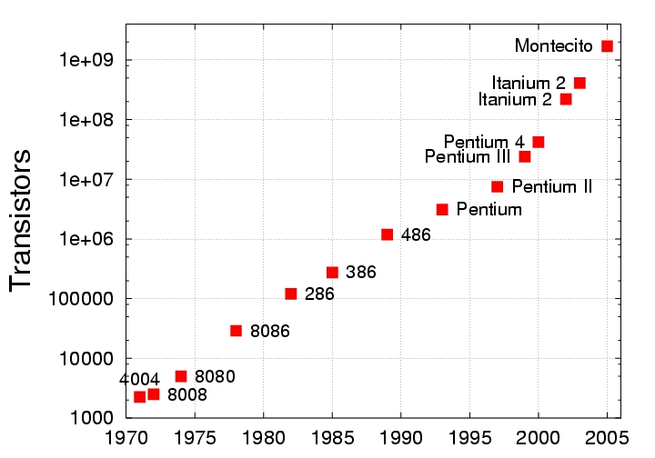
Resources
[Intel]
We do not worry about not having hardware resources
We worry about being able to use hardware resources
Notes:
Moore’s law is predicted to continue to hold for the next decade.

Slide 4
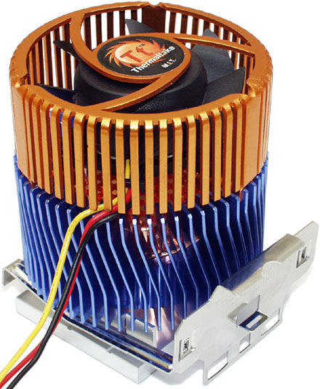
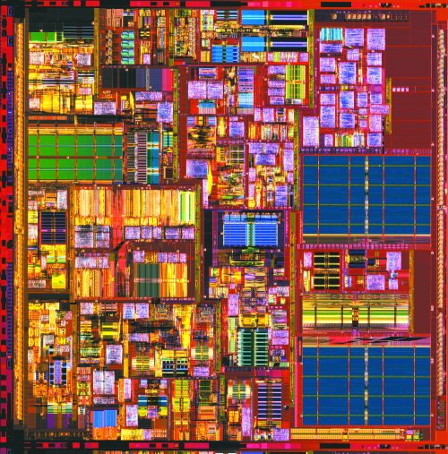
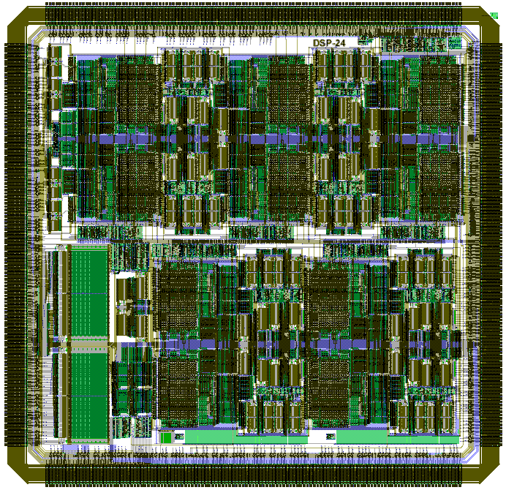
Complexity
10¹⁰
10⁹
gate
10⁸
Chip size
wire
10⁷
10⁶
10⁵
Designer productivity
5ps
20ps
10⁴
1981
1983
1985
1987
1989
1991
1993
1995
1997
1999
2001
2003
2005
2007
2009
ALUs
Cannot rely on global signals
(clock is a global signal)
Notes:
Complexity in current design manifests itself in many ways:
Design complexity outpaces productivity increase in CAD tools.
Wire delays dominate gate delays (this is also true for power consumption)
Power consumption skyrockets
Very little of a superscalar chip surface is devoted to actual computation, causing low energy efficiency
Clock cycles are too short to allow signals to propagate across the whole chip.

Slide 5
Complexity
10¹⁰
10⁹
Automatic
translation
C ! HW
Simple, short,
unidirectional
interconnect
Simple hw,
mostly idle
gate
10⁸
Chip size
wire
10⁷
10⁶
10⁵
Designer productivity
5ps
20ps
10⁴
1981
1983
1985
1987
1989
1991
1993
1995
1997
1999
2001
2003
2005
2007
2009
No interpretation
Distributed
control,
Asynchronous
ALUs
Cannot rely on global signals
(clock is a global signal)
Notes:
Complexity in current design manifests itself in many ways:
Design complexity outpaces productivity increase in CAD tools.
Wire delays dominate gate delays (this is also true for power consumption)
Power consumption skyrockets
Very little of a superscalar chip surface is devoted to actual computation, causing low energy efficiency
Clock cycles are too short to allow signals to propagate across the whole chip.

Slide 6
Our Proposal:
Application-Specific Hardware
ASH addresses these problems
ASH is not a panacea
ASH “complementary” to CPU
CPU
ASH
Low ILP computation
+ OS + VM
High-ILP
computation
$
Memory
Notes:
ASH has complementary properties to the processors; we envision their usage together in computer systems.

Slide 7

Outline
Problems of current architectures
CASH:
Compiling Application-Specific Hardware
ASH Evaluation
Conclusions
Notes:
Now we will describe a compiler which automatically generates application-specific hardware from high-level language programs.
Image of cash from http://members.hebusx.com/webmasters.php.

Slide 8
Application-Specific Hardware
C program
Compiler
Dataflow IR
HW backend
Dataflow machine
Reconfigurable/custom hw
Notes:
The dataflow machine generated is very close semantically to the internal compiler representation, which makes the translation particularly efficient.
In fact, the two are so close that in the following I will blur the distinction between the representation and the resulting circuits.
By going directly from program to hardware implementation we circumvent the limitations of a fixed ISA.

Slide 9
Computation Dataflow
Program
IR
Circuits
a
7
a
x = a & 7;
...
y = x >> 2;
&
&7
2
x
>>
>>2
Operations | Nodes | Pipeline stages
Variables | Def-use edges | Channels (wires)
No interpretation
Notes:
We do not have the disadvantages of the traditional dataflow machine model, because we implement the machines directly in hardware.

Slide 10
Basic Computation=
Pipeline Stage
+
latch
data
ack
valid
Notes:
The synthesized circuit are built from such constructs. The semantics of the internal representation is described in these terms.

Slide 11
Asynchronous Computation
+
+
+
+
data
ack
1
valid
2
3
4
+
+
+
+
latch
5
6
7
8
Notes:
Asynchronous computation is triggered by data availability; it is completely dynamically scheduled.

Slide 12
Distributed Control Logic
global
FSM
ack
rdy
+
-
short, local wires
Notes:
There is no centralized FSM controlling the behavior of the circuit; each producer-consumer pair has some control logic for handshaking.

Slide 13
MUX: Forward Branches
b
x
0
if (x > 0)
y = -x;
else
y = b*x;
*
-
>
!
φ
y
SSA
= no arbitration
Conditionals ) Speculation
Critical path
Notes:
Conditionals are compiled into circuits executing simultaneously all branches. This leads to speculative execution.
This is a form of static-single assignment, where the mux is corresponding to a “phi” node.
The SSA form implies that each wire has a single writer: there is no arbitration for accessing wires. Communication is thus lightweight.

Slide 14
Control Flow ) Data Flow
data
φ
Merge (label)
data
data
predicate
Gateway
p
Split (branch)
!
Notes:
Note: in reality the merge operator is slightly more complicated than described here, since multiple merge operators sometimes need to cooperate in order to correctly execute the program. These operators have surfaced repeatedly in dataflow machines and intermediate program representations, under various names. Note that merge nodes are another form of SSA “phi” nodes.

Slide 15
Loops
0
i
0
*
+1
int sum=0, i;
for (i=0; i < 100; i++)
sum += i*i;
return sum;
< 100
sum
+
return sum;
!
ret
back
Notes:
Loops can be built using merges and gateways as building blocks. Some gateways direct the data to the beginning of the loop while other direct the data out of the loop (red). They are controlled by complementary predicates.

Slide 16
Pipelining
i
1
*
100
+
<=
pipelined
multiplier
(8 stages)
int sum=0, i;
for (i=0; i < 100; i++)
sum += i*i;
return sum;
sum
+
step 1
Notes:
Let us look how the sum-of-squares program behaves at run-time.

Slide 17
Pipelining
i
1
*
100
+
<=
sum
+
step 2

Slide 18
Pipelining
i
1
*
100
+
<=
sum
+
step 3

Slide 19
Pipelining
i
1
*
100
+
<=
sum
+
step 4

Slide 20
Pipelining
i
1
i=1
100
+
<=
i=0
sum
+
step 5
Notes:
Pipelining occurs naturally, due to the asynchronous nature of the computation.
This phenomenon was exploited by the dataflow machines

Slide 21
Pipelining
i
1
*
100
+
i=1
<=
i=0
sum
+
step 6
back
Notes:
Pipelining may suffer from stalls due to unbalanced lengths of paths.

Slide 22
Pipelining
i
1
*
100
+
<=
i’s loop
Long
latency
pipe
predicate
sum
sum’s loop
+
step 7
Notes:
The i loop is coupled to the sum loop through the predicate. The acknowledgment
for the predicate prevents i’s loop from making progress.

Slide 23
Pipelining
i
1
*
100
+
critical path
<=
i’s loop
Predicate ack
edge is on the
critical path.
sum
sum’s loop
+
Notes:
The critical path of this circuit actually goes through an acknowledgment edge.

Slide 24
Pipeline balancing
i
1
*
100
+
i’s loop
<=
decoupling
FIFO
sum
sum’s loop
+
step 7
Notes:
By inserting FIFO stages on the predicate path we can decouple the two loops.

Slide 25
Pipeline balancing
i
1
*
100
+
i’s loop
critical path
<=
decoupling
FIFO
sum
sum’s loop
+
back
back to talk
Notes:
The critical path is minimal for the resulting circuit, implying maximal performance.

Slide 26
Procedures
Caller
Callee
Call
Argument
Return
Continuation

Slide 27
Memory Access
LD
Monolithic
Memory
pipelined
arbitrated
network
ST
LD
local communication
global structures
Future work: fragment this!
Notes:
The major drawback of our current implementation of ASH is the reliance on a monolithic memory model, which makes translation from C easy. Accessing memory requires the construction of arbitration and data networks, which are inherently not scalable. Future work will focus on fragmenting memory in localized storage; some research results on how this should be done have been published by other research groups. A monolithic memory is not inherent to the model.

Slide 28

Outline
Problems of current architectures
Compiling ASH
ASH Evaluation
Conclusions

Slide 29
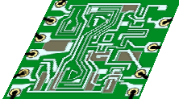
Evaluating ASH
C
Mediabench kernels
(1 hot function/benchmark)
CASH
core
Verilog
back-end
commercial tools
Synopsys,
Cadence P/R
180nm std. cell library, 2V
~1999
technology
Mem
ModelSim
(Verilog simulation)
performance
numbers
ASIC
Notes:
CASH generates Verilog, which is then synthesized using commercial tools in a 180nm technology. The results are evaluated using Verilog-level simulation.
We only model the computation and memory access network; we do not model the memory itself, the cost of the rest of the computation, and the overhead of starting/stopping computation.
We do not include the cost of memory in this comparison.

Slide 30
Compile Time
C
200 lines
CASH
core
20 seconds
Verilog
back-end
10 seconds
Synopsys,
Cadence P/R
20 minutes
1 hour
Mem
ASIC

Slide 31
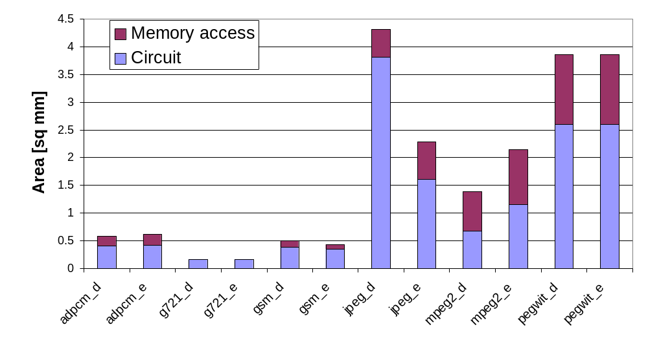
ASH Area (mm²)
P4: 217
minimal RISC core
Notes:
While some circuits require substantial area, it is certainly affordable, especially in future technologies.

Slide 32
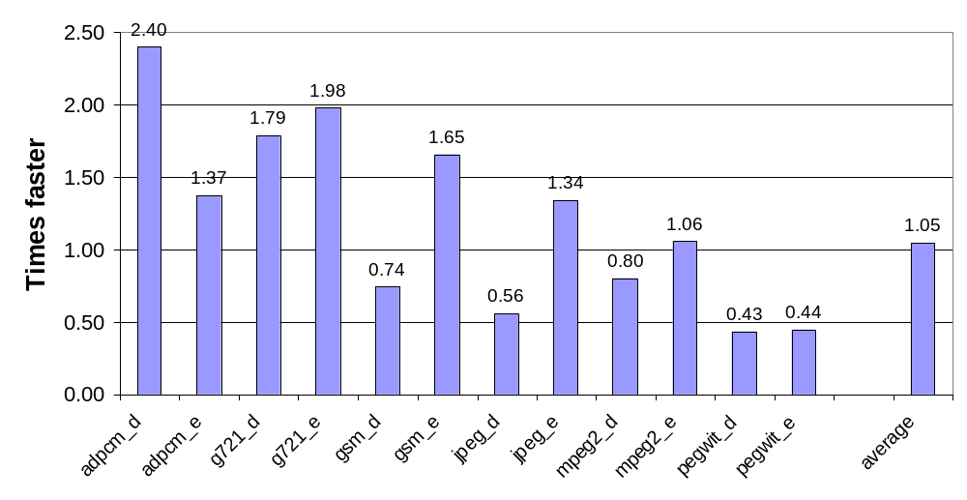
ASH vs 600MHz CPU
[4-wide OOO, .18 μm]
Notes:
On average ASH takes about 2 times as much time to execute a kernel when compared to a state-of-the-art 4-wide superscalar CPU in 180nm technology.
ASH’s functional units are much slower than the highly optimized CPU units, but ASH can benefit from superior parallelism.
These numbers are somewhat disappointing, so we have analyzed the results.

Slide 33
Bottleneck: Memory Protocol
LD
Memory
ST
LSQ
Enabling dependent operations requires round-trip to memory.
Exploring novel memory access protocols.
Notes:
We have uncovered the bottleneck in our current implementation: a naive stop-and-wait protocol for in-order data delivery.
Most programs are memory-network bound.
High-level simulations and limit studies show that this can be substantially improved by using a smart protocol for in-order data delivery coupled with fast token release to the dependent operations; this will enable much better parallelism in the computation.

Slide 34
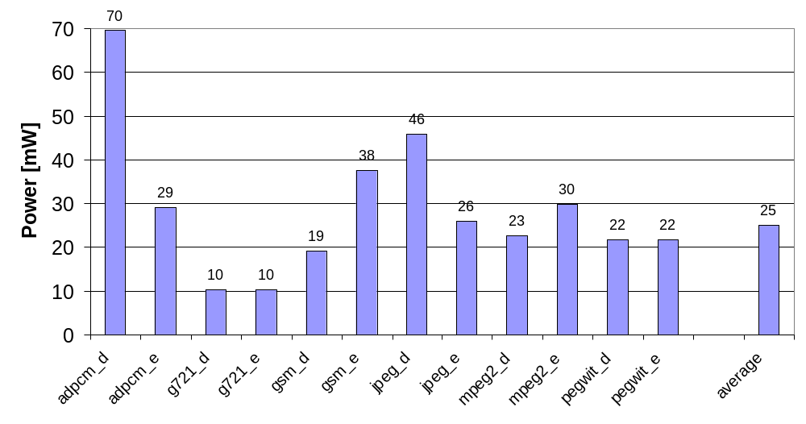
Power (mW)
Xeon
[+cache]
67000
mP
4000
DSP
110

Slide 35
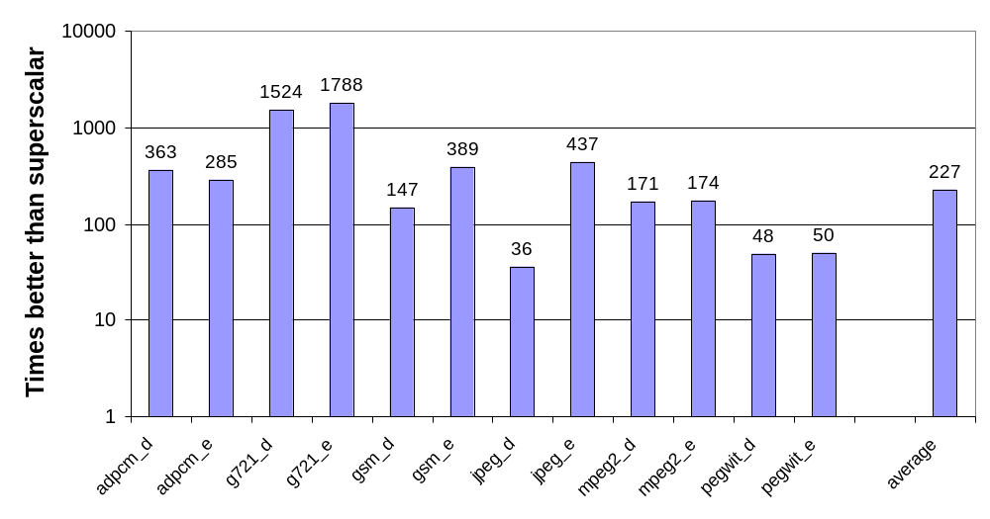
Energy-delay

Slide 36
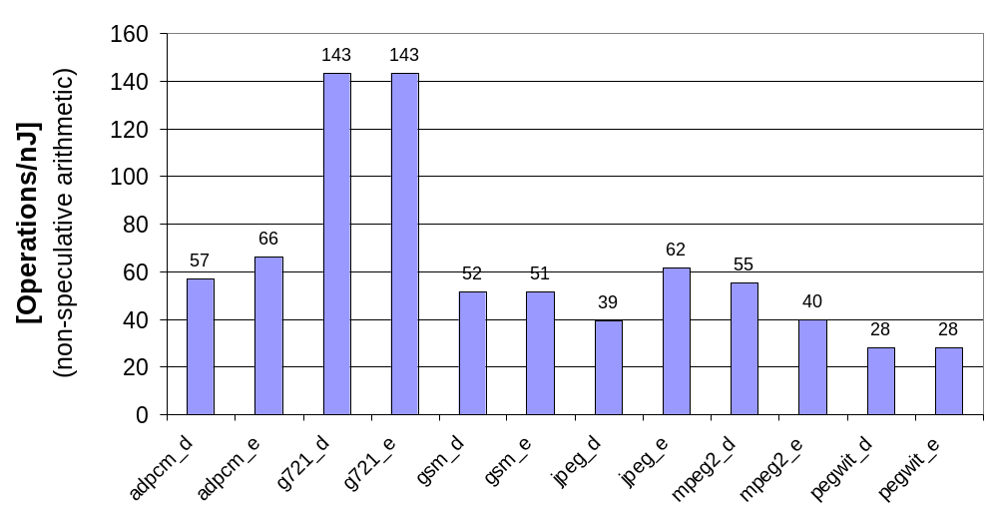
Energy Efficiency (op/nJ)

Slide 37
Energy Efficiency
1000x
Dedicated hardware
ASH media kernels
Asynchronous μP
FPGA
General-purpose DSP
Microprocessors
0
.
0
0
1
1
1
1
0
1
0
0
1
0
0
0
.
Energy Efficiency [Operations/nJ]
Notes:
This graph puts the energy efficiency of ASH in perspective, by comparing it with four other computational models. ASH fare extremely well, surpassing by far microprocessors (3 orders of magnitude; notice the logarithmic scale!), and surpassing by one to two orders of magnitude low-power DSP processors. (Note: we have used peak computation rate estimations for the processors, and sustained rates for ASH.)
ASH fares substantially better than an asynchronous microprocessor, proving that the overhead of instruction interpretation is responsible for low efficiency.
ASH is comparable to hand-crafted commercial, custom implemented dedicated hardware. This is a truly impressive achievement.

Slide 38
Outline
Problems of current architectures
Compiling ASH
Evaluation
Related work, Conclusions

Slide 39
Bilbliography
Dataflow: A Complement to Superscalar
Mihai Budiu, Pedro Artigas, and Seth Copen Goldstein
ISPASS 2005
Spatial Computation
Mihai Budiu, Girish Venkataramani, Tiberiu Chelcea, and Seth Copen Goldstein
ASPLOS 2004
C to Asynchronous Dataflow Circuits: An End-to-End Toolflow
Girish Venkataramani, Mihai Budiu, Tiberiu Chelcea, and Seth Copen Goldstein IWLS 2004
Optimizing Memory Accesses For Spatial Computation
Mihai Budiu and Seth Copen Goldstein
CGO 2003
Compiling Application-Specific Hardware
Mihai Budiu and Seth Copen Goldstein
FPL 2002

Slide 40

Related Work
Optimizing compilers
High-level synthesis
Reconfigurable computing
Dataflow machines
Asynchronous circuits
Spatial computation
We target an extreme point in the design space:
no interpretation,
fully distributed computation and control

Slide 41
ASH Design Point
Design an ASIC in a day
Fully automatic synthesis to layout
Fully distributed control and computation
(spatial computation)
  Replicate computation to simplify wires
Energy/op rivals custom ASIC
Performance rivals superscalar
E£t 100 times better than any processor

Slide 42
Conclusions
Spatial computation strengths
Feature | Advantages
No interpretation | Energy efficiency, speed
Spatial layout | Short wires, no contention
Asynchronous | Low power, scalable
Distributed | No global signals
Automatic compilation | Designer productivity

Slide 43
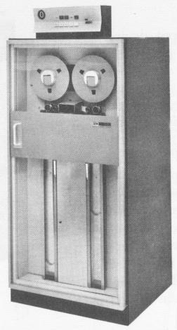
Backup Slides
Absolute performance
Control logic
Exceptions
Leniency
Normalized area
ASH weaknesses
Splitting memory
Recursive calls
Leakage
Why not compare to…
Targeting FPGAs
Notes:
Tape drive image from www.beagle-ears.com/lars/engineer/comphist/c20-1684/

Slide 44
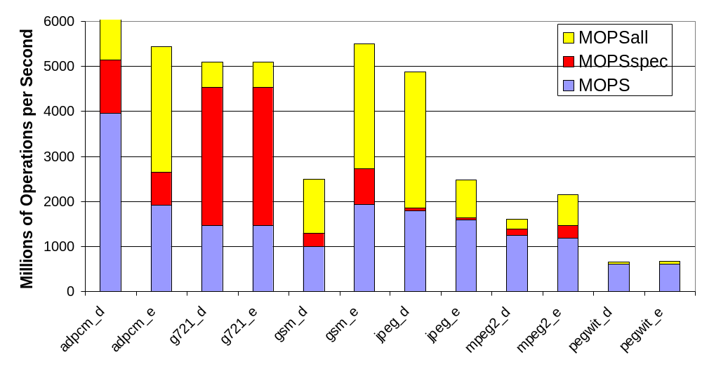
Absolute Performance
CPU range
back

Slide 45
Pipeline Stage
ack_{out}
rdy_{in}
C
ack_{in}
rdy_{out}
=
Δ
data_{in}
Reg
data_{out}
back
Notes:
This is currently the basic structure of the handshake control. This requires a C gate, a matched delay and a completion detection element.
Under very reasonable assumptions about the place-and-route process these circuits are guaranteed to be correct.
Furthermore, they can be easily synthesized using a synchronous tool-chain.
Computing the matching delay is the same as the traditional timing closure problem (but on a strictly local level).

Slide 46
Exceptions
Strictly speaking, C has no exceptions
In practice hard to accommodate exceptions in hardware implementations
An advantage of software flexibility:
PC is single point of execution control
CPU
ASH
Low ILP computation
+ OS + VM + exceptions
High-ILP
computation
$$$
Memory
back

Slide 47
Critical Paths
b
x
0
if (x > 0)
y = -x;
else
y = b*x;
*
-
>
!
y
Notes:
Speculation introduces the problem of long critical paths. The solution is on the next slide.

Slide 48
Lenient Operations
b
x
0
if (x > 0)
y = -x;
else
y = b*x;
*
-
>
!
y
Solves the problem of unbalanced paths
back
back to talk
Notes:
A lenient operation can generate the result before all of its inputs are known.
Leniency reduces the dynamic critical path.
Many other operations can be implemented leniently, such as Booleans.

Slide 49
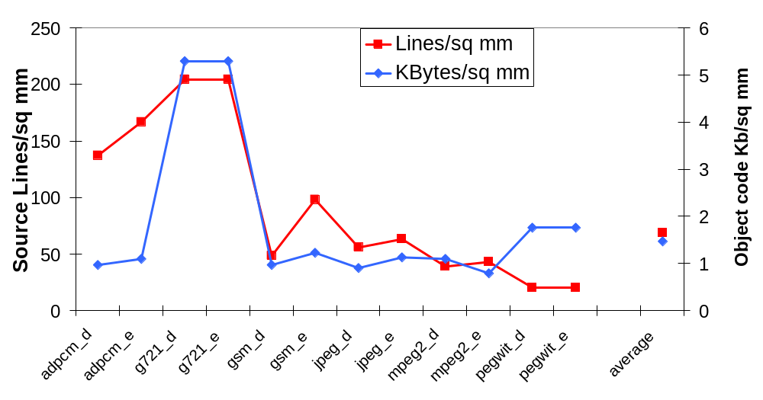
Normalized Area
back

Slide 50
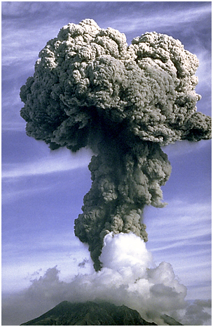
ASH Weaknesses
Both branch and join not free
Static dataflow
(no re-issue of same instr)
Memory is “far”
Fully static
  No branch prediction
  No dynamic unrolling
  No register renaming
Calls/returns not lenient
back
Notes:
These problems manifest themselves when implementing on ASH code with critical control-dependences and little ILP; then ASH is intrinsically weaker than a superscalar processor, which uses extra mechanisms to boost performance.
Photo of volcanic ash from http://photo2.si.edu/earthquakes/sakurajima.html

Slide 51
Branch Prediction
i
ASH crit path
1
CPU crit path
+
for (i=0; i < N; i++) {
...
if (exception) break;
}
<
exception
!
&
Predicted not taken
Effectively a noop for CPU!
Predicted taken.
result available before inputs
back
Notes:
(Successful) branch prediction in processor renders some computations irrelevant.
Since we transformed control-flow into dataflow, the gateway predicate is on the critical path for ASH, but not for processor!
In the thesis we suggest a way to add a limited form of branch-prediction to ASH without destroying its distributed structure.
The hard part is not prediction, but stopping runaway speculation which crosses hyperblock boundaries.

Slide 52
Memory Partitioning
MIT RAW project: Babb FCCM ‘99, Barua HiPC ‘00,Lee ASPLOS ‘00
Stanford SpC:
Semeria DAC ‘01, TVLSI ‘02
Illinois FlexRAM: Fraguella PPoPP ‘03
Hand-annotations #pragma
back

Slide 53
Recursion
save live values
recursive call
restore live values
stack
back

Slide 54
Leakage Power
P_{s} = k Area e^{-VT}
Employ circuit-level techniques
Cut power supply of idle circuit portions
  most of the circuit is idle most of the time
  strong locality of activity
back

Slide 55
Why Not Compare To…
In-order processor
  Worse in all metrics than superscalar, except power
  We beat it in all metrics, including performance
DSP
  We expect roughly the same results as for superscalar
  (Wattch maintains high IPC for these kernels)
ASIC
  No available tool-flow supports C to the same degree
Asynchronous ASIC
  We compared with a Balsa synthesis system
  We are 15 times better in Et compared to resulting ASIC
Async processor
  We are 350 times better in Et than Amulet (scaled to .18)
back

Slide 56
Why not target FPGA
Do not support asynchronous circuits
Very inefficient in area, power, delay
Too fine-grained for datapath circuits
We are designing an async FPGA
back

