Slide 1

a trillion-cell spreadsheet
VLDB
Los Angeles, CA August 28, 2019
Mihai Budiu, Parikshit Gopalan, Lalith Suresh, Udi Wieder, Marcos Aguilera, Han Kruiger

Slide 2


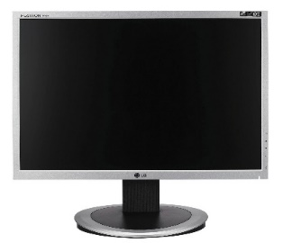
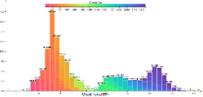
Browsing big data
Interactive visualization of billion row datasets
Slice and dice data with the click of a mouse
http://github.com/vmware/hillview
Apache 2 license

Slide 3


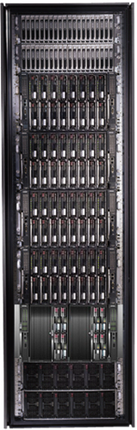
Bandwidth hierarchy
These channels are lossy!
Compute small & approximate data views with an error < channel error.

Slide 4
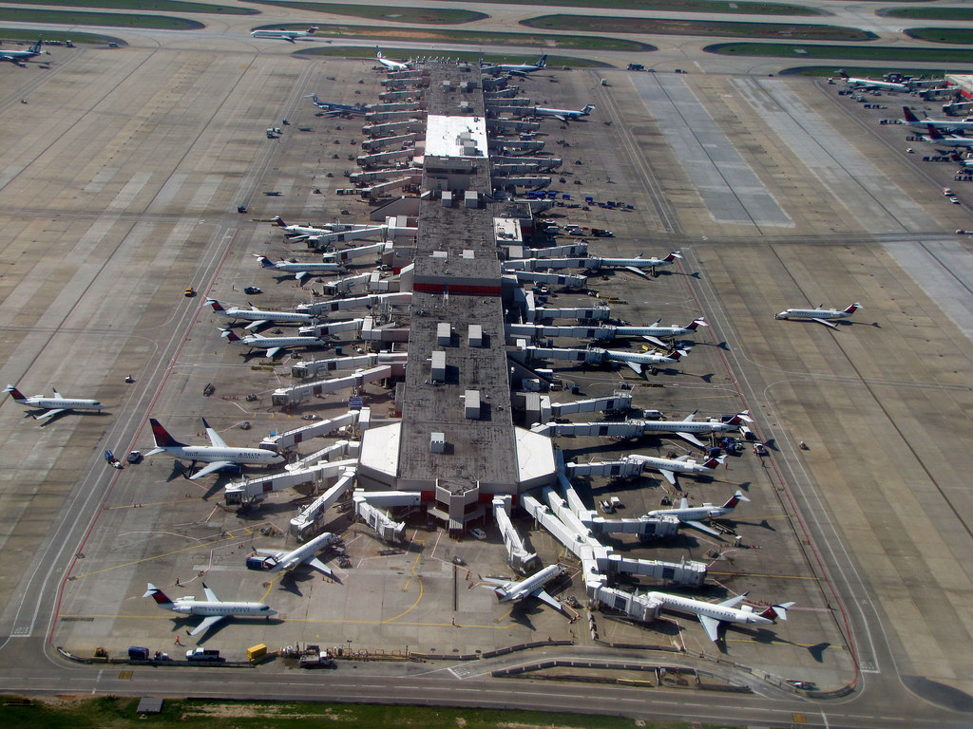
Demo
Browsing 140 million rows
.5M flights/month
All US flights in last 22.5 years
Public data from FAA website
Running on 15 small VMs in Amazon’s cloud (8GB of RAM, 2 CPU cores each) http://ec2-18-217-136-170.us-east-2.compute.amazonaws.com:8080/
Video

Slide 5
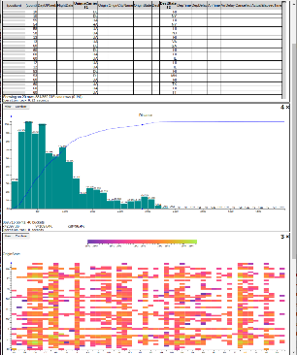


Hillview System architecture
workers
Leaf
node
In-memory
table
parallel
read
Aggregation
node
Leaf
node
In-memory
table
Web front-end
Root
node
In-memory
table
Storage
Leaf
node
In-memory
table
request
In-memory
table
Storage
Remote tables refs.
Aggregation
node
Leaf
node
In-memory
table
streaming
response
In-memory
table
Storage
Redo log
In-memory
table
Client
web browser
Storage
Aggregation network
Hillview cloud service

Slide 6
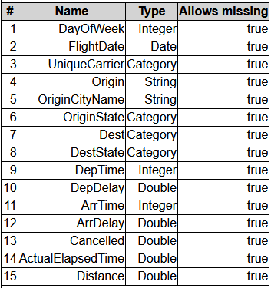
Vizketches: Computational Model
Output O
Post
processing
R must be “small”
(independent on n,
dependent on screen size)
R
merge
R
R
merge
merge
R
R
R
R
Streaming/ sampling algorithm
summarize
summarize
summarize
summarize
Input data, sharded
A restricted form of Map-Reduce: constant size outputs only, no data is moved.

Slide 7
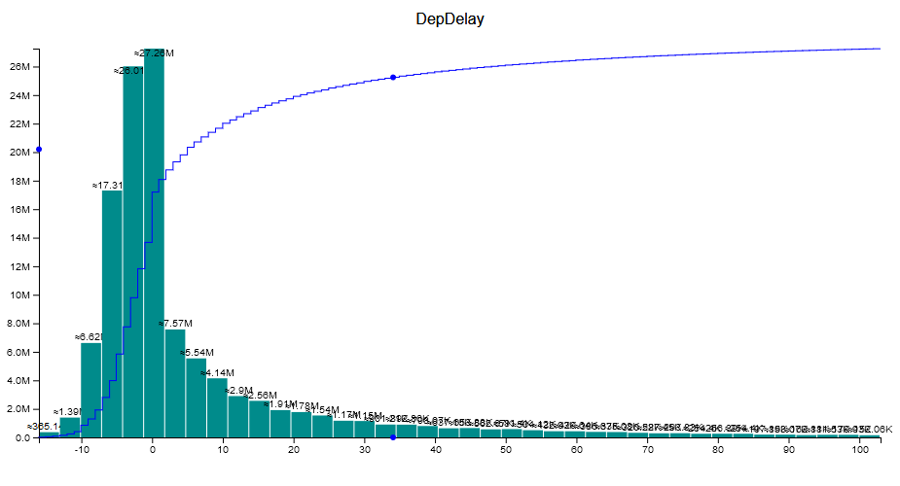
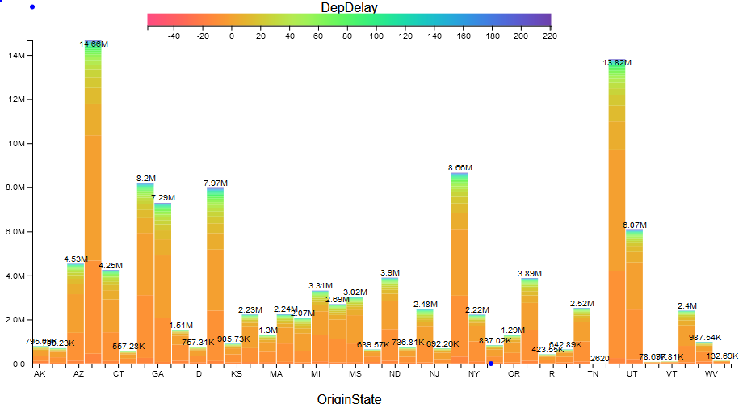
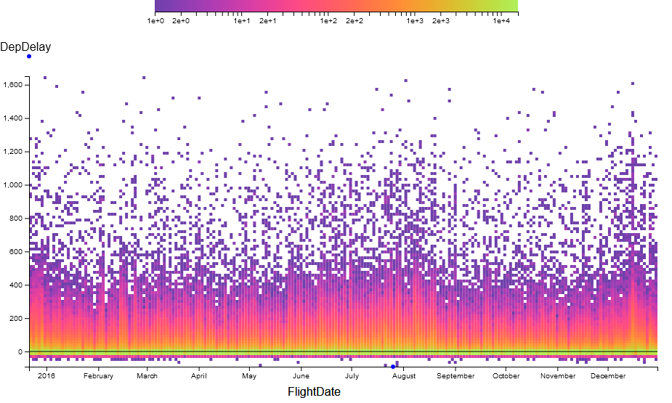
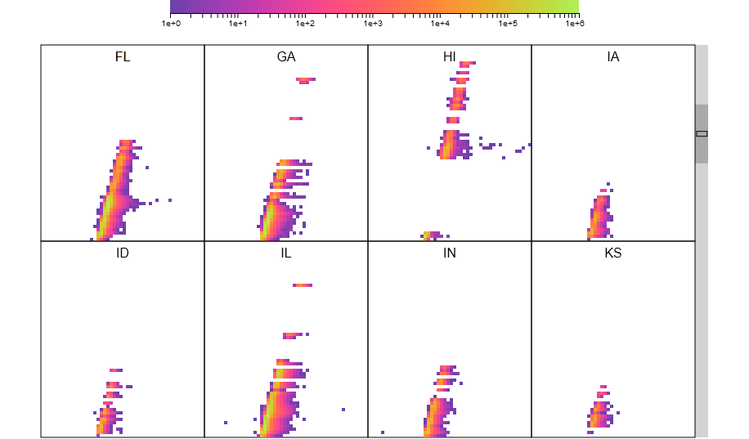
All views are produced by vizketches!
Hypothesis: Vizketches are a sufficiently powerful computational model for visualization tasks.
Efficiency enables interactivity.

Slide 8
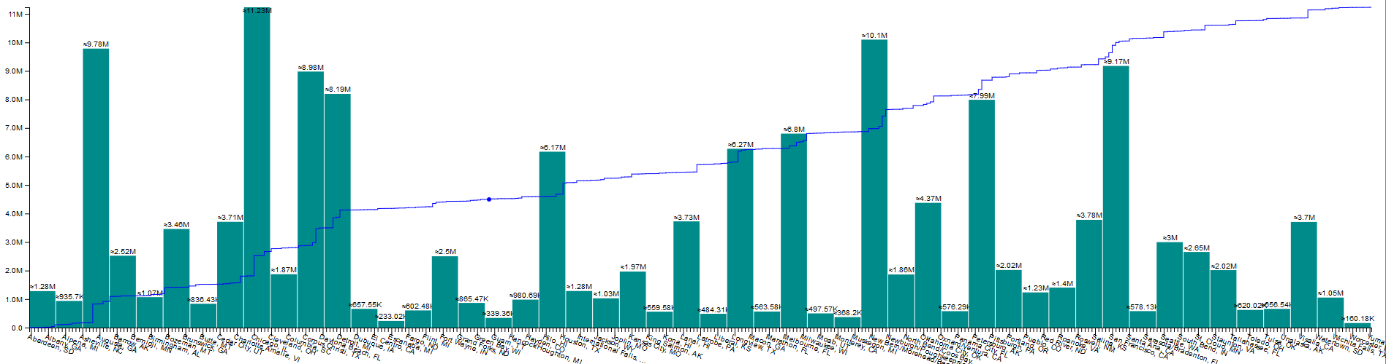
Histograms (GROUP BY + COUNT)
CDF
Histograms are mergeable (vector addition)
CDFs are prefix sums of histograms (at the pixel level)
Computed in two stages:
Choose buckets (based on screen size, data size)
Compute histogram

Slide 9
Histograms based on sampling
Exact histogram
Approximate histogram
μ < 1/2
Actual
Legal rendering
Actual
Legal rendering
Legal rendering
pixel row
Theorem: O((HB / μ)² log(1/δ)) samples are needed to compute an approximate histogram with probability 1 – δ.
H = screen size in pixels
B = number of buckets (< screen width in pixels)
No N in this formula!

Slide 10
Cluster-level weak scaling (8 machines, 54 cores each)
Histogram, 100M elements/shard, 64 shards/machine
Computation gets faster as dataset size grows!

Slide 11
Scaling data
ORC data files, includes I/O and rendering
71B cells
143B cells
1.43T cells

Slide 12

Summary
Hillview: interactive big data visualization engine
vizketches: mergeable summaries
Linear or sublinear execution times
Small outputs (polylog memory in input size)
Efficient by construction
Efficiency enables interactivity
Efficiency of rendering is a first-class concern
Formulating the right queries is important
Helper queries are used to construct query parameters
Many other details on system architecture in the paper

Slide 13
Backup slides

Slide 14
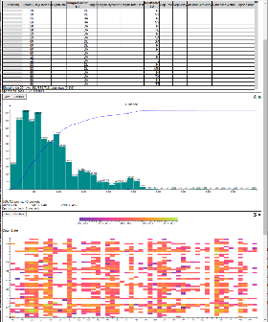
Evaluation system
TOR switch
LAN
Web front-end
Root aggregator
Worker
8 servers
Intel Xeon Gold 5120 2.2GHz (2 sockets x 14 cores x 2 hyperthreads)
128GB RAM/machine
Ubuntu Server
10Gbps Ethernet in rack
2 SSDs/machine
client
…
Worker
Worker
rack

