Slide 1
Monitoring and Debugging Dryad(LINQ) Applications with Daphne
Vilas Jagannath, Zuoning Yin, Mihai Budiu
University of Illinois, Microsoft Research SVC
International Workshop on High-Level Parallel Programming Models and Supportive Environments (HIPS) 2011

Slide 2


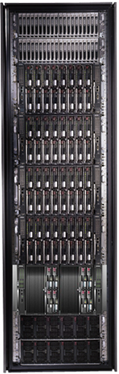


Programming Clusters: Marketing
Map-Reduce

Slide 3
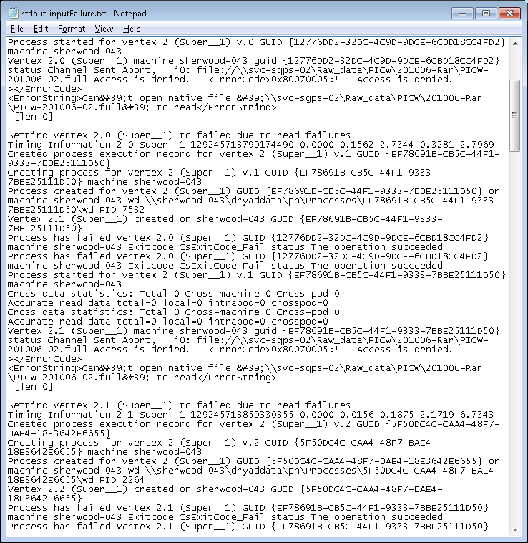
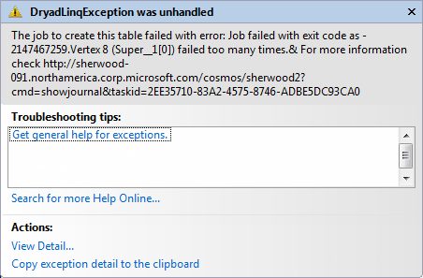
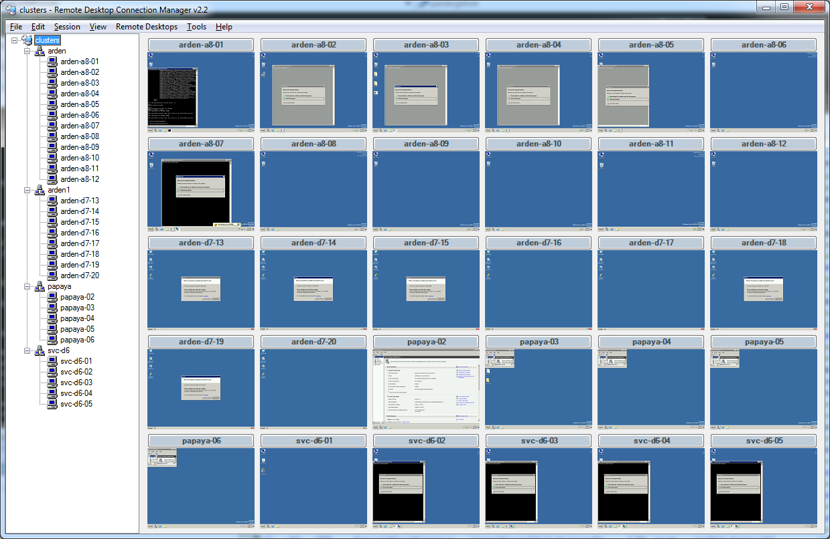
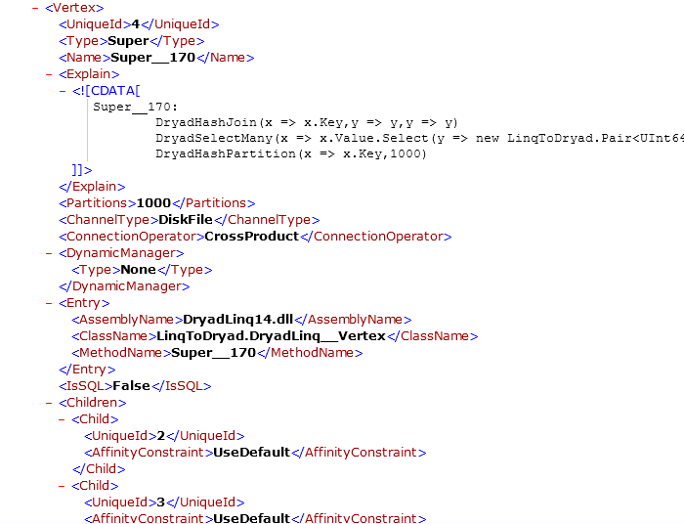
Programming Clusters: Reality

Slide 4
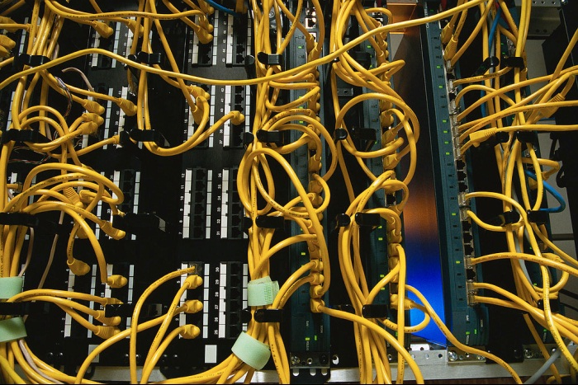
Complexity Exposed
Correctness or performance bugs break the single-system abstraction

Slide 5
Outline
Motivation
Job structure
The Job Object Model
Tools for job understanding
Conclusions

Slide 6
Data-Parallel Computation
Application
Sawzall, Java
≈SQL
LINQ, SQL
Sawzall,FlumeJava
Pig, Hive
DryadLINQ Scope
Language
Map-Reduce
Hadoop
Dryad
Execution
GFS BigTable
HDFS
S3
Cosmos
Azure HPC
Storage

Slide 7

2-D Piping
Unix Pipes: 1-D
grep | sed | sort | awk | perl
Dryad: 2-D
grep¹⁰⁰⁰ | sed⁵⁰⁰ | sort¹⁰⁰⁰ | awk⁵⁰⁰ | perl⁵⁰
Notes:
Dryad is a generalization of the Unix piping mechanism: instead of uni-dimensional (chain) pipelines, it provides two-dimensional pipelines. The unit is still a process connected by a point-to-point channel, but the processes are replicated.

Slide 8
Dryad Job Structure
Channels
Input files
Stage
Output files
grep
sort
awk
sed
perl
grep
sort
sed
awk
grep
sort
Vertices (processes)
Notes:
This is the basic Dryad terminology.

Slide 9

Dryad System Architecture
data plane
Network
job schedule
V
V
V
NS, Sched
Exec
Exec
Exec
control plane
Job manager
cluster
Notes:
The brain of a Dryad job is a centralized Job Manager, which maintains a complete state of the job.
The JM controls the processes running on a cluster, but never exchanges data with them.
(The data plane is completely separated from the control plane.)

Slide 10
How does it work in detail?
Localhost
Cluster/Cloud
IDE
Job Manager
(JM)
Vertex
Vertex
Application
L
R
IO
L
R
IO
L
R
IO
Storage
Storage
Storage
Firewall
Compiler
Exec
Exec
Exec
Job Submission
Cluster Scheduler
L: Logs, IO: Input/Output, R: Resources

Slide 11
Logs – lots of them
Job-related
Plan (xml), status, resources
Job-manager
stdout.txt, stderr.txt, *.log
Vertex
stdout.txt, *.log, *.xml, *.cmd

Slide 12
Monitoring Tools Structure
GUIs
Monitoring,
Profiling,
Debugging
Job Object Model
Cluster abstraction
Cosmos
Scope
HPC v2
HPC v3

Slide 13
Job Object Model
Views
Tools
Job
JOM
Plan
Vertices
Logs

Slide 14
Outline
Motivation
Job structure
The Job Object Model
Tools for job understanding
Conclusions

Slide 15
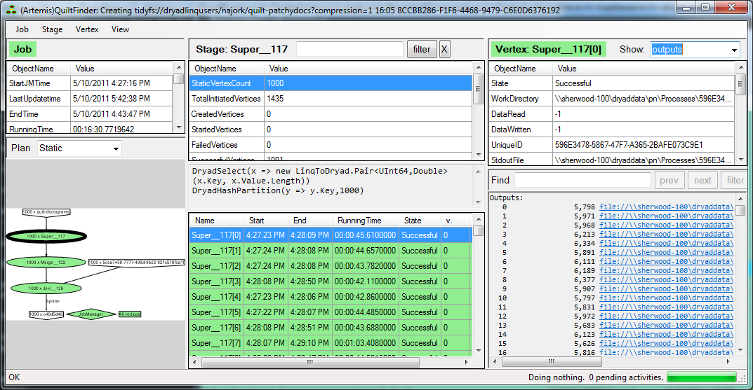
The Job Browser
Job
Stage
Vertex

Slide 16
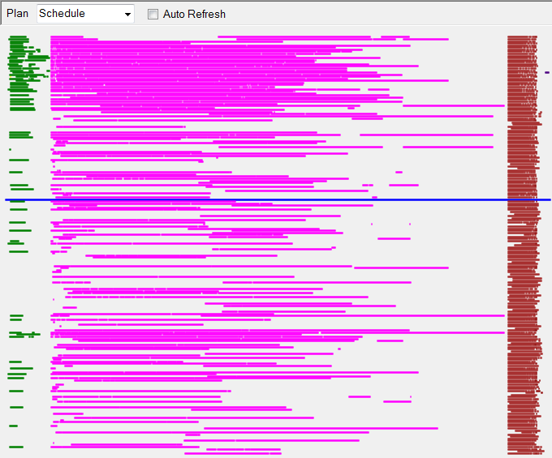
Job Schedule

Slide 17
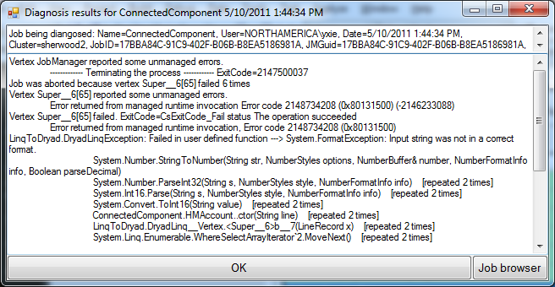
Failure diagnosis

Slide 18
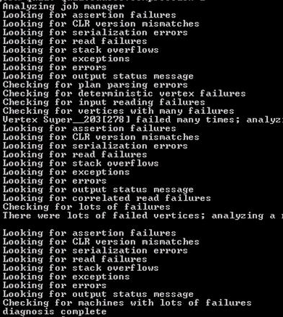
Diagnosis decision tree
“Hand-made”
Least portable tool
Incomplete
High-coverage
Bug types:
User level
System-level
Cluster malfunction

Slide 19
Powershell = Interactive Queries
$cluster = get-cluster X
$job = $cluster |
select-AllJobs |
sort-object Date |
select-object -last 1 |
select-DryadJob
$failed = $job.Vertices |
where-object { $_.State -eq "Failed" }

Slide 20
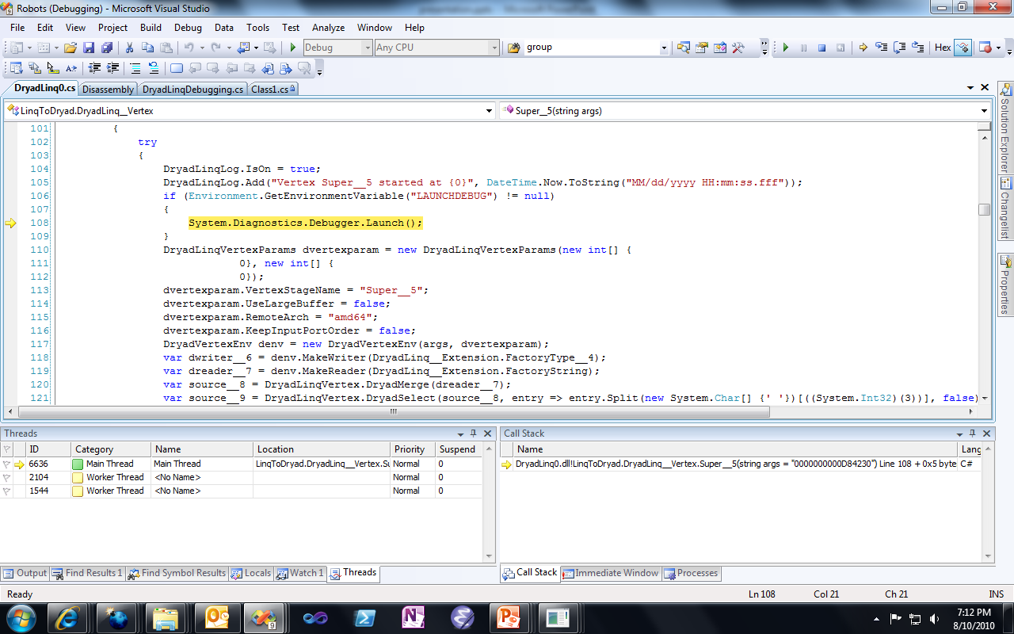
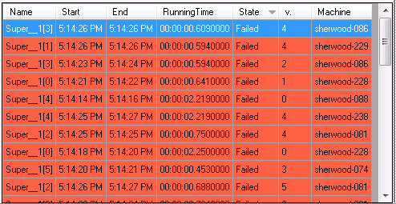
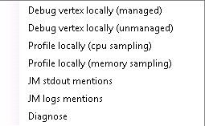
Vertex Debugging on Client

Slide 21
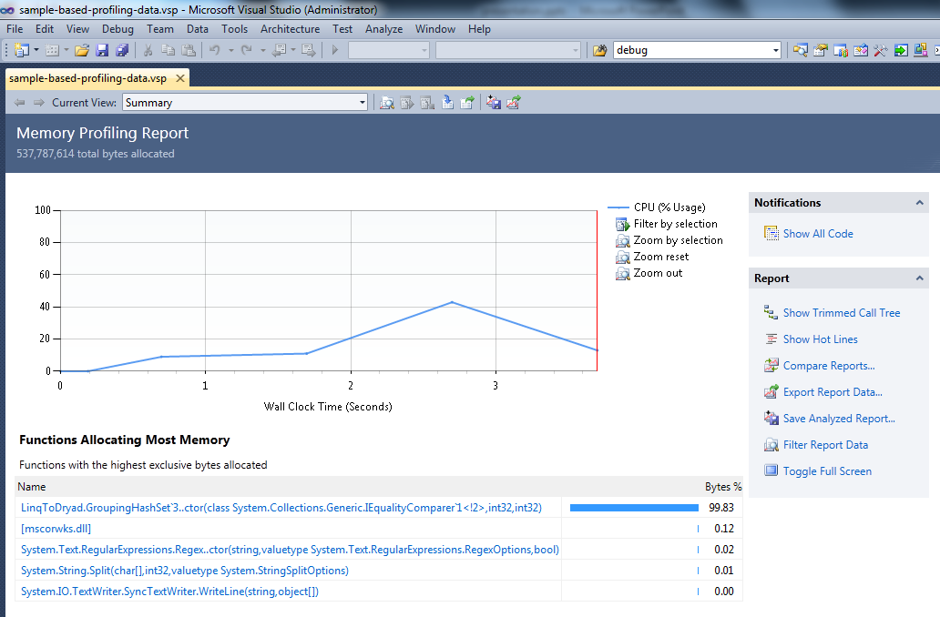
Vertex Profiling on Client

Slide 22
Debugging on Cluster
Breakpoint
where c.name.length > 10
Collection<T> collection;
var results = from c in collection
where c.name.length > 10
orderby c.age
select c.name;
Program
Job

Slide 23
Remote debugging
Breakpoint
Breakpoint hit…
Localhost
Cluster/Cloud
Visual Studio
attach
Job Manager
(JM)
Vertex 1
Vertex 2
Application
L
R
IO
L
R
IO
L
R
IO
Storage
Storage
Storage
Firewall
DryadLINQ
Exec
Exec
Exec
Job Submission
Cluster Scheduler
L: Logs, IO: Input/Output, R: Resources

Slide 24
Notifications: Our Implementation
Localhost
Cluster/Cloud
Visual Studio
attach
Job Manager
(JM)
Vertex 1
Vertex 2
Application
L
R
IO
L
R
IO
L
R
IO
Storage
Storage
Storage
DryadLINQ
Firewall
Exec
Exec
Exec
Job Submission
Cluster Scheduler
Daphne
L: Logs, IO: Input/Output, R: Resources

Slide 25
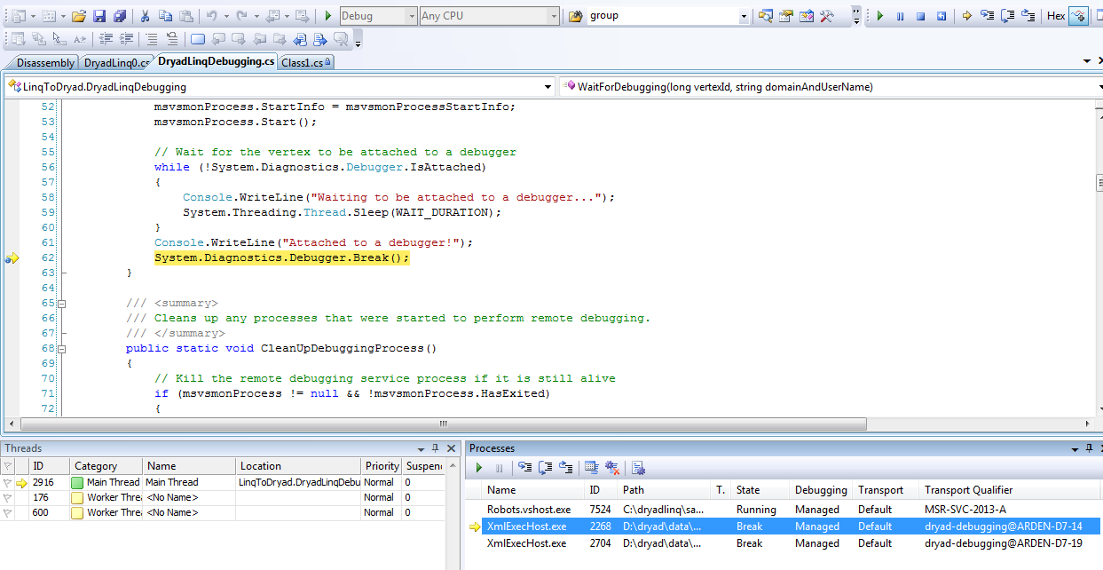
Remote debugging

Slide 26

Open Problems
What happens when 100,000 processes hit a breakpoint?
How to evaluate expressions in the debugger when state is distributed?
How to do large-scale performance debugging?
How to preserve map between distributed state and original program state?
How much can the illusion of a single system be preserved?

Slide 27
Conclusions
Single-machine abstractions break down in the presence of (performance/correctness) bugs
Job Object Model insulates tools from messy details
Design the cluster runtime to make it easy to build a JOM
Rich interactive tools easily built on top of JOM
Much more work needed for debugging at scale

