Slide 1
DryadInc: Reusing work in large-scale computations
Lucian Popa^{*+}, Mihai Budiu⁺,
Yuan Yu⁺, Michael Isard⁺
⁺ Microsoft Research Silicon Valley
* UC Berkeley

Slide 2
Problem Statement
…
Outputs
Distributed
Computation
…
Inputs
Append-only data
Goal: Reuse (part of) prior computations to:
Speed up the current job
Increase cluster throughput
Reduce energy and costs

Slide 3
Propose Two Approaches
1. IDE
Reuse IDEntical computations from the past
(like make or memoization)
2. MER
Do only incremental computation on the new data
and MERge results with the previous ones
(like patch)

Slide 4
Context
Implemented for Dryad
Dryad Job = Computational DAG
Vertex: arbitrary computation + inputs/outputs
Edge: data flows
Simple Example:
Record Count
Outputs
Add
A
Count
C
C
Inputs
(partitions)
I1
I2

Slide 5
IDE – IDEntical Computation
Record Count
First execution DAG
Outputs
Add
A
Count
C
C
Inputs
(partitions)
I1
I2

Slide 6
IDE – IDEntical Computation
Record Count
Second execution DAG
Outputs
Add
A
Count
C
C
C
Inputs
(partitions)
I1
I2
I3
New Input

Slide 7
IDE – IDEntical Computation
Record Count
Second execution DAG
Outputs
Add
A
Count
C
C
C
Inputs
(partitions)
I1
I2
I3
Identical subDAG

Slide 8
IDE – IDEntical Computation
Replace identical computational subDAG with
edge data cached from previous execution
IDE Modified DAG
Outputs
Add
A
Count
C
Inputs
(partitions)
Replaced with Cached Data
I3

Slide 9
IDE – IDEntical Computation
Replace identical computational subDAG with
edge data cached from previous execution
IDE Modified DAG
Outputs
Add
A
Count
C
Inputs
(partitions)
I3
Use DAG fingerprints to determine if computations are identical

Slide 10
Semantic Knowledge Can Help
Reuse Output
A
C
C
I1
I2

Slide 11
Semantic Knowledge Can Help
Previous Output
A
Merge (Add)
A
C
I3
C
C
I1
I2
Incremental DAG

Slide 12
MER – MERgeable Computation
User-specified
A
Merge (Add)
Automatically Inferred
A
C
I3
C
C
I1
I2
Automatically Built

Slide 13
MER – MERgeable Computation
Merge Vertex
Save to Cache
A
Incremental DAG – Remove Old Inputs
A
A
C
C
C
C
C
I1
Empty
I2
I1
I2
I3

Slide 14
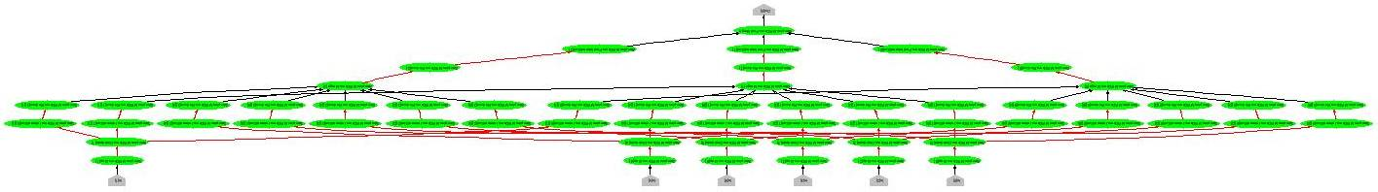
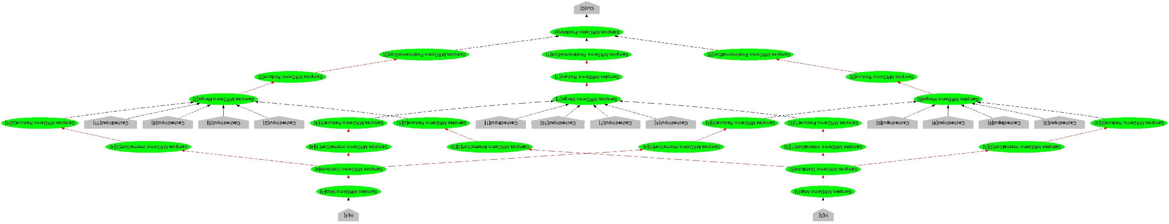
IDE in practice
6 input DAG
IDE 6 (4+2) input DAG

Slide 15
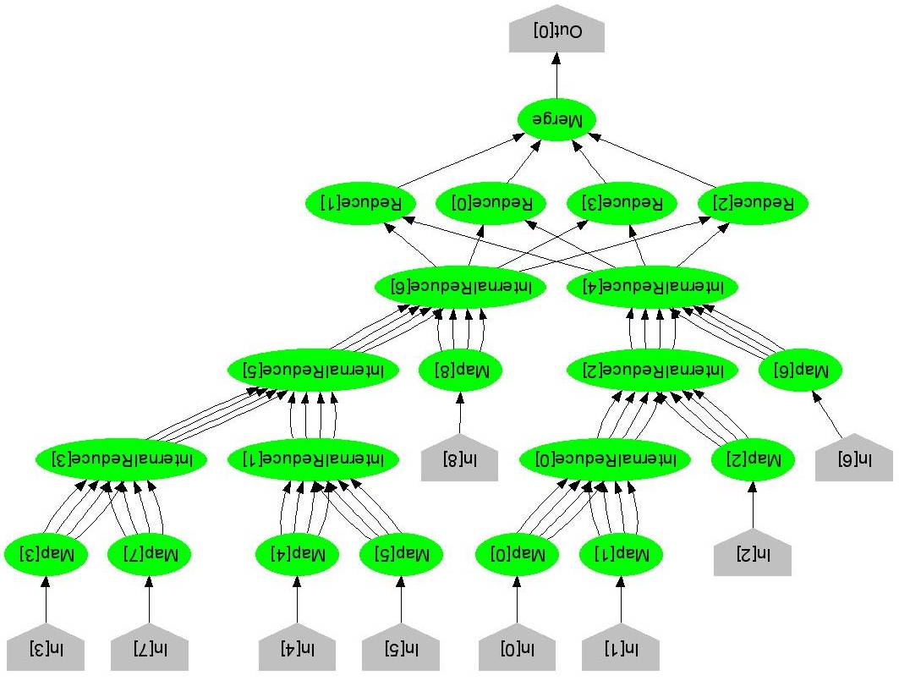
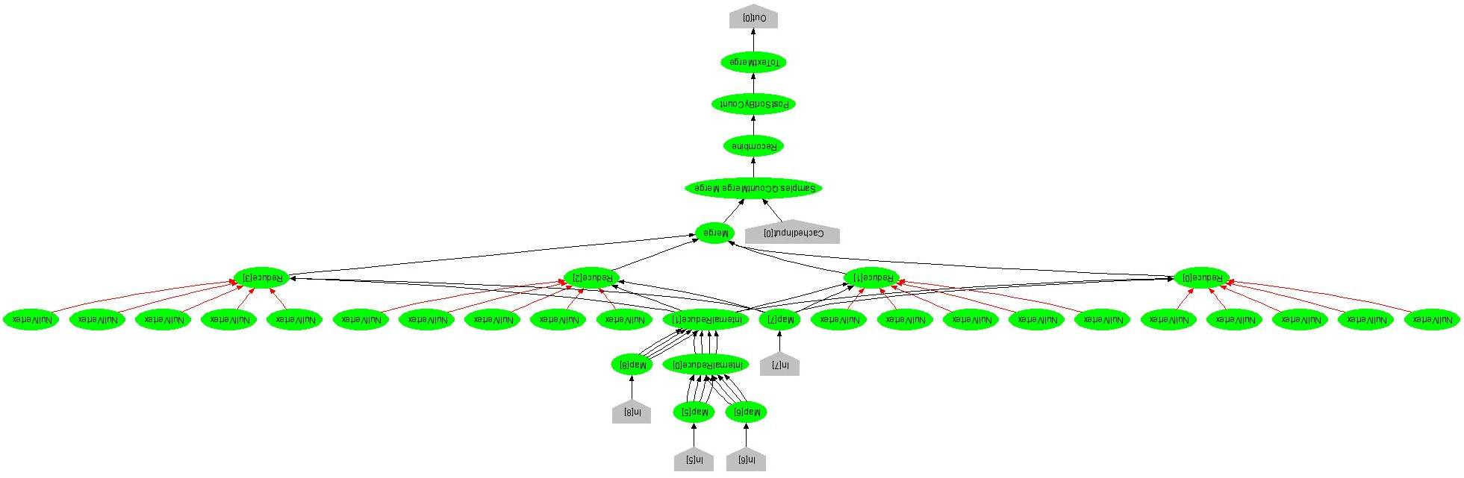
MER in practice
9 input DAG
MER 9 (5+4) input DAG
Empty
Empty

Slide 16
Evaluation – Running time
Word Histogram Application – 8 nodes
No Cache
IDE
MER

Slide 17
Discussion
MapReduce: just a particular case
IDE reuses the output of Mappers
MER requires combined Reduce function
Combine IDE with MER: benefits don’t add up
IDE can be used for the incremental DAG at MER
More semantic knowledge: further opportunities
Generate merge function automatically
Improve incremental DAG

Slide 18
Conclusions & Questions
Problem: reuse work in distributed computations on append-only data
Two methods:
INC – reuse IDEntical past computations
No user effort
MER – MERge past results with new ones
Small user effort, potentially larger gains
Implemented for Dryad

Slide 19
Backup Slides

Slide 20
Architecture
Dryad Job Manager
IDE/MER Rerun Logic
Modify DAG before run
RUN
Cache Server
Update cache after run

Slide 21
IDE – IDEntical Computation
Use fingerprints to identify identical computational DAGs
Guarantee that both computation and data are unchanged
First DAG
Second DAG
Store to Cache: <hash, outputs>

Slide 22
IDE – IDEntical Computation
Use a heuristic to identify the vertices to cache
First DAG
Second DAG
cached

Slide 23
Word Histogram Application
Outputs
Merge Sort
Count (Reduce)
…
m
Sort
Hash Distribute (Map)
n
…
Inputs

Slide 24
Evaluation – Running time
No Cache
IDE (4 ext)
MER (4 ext)
IDE (20 ext)
Results similar if 20 more inputs appended ~ 1.2GB
MER (20 ext)

