Slide 1
Large-scale Machine Learning using DryadLINQ
Mihai Budiu
Microsoft Research, Silicon Valley
HPA Workshop, Columbus, OH, May 1 2010

Slide 2
“What’s the point if I can’t have it?”
Dryad+DryadLINQ available for download
Academic license
Commercial evaluation license
Runs on Windows HPC platform
Dryad is in binary form, DryadLINQ in source
3-page licensing agreement
http://connect.microsoft.com/site/sitehome.aspx?SiteID=891

Slide 3
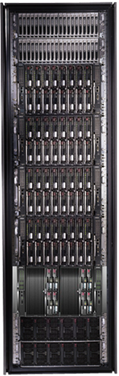
Goal of DryadLINQ
Notes:
Enable any programmer to write and run applications on small and large computer clusters.

Slide 4
Software Stack
Machine learning
.Net
DryadLINQ
Dryad
Cluster storage
Cluster services
Windows Server
Windows Server
Windows Server
Windows Server

Slide 5
Outline
Introduction
Dryad
LINQ & DryadLINQ
Machine learning on DryadLINQ
Conclusions

Slide 6
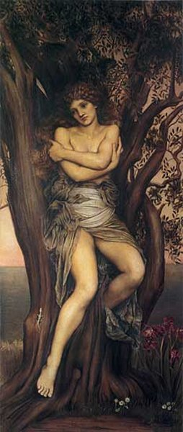
Dryad
Deployed since 2006
Running 24/7 on >> 10⁴ machines
Sifting through > 10Pb data daily
Clusters > 3000 machines
Jobs with > 10⁵ processes each
Platform for rich software ecosystem
Written at Microsoft Research, Silicon Valley

Slide 7

2-D Piping
Unix Pipes: 1-D
grep | sed | sort | awk | perl
Dryad: 2-D
grep¹⁰⁰⁰ | sed⁵⁰⁰ | sort¹⁰⁰⁰ | awk⁵⁰⁰ | perl⁵⁰
Notes:
Dryad is a generalization of the Unix piping mechanism: instead of uni-dimensional (chain) pipelines, it provides two-dimensional pipelines. The unit is still a process connected by a point-to-point channel, but the processes are replicated.

Slide 8
Virtualized 2-D Pipelines
Notes:
This is a possible schedule of a Dryad job using 2 machines.

Slide 9


Virtualized 2-D Pipelines

Slide 10

Virtualized 2-D Pipelines

Slide 11
Virtualized 2-D Pipelines

Slide 12
Virtualized 2-D Pipelines
2D DAG
multi-machine
virtualized
Notes:
The Unix pipeline is generalized 3-ways:
2D instead of 1D
spans multiple machines
resources are virtualized: you can run the same large job on many or few machines

Slide 13



Fault Tolerance
Notes:
Vertex failures and channel failures are handled differently.

Slide 14
Outline
Introduction
Dryad
LINQ & DryadLINQ
Machine learning on DryadLINQ
Conclusions

Slide 15
LINQ Data Model
.NET objects of type T
Collection
IQueryable<T>

Slide 16
LINQ Language Summary
Input
Where (filter)
Select (map)
GroupBy
OrderBy (sort)
Aggregate (fold)
Join

Slide 17

LINQ
=> DryadLINQ
Dryad
Notes:
DryadLINQ adds a wealth of features on top of plain Dryad.

Slide 18
Outline
Introduction
Dryad
LINQ & DryadLINQ
Machine learning on DryadLINQ
Conclusions

Slide 19
K-Means Clustering in LINQ
Vector NearestCenter(Vector point, IQueryable<Vector> centers)
{
var nearest = centers.First();
foreach (var center in centers)
if ((point - center).Norm() < (point - nearest).Norm()) nearest = center;
return nearest;
}
IQueryable<Vector> KMeansStep(IQueryable<Vector> vectors, IQueryable<Vector> centers)
{
return vectors.GroupBy(vector => NearestCenter(vector, centers))
.Select(g => g.Aggregate((x,y) => x+y) / g.Count());
}
IQueryable<Vector> KMeans(IQueryable<Vector> vectors, IQueryable<Vector> centers, int iter)
{
for (int i = 0; i < iter; i++)
centers = KMeansStep(vectors, centers);
return centers;
}

Slide 20
LINQ = .Net+ Queries
IQueryable<Vector>
KMeansStep(IQueryable<Vector> vectors,
IQueryable<Vector> centers)
{
return vectors
.GroupBy(vector => NearestCenter(vector, centers))
.Select(g => g.Aggregate((x,y) => x+y) / g.Count());
}
Notes:
Language Integrated Query is an extension of .Net which allows one to write declarative computations on collections (green part).

Slide 21

DryadLINQ Data Model
.Net objects
Partition
Collection

Slide 22

DryadLINQ = LINQ + Dryad
IQueryable<Vector>
KMeansStep( IQueryable<Vector> vectors, IQueryable<Vector> centers)
{
return vectors
.GroupBy(vector => NearestCenter(vector, centers))
.Select(g => g.Aggregate((x,y) => x+y) / g.Count());
}
collection
C#
C#
C#
C#
Dryad job
results
Notes:
DryadLINQ translates LINQ programs into Dryad computations:
- C# and LINQ data objects become distributed partitioned files.
- LINQ queries become distributed Dryad jobs.
- C# methods become code running on the vertices of a Dryad job.

Slide 23
K-Means
Vectors
Initial Centers
NearestCenter
GroupBy(centers)
Iter 1
Average(group)
Updated Centers
Iter 2

Slide 24
DryadLINQ Machine-Learning Apps
Decision trees
Markov chains
Singular value decomposition
Expectation maximization
K-means
Linear regression
Probabilistic Index Maps
Principal component analysis
Probabilistic Latent Semantic Indexing
Road network shortest-path preprocessing
Epitome computation
Neural network training
Graphical models

Slide 25
Aside: Map-Reduce in LINQ
M
M
M
map
public static IQueryable<S> MapReduce<T,M,K,S>(
this IQueryable<T> input,
Func<T, IQueryable<M>> mapper,
Func<M,K> keySelector,
Func<IGrouping<K,M>,S> reducer)
{
var map = input.SelectMany(mapper);
var group = map.GroupBy(keySelector);
var result = group.Select(reducer);
return result;
}
Q
Q
Q
sort
G₁
G₁
G₁
groupby
map
R
R
R
reduce
D
D
D
distribute
MS
MS
mergesort
groupby
G₂
G₂
partial aggregation
R
R
reduce
MS
MS
mergesort
G₂
G₂
groupby
reduce
R
R
reduce
X
X
consumer

Slide 26


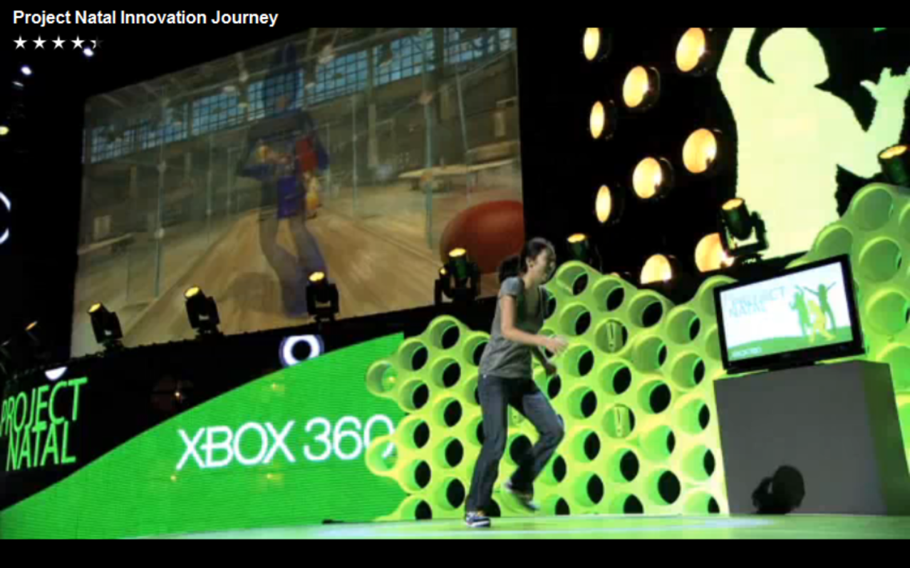
Real Example: Natal Training

Slide 27


Natal Problem
Recognize players from depth map
At frame rate
Minimize resource usage
Notes:
Image from http://r24085.ovh.net/images/Gallery/depthMap-small.jpg

Slide 28



Learn from Data
Rasterize
Motion Capture
(ground truth)
Training examples
Machine learning
Classifier

Slide 29
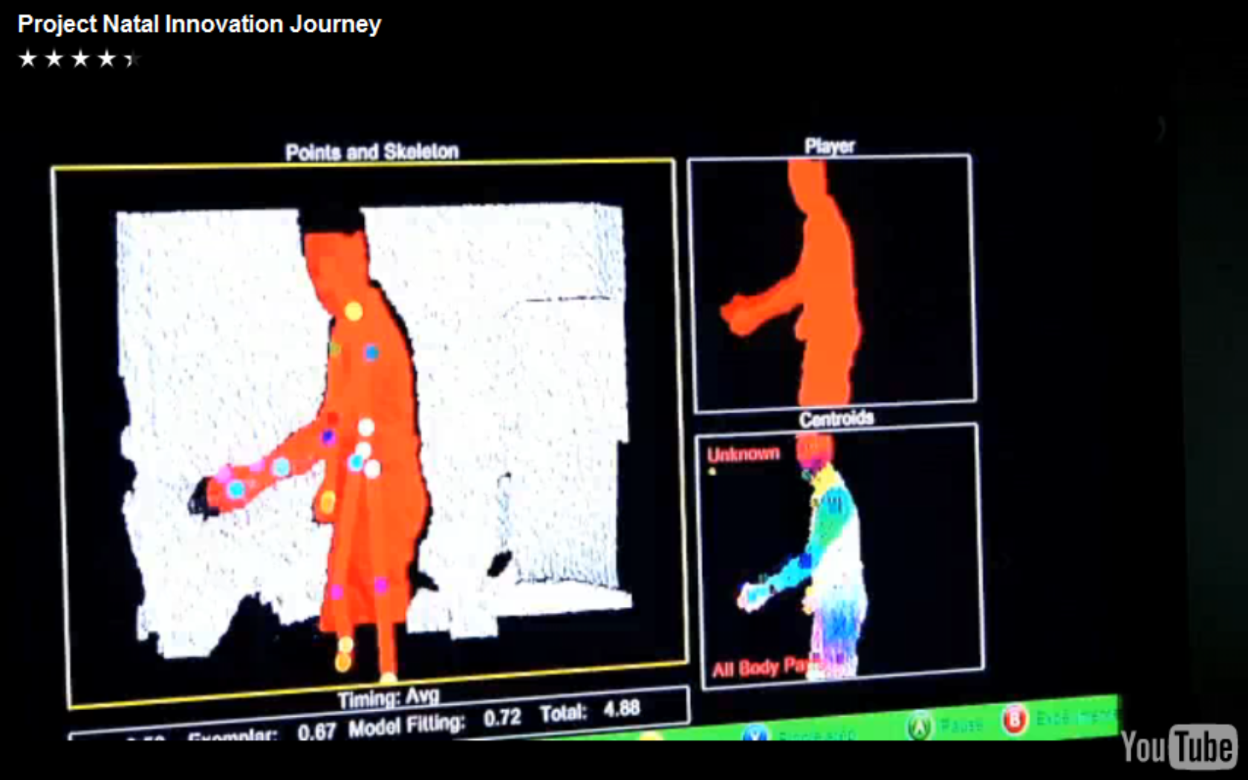
Running on Xbox

Slide 30

Cluster-based training
Classifier
Training examples
Machine learning
DryadLINQ
Dryad

Slide 31
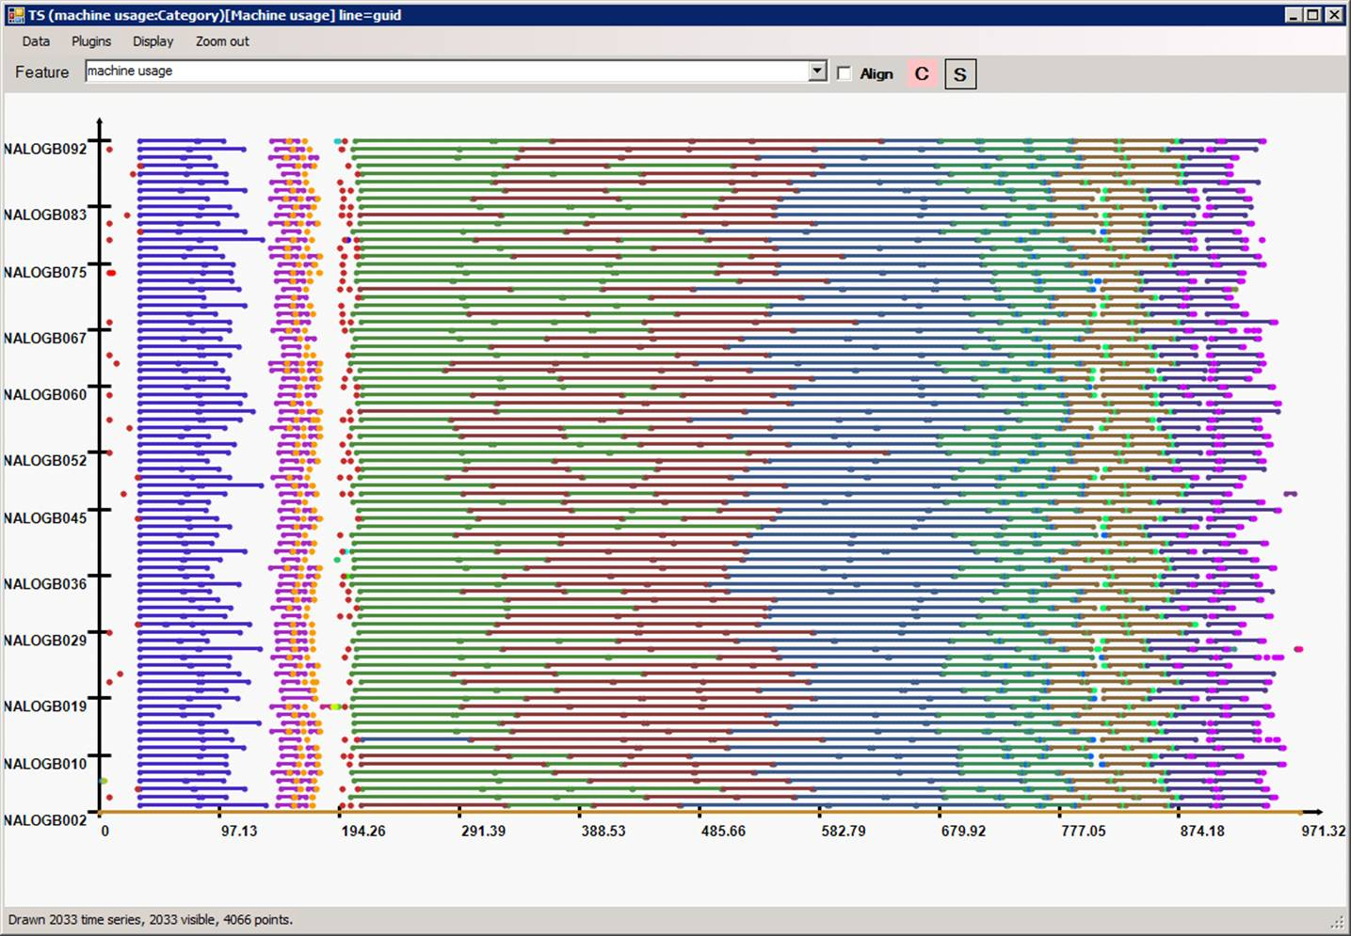
Highly efficient parallellization
machine
time

Slide 32

Conclusions
Visual Studio
LINQ
Dryad
=
32
Notes:
We believe that Dryad and DryadLINQ are a great foundation for cluster computing.

Slide 33
Backup Slides

Slide 34
Select Where SelectMany
GroupBy
Aggregate

Slide 35
c
m
Nested query
(collections c, m)
c.Select(e =>
new HashSet(m).Contains(e))
left
right
Join

Slide 36
V
Cholesky
A
A^{T}

Slide 37
records
Tree layer

Slide 38
Vectors
Initial Centers
100G
350B
Compute local nearest center
Group on center
24K
Compute nearest center
Group on center
Compute new centers
Iter 1
350B
Merge new centers
100G
24K
Iter 2
350B

Slide 39
V
Cholesky
35M
96B
Repartition
Merge
Join
71M
V x Cholesky
Sum, Repartition
36M
A
Merge
Join
20G
2G
A x V
Sum, Repartition
74M
A^{T}
Merge
20G
Join
A^{T} x A x V
1G
Sum
Plan in box is repeated 5 times

Slide 40
Decision Tree Training
records
12G
a
500K
b
12K
c
3K
d
16B
Tree layer

Slide 41
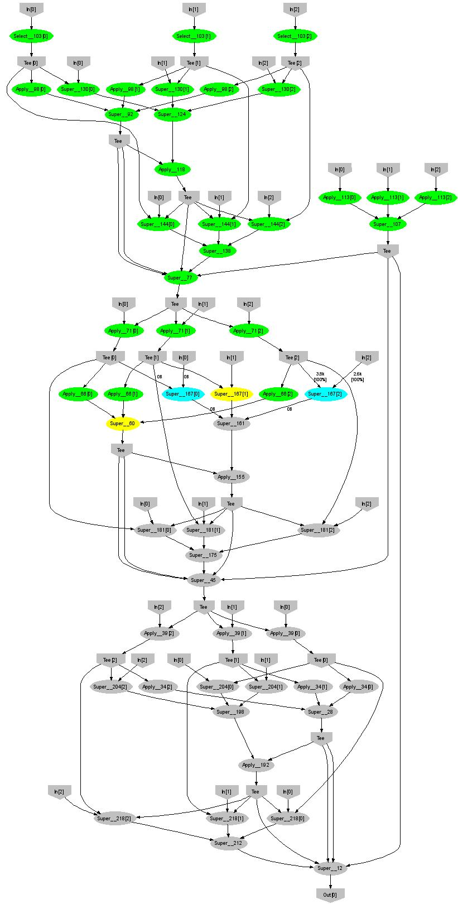
Expectation Maximization
160 lines
3 iterations shown
Notes:
More complicated, even iterative algorithms, can be implemented.

Slide 42
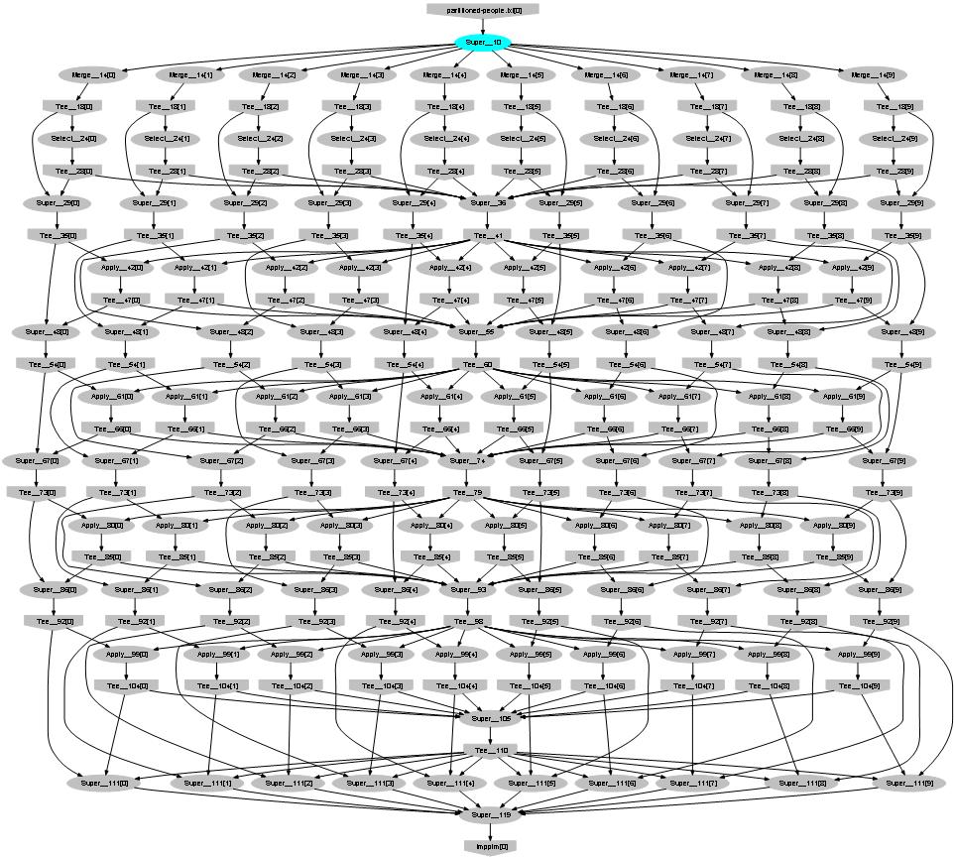
Probabilistic Index Maps
Images
features

Slide 43
Design Space
Grid
Internet
Data-
parallel
Search
Dryad
Shared
memory
Private
data
center
Transaction
HPC
Latency
Throughput
Notes:
Dryad is optimized for: throughput, data-parallel computation, in a private data-center.

Slide 44
Data-Parallel Computation
Application
SQL
Sawzall
≈SQL
LINQ, SQL
Parallel Databases
Sawzall
Pig, Hive
DryadLINQ Scope
Language
Map-Reduce
Hadoop
Dryad
Execution
Cosmos, HPC, Azure
GFS BigTable
HDFS
S3
Cosmos
Azure SQL Server
Storage

Slide 45
Dryad System Architecture
data plane
Files, TCP, FIFO, Network
job schedule
V
V
V
NS, Sched
PD
PD
PD
control plane
Job manager
cluster
Notes:
The brain of a Dryad job is a centralized Job Manager, which maintains a complete state of the job.
The JM controls the processes running on a cluster, but never exchanges data with them.
(The data plane is completely separated from the control plane.)

Slide 46
Dryad Job Structure
Channels
Input files
Stage
Output files
grep
sort
awk
sed
perl
grep
sort
sed
awk
grep
sort
Vertices (processes)
Notes:
This is the basic Dryad terminology.

Slide 47
Dryad = Execution Layer
Job (application)
Pipeline
≈
Dryad
Shell
Cluster
Machine
Notes:
In the same way as the Unix shell does not understand the pipeline running on top, but manages its execution (i.e., killing processes when one exits), Dryad does not understand the job running on top.

