Slide 1
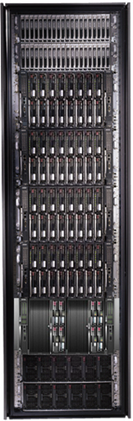
Cluster Computing with DryadLINQ
Mihai Budiu Microsoft Research Silicon Valley
IEEE Cloud Computing Conference July 19, 2008

Slide 2
Goal
Notes:
Enable any programmer to write and run applications on small and large computer clusters.

Slide 3
Design Space
Grid
Internet
Data-
parallel
Search
Dryad
Shared
memory
Private
data
center
Transaction
HPC
Latency
Throughput
Notes:
Dryad is optimized for: throughput, data-parallel computation, in a private data-center.

Slide 4

Data Partitioning
DATA
RAM
DATA
Notes:
A common scenario: too much data to process. Instead of trying to be clever, just use more machines and a brute-force algorithm.

Slide 5
Data-Parallel Computation
Sawzall, Pig
Parallel Databases
Map-Reduce
DryadLINQ Scope,PSQL
Application
Dryad
Execution
GFS BigTable
Cosmos
NTFS
Storage

Slide 6
Outline
Introduction
Dryad
DryadLINQ
Applications

Slide 7

2-D Piping
Unix Pipes: 1-D
grep | sed | sort | awk | perl
Dryad: 2-D
grep¹⁰⁰⁰ | sed⁵⁰⁰ | sort¹⁰⁰⁰ | awk⁵⁰⁰ | perl⁵⁰
Notes:
Dryad is a generalization of the Unix piping mechanism: instead of uni-dimensional (chain) pipelines, it provides two-dimensional pipelines. The unit is still a process connected by a point-to-point channel, but the processes are replicated.

Slide 8
Virtualized 2-D Pipelines
Notes:
This is a possible schedule of a Dryad job using 2 machines.

Slide 9


Virtualized 2-D Pipelines

Slide 10

Virtualized 2-D Pipelines

Slide 11
Virtualized 2-D Pipelines

Slide 12
Virtualized 2-D Pipelines
2D DAG
multi-machine
virtualized
Notes:
The Unix pipeline is generalized 3-ways:
2D instead of 1D
spans multiple machines
resources are virtualized: you can run the same large job on many or few machines

Slide 13
Architecture
data plane
Files, TCP, FIFO, Network
job schedule
V
V
V
NS
PD
PD
PD
control plane
Job manager
cluster
Notes:
The brain of a Dryad job is a centralized Job Manager, which maintains a complete state of the job.
The JM controls the processes running on a cluster, but never exchanges data with them.
(The data plane is completely separated from the control plane.)

Slide 14



Fault Tolerance
Notes:
Vertex failures and channel failures are handled differently.

Slide 15
Outline
Introduction
Dryad
DryadLINQ
Applications

Slide 16

DryadLINQ
Dryad
Notes:
DryadLINQ adds a wealth of features on top of plain Dryad.

Slide 17
LINQ = C# + Queries
Collection<T> collection;
bool IsLegal(Key);
string Hash(Key);
var results = from c in collection where IsLegal(c.key) select new { Hash(c.key), c.value};
Notes:
Language Integrated Query is an extension of C# which allows one to write declarative computations on collections (green part).

Slide 18

DryadLINQ = LINQ + Dryad
Collection<T> collection;
bool IsLegal(Key k);
string Hash(Key);
var results = from c in collection where IsLegal(c.key) select new { Hash(c.key), c.value};
Vertex code
Query plan
(Dryad job)
Data
collection
C#
C#
C#
C#
results
Notes:
DryadLINQ translates LINQ programs into Dryad computations:
- C# and LINQ data objects become distributed partitioned files.
- LINQ queries become distributed Dryad jobs.
- C# methods become code running on the vertices of a Dryad job.

Slide 19

Data Model
C# objects
Partition
Collection

Slide 20

Language Summary
Where
Select
GroupBy
OrderBy
Aggregate
Join
Apply
Materialize

Slide 21
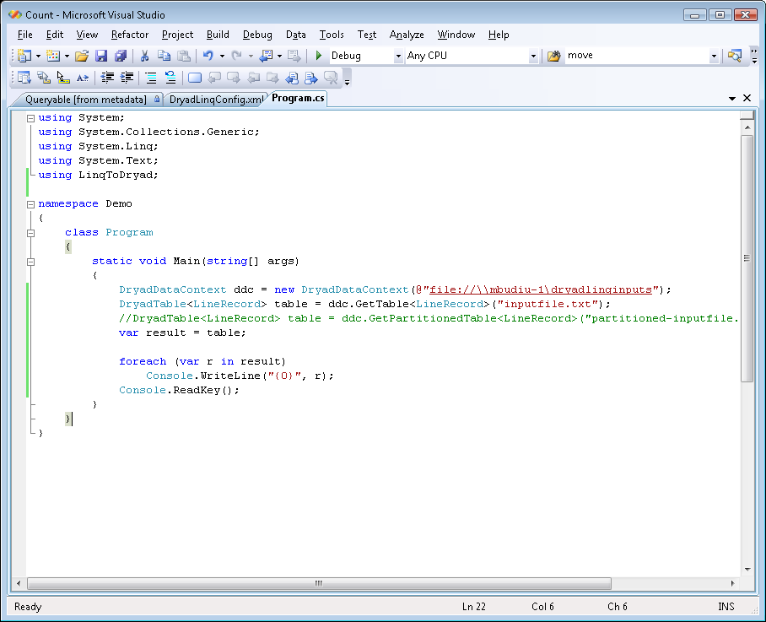
Demo
Done

Slide 22
Example: Histogram
public static IQueryable<Pair> Histogram(
IQueryable<LineRecord> input, int k)
{
var words = input.SelectMany(x => x.line.Split(' '));
var groups = words.GroupBy(x => x);
var counts = groups.Select(x => new Pair(x.Key, x.Count()));
var ordered = counts.OrderByDescending(x => x.count);
var top = ordered.Take(k);
return top;
}
“A line of words of wisdom”
[“A”, “line”, “of”, “words”, “of”, “wisdom”]
[[“A”], [“line”], [“of”, “of”], [“words”], [“wisdom”]]
[ {“A”, 1}, {“line”, 1}, {“of”, 2}, {“words”, 1}, {“wisdom”, 1}]
[{“of”, 2}, {“A”, 1}, {“line”, 1}, {“words”, 1}, {“wisdom”, 1}]
[{“of”, 2}, {“A”, 1}, {“line”, 1}]

Slide 23
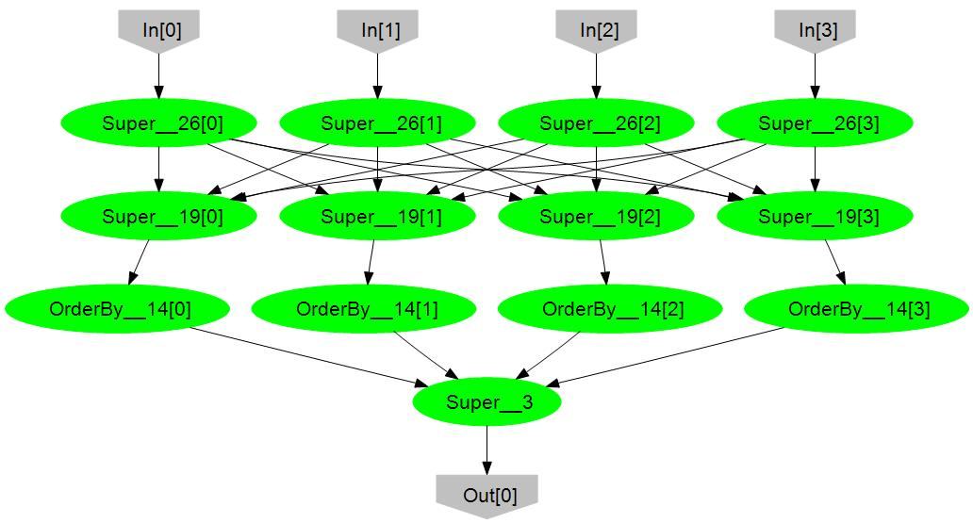
Histogram Plan
SelectMany
HashDistribute
Merge
GroupBy
Select
OrderByDescending Take
MergeSort
Take

Slide 24
Map-Reduce in DryadLINQ
public static IQueryable<S> MapReduce<T,M,K,S>(
this IQueryable<T> input,
Expression<Func<T, IEnumerable<M>>> mapper,
Expression<Func<M,K>> keySelector,
Expression<Func<IGrouping<K,M>,S>> reducer)
{
var map = input.SelectMany(mapper);
var group = map.GroupBy(keySelector);
var result = group.Select(reducer);
return result;
}

Slide 25
Map-Reduce Plan
M
M
M
M
M
M
M
map
Q
Q
Q
Q
Q
Q
Q
sort
G₁
G₁
G₁
G₁
G₁
G₁
G₁
groupby
map
M
R
R
R
R
R
R
R
reduce
D
D
D
D
D
D
D
distribute
G
R
MS
MS
MS
MS
MS
mergesort
groupby
X
G₂
G₂
G₂
G₂
G₂
partial aggregation
R
R
R
R
R
reduce
X
X
X
MS
MS
mergesort
static
dynamic
dynamic
G₂
G₂
groupby
reduce
R
R
reduce
X
X
consumer

Slide 26
Outline
Introduction
Dryad
DryadLINQ
Applications

Slide 27
Applications
Image processing
Ray
tracing
Combinatorial optimization
Log analysis
Graphs
Machine learning
Data analysis
Distributed Data Structures
DryadLINQ
Dryad
Notes:
I will now focus on a library for machine-learning algorithms we have built on top of DryadLINQ.

Slide 28
E.g: Linear Algebra
T
T
,
U
,
V
=
Notes:
Having vectors of vectors or matrices builds to a nice linear algebra library.

Slide 29
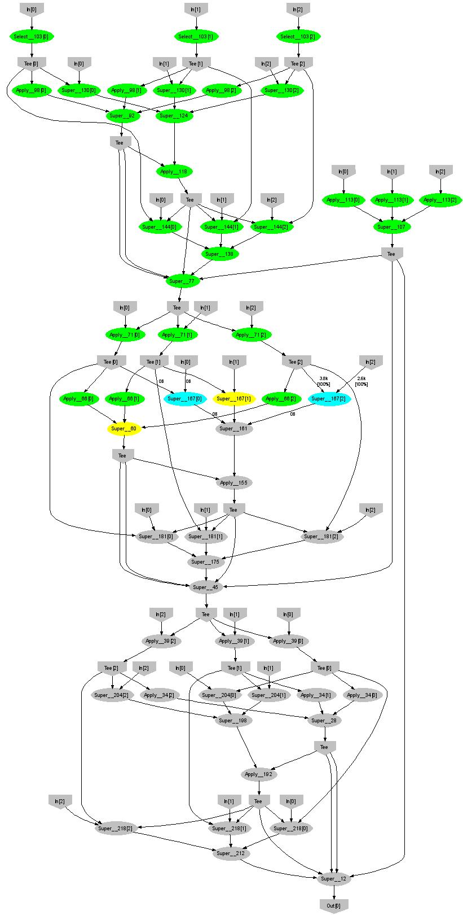
Expectation Maximization (Gaussians)
160 lines
3 iterations shown
Notes:
More complicated, even iterative algorithms, can be implemented.

Slide 30
Conclusions
Dryad = distributed execution environment
Supports rich software ecosystem
DryadLINQ = Compiles LINQ to Dryad
C# objects and declarative programming
.Net and Visual Studio for distributed programming
Notes:
We believe that Dryad and DryadLINQ are a great foundation for cluster computing.

Slide 31
Dryad Job Structure
Channels
Input files
Stage
Output files
grep
sort
awk
sed
perl
grep
sort
sed
awk
grep
sort
Vertices (processes)
Notes:
This is the basic Dryad terminology.

Slide 32
Linear Regression
Data
Find
S.t.
Notes:
We will show how to compute linear regression parameters.

Slide 33
Analytic Solution
X[0]
X[1]
X[2]
Y[0]
Y[1]
Y[2]
Map
X×X^{T}
X×X^{T}
X×X^{T}
Y×X^{T}
Y×X^{T}
Y×X^{T}
Reduce
Σ
Σ
[ ]⁻¹
*
A
Notes:
This expression uses a query plan composed of 2 (pairwise) maps and 2 reduces.

Slide 34
Linear Regression Code
Vectors x = input(0), y = input(1);
Matrices xx = x.Map(x, (a,b) => a.OuterProd(b));
OneMatrix xxs = xx.Sum();
Matrices yx = y.Map(x, (a,b) => a.OuterProd(b));
OneMatrix yxs = yx.Sum();
OneMatrix xxinv = xxs.Map(a => a.Inverse());
OneMatrix A = yxs.Map(xxinv, (a, b) => a.Mult(b));
Notes:
The complete source code for linear regression has 6 lines of code.

Slide 35
Dryad = Execution Layer
Job (application)
Pipeline
≈
Dryad
Shell
Cluster
Machine
Notes:
In the same way as the Unix shell does not understand the pipeline running on top, but manages its execution (i.e., killing processes when one exits), Dryad does not understand the job running on top.

Slide 36
Dryad Map-Reduce
Many similarities
Execution layer
Job = arbitrary DAG
Plug-in policies
Program=graph gen.
Complex ( features)
New (< 2 years)
Still growing
Internal
Exe + app. model
Map+sort+reduce
Few policies
Program=map+reduce
Simple
Mature (> 4 years)
Widely deployed
Hadoop
Notes:
This is a comparison between Microsoft Dryad and Google’s Map-Reduce.

Slide 37
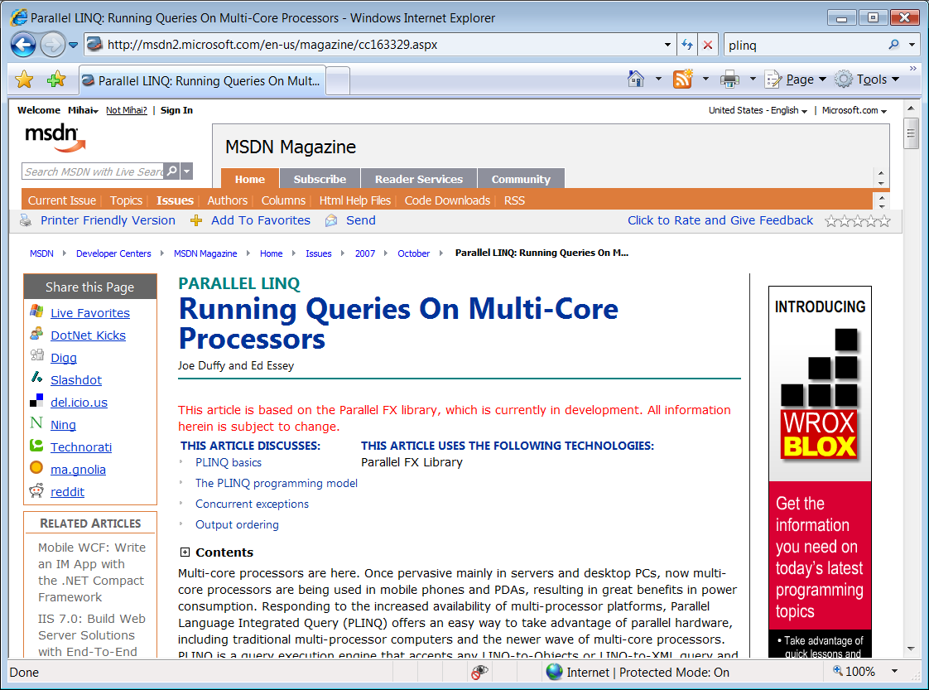
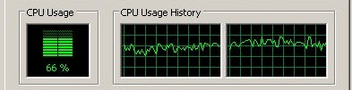

PLINQ
public static IEnumerable<TSource>
DryadSort<TSource, TKey>(IEnumerable<TSource> source,
Func<TSource, TKey> keySelector,
IComparer<TKey> comparer,
bool isDescending)
{
return source.AsParallel().OrderBy(keySelector, comparer);
}
Notes:
At the bottom DryadLINQ uses LINQ to run the computation in parallel on multiple cores.

Slide 38
Operations on Large Vectors: Map 1
T
f
U
f preserves partitioning
T
f
U
Notes:
One can apply an arbitrary C# side-effect free function f to all objects in a vector.

Slide 39
Map 2 (Pairwise)
T
f
U
V
T
U
f
V
Notes:
Or one can do it to a pair of vectors.

Slide 40
Map 3 (Vector-Scalar)
T
f
U
V
T
U
f
V
40
Notes:
Or one can use a vector and a scalar, replicating the scalar for each element of the vector.

Slide 41
Reduce (Fold)
f
U
U
U
U
f
f
f
U
U
U
f
U
Notes:
Finally, one can fold a vector to a scalar.

Slide 42
Software Stack
Applications
sed, awk, grep, etc.
C#
Data structures
legacy code
SSIS
PSQL
Perl
C++
Scope
C#
SQL server
Job queueing, monitoring
Distributed Shell (Nebula)
DryadLINQ
C++
Dryad
Distributed Filesystem (Cosmos)
CIFS/NTFS
Cluster Services
Windows Server
Windows Server
Windows Server
Windows Server

