Slide 1
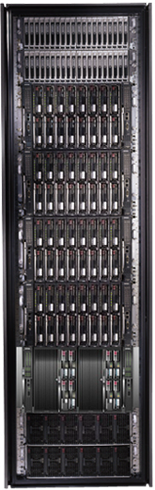
Cluster Computing with DryadLINQ
Mihai Budiu
Microsoft Research, Silicon Valley
Intel Research Berkeley, Systems Seminar Series
October 9, 2008

Slide 2








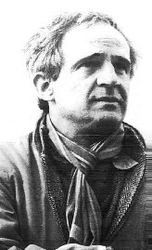




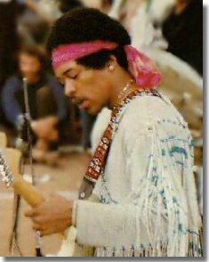

The Roaring ‘60s

Slide 3
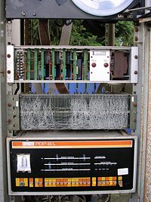
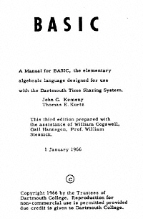

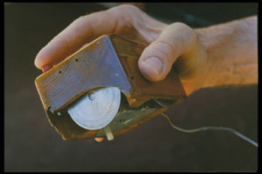
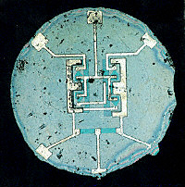

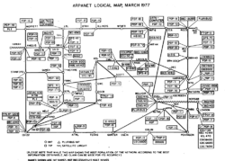
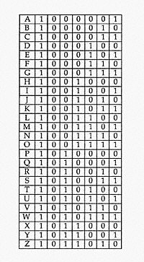
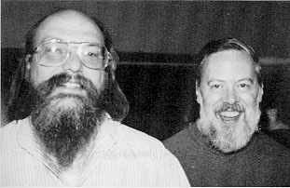
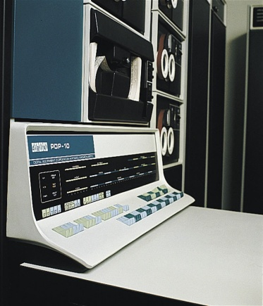
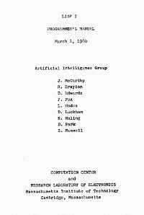
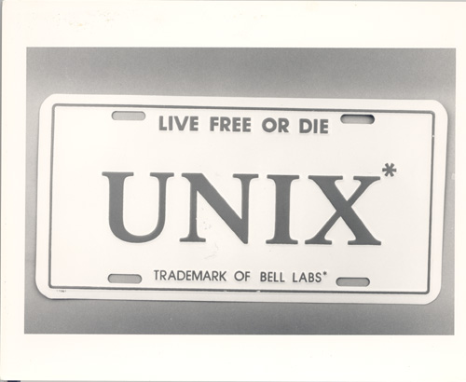
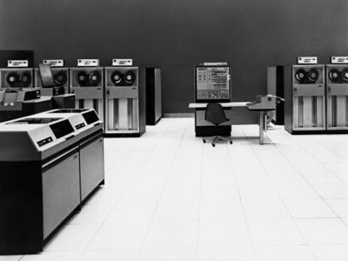
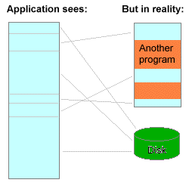
The other ‘60s
Spacewars
PDP/8
ARPANET
Multics
Time-sharing
(defun factorial (n)
(if (<= n 1) 1
(* n (factorial (- n 1)))))
Virtual memory
OS/360

Slide 4



What about us, now?

Slide 5
Layers
Applications
Programming Languages and APIs
Resource Management
Scheduling
Distributed Execution
Operating System
Caching and Synchronization
Storage
Identity & Security
Networking

Slide 6









Pieces of the Global Computer

Slide 7
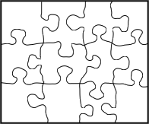
This Work

Slide 8
Outline
Introduction
Dryad
DryadLINQ
DryadLINQ Applications

Slide 9

Dryad
Continuously deployed since 2006
Running on >> 10⁴ machines
Sifting through > 10Pb data daily
Runs on clusters > 3000 machines
Handles jobs with > 10⁵ processes each
Platform for rich software ecosystem
Used by >> 100 developers
Written at Microsoft Research, Silicon Valley

Slide 10
Bibliography
Dryad: Distributed Data-Parallel Programs from Sequential Building Blocks
Michael Isard, Mihai Budiu, Yuan Yu, Andrew Birrell, and Dennis Fetterly
European Conference on Computer Systems (EuroSys), Lisbon, Portugal, March 21-23, 2007
DryadLINQ: A System for General-Purpose Distributed Data-Parallel Computing Using a High-Level Language
Yuan Yu, Michael Isard, Dennis Fetterly, Mihai Budiu, Úlfar Erlingsson, Pradeep Kumar Gunda, and Jon Currey
Symposium on Operating System Design and Implementation (OSDI), San Diego, CA, December 8-10, 2008

Slide 11

Software Stack
Applications
sed, awk,
perl, grep
Machine Learning
Data mining
SQL
C#
Graphs
legacy code
SSIS
PSQL
Scope
.Net
Distributed Data Structures
SQL server
Job queueing, monitoring
Distributed Shell
DryadLINQ
C++
Dryad
Distributed Filesystem (Cosmos)
CIFS/NTFS
Cluster Services
Windows Server
Windows Server
Windows Server
Windows Server

Slide 12
Goal
Notes:
Enable any programmer to write and run applications on small and large computer clusters.

Slide 13
Design Space
Grid
Internet
Data-
parallel
Search
Dryad
Shared
memory
Private
data
center
Transaction
HPC
Latency
Throughput
Notes:
Dryad is optimized for: throughput, data-parallel computation, in a private data-center.

Slide 14

Data Partitioning
DATA
RAM
DATA
Notes:
A common scenario: too much data to process. Instead of trying to be clever, just use more machines and a brute-force algorithm.

Slide 15

2-D Piping
Unix Pipes: 1-D
grep | sed | sort | awk | perl
Dryad: 2-D
grep¹⁰⁰⁰ | sed⁵⁰⁰ | sort¹⁰⁰⁰ | awk⁵⁰⁰ | perl⁵⁰
Notes:
Dryad is a generalization of the Unix piping mechanism: instead of uni-dimensional (chain) pipelines, it provides two-dimensional pipelines. The unit is still a process connected by a point-to-point channel, but the processes are replicated.

Slide 16
Virtualized 2-D Pipelines
Notes:
This is a possible schedule of a Dryad job using 2 machines.

Slide 17


Virtualized 2-D Pipelines

Slide 18

Virtualized 2-D Pipelines

Slide 19
Virtualized 2-D Pipelines

Slide 20
Virtualized 2-D Pipelines
2D DAG
multi-machine
virtualized
Notes:
The Unix pipeline is generalized 3-ways:
2D instead of 1D
spans multiple machines
resources are virtualized: you can run the same large job on many or few machines

Slide 21
Dryad Job Structure
Channels
Input files
Stage
Output files
grep
sort
awk
sed
perl
grep
sort
sed
awk
grep
sort
Vertices (processes)
Notes:
This is the basic Dryad terminology.

Slide 22
Channels
Finite streams of items
distributed filesystem files (persistent)
SMB/NTFS files (temporary)
TCP pipes (inter-machine)
memory FIFOs (intra-machine)
X
Items
M
Notes:
Channels are very abstract, enabling a variety of transport mechanisms.
The performance and fault-tolerance of these machanisms vary widely.

Slide 23
Dryad System Architecture
data plane
Files, TCP, FIFO, Network
job schedule
V
V
V
NS
PD
PD
PD
control plane
Job manager
cluster
Notes:
The brain of a Dryad job is a centralized Job Manager, which maintains a complete state of the job.
The JM controls the processes running on a cluster, but never exchanges data with them.
(The data plane is completely separated from the control plane.)

Slide 24



Fault Tolerance
Notes:
Vertex failures and channel failures are handled differently.

Slide 25
Policy Managers
R
R
R
R
Stage R
Connection R-X
X
X
X
X
Stage X
X Manager
R manager
R-X Manager
Job
Manager

Slide 26
Outline
Introduction
Dryad
DryadLINQ
DryadLINQ Applications

Slide 27

LINQ
=> DryadLINQ
Dryad
Notes:
DryadLINQ adds a wealth of features on top of plain Dryad.

Slide 28
LINQ = .Net+ Queries
Collection<T> collection;
bool IsLegal(Key);
string Hash(Key);
var results = from c in collection where IsLegal(c.key) select new { Hash(c.key), c.value};
Notes:
Language Integrated Query is an extension of .Net which allows one to write declarative computations on collections (green part).

Slide 29
LINQ System Architecture
Local machine
Execution engine
LINQ-to-obj
PLINQ
LINQ-to-SQL
LINQ-to-WS
DryadLINQ
Fickr
Oracle
LINQ-to-XML
Your own
.Net program
(C#, VB, F#, etc)
LINQ Provider
Query
Objects

Slide 30

DryadLINQ = LINQ + Dryad
Collection<T> collection;
bool IsLegal(Key k);
string Hash(Key);
var results = from c in collection where IsLegal(c.key) select new { Hash(c.key), c.value};
Vertex code
Query plan
(Dryad job)
Data
collection
C#
C#
C#
C#
results
Notes:
DryadLINQ translates LINQ programs into Dryad computations:
- C# and LINQ data objects become distributed partitioned files.
- LINQ queries become distributed Dryad jobs.
- C# methods become code running on the vertices of a Dryad job.

Slide 31

DryadLINQ Data Model
.Net objects
Partition
Collection

Slide 32
The DryadLINQ Provider
Client machine
.Net
DryadLINQ
Data center
Distributed query plan
Query Expr
Invoke
Query
Vertex code
Input Tables
ToCollection
Dryad JM
Dryad Execution
.Net Objects
Output DryadTable
Results
foreach
(11)
Output Tables

Slide 33
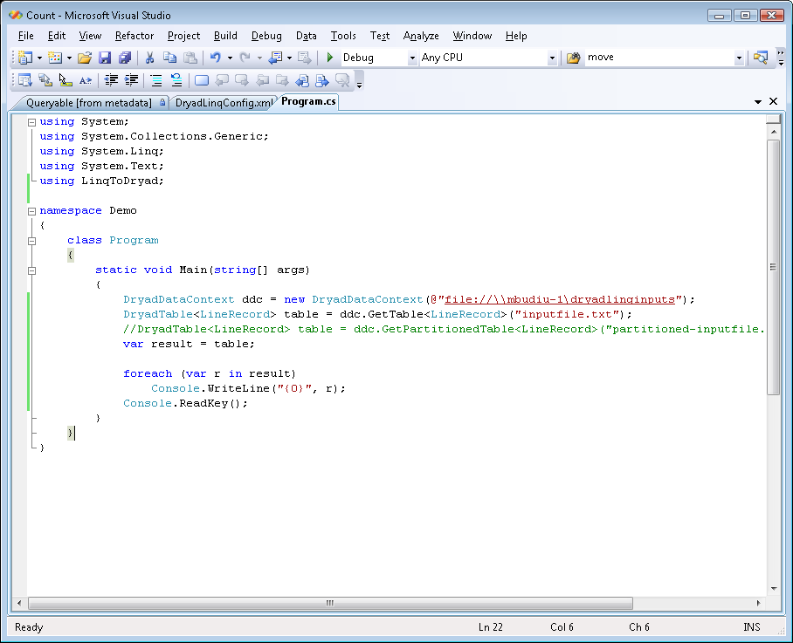
Demo

Slide 34
Example: Histogram
public static IQueryable<Pair> Histogram(
IQueryable<LineRecord> input, int k)
{
var words = input.SelectMany(x => x.line.Split(' '));
var groups = words.GroupBy(x => x);
var counts = groups.Select(x => new Pair(x.Key, x.Count()));
var ordered = counts.OrderByDescending(x => x.count);
var top = ordered.Take(k);
return top;
}
“A line of words of wisdom”
[“A”, “line”, “of”, “words”, “of”, “wisdom”]
[[“A”], [“line”], [“of”, “of”], [“words”], [“wisdom”]]
[ {“A”, 1}, {“line”, 1}, {“of”, 2}, {“words”, 1}, {“wisdom”, 1}]
[{“of”, 2}, {“A”, 1}, {“line”, 1}, {“words”, 1}, {“wisdom”, 1}]
[{“of”, 2}, {“A”, 1}, {“line”, 1}]

Slide 35
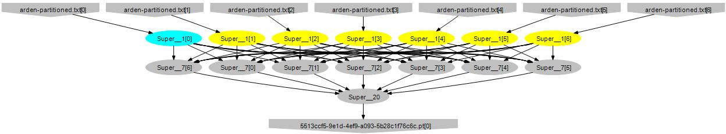
Histogram Plan
SelectMany
Sort
GroupBy+Select
HashDistribute
MergeSort
GroupBy
Select
Sort
Take
MergeSort
Take

Slide 36
Map-Reduce in DryadLINQ
public static IQueryable<S> MapReduce<T,M,K,S>(
this IQueryable<T> input,
Expression<Func<T, IEnumerable<M>>> mapper,
Expression<Func<M,K>> keySelector,
Expression<Func<IGrouping<K,M>,S>> reducer)
{
var map = input.SelectMany(mapper);
var group = map.GroupBy(keySelector);
var result = group.Select(reducer);
return result;
}

Slide 37
Map-Reduce Plan
M
M
M
M
M
M
M
map
Q
Q
Q
Q
Q
Q
Q
sort
G₁
G₁
G₁
G₁
G₁
G₁
G₁
groupby
map
M
R
R
R
R
R
R
R
reduce
D
D
D
D
D
D
D
distribute
G
R
MS
MS
MS
MS
MS
mergesort
groupby
X
G₂
G₂
G₂
G₂
G₂
partial aggregation
R
R
R
R
R
reduce
X
X
X
MS
MS
mergesort
static
dynamic
dynamic
G₂
G₂
groupby
reduce
S
S
S
S
S
S
R
R
reduce
A
A
A
X
X
consumer
T

Slide 38
Distributed Sorting in DryadLINQ
public static IQueryable<TSource>
DSort<TSource, TKey>(this IQueryable<TSource> source,
Expression<Func<TSource, TKey>> keySelector,
int pcount)
{
var samples = source.Apply(x => Sampling(x));
var keys = samples.Apply(x => ComputeKeys(x, pcount));
var parts = source.RangePartition(keySelector, keys);
return parts.OrderBy(keySelector);
}

Slide 39
Distributed Sorting Plan
DS
DS
DS
DS
DS
H
H
H
O
D
D
D
D
D
static
dynamic
dynamic
M
M
M
M
M
S
S
S
S
S

Slide 40

Language Summary
Where
Select
GroupBy
OrderBy
Aggregate
Join
Apply
Materialize

Slide 41
Combining Query Providers
Local machine
Execution engines
.Net program
(C#, VB, F#, etc)
LINQ Provider
PLINQ
Query
LINQ Provider
SQL Server
LINQ Provider
DryadLINQ
Objects
LINQ Provider
LINQ-to-obj

Slide 42
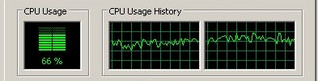

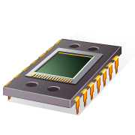
Using PLINQ
Query
DryadLINQ
Local query
PLINQ
Notes:
At the bottom DryadLINQ uses LINQ to run the computation in parallel on multiple cores.

Slide 43

Using LINQ to SQL Server
Query
DryadLINQ
LINQ to SQL
LINQ to SQL
Query
Query
Query
Query
Query

Slide 44
Using LINQ-to-objects
Local machine
LINQ to obj
debug
Query
production
DryadLINQ
Cluster

Slide 45
Outline
Introduction
Dryad
DryadLINQ
DryadLINQ Applications

Slide 46
Sample applications written using DryadLINQ | Class
Distributed linear algebra | Numerical
Accelerated Page-Rank computation | Web graph
Privacy-preserving query language | Data mining
Expectation maximization for a mixture of Gaussians | Clustering
K-means | Clustering
Linear regression | Statistics
Probabilistic Index Maps | Image processing
Principal component analysis | Data mining
Probabilistic Latent Semantic Indexing | Data mining
Performance analysis and visualization | Debugging
Road network shortest-path preprocessing | Graph
Botnet detection | Data mining
Epitome computation | Image processing
Neural network training | Statistics
Parallel statistical algorithms | Statistics
Distributed query caching | Optimization
Web indexing structure | Web graph

Slide 47
Linear Algebra & Machine Learning in DryadLINQ
Data analysis
Machine learning
Large Vector
DryadLINQ
Dryad
Notes:
I will now focus on a library for machine-learning algorithms we have built on top of DryadLINQ.

Slide 48
Operations on Large Vectors: Map 1
T
f
U
f preserves partitioning
T
f
U
Notes:
One can apply an arbitrary C# side-effect free function f to all objects in a vector.

Slide 49
Map 2 (Pairwise)
T
f
U
V
T
U
f
V
Notes:
Or one can do it to a pair of vectors.

Slide 50
Map 3 (Vector-Scalar)
T
f
U
V
T
U
f
V
50
Notes:
Or one can use a vector and a scalar, replicating the scalar for each element of the vector.

Slide 51
Reduce (Fold)
f
U
U
U
U
f
f
f
U
U
U
f
U
Notes:
Finally, one can fold a vector to a scalar.

Slide 52
Linear Algebra
T
T
,
U
,
V
=
Notes:
Having vectors of vectors or matrices builds to a nice linear algebra library.

Slide 53
Linear Regression
Data
Find
S.t.
Notes:
We will show how to compute linear regression parameters.

Slide 54
Analytic Solution
X[0]
X[1]
X[2]
Y[0]
Y[1]
Y[2]
Map
X×X^{T}
X×X^{T}
X×X^{T}
Y×X^{T}
Y×X^{T}
Y×X^{T}
Reduce
Σ
Σ
[ ]⁻¹
*
A
Notes:
This expression uses a query plan composed of 2 (pairwise) maps and 2 reduces.

Slide 55
Linear Regression Code
Vectors x = input(0), y = input(1);
Matrices xx = x.Map(x, (a,b) => a.OuterProd(b));
OneMatrix xxs = xx.Sum();
Matrices yx = y.Map(x, (a,b) => a.OuterProd(b));
OneMatrix yxs = yx.Sum();
OneMatrix xxinv = xxs.Map(a => a.Inverse());
OneMatrix A = yxs.Map(xxinv, (a, b) => a.Mult(b));
Notes:
The complete source code for linear regression has 6 lines of code.

Slide 56
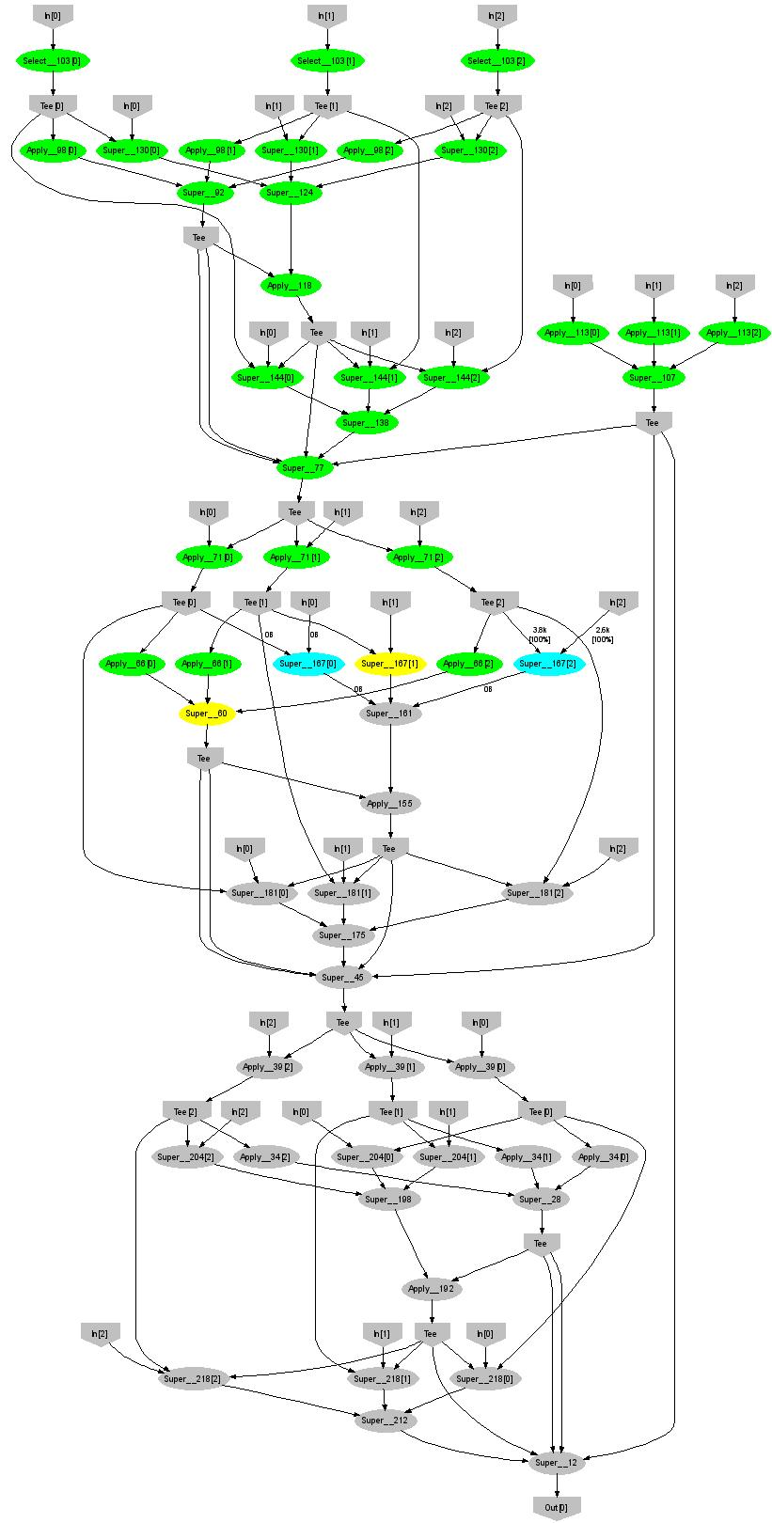
Expectation Maximization (Gaussians)
160 lines
3 iterations shown
Notes:
More complicated, even iterative algorithms, can be implemented.

Slide 57
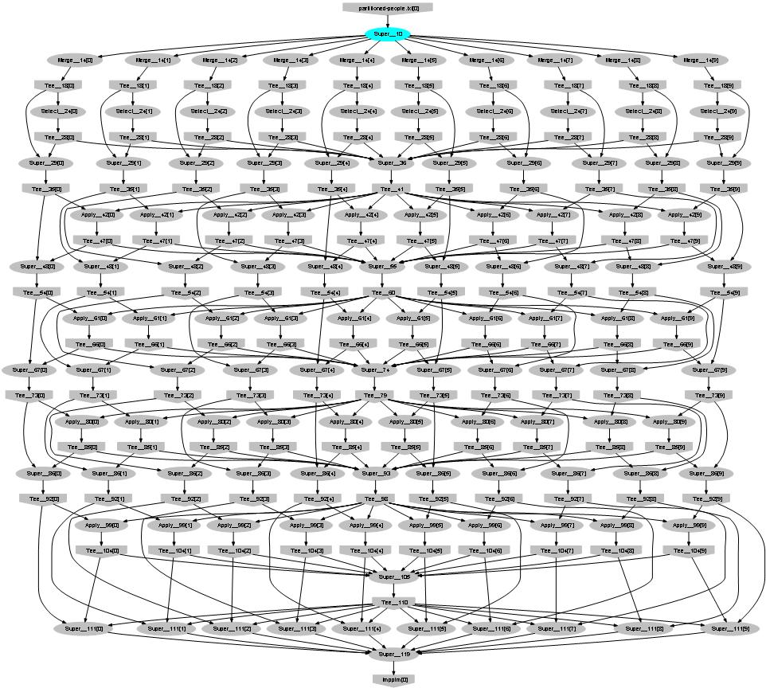
Probabilistic Index Maps
Images
features

Slide 58

Conclusions
Visual Studio
LINQ
Dryad
=
58
Notes:
We believe that Dryad and DryadLINQ are a great foundation for cluster computing.

Slide 59

Backup Slides

Slide 60
Data-Parallel Computation
Sawzall, Pig
Parallel Databases
Map-Reduce
DryadLINQ Scope,PSQL
Application
Dryad
Execution
GFS BigTable
Cosmos
NTFS
Storage

Slide 61
Dryad = Execution Layer
Job (application)
Pipeline
≈
Dryad
Shell
Cluster
Machine
Notes:
In the same way as the Unix shell does not understand the pipeline running on top, but manages its execution (i.e., killing processes when one exits), Dryad does not understand the job running on top.

Slide 62
DryadLINQ
Declarative programming
Integration with Visual Studio
Integration with .Net
Type safety
Automatic serialization
Job graph optimizations
static
dynamic
Conciseness
Notes:
DryadLINQ adds a wealth of features on top of plain Dryad.

Slide 63
Dynamic Graph Rewriting
X[0]
X[1]
X[3]
X[2]
X’[2]
Slow vertex
Duplicate vertex
Completed vertices
Duplication Policy = f(running times, data volumes)
Notes:
The handling of apparently very slow computation by duplication of vertices is handled by a stage manager.

Slide 64
Dynamic Aggregation
S
S
S
S
S
S
T
static
S
S
S
S
S
S
# 1
# 2
# 1
# 3
# 3
# 2
rack #
A
A
A
# 1
# 2
# 3
dynamic
T
Notes:
Aggregating data with associative operators can be done in a bandwidth-preserving fashion in the intermediate aggregations are placed close to the source data.

Slide 65
Range-Distribution Manager
S
S
S
[0-100)
S
S
S
Hist
[0-30),[30-100)
T
static
D
D
D
T
T
[0-?)
[0-30)
[?-100)
[30-100)
dynamic
65
Notes:
Using a connection manager one can load-balance the data distribution at run-time, based on data statistics obtained from sampling the data stream. In this case the number of destination vertices and the ranges for each vertex are decided dynamically.

Slide 66
Goal: Declarative Programming
X
X
X
X
S
S
S
T
T
T
T
static
dynamic
Notes:
We evolve towards a programming model in which resources are always allocated dynamically, based on demand.

Slide 67

Staging
1. Build
2. Send .exe
7. Serialize vertices
vertex code
5. Generate graph
JM code
Cluster services
6. Initialize vertices
3. Start JM
8. Monitor
Vertex execution
4. Query cluster resources
Notes:
Computation Staging

Slide 68
“What’s the point if I can’t have it?”
Glad you asked
We’re opening Dryad+DryadLINQ to a few academic partners
Expect an official announcement soon
Please talk to us if you are interested
Most likely not open-source (for now)

