Slide 1
DryadOpt: Branch-and-Bound on Distributed Data-Parallel Execution Engines
Mihai Budiu, Daniel Delling, Renato Werneck
Microsoft Research - Silicon Valley
IEEE International Parallel & Distributed Processing Symposium IPDPS 2011

Slide 2
DDPEEs
Your problem
Application
DryadOpt
FlumeJava
Pig, Hive
DryadLINQ Scope
Language
Map-Reduce
Hadoop
Dryad
Execution
GFS BigTable
HDFS
Cosmos
Azure HPC
Storage

Slide 3
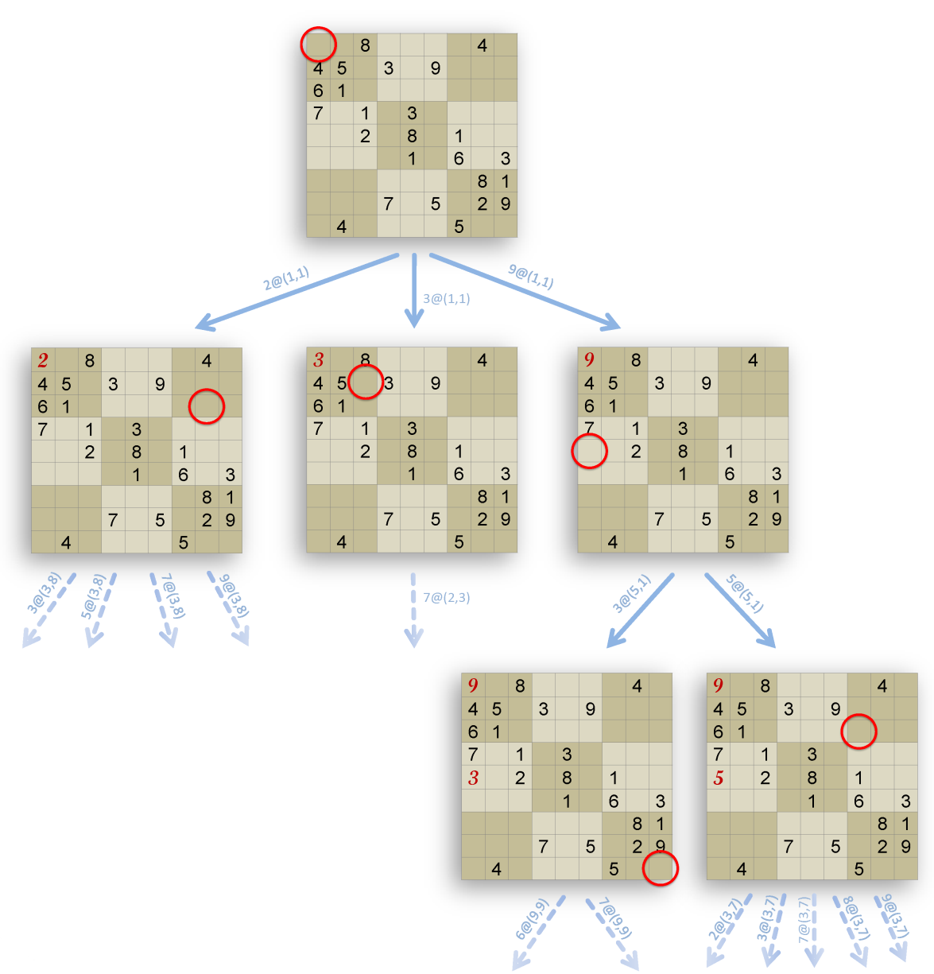
Branch-And-Bound (BB)
Solve optimization problems
Explore potential solutions tree
Bound solution cost
Prune search

Slide 4

Optimization Problems
Minimize/maximize cost
Many are NP-hard
Arise frequently in practice
Parallelism = linear speedup/exponential algorithm
may make a solution practical
e.g., one CPU-year / day
real-world instances are not always hard
relatively small problems

Slide 5
Why Is This Work Interesting?
Generic distributed BB implementation
Separate sequential and parallel components
Parallelism hidden from user
DDPEEs offer a restricted computation model
Communication is expensive
DDPEEs require idempotent computations
(DryadOpt uses any sequential solver)
DryadOpt exploits parallelism well (CPU/core)

Slide 6
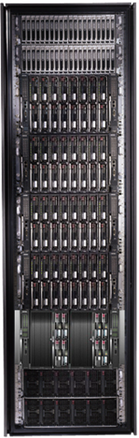
Generic Solution Search
Sequential Solver
User
Solver API
DryadOpt
We

Slide 7
Concern Separation
Steiner
tree
Travelling salesman
Optimization problem
Specialized
sequential solvers
Solver interface
Sequential engine
Multi-core engine
Distributed engine (DryadOpt)
Solver engines

Slide 8
Outline
Introduction
Mapping BB to DDPEEs
Running the algorithm
Parallelization details
Performance results
Conclusions

Slide 9

DDPEE Computation Structure
Input
Computations
Output
Communication
Computation graph is statically constructed

Slide 10
Unbalanced Search Trees
No static tree partition will work well

Slide 11

Algorithm structure
Dynamic load-balancing
Iterative computation
Expand tree
Load-balance
Iterate

Slide 12


Distributing Search Trees

Slide 13
Outline
Introduction
Mapping BB to DDPEEs
Running the algorithm
Parallelization details
Performance results
Conclusions

Slide 14

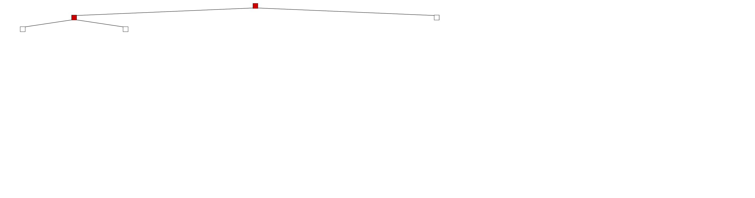
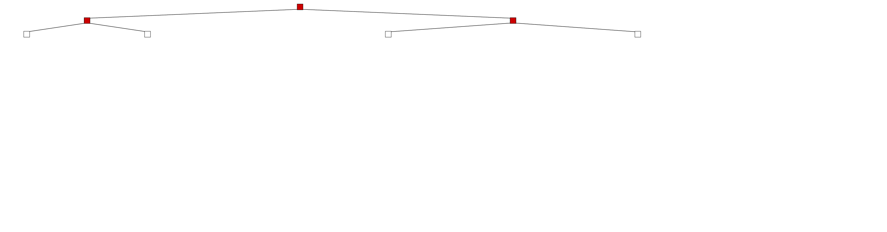
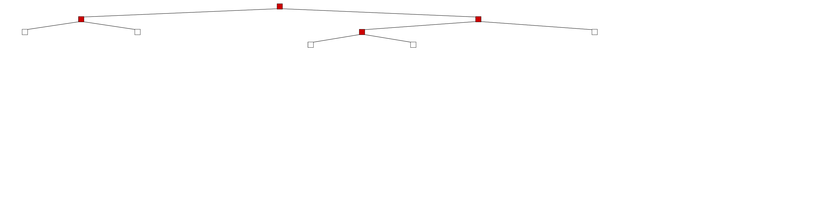
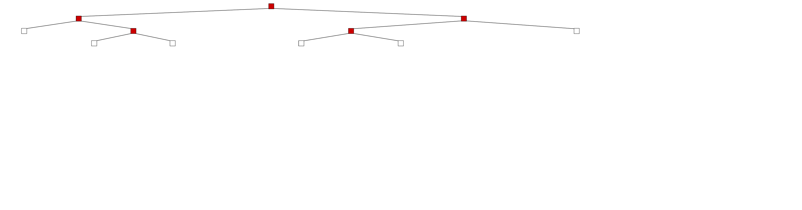
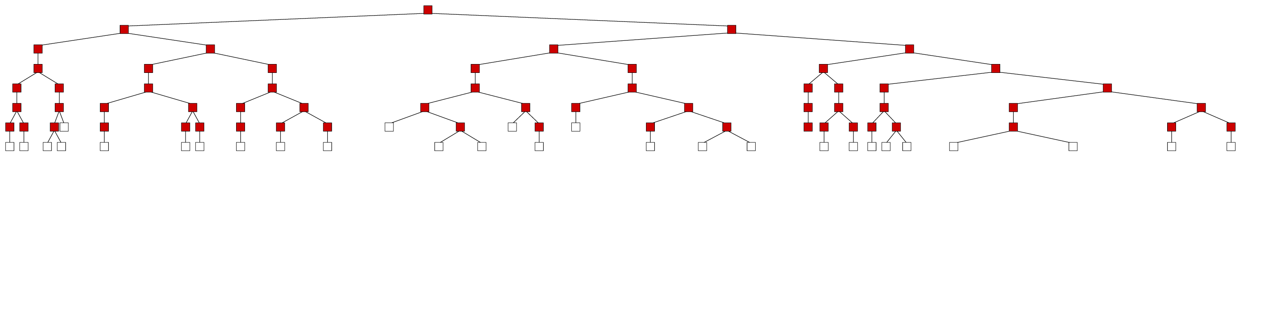
1. Start tree on a single machine

Slide 15
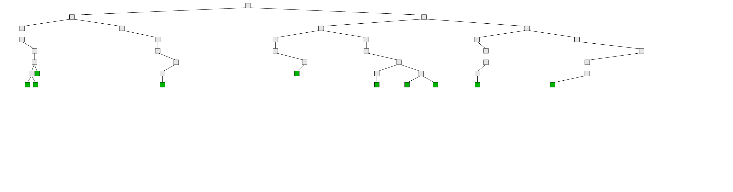
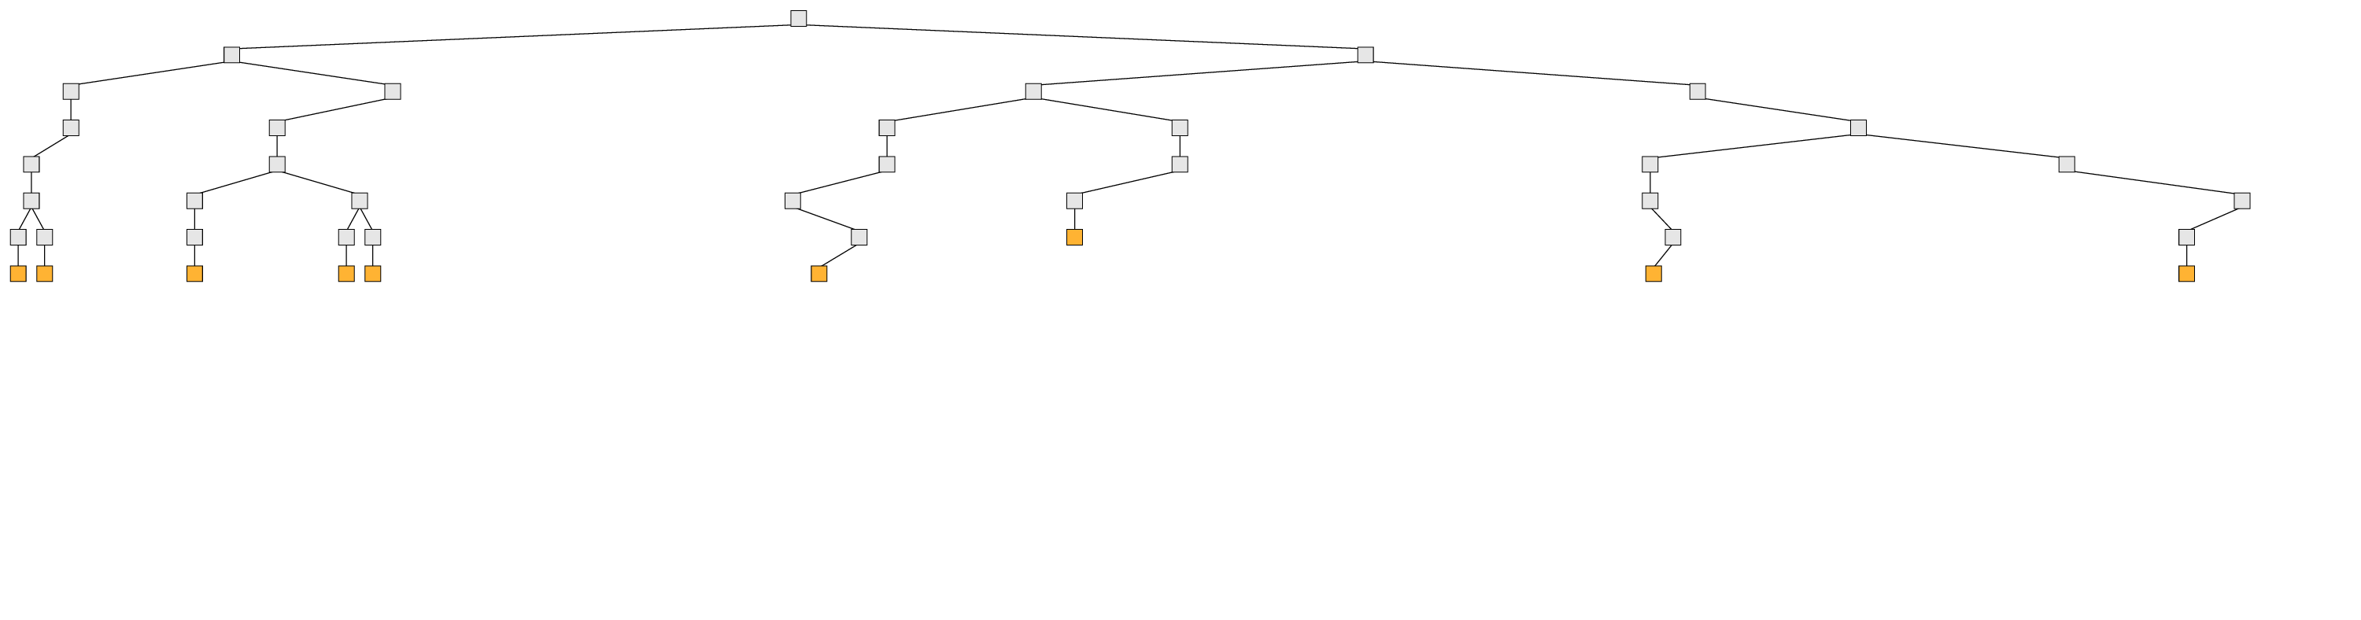
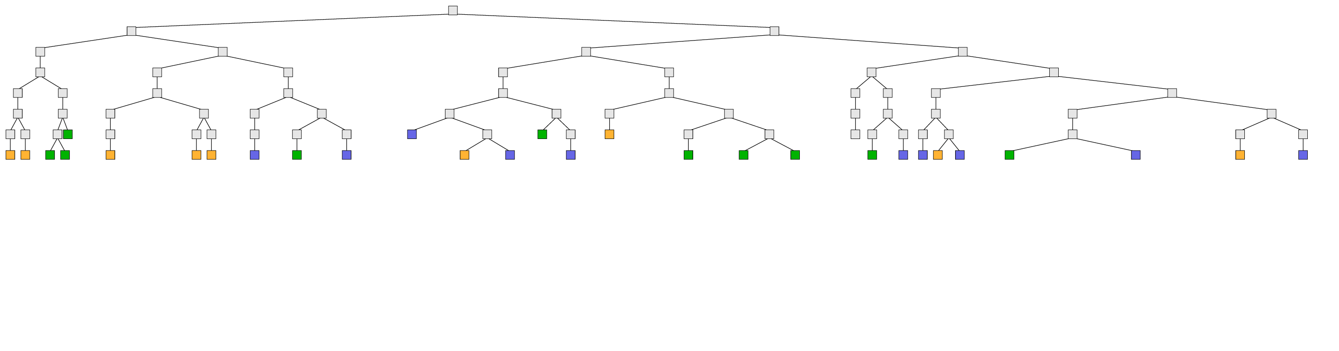
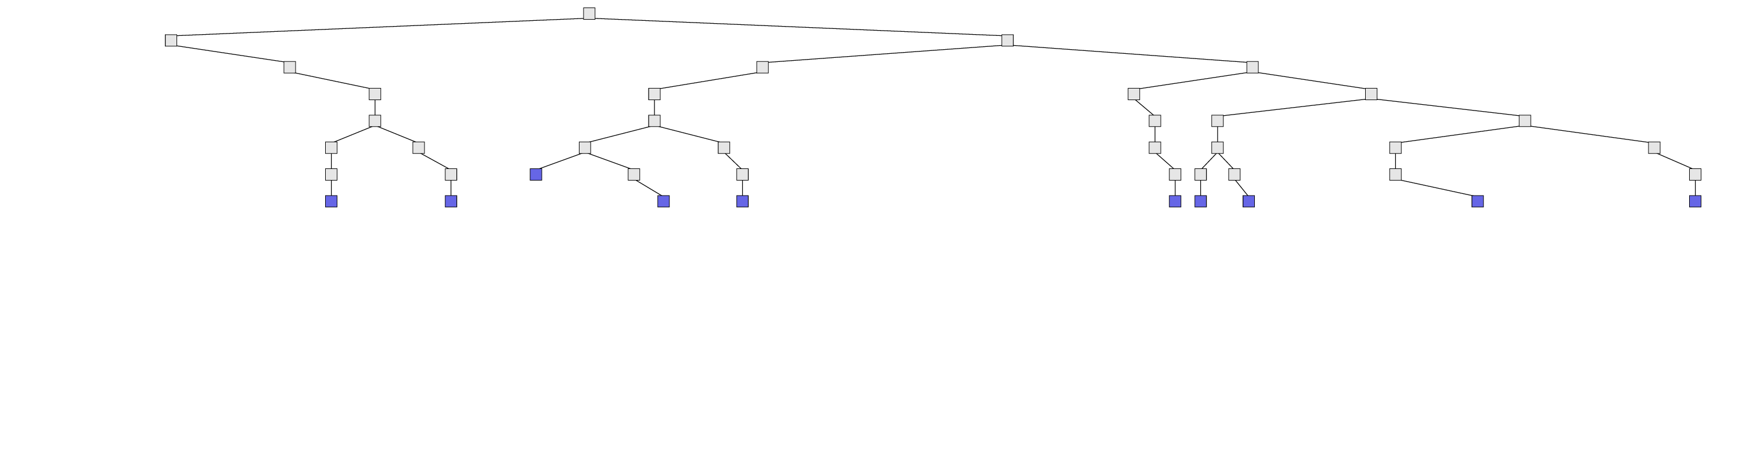
2. Split the open problems randomly
3. Distribute open problems

Slide 16
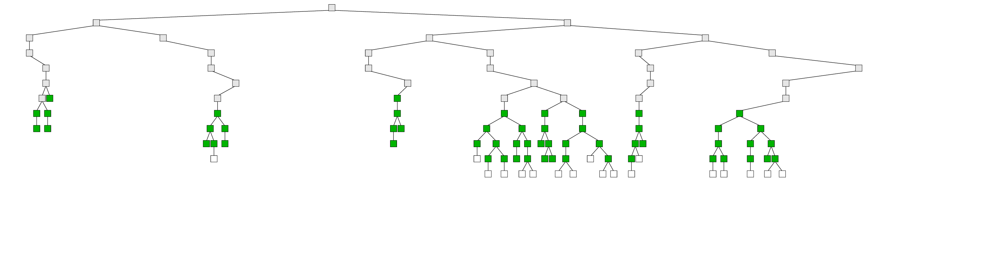
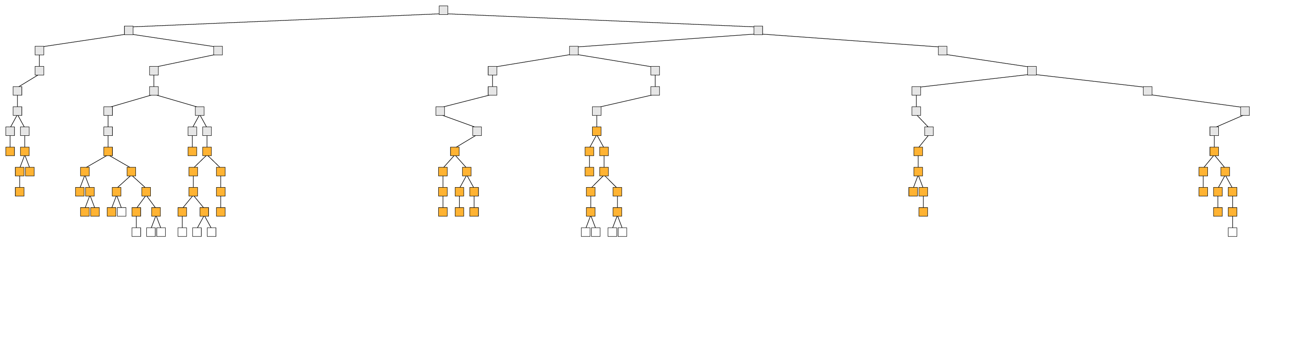
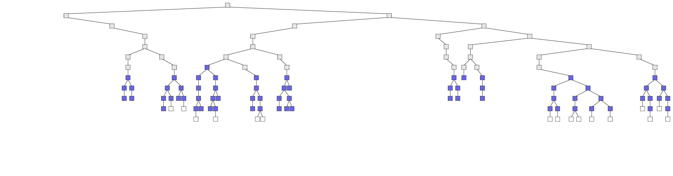
4. Proceed independently

Slide 17
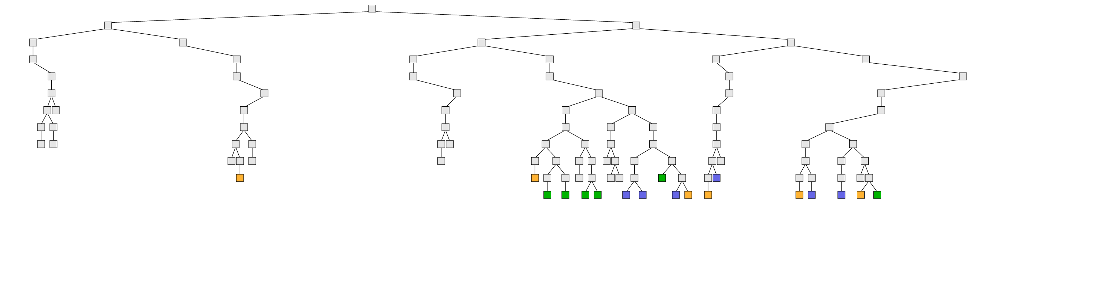
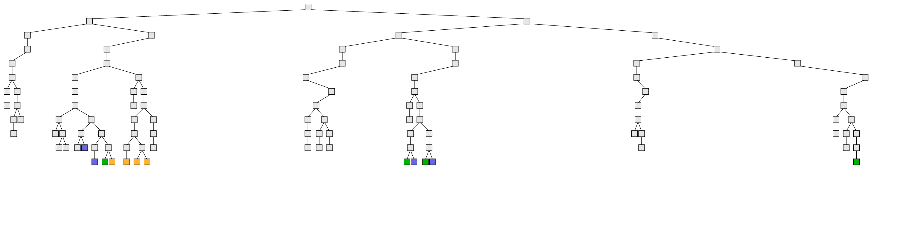
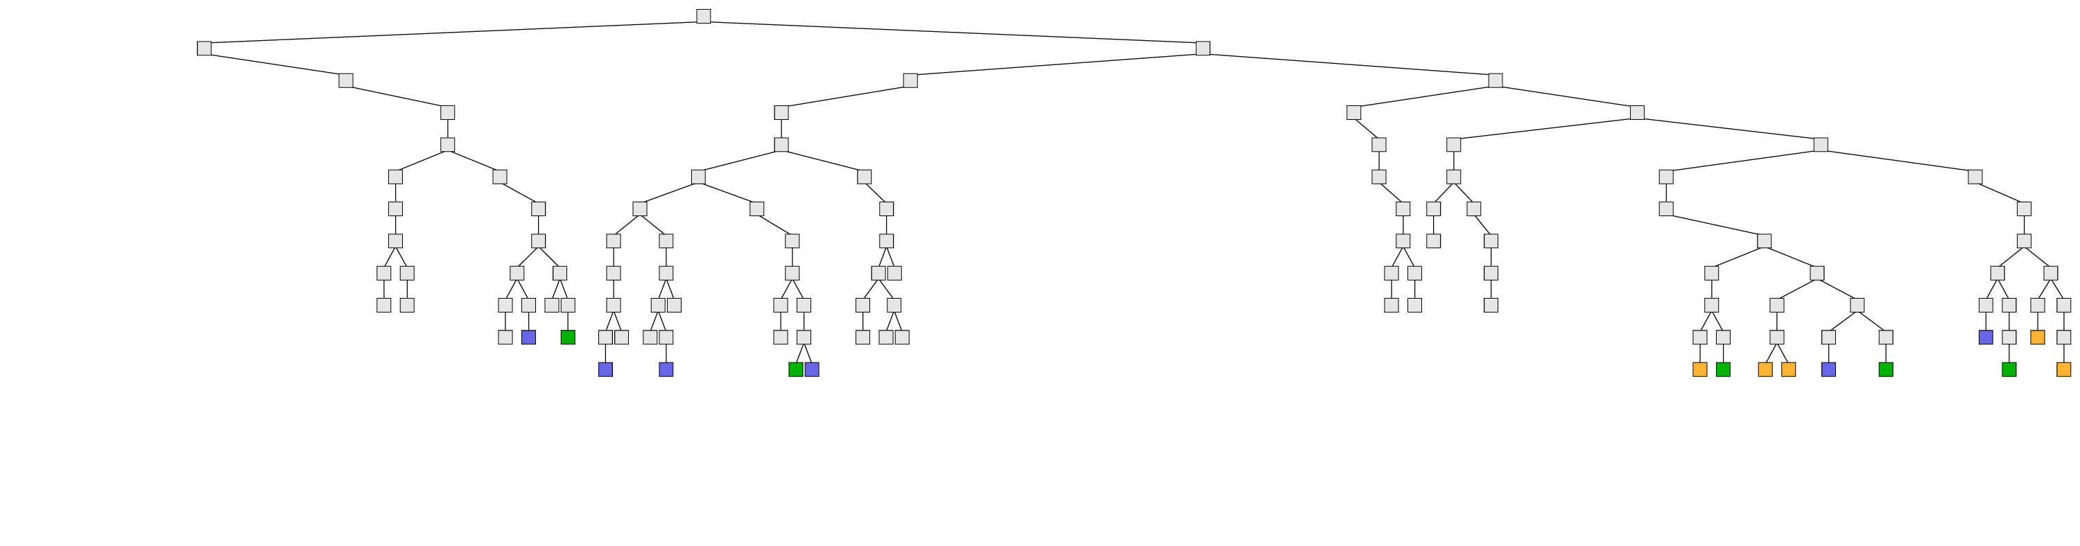
5. Split Independently, Randomly

Slide 18
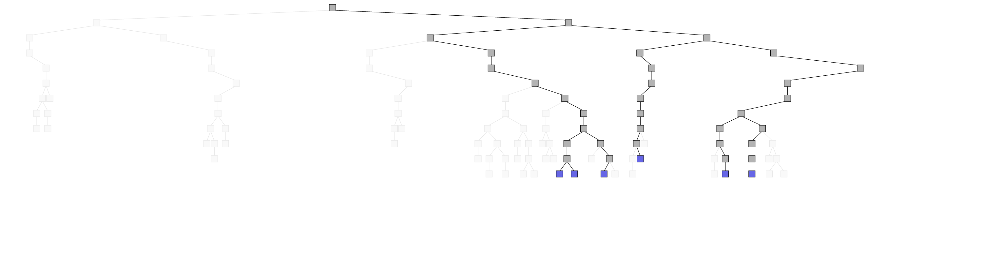
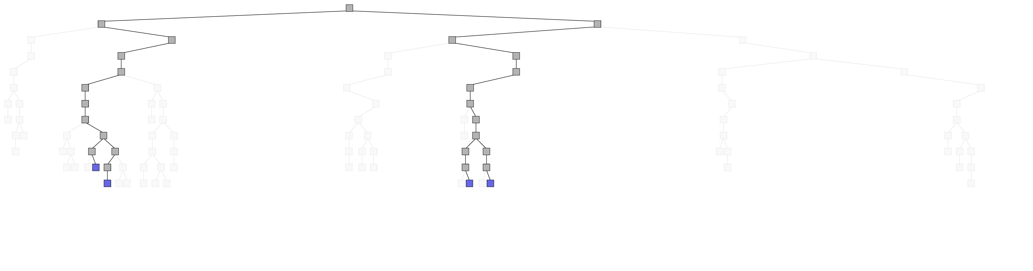
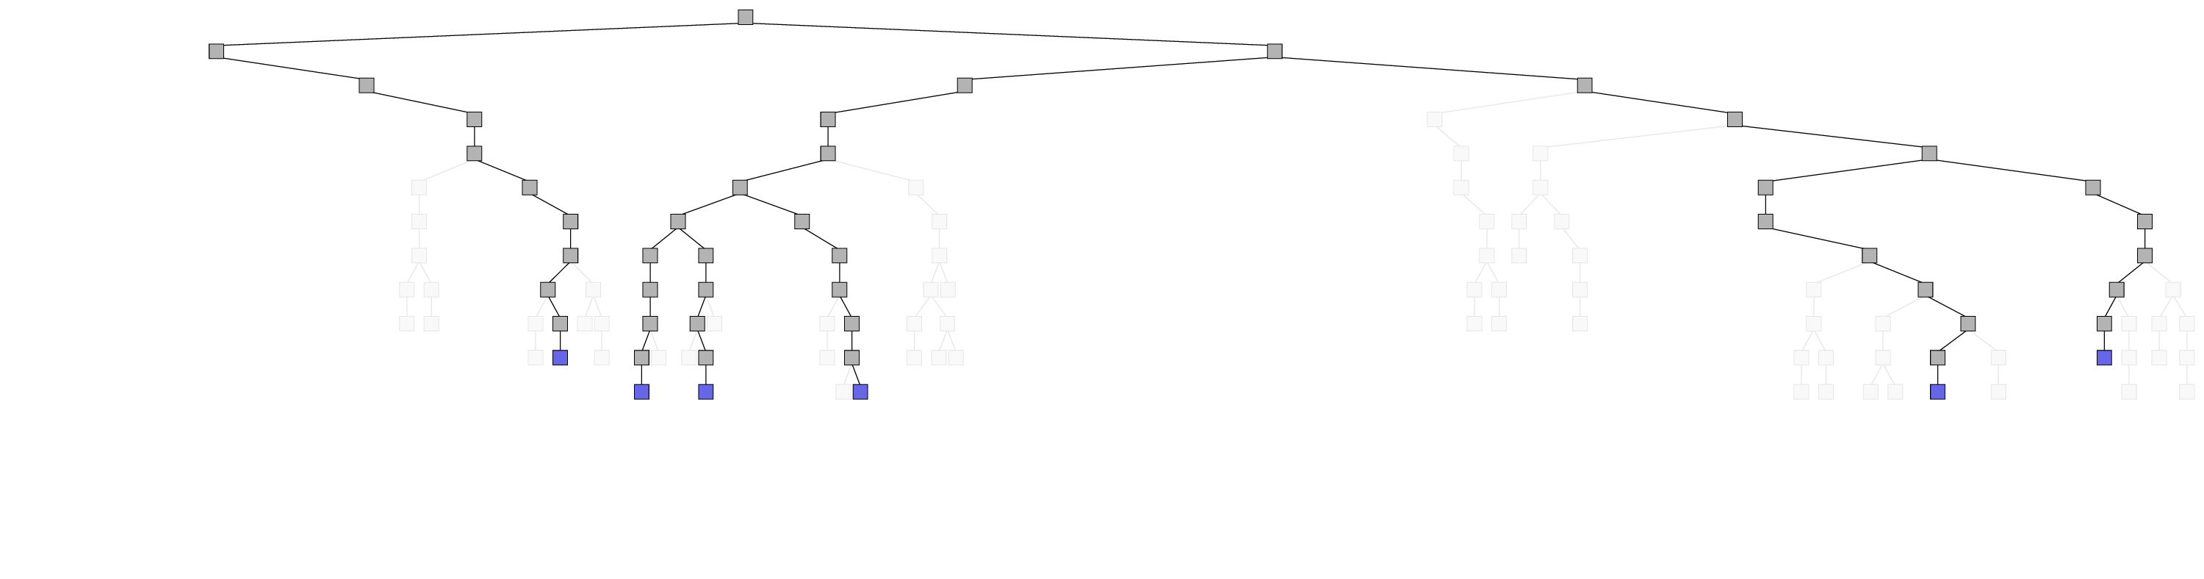
6. Redistribute

Slide 19
7. Merge

Slide 20
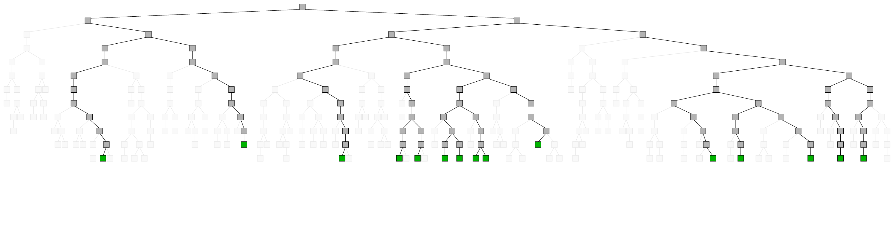
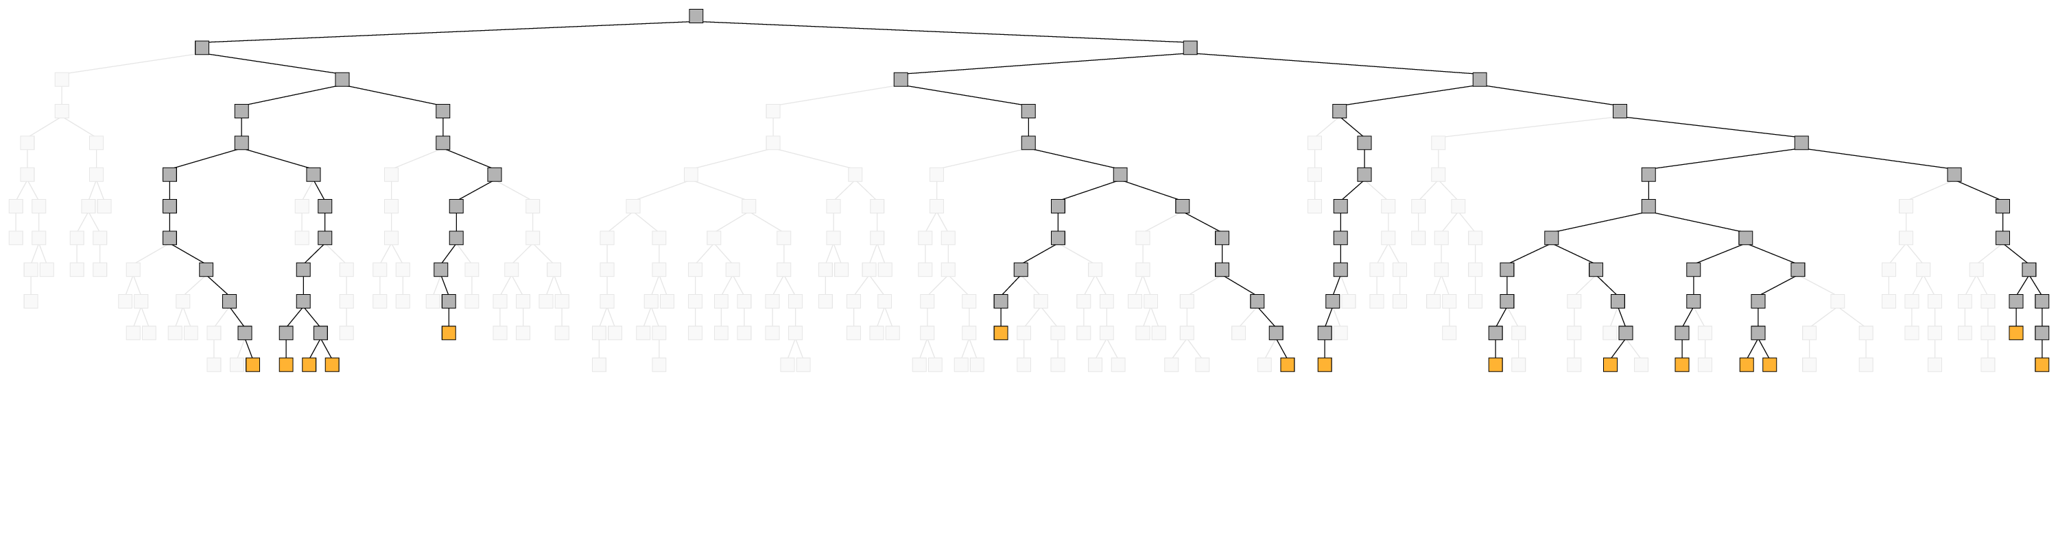
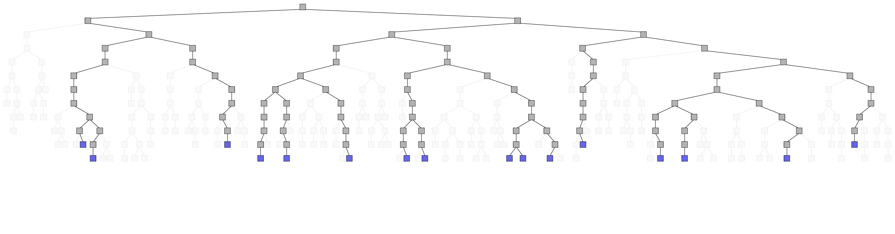
8. Iterate

Slide 21
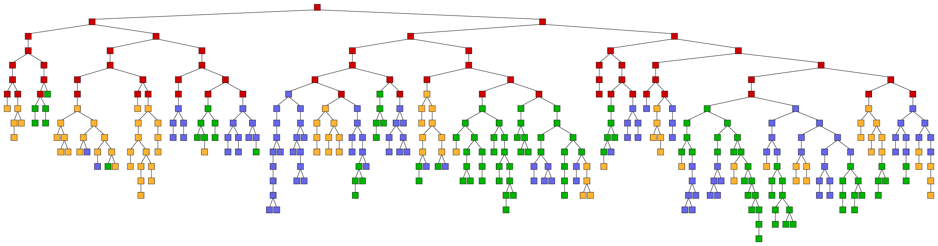
Final Tree

Slide 22
Outline
Introduction
Mapping BB to DDPEEs
Running the algorithm
Parallelization details
Performance results
Conclusions

Slide 23

Bird’s Eye View
Broadcast
Current frontier
Sequential solver
New frontier
Load-balancing
instance
global state
New frontier
computation
Aggregate state
Termination test
Repeat if not done

Slide 24
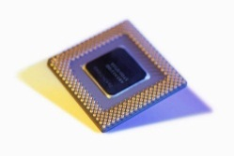
Nested Parallelism
Partition
Merge
Inter-machine parallelism
Inter-core parallelism

Slide 25

Other Details in Paper
Cluster resources are unpredictable
Outliers can lead to low cluster utilization
Use real-time scheduling
Sequential solver is not idempotent
Fault tolerance-triggered re-executions can lead to incorrect results
Ckeckpoint frontier at suitable execution points

Slide 26

Other Details in Paper
Trade-off memory/load balancing
The frontier can grow very large
Adjust dynamically tree traversal strategy BFS/DFS
Sub-problems may differ little from problem
Many sub-problems can cause memory pressure
Use an incremental sub-problem representation

Slide 27
Outline
Introduction
Mapping BB to DDPEEs
Running the algorithm
Parallelization details
Performance results
Conclusions

Slide 28
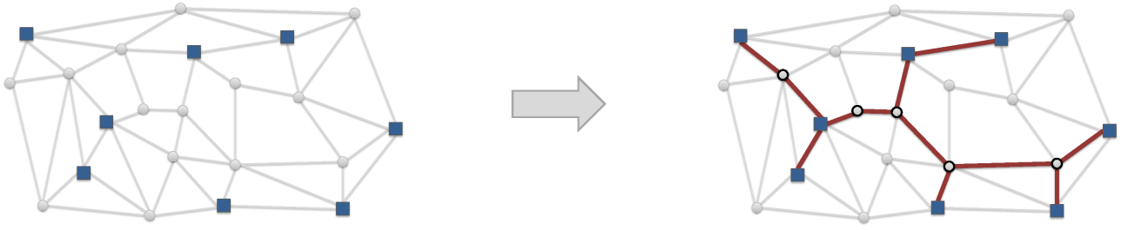
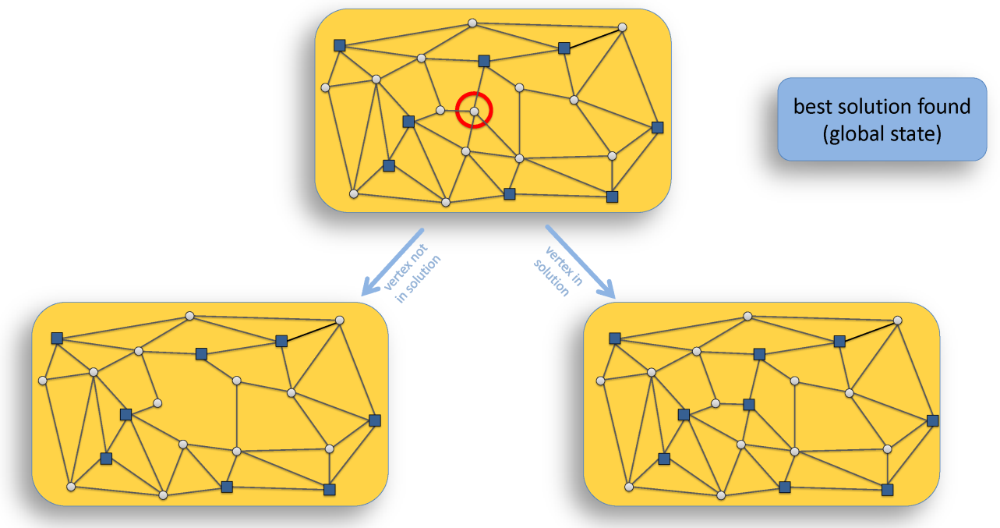
Benchmark: Steiner Tree Solver

Slide 29
Cluster
Machines
2 dual-core AMD Opteron 2.6Ghz
16 GB RAM
Windows Server 2003
DryadLINQ
128 machines (512 cores)

Slide 30
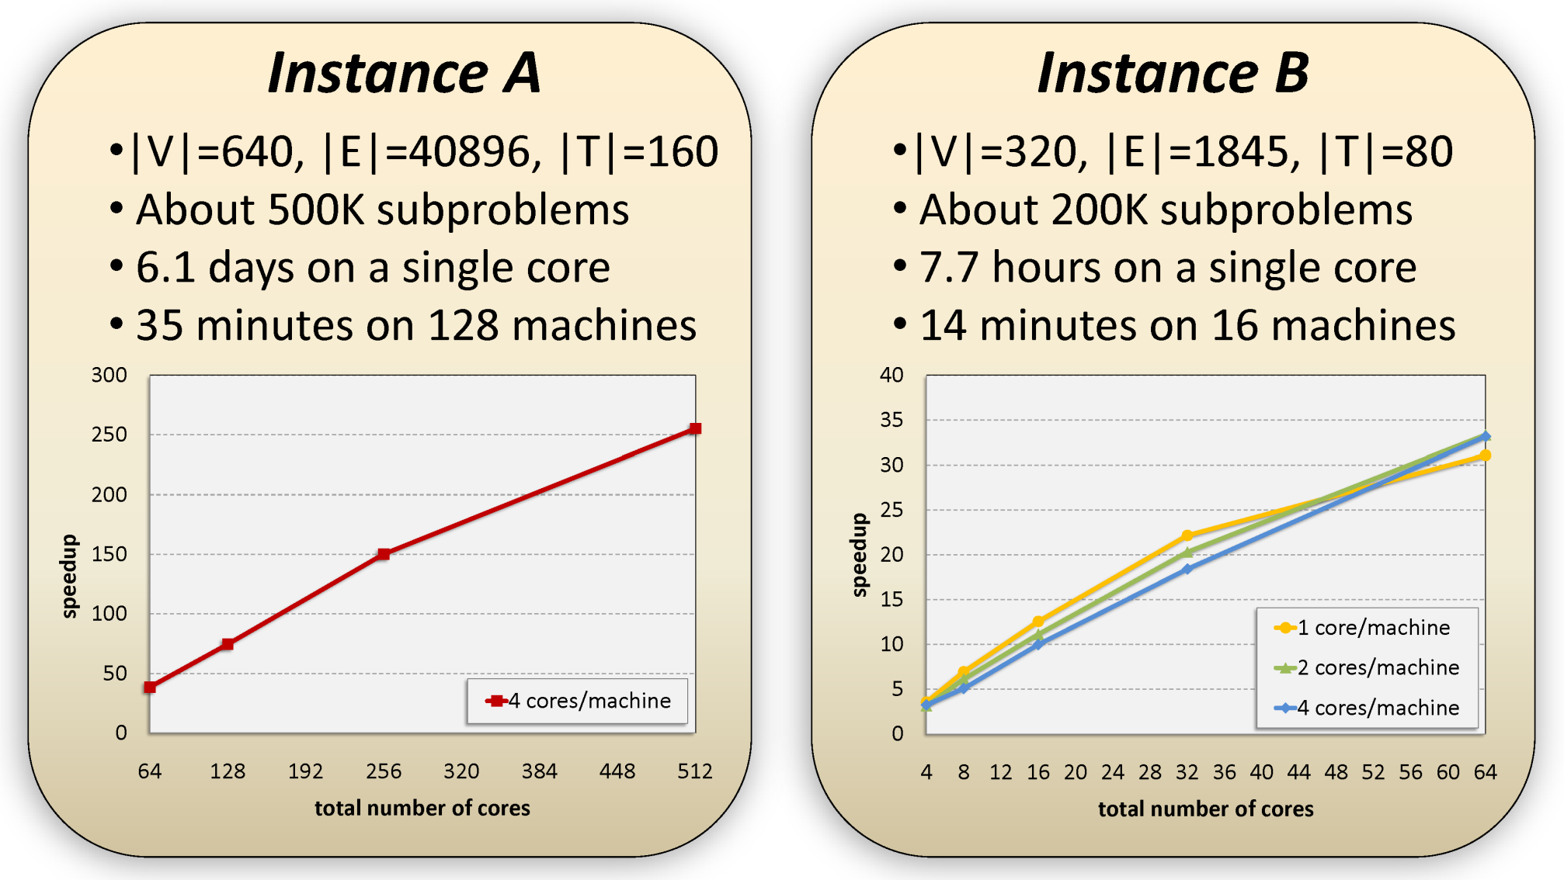
Scalability

Slide 31

Conclusions
Generic parallelization (problem-independent)
Nested machine/core parallelization
Careful scheduling needed for good performance
Solvers are not idempotent: interference with fault-tolerance mechanisms
Search Tree Exploration is efficiently parallelizable in the DDPEE model

Slide 32
Backup Slides

Slide 33
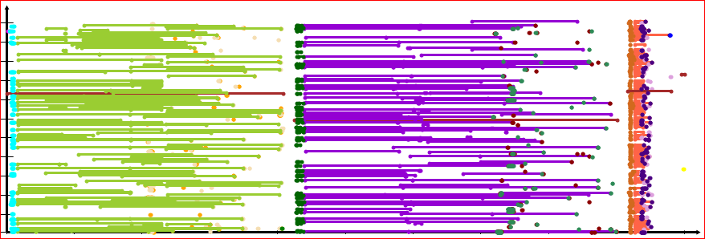
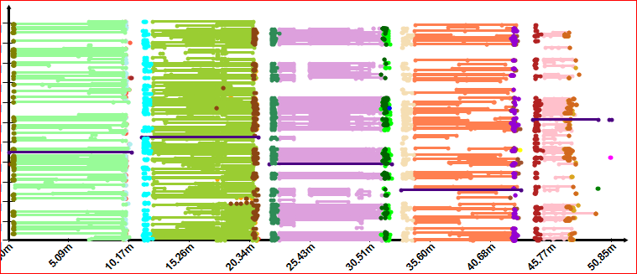
Real-Time Scheduling

Slide 34
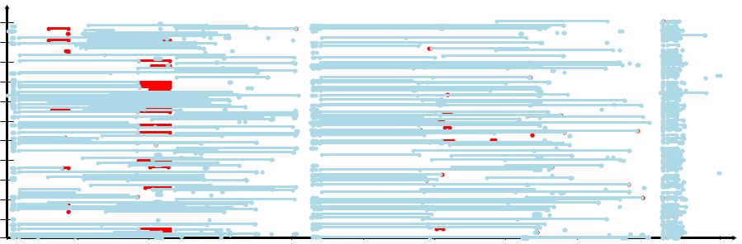
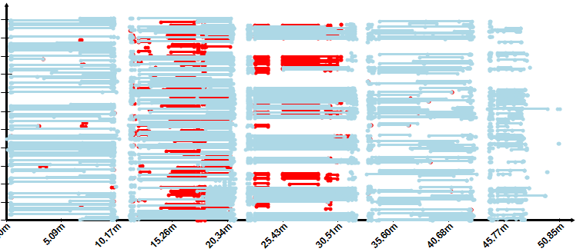
Cluster machine
Relative-time scheduling
61m
Cluster machine
Real-time scheduling
time
real-time deadlines
Preempted Completed

Slide 35
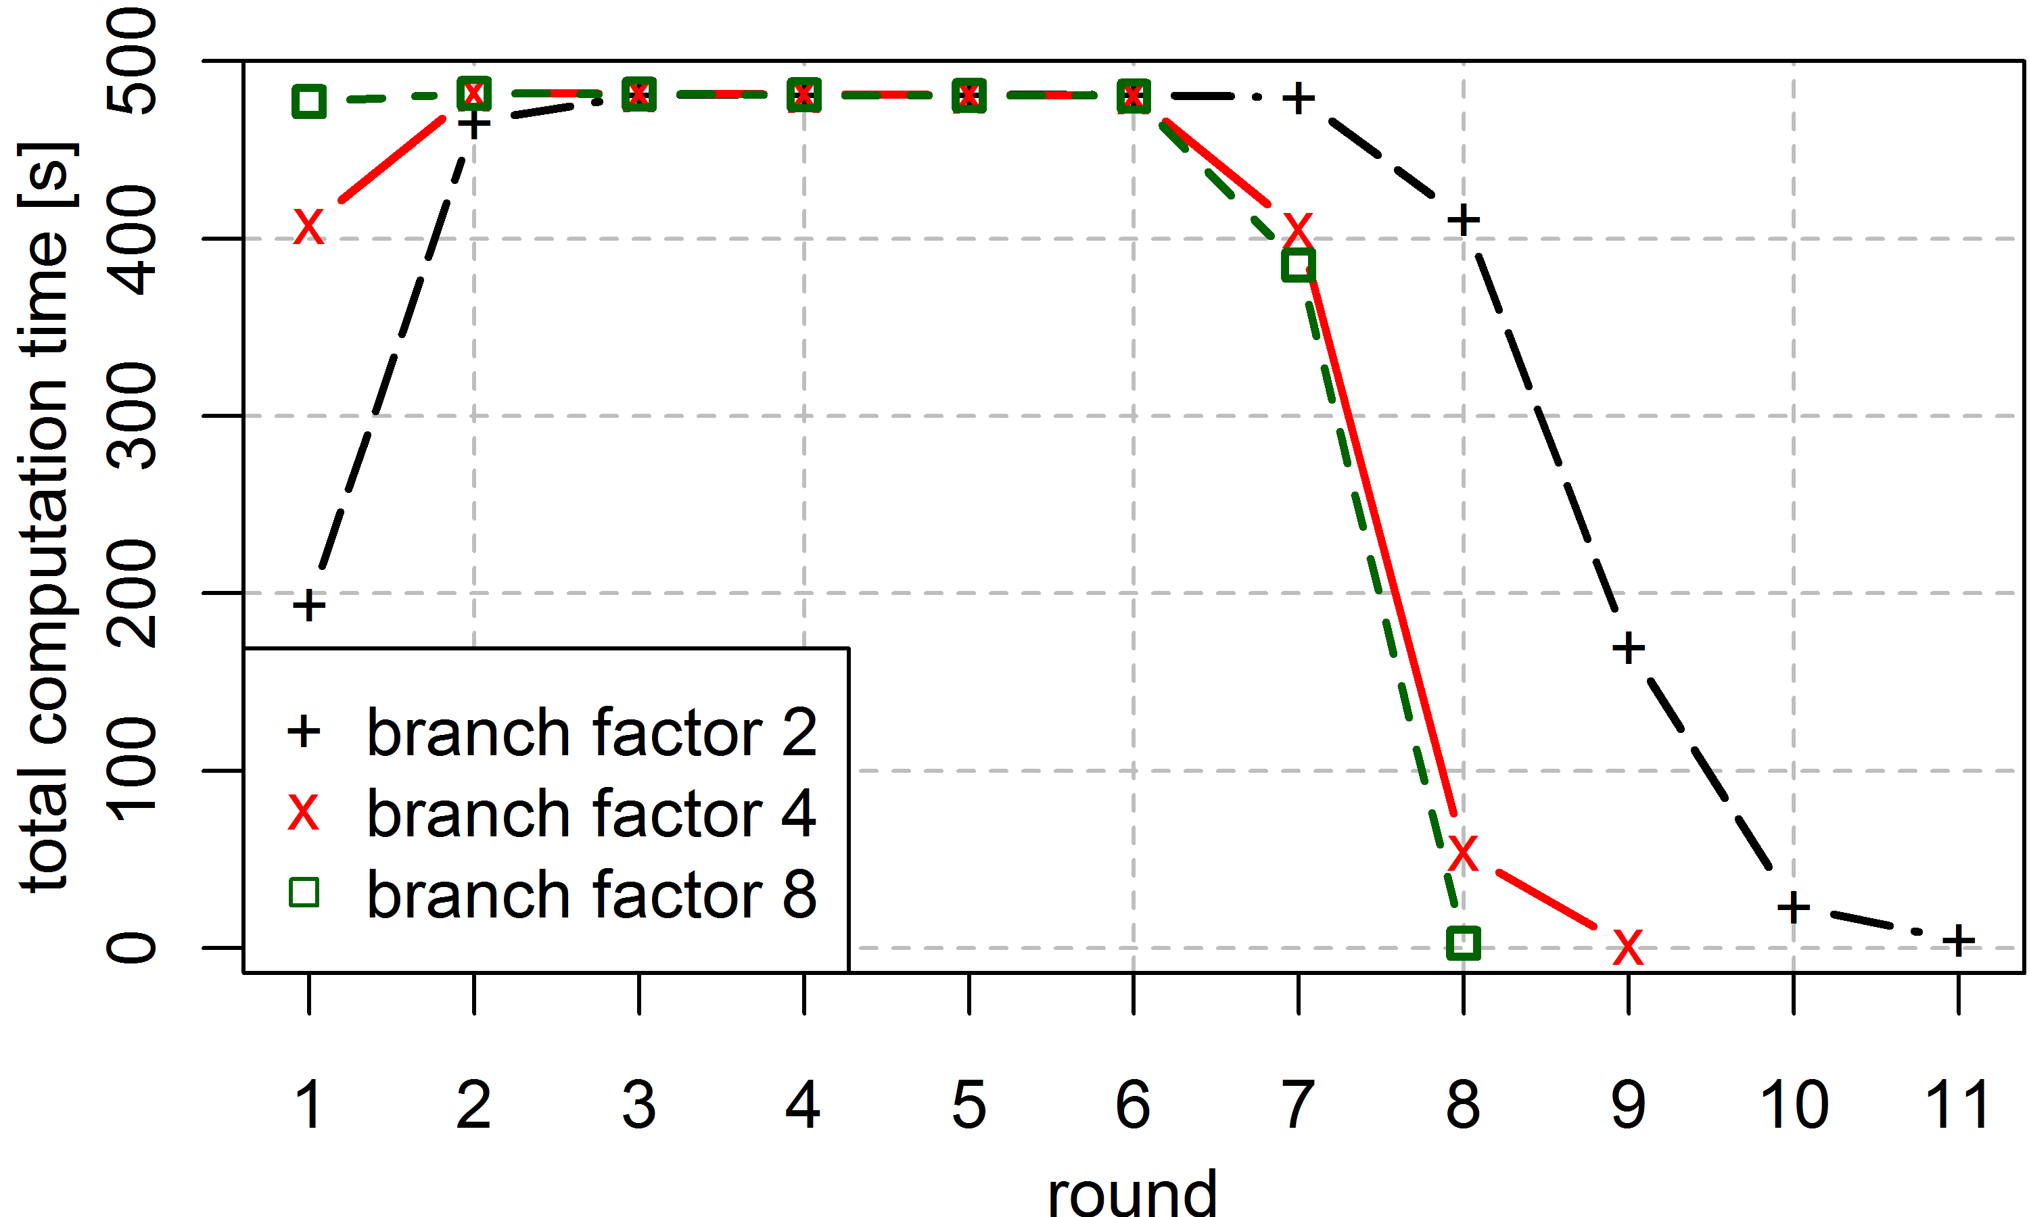
Load-Balancing

Slide 36
Tree Traversal Strategies
BFS:
large frontier
Efficient load-balancing
Memory pressure
DFS
Reduces # of open subproblems
Solution: dynamically switch BFS ⬄ DFS

Slide 37
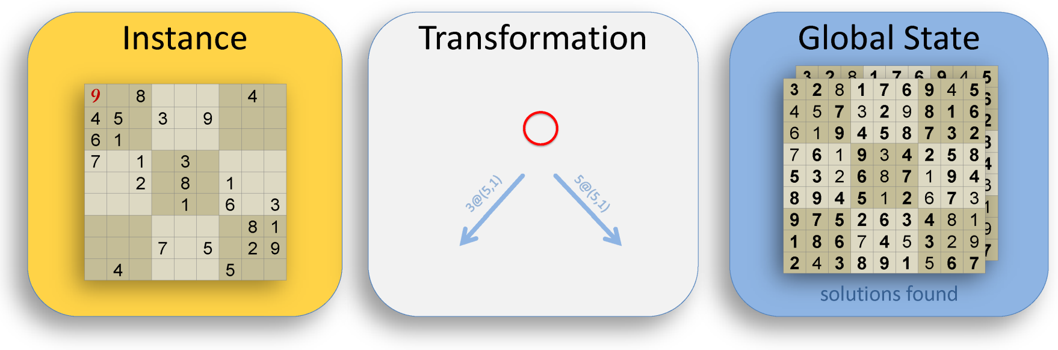
The Solver API
[Serializable] interface IBBInstance {}
[Serializable] interface IBBGlobalState {
void Merge (IBBGlobalState s);
void Copy (IBBGlobalState s); }
List<IBBInstance>
Solve (List<IBBInstance> incrementalSteps,IBBGlobalState state,BBConfig c)

Slide 38
Re-execution & Idempotence
X
Y
X
Y
X
Y
X
Y
X
Y
Y
X
Y
Y
?
Y
X
Y
Y

