Slide 1

Dataflow:
A Complement to Superscalar
Mihai Budiu – Microsoft Research
Pedro V. Artigas – Carnegie Mellon University
Seth Copen Goldstein – Carnegie Mellon University
2005
Notes:
Planets image courtesy mostly of NASA, but from other web sites as well.

Slide 2
Computer Architecture
-- A Simplified History --
superscalar
dataflow
1967
1990
2005

Slide 3
This Work
Re-evaluate dataflow
  Same workloads as superscalar
  (C programs: Mediabench, Spec)
  Modern performance analysis tool
  (whole-program critical path)
Use of superscalar mechanisms in dataflow

Slide 4
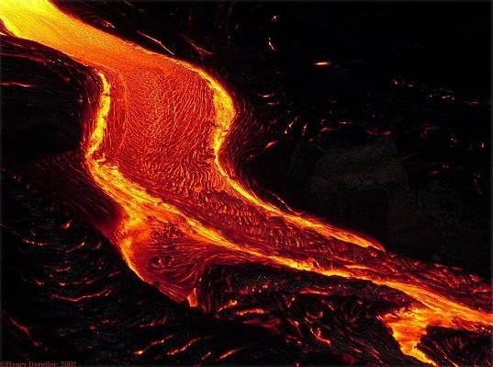
Why Study Dataflow
Naturally exploit ILP
Potentially very high ILP
Simple, regular
microarchitecture
Very low power
[1/1000 superscalar]
Suitable for stream processing

Slide 5
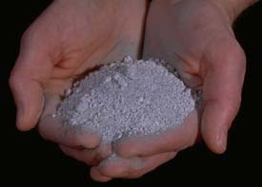
Outline
Motivation
ASH: A Static Dataflow Model
Explaining bottlenecks
Conclusions

Slide 6
Application-Specific Hardware
C program
Compiler
Dataflow IR
HW dataflow machine
Notes:
The dataflow machine generated is very close semantically to the internal compiler representation, which makes the translation particularly efficient.
In fact, the two are so close that in the following I will blur the distinction between the representation and the resulting circuits.
By going directly from program to hardware implementation we circumvent the limitations of a fixed ISA.

Slide 7
Computation Dataflow
Program
IR
Circuits
a
7
a
x = a & 7;
...
y = x >> 2;
&
&7
2
x
>>
>>2
Operations | Nodes | Pipeline stages
Variables | Def-use edges | Channels (wires)
Pure dataflow: no program counter
Notes:
We do not have the disadvantages of the traditional dataflow machine model, because we implement the machines directly in hardware.

Slide 8
Basic Computation=
Pipeline Stage
+
latch
data
ack
valid
Notes:
The synthesized circuit are built from such constructs. The semantics of the internal representation is described in these terms.

Slide 9
Control Flow => Data Flow
data
Merge (label)
data
data
predicate
Gateway
p
Split (branch)
!
Notes:
Note: in reality the merge operator is slightly more complicated than described here, since multiple merge operators sometimes need to cooperate in order to correctly execute the program.
The merge is also called “mu”, while the gateway is also called “eta”.

Slide 10
Loops
0
i
0
*
+1
int sum=0, i;
for (i=0; i < 100; i++)
sum += i*i;
return sum;
< 100
sum
+
return sum;
!
ret
Notes:
Loops can be built using merges and gateways as building blocks. Some gateways direct the data to the beginning of the loop while other direct the data out of the loop (red). They are controlled by complementary predicates.

Slide 11
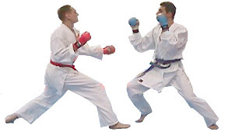
Comparison: Idealized Simulation
Compared to 4-wide OOO SimpleScalar
Same operation latencies
Same memory hierarchy (LSQ, L1, L2)
not free

Slide 12
Obvious!
wrong!
ASH runs at full dataflow speed,
and has no resource limitations, so CPU cannot do any better
(if compilers equally good)

Slide 13
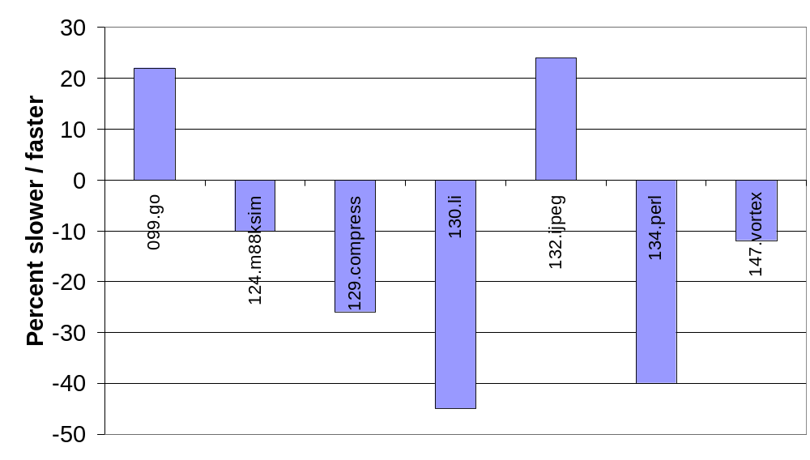
SpecInt95, ASH vs 4-way OOO

Slide 14
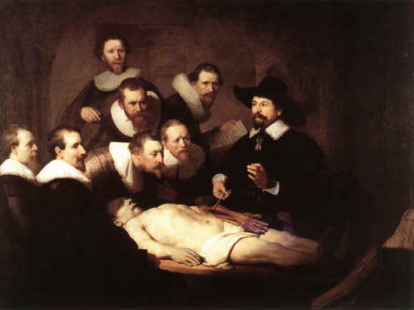
Outline
Motivation
ASH: A Static Dataflow Model
Dissection: explaining bottlenecks
Conclusions

Slide 15

The Scalpel
CASH
Simulator
C
ASH
ASH
drawings
trace
Automatic
analysis
Dynamic Critical Path

Slide 16
The (Loop) Body
for (j = 0; X[j].r != 0xF; j++)
if (X[j].r == i)
break;
SpecINT95: 124.m88ksim, init_processor()

Slide 17
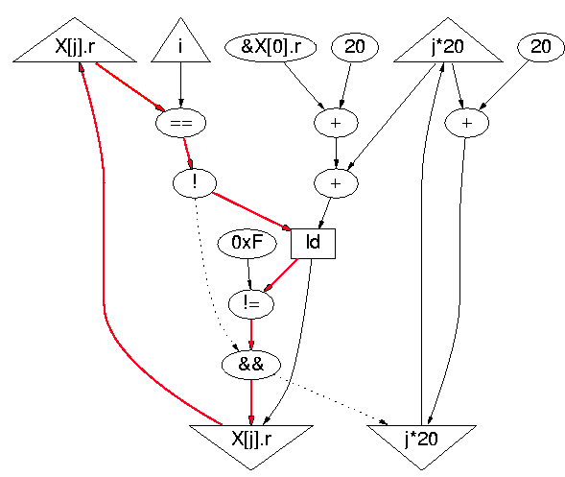
Dynamic Critical Path
definition
sizeof(X[j])
load predicate
loop predicate
for (j = 0; X[j].r != 0xF; j++)
if (X[j].r == i)
break;

Slide 18
MIPS gcc Code
LOOP:
L1: beq $v0,$a1,EXIT ; X[j].r == i
L2: addiu $v1,$v1,20 ; &X[j+1].r
L3: lw $v0,0($v1) ; X[j+1].r
L4: addiu $a0,$a0,1 ; j++
L5: bne $v0,$a3,LOOP ; X[j+1].r == 0xF
EXIT:
for (j = 0; X[j].r != 0xF; j++)
if (X[j].r == i)
break;
L1=>L2=>L3=>L5=>L1
4-instructions loop-carried dependence

Slide 19
If Branch Prediction Correct
LOOP:
L1: beq $v0,$a1,EXIT ; X[j].r == i
L2: addiu $v1,$v1,20 ; &X[j+1].r
L3: lw $v0,0($v1) ; X[j+1].r
L4: addiu $a0,$a0,1 ; j++
L5: bne $v0,$a3,LOOP ; X[j+1].r == 0xF
EXIT:
for (j = 0; X[j].r != 0xF; j++)
if (X[j].r == i)
break;
L1=>L2=>L3=>L5=>L1

Slide 20
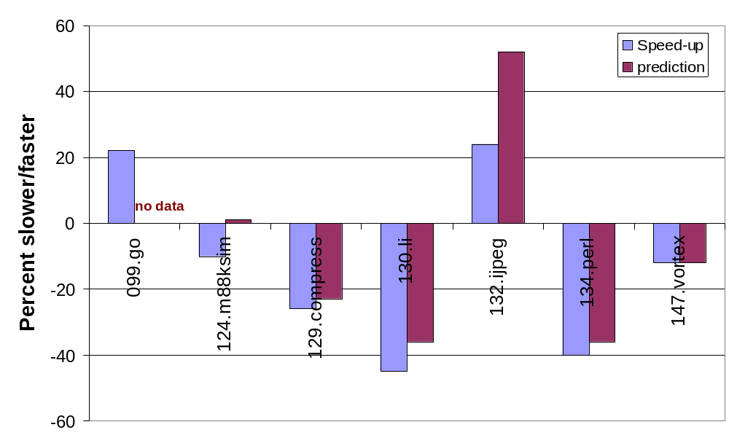
SpecInt95, perfect prediction

Slide 21
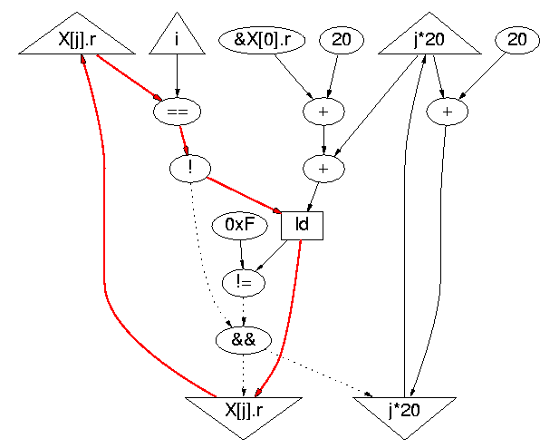

Critical Path with Prediction
Loads are not
speculative
for (j = 0; X[j].r != 0xF; j++)
if (X[j].r == i)
break;

Slide 22
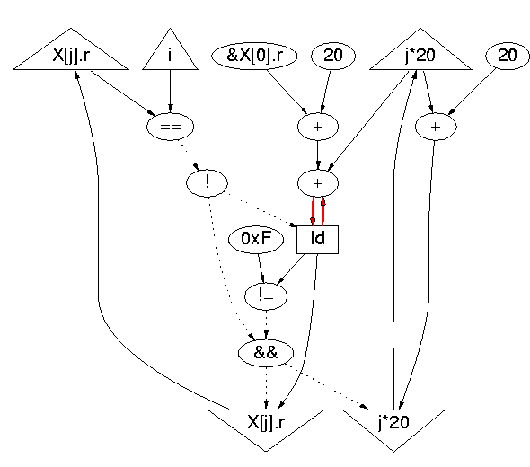
Prediction + Load Speculation
ack edge
~4 cycles!
Load not pipelined
(self-anti-dependence)
for (j = 0; X[j].r != 0xF; j++)
if (X[j].r == i)
break;

Slide 23
OOO Pipe Snapshot
LOOP:
L1: beq $v0,$a1,EXIT ; X[j].r == i
L2: addiu $v1,$v1,20 ; &X[j+1].r
L3: lw $v0,0($v1) ; X[j+1].r
L4: addiu $a0,$a0,1 ; j++
L5: bne $v0,$a3,LOOP ; X[j+1].r == 0xF
EXIT:
register
renaming
IF
DA
EX
WB
CT
L3
L3
L3
Notes:
[IF] [DA] [EX] [WB] [CT]

Slide 24
Conclusions:
Limitations of Static Dataflow
dataflow state is “more” distributed
“control” dependences still limit ILP
nontrivial to squash distributed speculation
good prediction may need global information
self-antidependences can be critical (removed by register renaming)
distributed computation => more remote accesses
more synchronization in dataflow (“join” is not free)
Notes:
von Neumann photo from http://www.lanl.gov/worldview/welcome/history/21_implosion.html

Slide 26

Unrolling Does Not Help
for(i = 0; i < 64; i++) {
for (j = 0; X[j].r != 0xF; j+=2) {
if (X[j].r == i)
break;
if (X[j+1].r == 0xF)
break;
if (X[j+1].r == i)
break;
}
Y[i] = X[j].q;
}
when 1 iteration
Notes:
Overhead projector image from staples.com

Slide 27
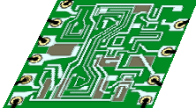
How Performance Is Evaluated
Unlimited ILP
static dataflow
Mem
CASH
L2
1/4M
C
L1
8K
LSQ
gcc
Simple
Scalar
2
8
72
Notes:
This is the model used to generate the data in the “performance” slide.

Slide 28
Last-Arrival Events
Event enabling the
generation of a result
May be an ack
Critical path=collection
of last-arrival edges
+
data
ack
valid
Notes:
Both the internal representation and the synthesized circuit are built from such constructs.

Slide 29
Dynamic Critical Path
Some edges may repeat
Trace back along
last-arrival edges
Start from last node
back
back to talk

Slide 30
History
Out-of-order
Branch pred
Speculation
Tomasullo
IBM 360
1967
Fisher
VLIW
Thornton
CDC
1964
Smith
Br pred
1981
Cocke
Superscalar
1985
Smith
Precise spec
1988
Karp
Graph model
1966
Dennis
Dataflow lang
1974
Arvind
Tagged-token
1977
Papadopoulos
Monsoon
1988
Burger
TRIPS
2001
Oskin
WaveScalar
2003

