Slide 1
Parallelizing Large-Scale Data-Processing Applications with Data Skew: A Case Study in Product-Offer Matching
Ekaterina Gonina
UC Berkeley
Anitha Kannan, John Shafer, Mihai Budiu
Microsoft Research
MapReduce’11 Workshop. June 8, 2011. San Jose, CA

Slide 2
Motivation
Enabling factors:
Web-scale data
Cluster computing platforms
Web-scale data
large
skewed
MapReduce frameworks do not handle skew well
Build data-dependent optimizations
Adapt computation to nature of data
Product-Offer matching as an example of application with large (factors of 10^5) data skew
Notes:
Connect motivation to next slide

Slide 3
Outline
Product-Offer Matching: Application in E-Commerce
Data Skew
Parallel Implementation with DryadLINQ
Algorithm
Three distributed join strategies
Results
Conclusion

Slide 4
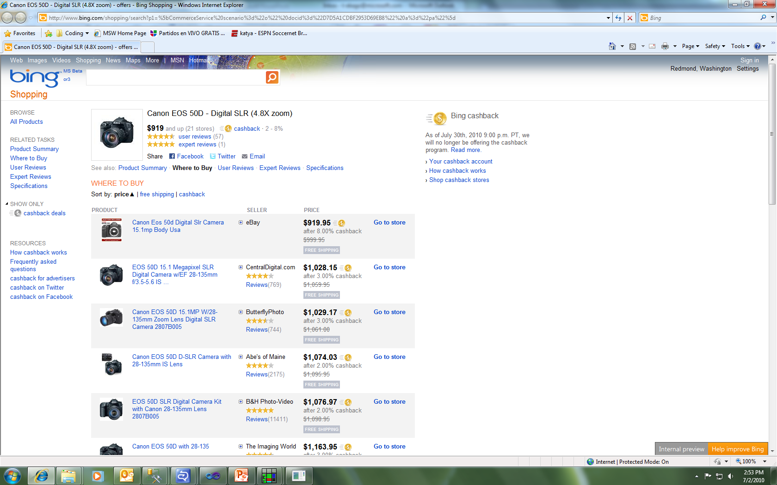
Product-Offer Matching
Product from shopping DB
Automatic matching
Over a week for 30M offers
Offers from Various Vendors
Notes:
Make sure to talk about the UI, Currently this requires hours and days

Slide 5
Product-Offer Matching
Search engines provide e-commerce search services that allow users to sift through catalogs of product information
Merchants offers of a product need to be matched to the catalog entry for the product
-> Product-Offer Matching

Slide 6
Product-Offer Matching Algorithm
1. Offline training phase
Learning per-category matching functions
2. Online matching phase
Match products to offers for each category
Notes:
Cite KDD paper, how much we wanna scale up
How long does each phase take and how often do we do it

Slide 7
Need for Efficient Parallelization
Publish a new Offer database on a daily basis
Matching only on a subset of offers (1M)
3 hours on 3 machines (9 hours sequentially)
Full set of offers (>30M) would take over a week
Anticipating growth in
Offers set from merchants
Product selection in catalog
Focus: scalable parallelization of the matching algorithm
Notes:
Emphasize the significance of fast implementation

Slide 8
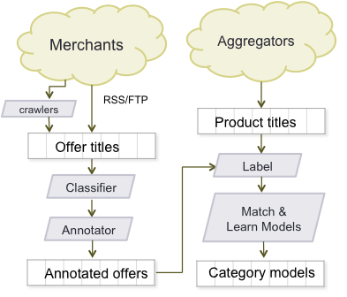
Offline Training Phase
Learn per-category matching functions

Slide 9
Product-Offer Matching – Online Matching Phase
Foreach offer string, category c
Annotate the offer by extracting attributes
Select a set of products, P from c for a potential match
For each product p in P
Compute matching score based on attributes using learned model
Return p(s) with maximum score
Product1:
Category: Digital Cameras
Brand: Panasonic
Product line: Lumix
Model: DMC-FX07B
Color: black
Title: Panasonic Lumix DMC-FX07B digital camera silver
Category: digital camera
Category: Digital Cameras
Brand: Panasonic
Product line: Lumix
Model: DMC-FX07B Color: silver
Product2:
Category: Digital Cameras
Brand: Canon
Product line: Powershot
Model: 30M
Color: silver
Notes:
Example

Slide 10
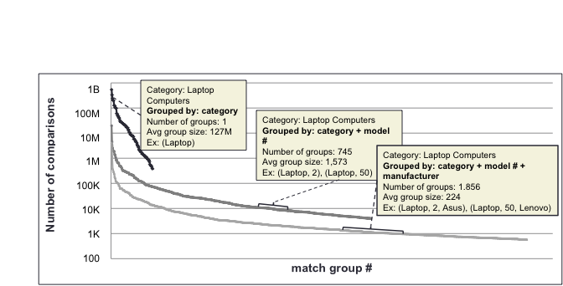
Matching Set Size Reduction
Num offers * num products
Matching job
Notes:
Define match group and comparison

Slide 11
Outline
Product-Offer Matching: Application in E-Commerce
Data Skew
Parallel Implementation with DryadLINQ
Algorithm
Three distributed join strategies
Results
Conclusion

Slide 12
Parallel Computation Frameworks
Offer matching
Application
SQL
Sawzall, Java
≈SQL
LINQ, SQL
Parallel Databases
Sawzall,FlumeJava
Pig, Hive
DryadLINQ Scope
Language
Map-Reduce
Hadoop
Dryad
Runtime Environment
GFS BigTable
HDFS
S3
Cosmos
Azure SQL Server
Storage
System
Notes:
Diagram – from the DryadLINQ external research page

Slide 13
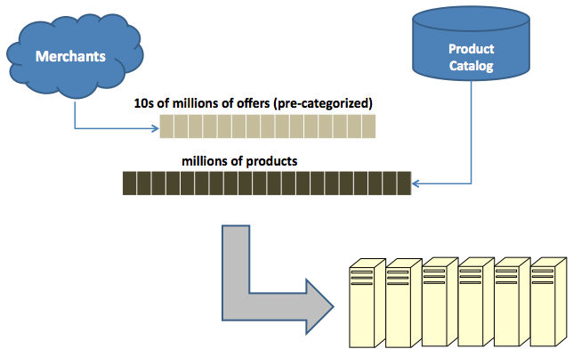
Nested Parallelization
DryadLINQ across machines
Multi-threading across cores
Ni-1
Ni
(Node i)
Ni+1
Ni+2
C1
C2
C3
C4
T1 | T2
L3 $
DRAM
4 cores/node
2 threads/core
8MB L3 Cache/node
16GB DRAM/node
Notes:
Diagram shows an example architecture of cluster of nodes, with one node architecture enlarged (4 cores 2 threads/core)

Slide 14
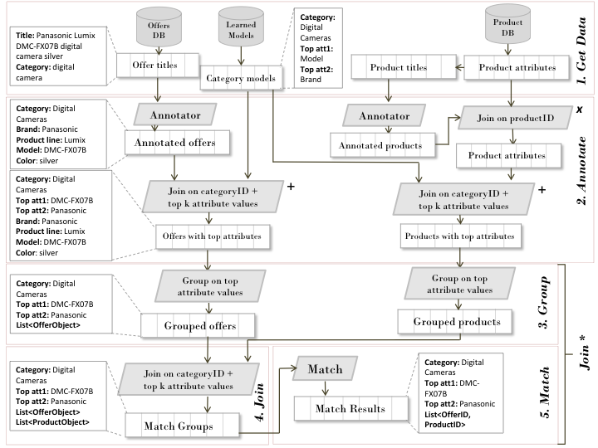
Algorithm outline

Slide 15
Algorithm outline
Notes:
Refer to example

Slide 16
Algorithm outline

Slide 17
Algorithm outline

Slide 18
Algorithm outline
Hash-Partition Join
Broadcast Join
Skew-Adaptive Join

Slide 19
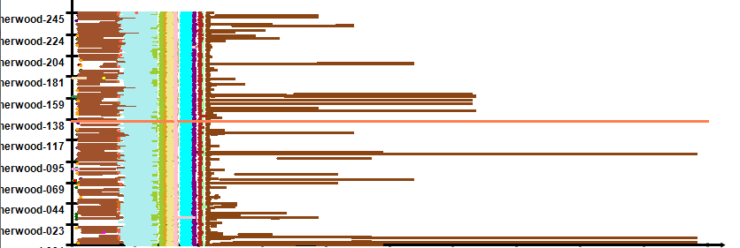

Skew & Scheduling
Machines
Parallel jobs
0
10
20
30
40
50
60
70
80
90
100
110
time (min)
Schedule of Offer Matching with no Skew Adaptation

Slide 20
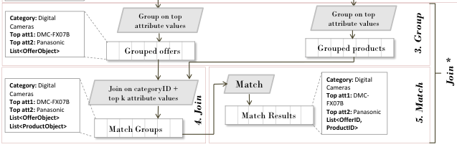
Skew-Adaptive Join
Group Join: build lists of offers and products with matching values for top attributes
Join groups: distributed join using deterministic hash-partition
Dynamically re-partition large groups

Slide 21
Dynamic Repartitioning
After creating joined lists of offers and products – need to estimate the skew and redistribute
Dynamically repartition data if work/group is greater than a threshold
Split the offer list into several smaller lists
Replicate the product list

Slide 22
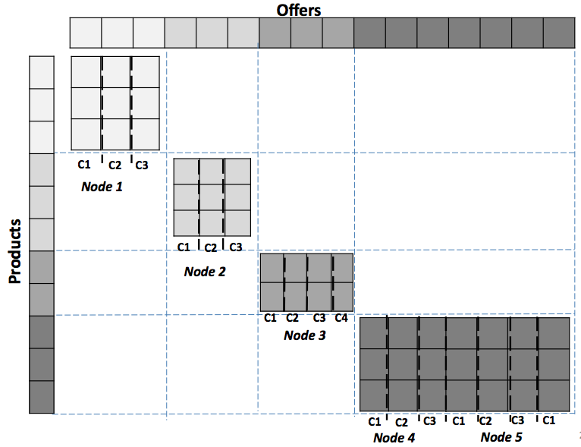
Dynamic Repartitioning

Slide 23
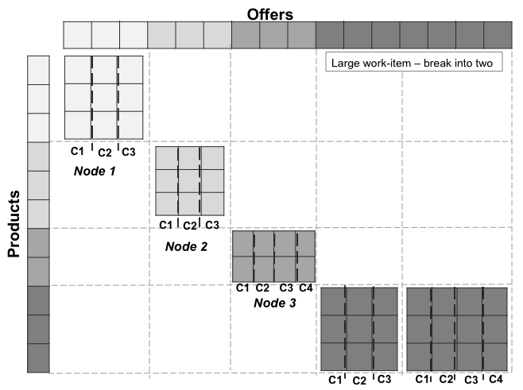
Dynamic Repartitioning
Notes:
Threshold for dividing jobs

Slide 24
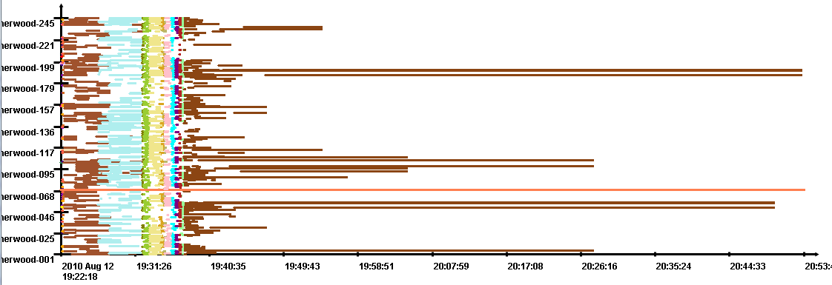
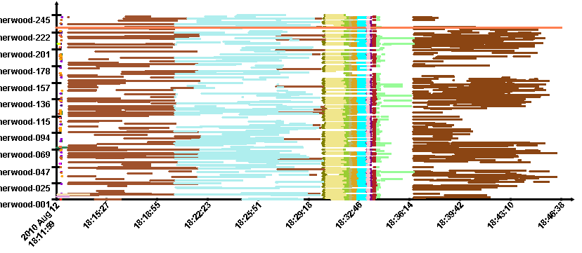
Skew & Scheduling
Grouping by Category
1 hour 50 min
Machines
Parallel jobs
0
10
20
30
40
50
60
70
80
90
100
110
time (min)
Grouping by Category and
1 top attribute
1 hour 40 min
Machines
0
10
20
30
40
50
60
70
80
90
100
time (min)
Grouping by Category and
1 top attribute
+ Dynamic Repartitioning
35 min
Machines
4M offers
256 partitions
# nodes determined at runtime
0
10
20
30
time (min)

Slide 25
Outline
Product-Offer Matching: Application in E-Commerce
Data Skew
Parallel Implementation with DryadLINQ
Algorithm
Three distributed join strategies
Results
Conclusion

Slide 26
Speedup
~78h
44h
8h06m
74x
2h18m
106x
110x
63m
25m
55x
4.4m
2.5m

Slide 27
Scaling
7M
4M
1M
250K

Slide 28
Conclusion
Parallelization of large-scale data processing: multiple join strategies
Dynamically estimate skew
Repartition data based on skew
Mix of high-level and low level primitives => can implement custom strategies
Result:
4 min - 1M offers (9 hours before)
25 min - 7M offers (>3 days before)
Notes:
Recap the problem, current implementation -> skew reduction allowed for …

Slide 29
Thank you!
Questions?

Slide 30
Backup Slides

Slide 31
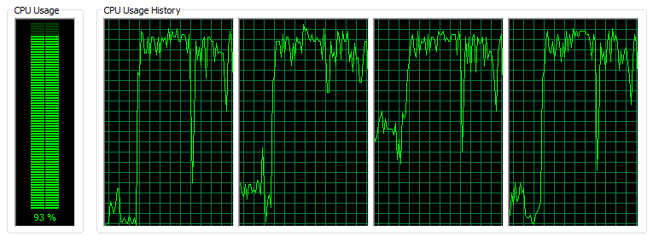
Multi-threaded Matching
Each node gets assigned a set of matching jobs
Split each job among N threads on a single node
Each thread gets K/N offers (K = #offers in current job)
Each thread computes a maximum match for its offers
Multi-core parallelization gave 3.5x improvement on one category, 1.5x on average (fork-join overhead)

Slide 32
Product-Offer Matching System
2. Online matching phase
Input:
Offer strings from different merchants – Pre-categorized
Database of products
Output:
Best matching product(s) for each offer string

Slide 33
Online Shopping
Over 77% of the U.S. population is now online
80% expected to make an online purchase in next 6 months
U.S. online retail spending surpassed $140B in 2010 and is on track to surpass $250B by 2014
80% of online purchases start with search
Key gateway into this huge market

Slide 34
Product Consideration Set Selection
Select a set of products to match to an offer (offer’s consideration set)
Baseline: all products in the category the offer was classified to
Too many offer-product comparisons (~10K)
Too few actually relevant (10-100)
Large skew in the distribution of products and offers across categories

Slide 35
Product Consideration Set Selection
Algorithmically reduce the size of the consideration set by selecting products that match the offer on top attributes*
Ex: for offer with attribute [brand name] and value [“Canon”] only select products with this value
* Top attributes = attributes with highest weight in the learned per-category matching models

Slide 36
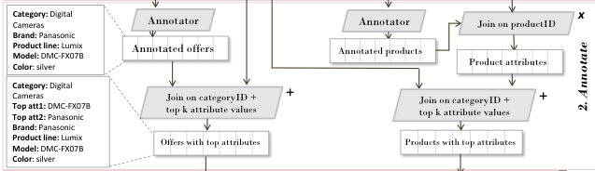
Three Join() Operations
1. Broadcast Join – join big table of offers and products with small table of category attributes
- Broadcast the small table
2. Distributed Join – regular partitioned join on table of product attributes and annotated products
- Hash-partition both input sets based on product ID key

Slide 37


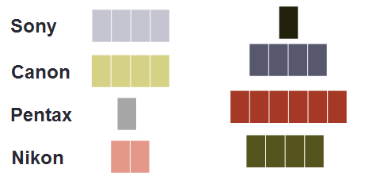
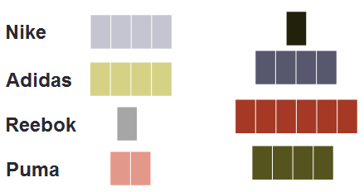
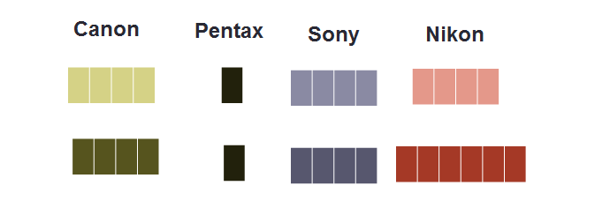
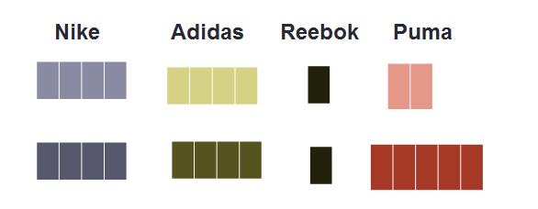
DryadLINQ parallelization
For each category
tagger
Offer DB
1. Get Data
Product DB
2. Group
Category 1
Category 2
…
3. Join & Match
…

Slide 38
DryadLINQ parallelization
Lincoln tagger
Cosmos
1. Get Data
Lincoln-Master-PA
Get offer attributes based on its category
Load the Lincoln Tagger
Extract numeric and string attributes from offer title
Extract candidate model number
Get product attributes based on its category
Get attributes from the Database
Annotate product titles
Merge based on precedence
“CGA-S002 Panasonic Lumix DMC-FZ5S 8.2Mp Digital Camera”
Brand Name: Panasonic
Resolution: 8.2
Product Line: Lumix
“CGA-S002 Panasonic Lumix DMC-FZ5S Digital Camera”
MN: CGAS002
MN: DMCFZ5S
Job = annotating 1 title
Millions of jobs

Slide 39
DryadLINQ parallelization
Category 1
Category 2
2. Group
Group offers and products based on keys
Top weighted attributes in each category
For each offer/product select values for the top attributes
Multiple values for each attributes
Extract only numeric part of model for model number attribute key
Ex: “4362_Canon_30”, “4458_Nike_Cotton”
Job distribution on the cluster nodes is based on this key
10-100K groups

Slide 40
DryadLINQ parallelization
3. Join & Match
…
Join offer and product groups on keys:
categoryId + attribute values(s)
Ex: “4362_Canon_30”
Match offers to products within each group
Compute best match for each offer in the set
Similarity feature vector * weights
Strict equality for strings
Within threshold for numeric
String alignment scorer for model number
Multi-threaded implementation
LINQ join
Apply Matching function on each group

Slide 41
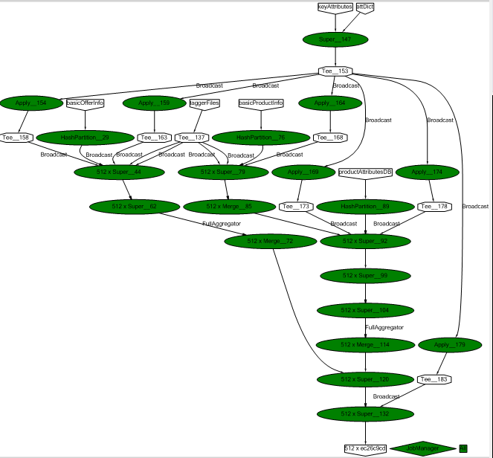
DryadLINQ Parallelization
Data input tables
512 parallel jobs
Annotate offers
Annotate products
Group products
Group products
Join
Match

