Slide 1
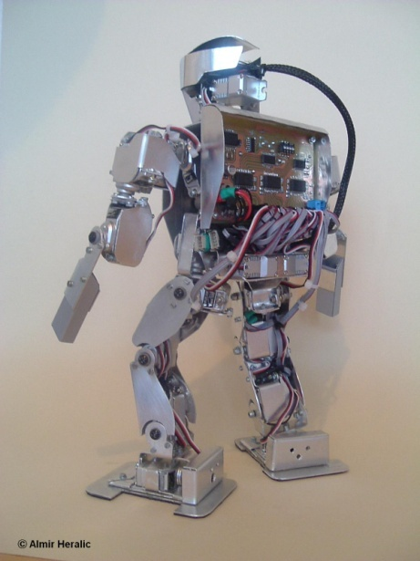

Machine Learning in DryadLINQ
Kannan Achan
Mihai Budiu
MSR-SVC, 1/30/2008

Slide 2

Goal

Slide 3
The Software Stack
Data analysis
Machine learning
Large Vector
DryadLINQ
Dryad
Distributed Filesystem: Cosmos
Cluster Services
Windows Server
Windows Server
Windows Server

Slide 4

Dryad

Slide 5

Dryad Jobs
Input files
R
R
R
R
Stage
X
X
X
X
X
X
M
M
M
M
Vertices (processes)
Channels
M
M
Output files

Slide 6

LINQ and C#

Slide 7
LINQ
Collection<T> collection;
bool IsLegal(Key);
string Hash(Key);
var results = from c in collection where IsLegal(c.key) select new { Hash(c.key), c.value};

Slide 8
DryadLINQ = LINQ + Dryad
Collection<T> collection;
bool IsLegal(Key k);
string Hash(Key);
var results = from c in collection where IsLegal(c.key) select new { Hash(c.key), c.value};
Vertex code
Query plan
(Dryad job)
Data
collection
C#
C#
C#
C#
results

Slide 9
Recall: The Software Stack
Data analysis
Machine learning
Large Vector
DryadLINQ
Dryad
Distributed Filesystem: Cosmos
Cluster Services
Windows Server
Windows Server
Windows Server

Slide 10
Very Large Vector Library
PartitionedVector<T>
T
T
T
Scalar<T>
T

Slide 11
Operations on Large Vectors: Map 1
T
f
U
f preserves partitioning
T
f
U

Slide 12
Map 2 (Pairwise)
T
f
U
V
T
U
f
V

Slide 13
Map 3 (Vector-Scalar)
T
f
U
V
T
U
f
V
13

Slide 14
Reduce (Fold)
f
U
U
U
U
f
f
f
U
U
U
f
U

Slide 15
Linear Algebra
T
T
,
U
,
V
=

Slide 16
Linear Regression
Data
Find
S.t.

Slide 17
Analytic Solution
X[0]
X[1]
X[2]
Y[0]
Y[1]
Y[2]
Map
X×X^{T}
X×X^{T}
X×X^{T}
Y×X^{T}
Y×X^{T}
Y×X^{T}
Reduce
Σ
Σ
[ ]⁻¹
*
A

Slide 18
Linear Regression Code
Matrices xx = x.PairwiseOuterProduct(x);
OneMatrix xxs = xx.Sum();
Matrices yx = y.PairwiseOuterProduct(x);
OneMatrix yxs = yx.Sum();
OneMatrix xxinv = xxs.Map(a => a.Inverse());
OneMatrix A = yxs.Map( xxinv, (a, b) => a.Multiply(b));

Slide 19
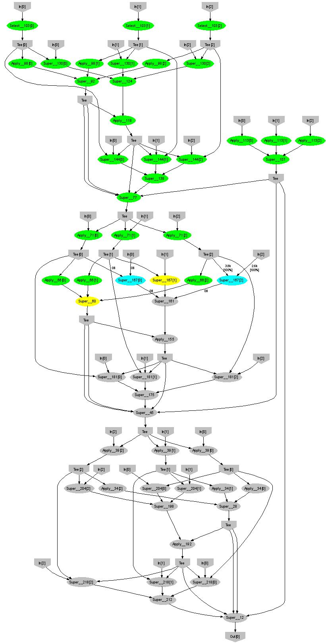
Expectation Maximization
160 lines
3 iterations shown

Slide 20
Understanding Botnet Traffic using EM
3 GB data
15 clusters
60 computers
50 iterations
9000 processes
50 minutes

Slide 21
Conclusions
Dryad simplifies programming large clusters
DryadLINQ = declarative programming for Dryad jobs
The Large Vector library provides simple mathematical primitives on top of DryadLINQ
Matlab-style coding for writing distributed numeric computations
Data analysis
ML
Large Vector
DryadLINQ
Dryad
Distributed Filesystem
Cluster Services
Win
Win
Win

Slide 22

Backup Slides

Slide 23
Chaining
X[0]
X[1]
X[2]
Y[0]
Y[1]
Y[2]
X×X^{T}
X×X^{T}
X×X^{T}
Y×X^{T}
Y×X^{T}
Y×X^{T}
Σ
Σ
Σ
Σ
Σ
Σ
Σ
Σ
[ ]⁻¹
*
A

Slide 24
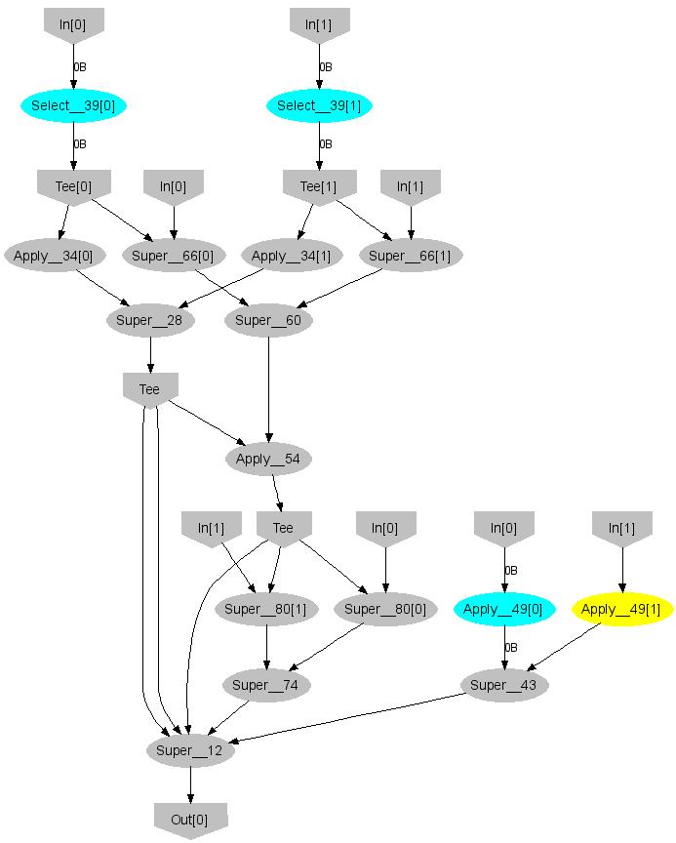
EM Structure
E stage
π
μ
σ
Input size
All parameters

