Slide 1
Inter-Iteration
Scalar Replacement in the
Presence of Control-Flow
Mihai Budiu – Microsoft Research, Silicon Valley
Seth Copen Goldstein – Carnegie Mellon University
ODES 2005

Slide 2
Summary
What: compiler optimization
Where: dense regular matrix codes
  FORTRAN
  some media processing
Goal: reduce number of memory accesses
How: allocate array elements to registers
New: optimal algorithm based on predication

Slide 3
Outline
Scalar Replacement
Predicated PRE
Combining the two
Results

Slide 4
Scalar Replacement
tmp = a[i];
tmp += 2;
tmp <<= 4;
a[i] = tmp;
a[i] = a[i] + 2;
a[i] <<= 4;
Front-end
ld a[i]
arith ...
st a[i]
ld a[i]
arith …
st a[i]
ld a[i]
arith …
arith …
st a[i]
Back-end

Slide 5
Inter-Iteration Scalar Replacement
tmp0 = a[0];
for (i=0; i < N; i++) {
tmp1 = a[1];
a[i] = tmp0 + tmp1;
tmp0 = tmp1;
}
for (i=0; i < N; i++)
a[i] += a[i+1];
Runtime
ld a[0]
ld a[1]
st a[0]
ld a[2]
st a[1]
i=0
ld a[0]
ld a[1]
st a[0]
ld a[1]
ld a[2]
st a[1]
i=0
tmp1
i=1
i=1

Slide 6
Rotating Scalars
for (…) {
….
tmp0 = tmp1;
tmp1 = tmp2;
tmp2 = tmp3;
tmp3 = a[i+4];
}
for (i=0; i < N; i++)
a[i] += a[i+3];
Invariant:
tmp0 = a[i+0]
tmp1 = a[i+1]
tmp2 = a[i+2]
tmp3 = a[i+3]
Itanium has hardware support for rotating registers.

Slide 7

Control-Flow
for (i=0; i < N; i++)
if (i & 1)
a[i] += a[i+3];

Slide 8
Outline
Scalar Replacement
Predicated PRE
Combining the two
Results

Slide 9
Availability
y = a[i];
...
if (x) {
...
... = a[i];
}
y
Notes:
Replace expressions already computed with scalar values.

Slide 10
Conservative Analysis
if (x) {
...
y = a[i];
}
...
... = a[i];
y?
Notes:
Conservativeness must assume that the expression is not available.

Slide 11
Predicated PRE
flag = false;
if (x) {
...
y = a[i];
flag = true;
}
...
... = flag ? y : a[i];
Invariant: flag = true y = a[i]
Notes:
Solution: maintain dynamically the availability state of an expression; predicate its re-computation.

Slide 12
Outline
Scalar Replacement
Predicated PRE
Combining the two
Results

Slide 13
Scalars and Flags
for (i=0; i < N; i++)
if (i & 1)
a[i] += a[i+3];
Invariant:
(valid₀ = true) tmp₀ = a[i+0]
(valid₁ = true) tmp₁ = a[i+1]
(valid₂ = true) tmp₂ = a[i+2]
(valid₃ = true) tmp₃ = a[i+3]
bool
scalar

Slide 14
Scalar Replacement Algorithm
if (! valid_{k}) {
ld a[i+k] tmp_{k} = a[i+k];
valid_{k} = true;
}
Can be implemented with predication or conditional moves
tmp_{k} = v;
valid_{k} = true;
st a[i+k], v

Slide 15

Optimality
No scalarized memory location is
read or written two times
The resulting program touches
exactly the same memory locations
as the original program
Proof: trivial based on valid flags invariant
[given perfect dependence analysis and enough registers]

Slide 16
Additional Details
(see paper)
Initialize valid_{k} to false
Rotate scalars and valid flags
Use ‘dirty_{k}’ flags to avoid extra stores
Postlude for missing stores:
  if (valid_{k}) a[N+k] = tmp_{k}
Lift loop-invariant accesses
  (finding loop-invariant predicates)
Hardware support
(for rotating registers and flags).

Slide 17
Outline
Scalar Replacement
Predicated PRE
Combining the two
Results

Slide 18
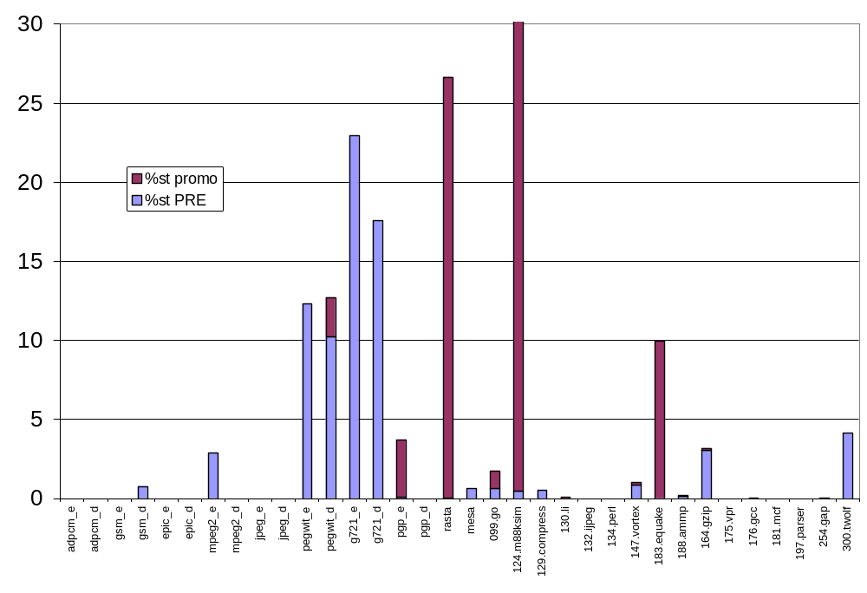
Redundant Stores
% reduction
Notes:
We applied SIDE to memory access removal through register promotion; it can be very effective.

Slide 19
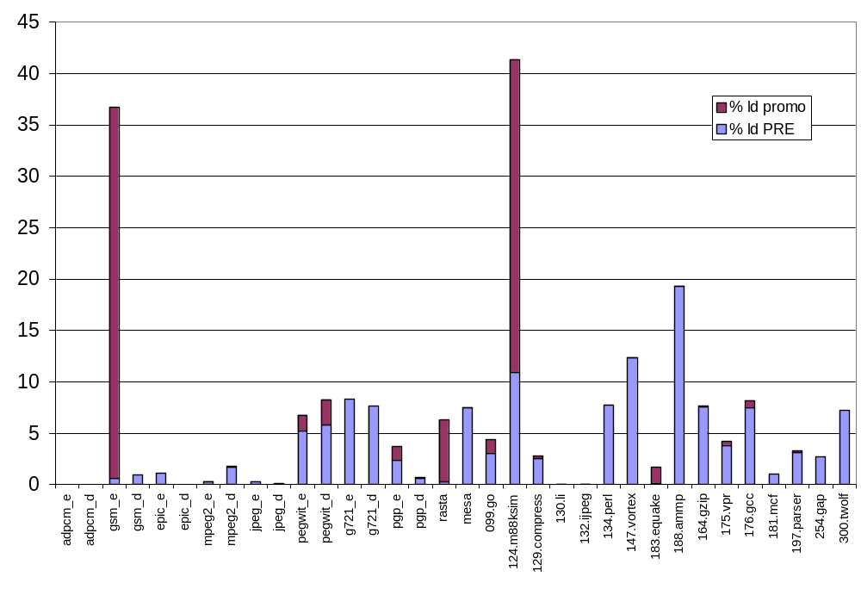
Redundant Loads
% reduction

Slide 20
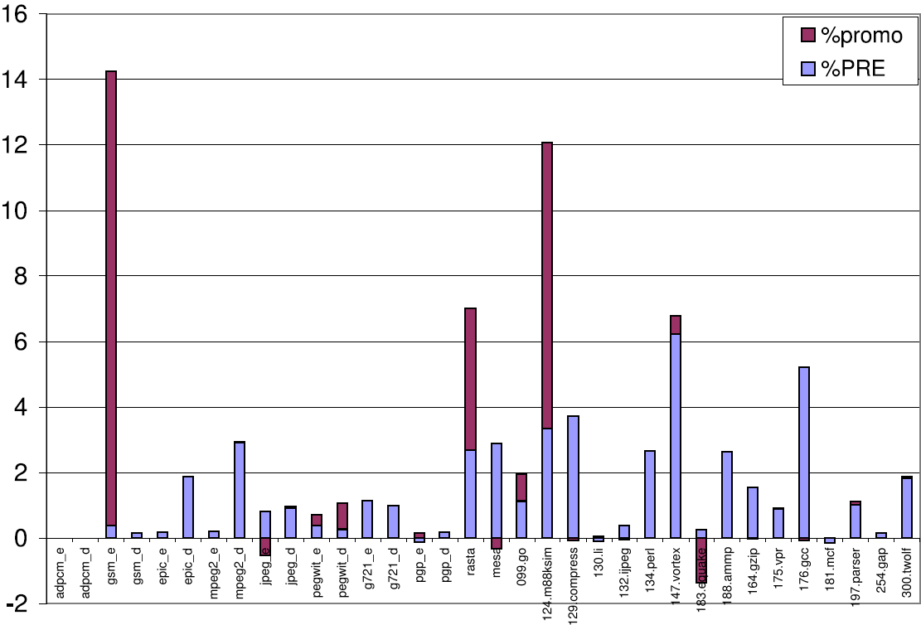
Performance Impact
[target: Spatial Computation]
Removed accesses tend to be cache hits:
small contribution to running time.
% reduction running time

Slide 21
Conclusions
Use predicates to dynamically detect redundant memory accesses
Simple algorithm gives “optimal” result even with un-analyzable control flow
Can dramatically reduce memory accesses

Slide 22
Related Work
Carr & Kennedy, PLDI 1990
Scalar Replacement
- Arrays, no control flow -
Carr & Kennedy, SPE 1994
Generalized Scalar Replacement
- Restricted control-flow -
Morel & Renvoise, CACM 1979
Partial Redundancy Elimination
- Not across remote iterations -
Scholz, Europar 2003
Predicated PRE
- Single iteration, no writes -
This work, ODES 2005
PPRE across iterations
- Optimal -
Non-speculative promotion
Speculative promotion

