Slide 1
Comparing P4 and eBPF
January 8, 2021
Mihai Budiu
VMware Research Group

Slide 2
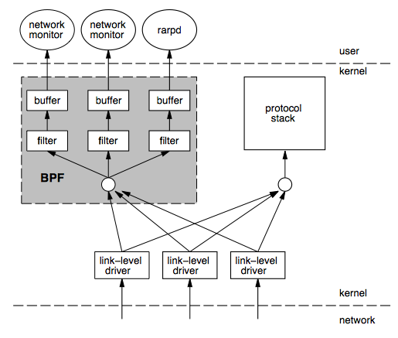
BPF
Berkeley Packet Filters
Steven McCanne & Van Jacobson, 1992 http://www.tcpdump.org/papers/bpf-usenix93.pdf
Instruction set & virtual machine (aka machine language)
Express packet filtering policies
Originally interpreted
“Safe” interpreter in kernel space

Slide 3
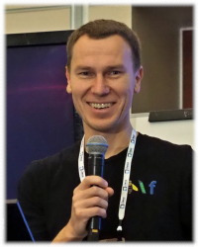
EBPF
Extended BPF, Linux only
Project leader: Alexei Starovoitov, Facebook
Larger register set
JIT + verifier instead of interpreter
Maps (“tables”) for kernel/user communication
Whitelisted set of kernel functions that can be called from EBPF (and a calling convention)
“Execute to completion” model
C -> EBPF LLVM back-end (gcc not yet)
Used for packet processing and code tracing

Slide 4
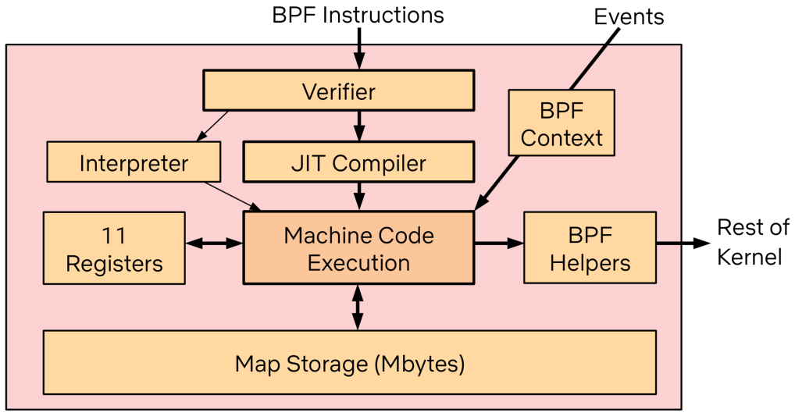
BPF Runtime
Slide from Brendan Gregg

Slide 5

It’s all about trust
The main goal is kernel safety, not correctness
Trusted computing base: entirely in kernel
BPF loader
Kernel verifier (must be simple)
Kernel JIT (must be simple)
Whitelisted helper functions
Not trusted: compiler, eBPF program writer

Slide 6

EBPF’s world
Userspace
eBPF
map
Linux kernel
Linux
TC
kernel hook
Network driver
kernel hook
EBPF
EBPF
helper
Arbitrary
function
EBPF
Each hook provides different capabilities for the EBPF programs.
Note: XDP is just another hook, which allows packet access very early.

Slide 7
BPF Memory Safety
Packet
Scratch area
All memory operations (load/store) are bounds-checked
Program is terminated on out-of-bounds access

Slide 8
BPF Code Safety
Code is read-only
Enforced by static code verifier
Originally backwards branches were prohibited
“Tail calls” are limited to 32
Static loop counts are supported
Branch targets are bounds checked

Slide 9
EBPF Memory Model
user
kernel
Registers
Data
packet buffer
Scratch area
on stack
Maps
(arrays & hash-tables)
(Tracing eBPF programs are allowed to read (dereference) arbitrary pointers,
using the bpf_probe_read_*() helpers, but cannot cause page faults)

Slide 10
EBPF Maps
Userspace-only:
int bpf_create_map(int map_id, int key_size, int value_size, int max_entries);
int bpf_delete_map(int map_id);
User and kernel: int bpf_update_elem(int map_id, void *key, void *value);
void* bpf_lookup_elem(int map_id, void *key);
int bpf_delete_elem(int map_id, void *key);
int bpf_get_next_key(int map_id, void *key, void *next_key);
All of these are multi-core atomic (using RCU)
Per-core variants possible
Can be attached to file descriptors
lifetime not connected eBPF programs

Slide 11
BPF Type Format
Metadata describing BPF program
i.e., dynamic type information about tables and data structures
BPF loader rewrites BPF program to adjust offsets to currently running kernel
Generated by LLVM (aka DWARF)
Enables portable BPF programs (cross-compiled)

Slide 12
Packet Processing Model
Tables
Userspace
EBPF
IF0
IF0
IF1
IF1
ingress
egress
TC
Linux kernel

Slide 13
Comparison
Feature | P4 | eBPF
Level | High | Low
Safe | Yes | Yes
Safety | Type system | Verifier
Loops | In parsers | Tail calls (dynamic limit), statically bounded loops
Resources | Statically allocated | Statically allocated
Policies | Tables (match+action) | Maps (tables)
Extern helpers | Target-specific | Hook-specific
Control-plane API | Synthesized by compiler | eBPF maps
Targets | ASIC, software, FPGA, NIC | Linux kernel
Licensing | Apache | GPL (Linux kernel)
Tools | Compilers, simulators | LLVM, examples, growing, bcc
Concurrency | No shared R/W state | Maps are thread-safe (RCU)

Slide 14
EBPF P4
Complex actions
Read kernel
data structures
Learning
Extern functions
Packet filtering
Packet editing
Parser loops
R/W tables
from kernel
Forwarding
TCAMs
Tracing

Slide 15
Limitations – part 1
Feature | P4 | eBPF
Loops | Parsers | Tail call, static bounds
Nested headers | Bounded depth | Bounded depth
Multicast/broadcast | External | Helper functions
Packet segmentation | No | No
Packet reassembly | No | No
Timers/timeouts/aging | No | No
Queues | No | No
Scheduling | No | No
Data structures | No | No
Payload processing | No | No
State | Registers/counters | Maps
Linear scans | No | No

Slide 16
Limitations – part 2
Feature | P4 | eBPF
Network levels | L2, L3 | L2, L3
Synchronization (data/data, data/control) | No | Data-plane spin-locks No data/control sync
Execution model | Event-driven | Event-driven
Block (sleep) | No | Only tracepoints
Resources | Statically allocated | Limited stack and buffer
Malloc | No | No
Control-plane support | Complex | Simple
Safety | Safe | Verifier rejects safe programs
Compiler | Target-dependent | LLVM code not always efficient

Slide 17
Conclusions
P4: suitable for switching, not for end-points
eBPF: simple packet filtering/rewriting
Neither P4 nor eBPF are good enough to implement a full end-point networking stack

Slide 18
References
Creating Complex Network Services with eBPF: Experience and Lessons Learned, HPSR 2018
BPF and XDP Reference Guide, Cilium, Retrieved January 2021
Concurrency management in BPF, Johnathan Corbet, LWN, Feb 2019
An introduction to the BPF Compiler Collection, Matt Fleming, LWN, Dec 2017
A thorough introduction to eBPF, Matt Fleming, LWN, Dec 2017
Sleepable BPF programs, Johnathan Corbet, LWN, July 2020
Extended BPF, Brendan Gregg, Ubuntu Masters, July 2019
https://ebpf.io/, Retrieved January 2021
https://www.kernel.org/doc/html/latest/bpf/index.html, Retrieved Jan 2021
BPF Portabilty and CO-RE, Andrii Nakryiko, Feb 2020
BPF Compiler Collection (BCC), IOVisor, Retrieved Jan 2021
P4 to eBPF/XDP/uBPF compilers, Retrieved Jan 2021
XFI: Software Guards for System Address Spaces, OSDI 2006 – “EBPF for Windows”

