Slide 1
Packet processing with P4 and eBPF
TC/P4 workshop
Intel, June 8, 2018
Mihai Budiu
VMware Research Group

Slide 2
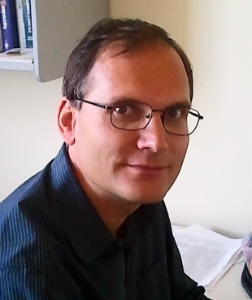
My Background
Ph.D. from CMU (computer architecture, compilers)
Microsoft Research (security, big data, machine learning)
Barefoot Networks (P4 design and implementation)
VMware Research (P4, SDNs, big data)

Slide 3

Presentation outline
P4
eBPF
Comparison

Slide 4

http://P4.org

Slide 5

Language evolution
P4: Programming Protocol-Independent Packet Processors
Pat Bosshart, Dan Daly, Glen Gibb, Martin Izzard, Nick McKeown, Jennifer Rexford, Cole Schlesinger, Dan Talayco, Amin Vahdat, George Varghese, David Walker ACM SIGCOMM Computer Communications Review (CCR). Volume 44, Issue #3 (July 2014)
P4₁₄ spec, reference implementation and tools released in Spring 2015 (mostly by Barefoot Networks), Apache 2 license, http://github.com/p4lang
P4₁₆ spec, draft reference implementation and tools released in December 2016; spec finalized May 2017, http://github.com/p4lang/p4-spec

Slide 6
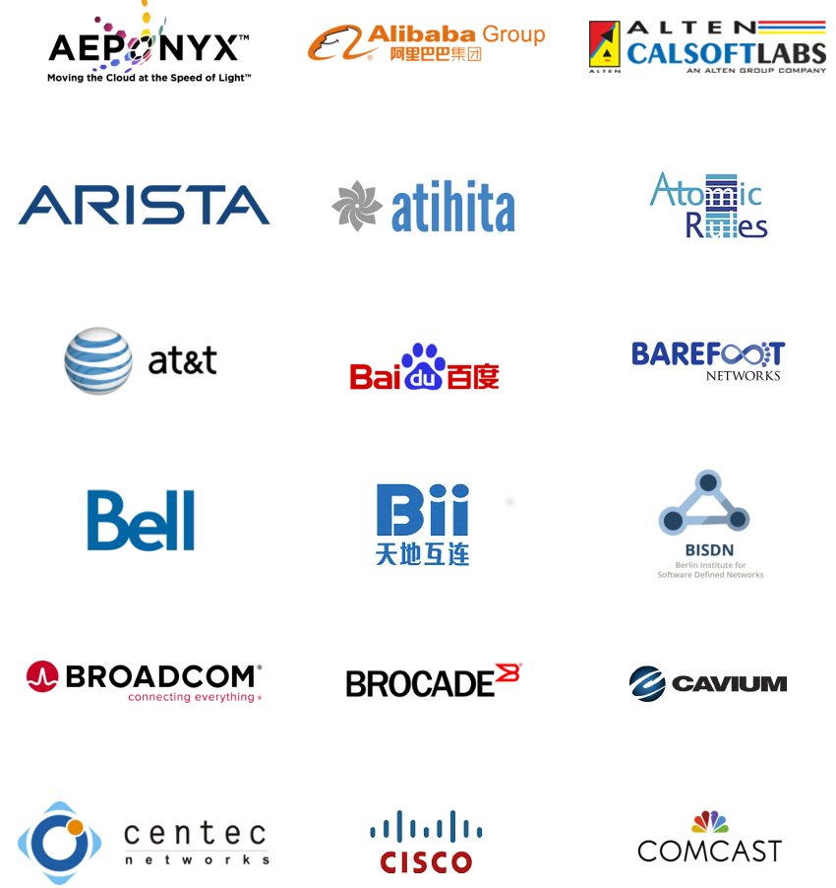





P4.org Consortium
Carriers, cloud operators, chip cos, networking, systems, universities, start-ups

Slide 7

Traditional switch architecture
Control-plane CPU
Control plane
Table management
Data plane
Switch ASIC
Look-up tables (policies)

Slide 8

Software-Defined Networking
Policies/signaling
Controller
Dumb control plane
Data plane

Slide 9
The P4 world
Upload program
Policies/signaling
Dumb control plane
Programmable data plane
SW: P4

Slide 10

P4 Language Overview
Suitable for levels 2 & 3
High-level, type, memory-safe (no pointers)
Bounded execution (no loops)
Statically allocated (no malloc, no recursion)
Sub-languages:
Parsing headers
Packet header rewriting
Target architecture description

Slide 11
P4₁₆ data plane model
Programmable blocks
extern
Data plane
P4
P4
P4
Fixed function

Slide 12

eBPF

Slide 13
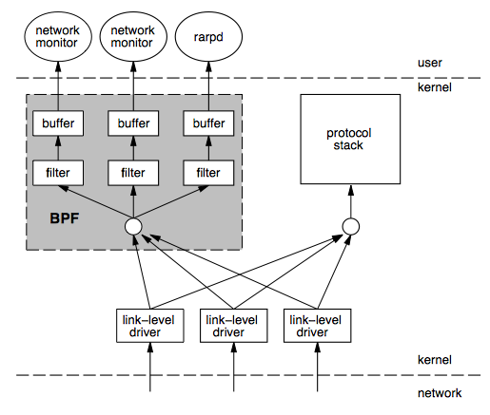
BPF
Berkeley Packet Filters
Steven McCanne & Van Jacobson, 1992 http://www.tcpdump.org/papers/bpf-usenix93.pdf
Instruction set & virtual machine
Express packet filtering policies
Originally interpreted
“Safe” interpreter in kernel space

Slide 14
EBPF
Extended BPF, Linux only
Project leader: Alexei Starovoitov, Facebook
Larger register set
JIT + verifier instead of interpreter
Maps (“tables”) for kernel/user communication
Whitelisted set of kernel functions that can be called from EBPF (and a calling convention)
“Execute to completion” model
C -> EBPF LLVM back-end
Used for packet processing and code tracing

Slide 15

EBPF’s world
Userspace
eBPF
map
Linux kernel
Linux
TC
kernel hook
Network driver
kernel hook
EBPF
EBPF
helper
Arbitrary
function
EBPF
Each hook provides different capabilities for the EBPF programs.

Slide 16
A Nice EBPF paper
Creating Complex Network Services with eBPF: Experience and Lessons Learned, Proceedings of IEEE High Performance Switching and Routing (HPSR18), Bucharest, Romania, June 2018
http://fulvio.frisso.net/files/18HPSR-ebpf-lessons-learned.pdf

Slide 17
Comparison
Feature | P4 | eBPF
Level | High | Low
Safe | Yes | Yes
Safety | Type system | Verifier
Loops | In parsers | Tail calls (dynamic limit)
Resources | Statically allocated | Statically allocated
Policies | Tables (match+action) | Maps (tables)
Extern helpers | Target-specific | Hook-specific
Control-plane API | Synthesized by compiler | eBPF maps
Targets | ASIC, software, FPGA, NIC | Linux kernel
Licensing | Apache | GPL (Linux kernel)
Tools | Compilers, simulators | LLVM
Concurrency | No shared R/W state | Maps are thread-safe (RCU)

Slide 18
EBPF P4
Complex actions
Read kernel
data structures
Learning
Extern functions
Packet filtering
Packet editing
Parser loops
R/W tables
from kernel
Forwarding?
TCAMs
Tracing

Slide 19
Limitations – part 1
Feature | P4 | eBPF
Loops | Parsers | Tail call
Nested headers | Bounded depth | Bounded depth
Multicast/broadcast | External | Helpers
Packet segmentation | No | No
Packet reassembly | No | No
Timers/timeouts/aging | No | No
Queues | No | No
Scheduling | No | No
Data structures | No | No
Payload processing | No | No
State | Registers/counters | Maps
Linear scans | No | No

Slide 20
Limitations – part 2
Feature | P4 | eBPF
Network levels | L2, L3 | L2, L3
Synchronization (data/data, data/control) | No | No
Execution model | Event-driven | Event-driven
Resources | Statically allocated | Limited stack and buffer
Control-plane support | Complex | Simple
Safety | Safe | Verifier rejects safe programs
Compiler | Target-dependent | LLVM code not always efficient

Slide 21
Conclusions
P4: suitable for switching, not for end-points
eBPF: simple packet filtering/rewriting
Neither language is good enough to implement a full end-point networking stack
Next presentation: P4 => C => XDP

Slide 22

Brief P4₁₆ TUTORIAL

Slide 23

P4 Community
http://github.com/p4lang
http://p4.org
Mailing lists
Workshops
P4 developer days
Working groups
Language
Architecture
Control-plane API
Applications
Education
Academic papers (SIGCOMM, SOSR)

Slide 24

Available Software Tools
Compilers for various back-ends
Netronome chip, Barefoot chip, eBPF, Xilinx FPGA
(open-source and proprietary)
Multiple control-plane implementations
SAI, OpenFlow
Simulators
Testing tools
Sample P4 programs
Tutorials

Slide 25
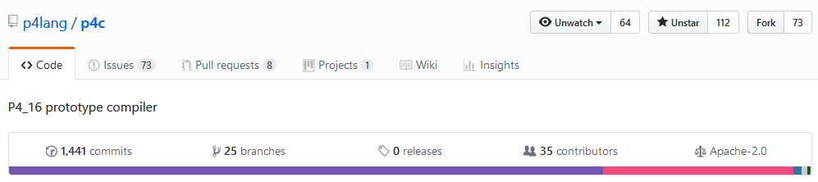
P4₁₆
Most recent revision of P4
C-like syntax; strongly typed
No loops, pointers, recursion, dynamic allocation
Spec: http://github.com/p4lang/p4-spec
Reference compiler implementation (Apache 2 license): http://github.com/p4lang/p4c

Slide 26
Example packet processing pipeline
Programmable
parser
eth
vlan
ipv4
Headers
Payload
Packet (byte[])
Programmable
match-action
units
eth
ipv4
port
Queueing/
switching
mtag
err
bcast
Metadata
Headers
eth
mtag
ipv4
Programmable
reassembly
Packet

Slide 27
Language elements
Programmable
parser
State-machine; bitfield extraction
Programmable
match-action
units
Table lookup; bitfield manipulation; control flow
Programmable
reassembly
Bitfield reassembly
Data-types
Bitstrings, headers, structures, arrays
user
Target
description
target
Interfaces of programmable blocks
External libraries
Support for custom accelerators

Slide 28
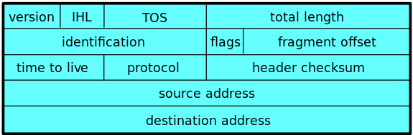
Data Types
typedef bit<32> IPv4Address;
header IPv4_h { bit<4> version; bit<4> ihl; bit<8> tos; bit<16> totalLen; bit<16> identification; bit<3> flags; bit<13> fragOffset; bit<8> ttl; bit<8> protocol; bit<16> hdrChecksum; IPv4Address srcAddr; IPv4Address dstAddr; }
// List of all recognized headers struct Parsed_packet { Ethernet_h ethernet; IPv4_h ip; }
header = struct + valid bit
Other types: array of headers,
error, boolean, enum

Slide 29
Parsing = State machines
dst
src
type
IP header
IP payload
ethernet header
parser Parser(packet_in b, out Parsed_packet p) { state start { b.extract(p.ethernet); transition select(p.ethernet.type) { 0x0800: parse_ipv4; default: reject; } }
state parse_ipv4 { b.extract(p.ip); transition accept; } }
start
parse_ipv4
accept
reject

Slide 30
Actions
~ Objects with a single method.
Straight-line code.
Reside in tables; invoked automatically on table match.
Action data; from control plane
action Set_nhop(IPv4Address ipv4_dest, PortId port) { nextHop = ipv4_dest; outCtrl.outputPort = port; }
class Set_nhop {
IPv4Address ipv4_dest;
PortId port;
void run() {
nextHop = ipv4_dest; outCtrl.outputPort = port
}
}
Java/C++ equivalent code.

Slide 31
Tables
Map<K, Action>
table ipv4_match { key = { headers.ip.dstAddr: exact; } actions = { drop; Set_nhop; } default_action = drop; }
dstAddr | action
0.0.0.0 | drop
10.0.0.1 | Set_nhop(10.4.3.4, 4)
224.0.0.2 | drop
192.168.1.100 | drop
10.0.1.10 | Set_nhop(10.4.2.1, 6)
Populated by the control plane

Slide 32
Match-Action Processing
Control plane
action code
key
action
Execute
action data
Code & data
Lookup
headers &
metadata
Action
headers &
metadata
Lookup key
Lookup table

Slide 33
Control-Flow
Ipv4_match
control Pipe(inout Parsed_packet headers, in InControl inCtrl,// input port out OutControl outCtrl) { // output port IPv4Address nextHop; // local variable
action Drop_action() { … }
action Set_nhop(…) { … }
table ipv4_match() { … }
…
apply { // body of the pipeline ipv4_match.apply(); if (outCtrl.outputPort == DROP_PORT) return;
dmac.apply(nextHop); if (outCtrl.outputPort == DROP_PORT) return;
smac.apply(); } }
dmac
smac

Slide 34
Packet Generation
Convert headers back into a byte stream.
Only valid headers are emitted.
control Deparser(in Parsed_packet p, packet_out b) { apply { b.emit(p.ethernet); b.emit(p.ip); } }

Slide 35
P4 Program structure
#include <core.p4> // core library #include <target.p4> // target description
#include "library.p4" // library functions
#include "user.p4" // user program

Slide 36
P4 Compiler data flow
mid- end
ebpf
back-end
C code
P4₁₄
parser
v1 IR
convert
P4₁₄
frontend
mid- end
BMv2
back-end
IR
IR
JSON
P4₁₆
parser
P4₁₆
mid- end
your own backend
target- specific
code

Slide 37
Architecture declaration
Provided by the target manufacturer
struct input_metadata { bit<12> inputPort; }
struct output_metadata { bit<12> outputPort; }
parser Parser<H>(packet_in b, out H headers);
control Pipeline<H>(inout H headers, in input_metadata input, out output_metadata output);
control Deparser<H>(in H headers, packet_out p);
package Switch<H>(Parser<H> p, Pipeline<H> p, Deparser<H> d);
H = user-specified header type
Switch
Parser
Pipeline
Deparser

Slide 38
Support for custom “accelerators”
extern bit<32> random();
extern Checksum16 { void clear(); // prepare unit for computation void update<T>(in T data); // add data to checksum void remove<T>(in T data); // remove data from checksum bit<16> get(); // get the checksum for data added }
External function
External object with methods. Methods can be invoked like functions.
Some external objects can be accessed from the control-plane.

Slide 39
P4 software workflow
User-supplied
Control-plane
P4 program
P4 compiler
API
LOAD
API
control
signals
P4 architecture
model
Dataplane runtime
Data plane
LOAD
Tables
extern objects
target
Manufacturer supplied

Slide 40
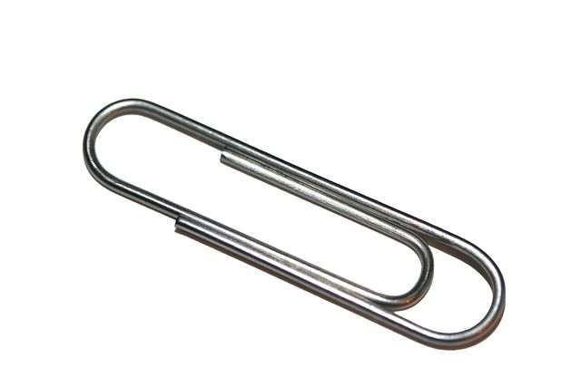
Limitations of P4₁₆
The core P4 language is very small
Highly portable among many targets
But very limited in expressivity
Accelerators can provide additional functionality
May not be portable between different targets

Slide 41


What is missing
Floating point
Pointers, references
Data structures, recursive data types
Dynamic memory management
Loops, iterators (except the parser state-machine)
Recursion
Threads
=> Constant work/byte of header

Slide 42

What cannot be done in (pure) P4
Multicast or broadcast
Queueing, scheduling, multiplexing
Payload processing: e.g., encryption
Packet trailers
Persistent state across packets
Communication to control-plane
Inter-packet operations (fragmentation and reassembly)
Packet generation
Timers

Slide 43
More About EBPF

Slide 44
BPF Memory Safety
Packet
Scratch area
All memory operations (load/store) are bounds-checked
Program is terminated on out-of-bounds access

Slide 45
BPF Code Safety
Code is read-only
Enforced by static code verifier
Originally backwards branches prohibited
Branches are bounds checked

Slide 46
EBPF Memory Model
user
kernel
Registers
Data
(packet buffer
Scratch area
on stack
Maps
(arrays & hash-tables)

Slide 47
EBPF Maps
Userspace-only:
int bpf_create_map(int map_id, int key_size, int value_size, int max_entries);
int bpf_delete_map(int map_id);
User and kernel: int bpf_update_elem(int map_id, void *key, void *value);
void* bpf_lookup_elem(int map_id, void *key);
int bpf_delete_elem(int map_id, void *key);
int bpf_get_next_key(int map_id, void *key, void *next_key);
All of these are multi-core atomic (using RCU)

Slide 48
Packet Processing Model
Tables
Userspace
EBPF
IF0
IF0
IF1
IF1
ingress
egress
TC
Linux kernel

