Slide 1
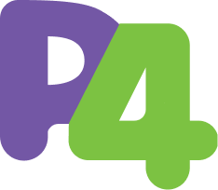
What’s new in P4-16
Mihai Budiu
on behalf of the
P4 Language Design Working Group
P4 workshop
April 2023, Santa Clara, CA

Slide 2
Open-source Language Design Process
Monthly meetings on zoom
First Monday of every month
See the p4.org calendar
Any ONF member can participate
Proposals and implementations tracked on github
https://github.com/p4lang/p4-spec
Discussion meetings available on github as well
Changes prototyped in the open-source compiler
We welcome new participants

Slide 3
P4-16 1.2.4 to be released
Yearly release cadence
Previous release was in July 2022
Many clarifications
A few small improvements
Fully backwards compatible with 1.2.3

Slide 4
Clarifications
Driven by formal modelling of P4 syntax and semantics
Several academic teams (Princeton, Cornell)
“list expressions” -> “tuple expressions”
Semantics of ‘exact’, ‘ternary’, ‘lpm’ is now part of the spec
Semantics of “negative” ranges such as 5..2 (empty)
Many small other fixes

Slide 5
New features
static_assert – compile-time assertions
const bool _check = static_assert(V1MODEL_VERSION > 20180000,
"Expected a v1 model version >= 20180000");
Allow comparisons for tuples
Optional trailing commas
enum E {
#if SUPPORT_A
a,
#endif
b,
c,
}

Slide 6
A new list<> type
Currently we only have list literals
Can be used in constructor parameters
extern E {
E(list<pair_t> data);
void run();
}
control c() {
E((list<pair_t>) {{2, 3}, {4, 5}}) e;
apply {
e.run();
}
}

Slide 7
More kinds of expressions
Invalid header and invalid union literals
{#} (a single token)
Stack initializers
H<bit<32>>[3] s;
s = (H<bit<32>>[3]){ {0, 1}, {2, 3}, (H<bit<32>>){#} };

Slide 8
Non-const table entries
table t {
… largest_priority_wins = false; priority_delta = 10; entries = { const priority=10: (0x01, 0x1111 &&& 0xF ) : a(1);
(0x02, 0x1181 ) : a(2); (0x03, 0x1000 &&& 0xF000) : a(3); const (0x04, 0x0210 &&& 0x02F0) : a(4); priority=40: (0x04, 0x0010 &&& 0x02F0) : a(5); (0x06, _ ) : a(6); }}

Slide 9
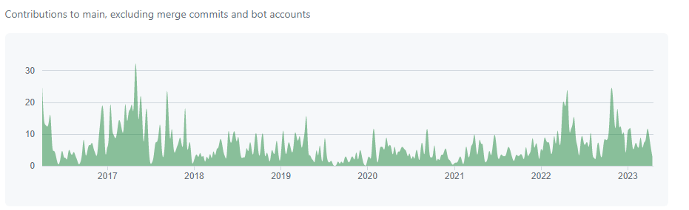
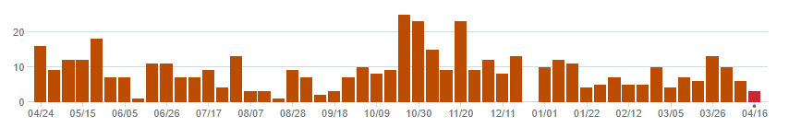
Compiler implementation
Commits during the last 12 months

Slide 10
Open-source compiler contributions
Several complex O/S backends contributed
DPDK backend (generates DPDK assembly)
P4 to ebpf/PSA – production quality
Testing backend – P4 test generation using symbolic execution
PTF (Packet Test Framework) Python-based testing for many backends
Many bug fixes and improvements
Default initializers fully implemented (…)
Code style enforced across all languages
Improvements in build process
Loop unrolling for parsers

