Slide 1
Compiling P4 to eBFP targets
Netronome, Santa Clara
July 12, 2018
Mihai Budiu, William Tu, Fabian Ruffy
VMware, UBC

Slide 2
Outline
The open-source p4c compiler
Introduction to BPF and eBPF
Comparing P4 and eBPF features and limitations
Compiling P4 to eBPF
p4c-ebpf
p4c-xdp
Testing the compiler

Slide 3

The open-source P4₁₆ compiler

Slide 4
P4 software workflow
User-supplied
Control-plane
P4 program
P4 compiler
API
LOAD
API
control
signals
P4 architecture
model
Dataplane runtime
Data plane
LOAD
Tables
extern objects
target
Manufacturer supplied

Slide 5
P4₁₆ data plane model
Programmable blocks
Data plane
P4
P4
P4
Fixed function
Interfaces

Slide 6
Compiler data flow
mid- end
ebpf
back-end
C code
P4₁₄
parser
v1 IR
convert
P4₁₄
frontend
mid- end
BMv2
back-end
IR
IR
JSON
P4₁₆
parser
P4₁₆
mid- end
your own backend
target- specific
code

Slide 7
Structure
Library of pre-built passes
Fixed
Mix and match
Custom
Front-end
Mid-end
Back-end
P4
IR
IR
main()
libFrontEnd.a
Target-independent
~48 distinct passes
~33 distinct passes
Simplify IR eliminating constructs gradually

Slide 8
Implementation details
Common infrastructure for all compiler passes
Same IR and visitor base classes
Common utilities (error reporting, collections, strings, etc.)
C++11, using garbage-collection (-lgc)
Clean separation between front-end, mid-end and back-end
New mid+back-ends can be added easily
IR can be extended (front-end and back-end may have different IRs)
IR can be serialized to/from JSON
Passes can be added easily

Slide 9
Repository
https://github.com/p4lang/p4c.git
Required software is described in README.md
Need a U*X system (Linux or MacOS)
To build:
cd p4c
./bootstrap.sh
cd build
make –j4
make check –j4

Slide 10
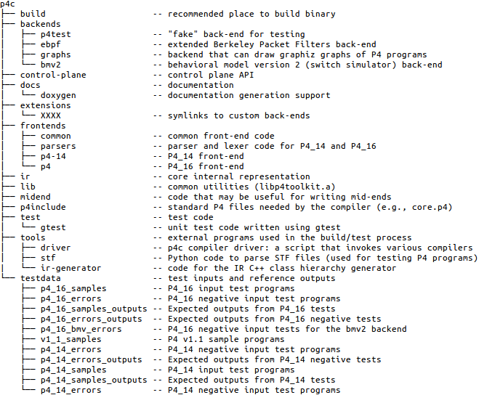
Source tree

Slide 11
How do I create a new back-end?
Keep your code in a separate repository
Create a symlink to your code in the extensions folder
e.g., ln –s myBackEnd extensions
Files you have to provide:
CMakeLists.txt – included in compiler top-level makefile
You can extend the IR (add new *.def files)

Slide 12
Intermediate Representation (IR)
Immutable
Can share IR objects safely
Even in a multi-threaded environment
You cannot corrupt someone else’s state
Strongly-typed (hard to build incorrect programs)
DAG structure, no parent pointers
Manipulated by visitors
IR class hierarchy is extensible

Slide 13

Visitors
IR classes
 | Add | Subtract | VarDecl | Parser | Control | Header | …
Base
ConstantFolding
DefUseAnalysis
DeadCode
Inlining
…
Auto-generated
IR
manipulations
(visitors)
Write only what you need

Slide 14

Creating a new target for P4
Understand P4₁₆: expressiveness and limitations
Understand your target: expressiveness and limitations
Do you want a programmable target?
Or do you just want to port an existing application to your target?
Try to write some mock-up P4 programs for your target
Understand whether P4 is a good language to describe your application
Create a P4 architectural model for your target
see files in p4include: ebpf_model.p4 and v1model.p4
Define the programmable blocks and the external modules available
Write a back-end supporting your target and model
Implement a runtime for your target – including the external objects
Implement a matching control-plane for your target

Slide 15
How do I get started writing compiler code?
Read the P4₁₆ spec
Browse the *.def IR definition files and understand what they represent
Understand the visitor interfaces (Inspector, Transform)
Read the documentation to know what tools are available
The compiler doxygen documentation
The compiler design presentation from the repository (superset of this one)
Browse the code top-down (starting from main)

Slide 16

Creating a new target model
Describes the interaction between P4 and the target
A P4 program
Describes the programmable blocks, and their interfaces to the environment
Describes the available extern objects
A document describing the rest
Semantics of the extern objects
What happens outside of P4:
data flow,
interpretation of signals (“intrinsic metadata”)
A real-world target can be quite complicated
The Portable Switch Architecture spec is 62 pages of dense text

Slide 17

eBPF

Slide 18
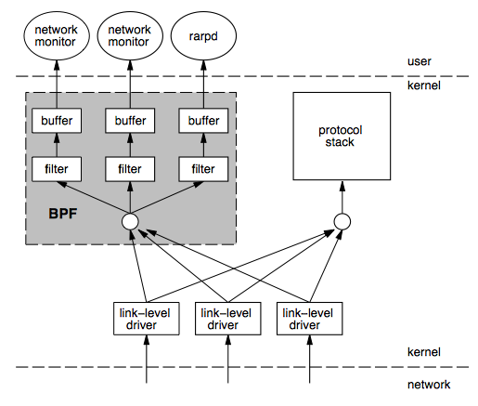
BPF
Berkeley Packet Filters
Steven McCanne & Van Jacobson, 1992 http://www.tcpdump.org/papers/bpf-usenix93.pdf
Instruction set & virtual machine
Describe packet filtering policies
Originally interpreted
“Safe” interpreter in kernel space

Slide 19
BPF Memory Safety
Packet
Scratch area
All memory operations (load/store) are bounds-checked
Program is terminated on out-of-bounds access

Slide 20

BPF Code Safety
Code is read-only
Enforced by static code verifier
Originally backwards branches prohibited
Branches are bounds checked

Slide 21

EBPF
Extended BPF, Linux only
Project leader: Alexei Starovoitov, Facebook
Larger register set
JIT + verifier instead of interpreter
Maps (“tables”) for kernel/user communication
Whitelisted set of kernel functions that can be called from EBPF (and a calling convention)
“Execute to completion” model
C -> EBPF LLVM back-end
Used for packet processing and code tracing
Lots of planned improvement in the future

Slide 22

EBPF’s world
Userspace
eBPF
map
Linux kernel
Linux
TC
kernel hook
Network driver
kernel hook
EBPF
EBPF
helper
Arbitrary
function
EBPF
Each hook provides different capabilities for the EBPF programs.

Slide 23
EBPF Memory Model
user
kernel
Registers
Data
(packet buffer
Scratch area
on stack
Maps
(arrays & hash-tables)

Slide 24
EBPF Maps
Userspace-only:
int bpf_create_map(int map_id, int key_size, int value_size, int max_entries);
int bpf_delete_map(int map_id);
User and kernel: int bpf_update_elem(int map_id, void *key, void *value);
void* bpf_lookup_elem(int map_id, void *key);
int bpf_delete_elem(int map_id, void *key);
int bpf_get_next_key(int map_id, void *key, void *next_key);
All of these are multi-core atomic (using RCU)

Slide 25
A Nice EBPF paper
Creating Complex Network Services with eBPF: Experience and Lessons Learned, Proceedings of IEEE High Performance Switching and Routing (HPSR18), Bucharest, Romania, June 2018
http://fulvio.frisso.net/files/18HPSR-ebpf-lessons-learned.pdf

Slide 26
Comparison P4/eBPF
Feature | P4 | eBPF
Level | High | Low
Safe | Yes | Yes
Safety | Type system | Verifier
Loops | In parsers | Tail calls (dynamic limit)
Resources | Statically allocated | Statically allocated
Policies | Tables (match+action) | Maps (tables)
Extern helpers | Target-specific | Hook-specific
Control-plane API | Synthesized by compiler | eBPF maps
Targets | ASIC, software, FPGA, NIC | Linux kernel
Licensing | Apache | GPL (Linux kernel)
Tools | Compilers, simulators | LLVM
Concurrency | No shared R/W state | Maps are thread-safe (RCU)

Slide 27
Limitations – part 1
Feature | P4 | eBPF
Loops | Parsers | Tail call
Nested headers | Bounded depth | Bounded depth
Multicast/broadcast | External | Helpers
Packet segmentation | No | No
Packet reassembly | No | No
Timers/timeouts/aging | No | No
Queues | No | No
Scheduling | No | No
Data structures | No | No
Payload processing | No | No
State | Registers/counters | Maps
Linear scans | No | No

Slide 28
Limitations – part 2
Feature | P4 | eBPF
Network levels | L2, L3 | L2, L3
Synchronization (data/data, data/control) | No | No
Execution model | Event-driven | Event-driven
Resources | Statically allocated | Limited stack and buffer
Control-plane support | Complex | Simple
Safety | Safe | Verifier rejects safe programs
Compiler | Target-dependent | LLVM code not always efficient

Slide 29

Limitations’ Summary
P4: suitable for switching, not for end-points
eBPF: simple packet filtering/rewriting
Neither language is good enough to implement a full end-point networking stack

Slide 30

Compiling P4 to eBPF

Slide 31

Which eBPF?
User space
There isn’t really a “one eBPF”
The interface of an eBPF program to the environment depends on the selected hook!
(This makes many eBPF conversations very confusing)
socket
Kernel
space
IP/routing
Bridge hook
tc
Your Program
driver
eBPF hook point
Hardware
Example of TC+eBPF

Slide 32

Two P4 eBPF models
P4 is clear in this respect
A P4 model specifies it’s interfaces to the environment
ebpf_model.p4: a packet filter
xdp_model.p4: a packet switch

Slide 33

Two eBPF back-ends
p4c-ebpf is part of the open-source distribution
http://github.com/p4lang/p4c
p4c/backends/ebpf
p4c-xdp is a separate open-source project
http://github.com/vmware/p4c-xdp
Built as an extension of the p4c compiler
Reuses much of the code
Not production-ready
Need more work
Known bugs and limitations
Code generated not very efficient
p4c-xdp
p4c-ebpf

Slide 34
P4₁₆ data plane model
Programmable blocks
Data plane
P4
P4
P4
Fixed function
Interfaces

Slide 35
The packet filter model
Control-plane API
Parser
Match+
Action
EBPF tables
packet in
bool drop
headers
This is ebpf_model.p4

Slide 36
ebpf_model.p4
extern CounterArray {
CounterArray(bit<32> max_index, bool sparse);
void increment(in bit<32> index);
}
extern array_table {
array_table(bit<32> size);
}
extern hash_table {
hash_table(bit<32> size);
}
parser parse<H>(packet_in packet, out H headers);
control filter<H>(inout H headers, out bool accept);
package ebpfFilter<H>(parse<H> prs, filter<H> filt);

Slide 37
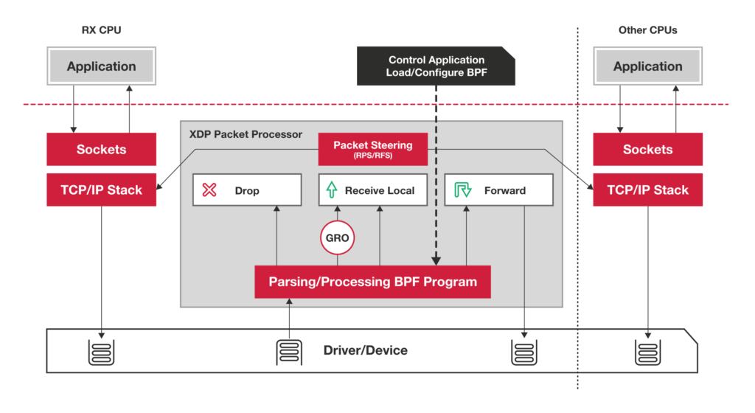
XDP: eXpress Data Path
https://www.iovisor.org/technology/xdp

Slide 38
The XDP switching model
Control-plane API
Drop/tx/pass
Output port
Input port
Parser
Match+
Action
Deparser
EBPF tables
packet in
packet out
headers
headers
XDP Data Plane

Slide 39
xdp_model.p4
#include <ebpf_model.p4>
enum xdp_action { XDP_ABORTED, // some fatal error occurred during processing; XDP_DROP, // packet should be dropped XDP_PASS, // packet should be passed to the Linux kernel XDP_TX // packet resent out on the same interface }
struct xdp_input { bit<32> input_port; }
struct xdp_output { xdp_action output_action; bit<32> output_port; // output port for packet }
parser xdp_parse<H>(packet_in packet, out H headers);
control xdp_switch<H>(inout H hdrs, in xdp_input i, out xdp_output o);
control xdp_deparse<H>(in H headers, packet_out packet);
package xdp<H>(xdp_parse<H> p, xdp_switch<H> s, xdp_deparse<H> d);

Slide 40
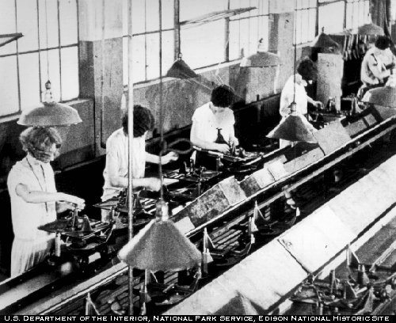
P4₁₆-> C -> eBPF
Generate stylized C
No loops, all data on stack
Parser loops currently not supported
Will be supported by loop unrolling only
EBPF tables for control/data-plane communication
XDP: Filtering, forwarding, encapsulation
Currently use Linux TC subsystem for forwarding
When XDP supports forwarding it can be done natively

Slide 41
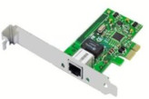
Flow
control-plane.c
app.p4
p4c-xdp
app.h
Control-plane API
app.c
Clang + LLVM
User space
BPF system call
Kernel space
app.o
Verifier
exe
Match-Action
tables
Data Plane XDP driver
Hardware

Slide 42
Simple Example
Parse Ethernet and IPv4 header
Lookup a table using Ethernet’s destination as key
Based on Ethernet’s destination address, execute one action:
Drop the packet (XDP_DROP)
Pass the packet to network stack (XDP_PASS)
Network stack
Parser
Match+
Action
Deparser
packet
Drop

Slide 43
P4 Headers
header Ethernet { bit<48> source; bit<48> dest; bit<16> protocol; }
header IPv4{ bit<4> version; bit<4> ihl; bit<8> diffserv; … }
struct Headers { Ethernet eth; IPv4 ipv4; }
struct Ethernet{ u8 source[6]; u8 destination[6]; u16 protocol; u8 ebpf_valid; }
struct IPv4 { u8 version; /* bit<4> */ u8 ihl; /* bit<4> */ u8 diffserv; /* bit<8> */
p4c-xdp
C struct + valid bit
Currently each header field is re-aligned
Inefficient design
Notes:
struct IPv4 { u8 version; /* bit<4> */ u8 ihl; /* bit<4> */ u8 diffserv; /* bit<8> */ u16 totalLen; /* bit<16> */ u16 identification; /* bit<16> */ u8 flags; /* bit<3> */ u16 fragOffset; /* bit<13> */ u8 ttl; /* bit<8> */ u8 protocol; /* bit<8> */ u16 hdrChecksum; /* bit<16> */ u32 srcAddr; /* bit<32> */ u32 dstAddr; /* bit<32> */ u8 ebpf_valid;};

Slide 44
P4 Protocol Parser
﻿parser Parser(packet_in packet, out Headers hd) {
state start { packet.extract(hd.ethernet); transition select(hd.ethernet.protocol) { 16w0x800: parse_ipv4; default: accept; }
state parse_ipv4 { packet.extract(hd.ipv4); transition accept; }}
p4c-xdp
struct Headers hd = {};
…
if (end < start + header_size)
goto reject;
hd.ethernet.destination[0] = load_byte(…);
…

Slide 45
Match-Action
﻿control Ingress (inout Headers hdr,
in xdp_input xin, out xdp_output xout) {
action Drop_action() { xout.output_action = xdp_action.XDP_DROP; }
action Fallback_action() { xout.output_action = xdp_action.XDP_PASS; }
table mactable {
key = {hdr.ethernet.destination : exact; }
actions = { Fallback_action; Drop_action; }
implementation = hash_table(64); } … }
p4c-xdp
struct mactable_value {
enum mactable_actions action;
union {
struct {
} Fallback_action;
struct {
} Drop_action;
} u;
}
﻿struct mactable_key {
u8 field0[6];
}
enum mactable_actions {
Fallback_action,
Drop_action,
}

Slide 46
Control-plane API in C
Generated by compiler
﻿#include ”xdp1.h”
int main () {
int fd = bpf_obj_get(MAP_PATH);
…
struct mactable_key key;
memcpy(key.field0, MACADDR, 6);
struct mactable_value value;
value.action = Fallback_action;
bpf_update_elem(fd, &key, &value, BPF_ANY);
}

Slide 47
Deparser: Update the Packet
﻿control Deparser(in Headers hdrs, packet_out packet) { apply { packet.emit(hdrs.ethernet); packet.emit(hdrs.ipv4); }}
p4c-xdp
bpf_xdp_adjust_head(skb, offset); ebpf_byte = ((char*)(&hd.ethernet.destination))[0];
write_byte(ebpf_packetStart, BYTES(ebpf_packetOffsetInBits) + 0, ebpf_byte);
…
ebpf_packetOffsetInBits += 48;

Slide 48
Complete C program structure
﻿SEC(“prog”) int ebpf_filter(struct xdp_md *skb) { struct Headers hd = {}; …
/* parser */ if (end < start + header_size) goto reject;
hd.ethernet.destination[0] = load_byte(…); …
/* match+action*/ value = bpf_map_lookup_elem(key); switch(value->action) { case Drop_action: … }
/* deparser */ xdp_adjust_head(amount);
// update packet header
return xout.xdp_output; }
Parser:
Check packet access boundary.
Walk through the protocol graph.
Save in “struct Headers hd.”
Match+Action:
Extract key from struct Headers
Lookup BPF hash map
Execute the correponding action
Deparser
Convert headers back into a byte stream.
Only valid headers are emitted.

Slide 49
Changing headers
xdp_adjust_head() helper
VLAN push
packet.emit(hdrs.ethernet);
packet.emit(hdrs.vlan);
packet.emit(hdrs.ipv4);
VLAN pop
hdrs.vlan.setInvalid();
skb->data
skb->data
ETH
IPv4
payload
ETH
VLAN
IPv4
payload

Slide 50
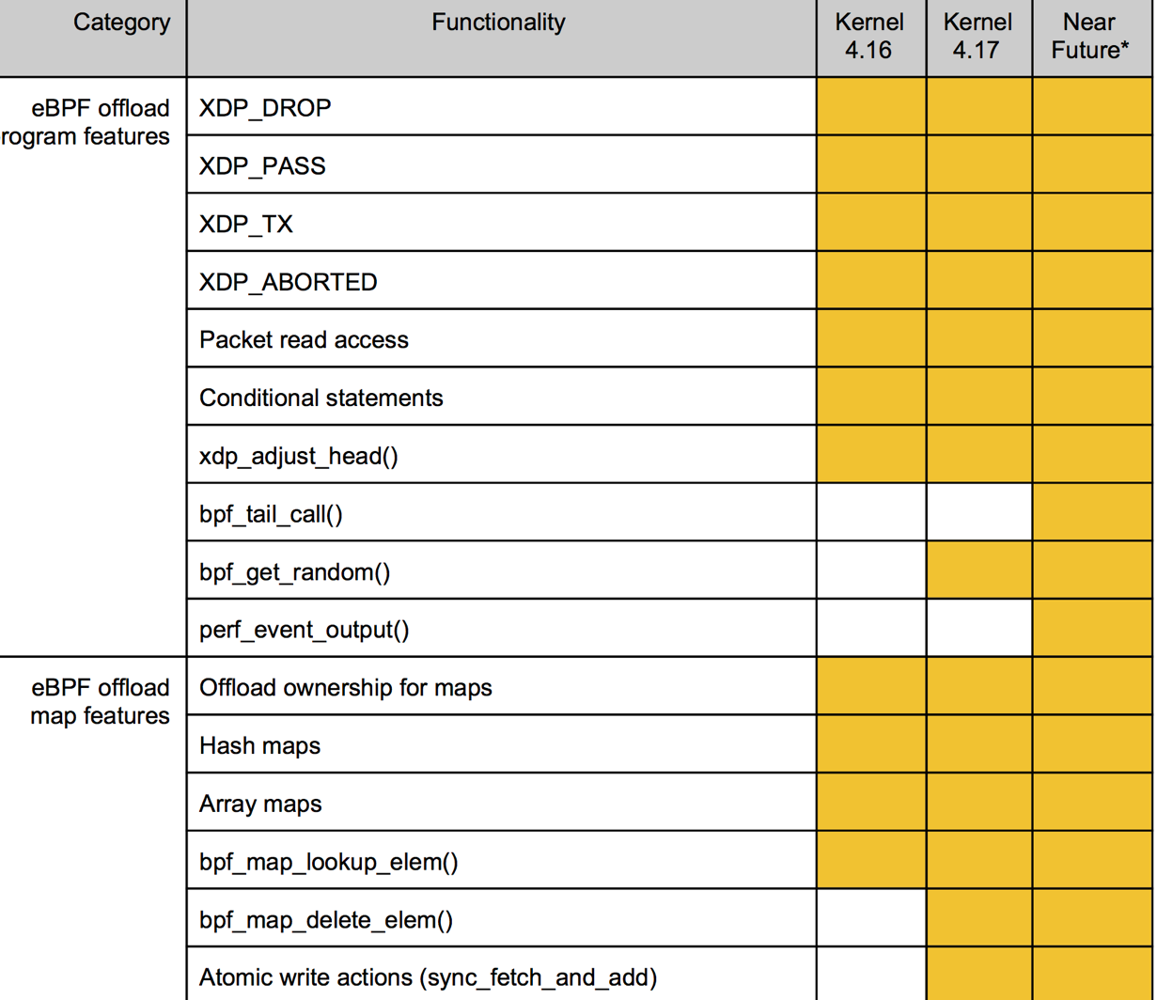
Netronome’s NIC support
eBPF Offload Getting Started Guide
Netronome CX SmartNIC
Revision 1.0 − April 2018

Slide 51


Setup and Installation
Run P4-XDP
sender
Linux kernel
4.10.0-rc7
IP: 2.2.2.9
16-core Intel Xeon
E5 2650 2.4GHz
32GB memory
Intel i40e driver
Intel X710 10GbE
Dual port i40e
Intel X710 10GbE
i40e driver with XDP patch
Dependencies:
P4 2016: https://github.com/p4lang/p4c
Linux >= 4.10.0-rc7: http://www.kernel.org/
iproute2 >= 4.8.0: https://www.kernel.org/pub/linux/utils/net/iproute2/
clang+LLVM >=3.7.1: http://llvm.org/releases
Source code at Github
Vagrant box / docker image available
P4C-XDP binary
#./p4c-xdp --target xdp -o <output_file> <input p4>

Slide 52

Difficulties
eBPF verifier
Cannot handle large programs
Limited stack space (512 bytes)
Overly conservative/imprecise (rejects safe programs)
No way to express eBPF tail calls in C (parser loops)
LLVM eBPF back-end generates inefficient code
E.g. stores each char as a 64-bit word on stack
Ternary (wildcarded) map not supported
Create a flow key by parsing subset of a protocol’s fields

Slide 53

Test cases
Basic parser
Parser + deparser
Parser + table lookup + deparser
Parser + table lookup with complex key + deparser
Control plane
Change TTL
SNAT and checksum recalculation
Recompute ipv4 checksum
Count packets
Bounce back (swap ethernet addresses)
Parse ipv4/ipv6 ping
Multiple tables
Multiple actions
Encapsulation
External helpers

Slide 54

Testing P4-eBPF Programs

Slide 55
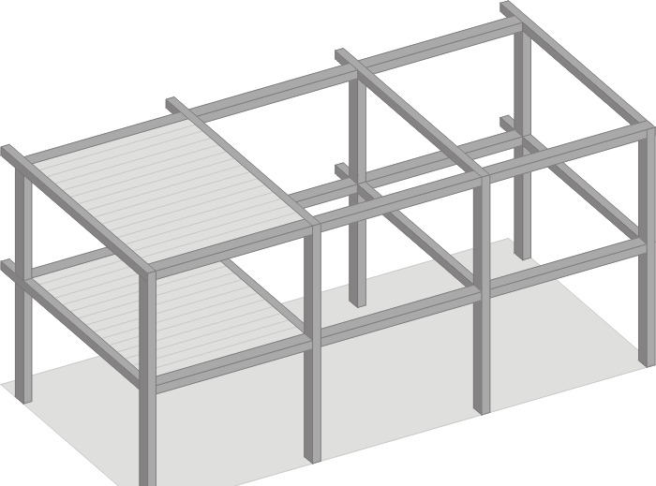
Test Frameworks
Use p4c compiler testing framework
User-space testing
User-space wrappers around eBPF tables and APIs
Reads and writes packets from pcap files
Kernel-space testing
Loads eBPF program in kernel
I/O connected to virtual interfaces
Interfaces connected to pcap files in user-space

Slide 56

Why test in user-space?
Test the compiler correctness
C output must be functionally equivalent to P4
Fewer dependencies
Does not require specific versions of
Linux kernel
llvm
tc
Does not depend on eBPF verifier
We can use simple debugging tools (e.g., GDB)

Slide 57

Simple test framework (stf)
Data plane testing language
Describes in a text file
Input packets (per port)
Expected output packets (per port)
Initial state of tables
Final state of counters
Used to:
Execute programs generated by the compiler
Validate the output they produce
Compiler comes with a Python parser for STF

Slide 58
Example STF file
Priority
Key value (hex, bin or oct)
Table name
Table key field
Action name
Action data
add ipchk 0 ipv4.src:0xFFFF0101 forward(port:2)
setdefault encap drop()
expect 2 00000101 ******** **** 7f 66 packet 0 00000101 00000202 0303 55 66 7777 88 00 expect 3 00000202 ******** **** 07 66 packet 2 00000202 00000303 0404 55 66 7777 88 00
# comment
Add table entries
Set default action
Expected packets
Sent packets
Packet contents in hex (prefix of contents for received packets)
Interface #
* = don’t care

Slide 59
Pcap File Library
List
List
struct pcap_pkt; // contains interface ID
struct pcap_list;
struct pcap_list_array;
pcap_pkt* copy_packet(pcap_pkt* packet);
pcap_list* allocate_list();
void delete_list(pcap_list* l);
pcap_list* append_packet(pcap_list* list, pcap_pkt* packet);
pcap_pkt* get_packet(pcap_list* list, int index);
pcap_list *read_pkts_from_pcap(char* file, int interface);
int write_pkts_to_pcap(char* file, pcap_list* l);
void sort_pcap_list(pcap_list* l); /* sort on time stamp */
pcap_list *merge_and_delete_pcap_lists(pcap_list_array* a);
pcap_list_array *split_and_delete_list(pcap_list* l); // on interface
List array
packets

Slide 60
Testing the eBPF back-end in user-space
simple test framework
run-ebpf-test.py
p.stf
linked
pass/fail
Table management
expected packets
compare
in.pcap
runtime
out.pcap
p4c-ebpf
P4 program
C Program (compilable to eBPF)
Currently open-loop testing only (no control messages received from simulator).
In progress: adapting this to p4c-xdp.

Slide 61
Testing the eBPF back-end in kernel space
simple test framework
run-ebpf-test.py
linked
p.stf
table management
pass/fail
in.pcap
C runtime
compare
C Program
llvm
eBPF object
packet
out.pcap
expected packets
tables
p4c-ebpf
packet
kernel
P4 program
tc filter
veth
veth
Bridge
ebpf program

