Slide 1
Linux Network Programming with P4
Linux Plumbers 2018
Fabian Ruffy, William Tu, Mihai Budiu
VMware Inc. and University of British Columbia

Slide 2
Outline
Introduction to P4
XDP and the P4 Compiler
Testing
Example
Performance Results
Discussion
Fabian
William

Slide 3

What is P4?
High-level programming language for network data planes
Allows for protocol flexibility
Specifies a packet processing pipeline
Compiled and loaded into target platform
Open and standardized
P4: Programming Protocol-Independent Packet Processors
Pat Bosshart, Dan Daly, Glen Gibb, Martin Izzard, Nick McKeown, Jennifer Rexford, Cole Schlesinger, Dan Talayco, Amin Vahdat, George Varghese, David Walker ACM SIGCOMM Computer Communications Review (CCR). Volume 44, Issue #3 (July 2014)

Slide 4

P4 Essentials
C-like, strongly typed language
Type and memory-safe (no pointers)
Bounded execution (no loops)
Statically allocated (no malloc, no recursion)
Spec: http://github.com/p4lang/p4-spec
Reference compiler implementation: http://github.com/p4lang/p4c (Apache 2 license)

Slide 5
P4 Software Workflow
User-supplied
Control Plane
P4 Program
P4 Compiler
RUNTIME
Add/remove table entries
Extern control
Packet-in/out
P4 Architecture
Model
CPU port
Data Plane
Target-specific configuration binary
Tables
Extern
objects
Load
Target
Supplied

Slide 6

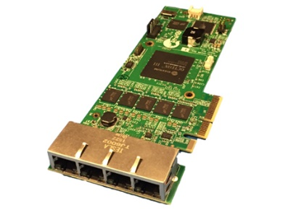
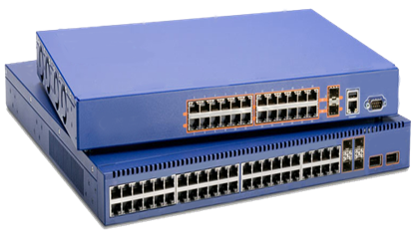
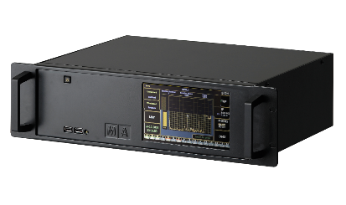
P4₁₆ generic data-plane model
os_lib.p4
switch_lib.p4
npu_lib.p4
nic_lib.p4
The networking stack of the OS
program.p4

Slide 7

P4 and XDP

Slide 8

eBPF/XDP
Virtual machine running in the Linux kernel
Provides:
The ability to write restricted C and run it in the kernel
A set of kernel hook points invoking the eBPF program
Extensible, safe and fast
Alternative to user-space networking
User space
Kernel
space
socket
IP/routing
Bridge hook
tc
Your Program
eBPF hook point
driver
A programmable data plane in the Linux kernel!
Hardware
Example of TC+eBPF

Slide 9
P4 vs eBPF/XDP
Feature | P4 | eBPF/XDP
Level | High | Low
Safe | Yes | Yes
Safety | Type system | Verifier
Loops | In parsers | Tail calls (dynamic limit)
Resources | Statically allocated | Statically allocated
Policies | Tables (match+action) | Maps (tables)
Extern helpers | Target-specific | Hook-specific
Control-plane API | Synthesized by compiler | eBPF maps

Slide 10
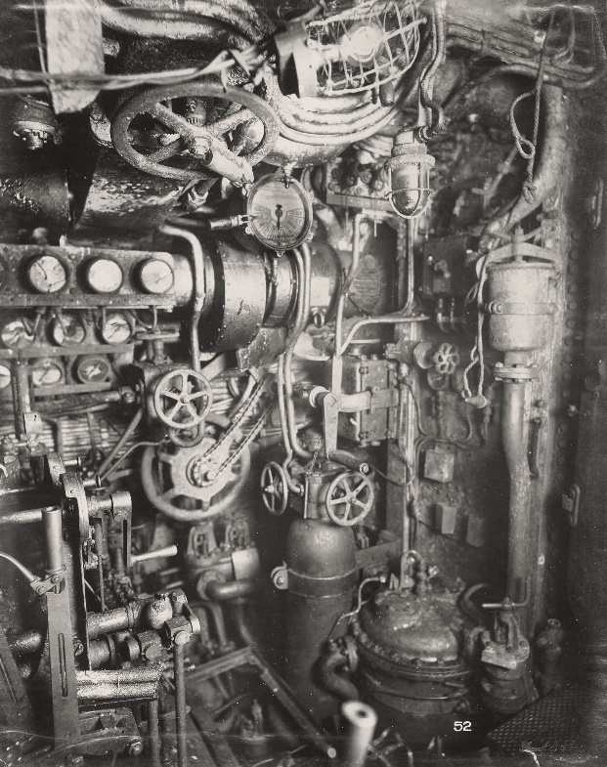
The P4 eBPF backends
p4c-ebpf is part of the open-source distribution
http://github.com/p4lang/p4c/backends/ebpf
p4c-xdp is a separate open-source project
http://github.com/vmware/p4c-xdp
Extension of the p4c compiler
Reuses much of the code
Not production-ready
Needs more work
Known bugs and limitations
Generated not efficient yet
p4c-xdp
p4c-ebpf

Slide 11
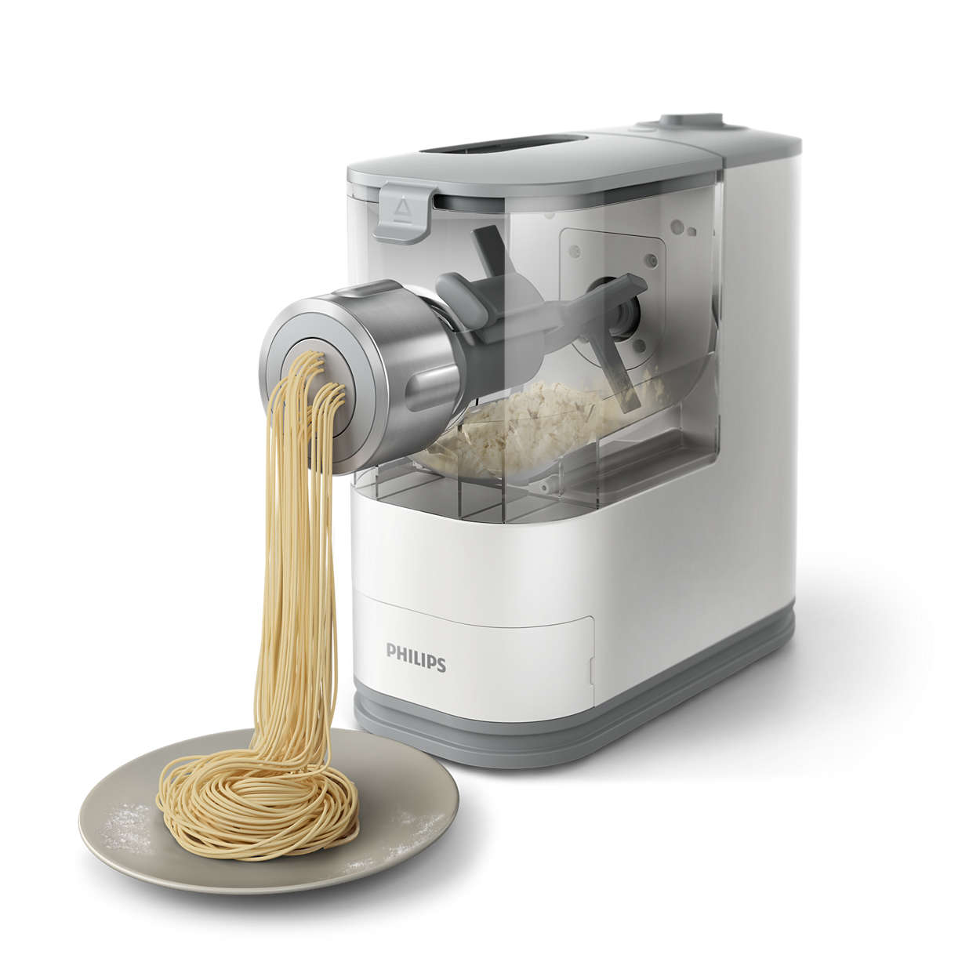
Generating XDP code

Slide 12
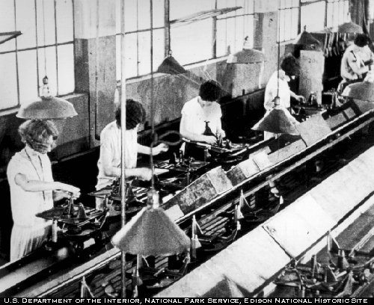
P4₁₆ -> C -> eBPF/XDP
Generates stylized C
No tail calls yet, all data on stack
eBPF tables control/data-plane communication
Can do filtering, forwarding, encapsulation
Relies on Linux TC for forwarding
We plan on switching to libbpf

Slide 13
The XDP Switching Model
Control-plane API
Drop/Forward/Pass
Input port
Parser
Match+
Action
Deparser
EBPF tables
packet in
packet out
headers
headers
XDP Data Plane

Slide 14
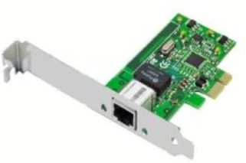
Flow
control-plane.c
app.p4
p4c-xdp
app.h
Control-plane API
app.c
Clang + LLVM
User space
BPF system call
Kernel space
app.o
Verifier
exe
Match-Action
tables
Data Plane XDP driver
Hardware

Slide 15

Testing P4-XDP code

Slide 16
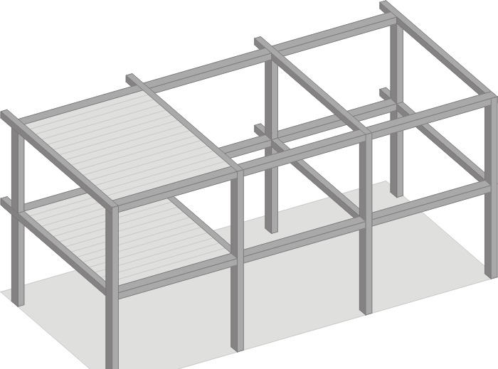
Test Frameworks
User-space testing
Isolates specification from implementation
Validates correctness of generated code
User-space wrappers around eBPF tables and APIs
Reads and writes packets from capture files
Kernel-space testing
Loads eBPF program into kernel
I/O connected to virtual interfaces
Writes capture files to interfaces in user-space
Records output using tcpdump

Slide 17
Five Testing Stages
compile p4
runtime source
compile data-plane
runtime executable
run
output0.pcap
output1.pcap
….
check results
1
3
4
5
test.p4
parse stf
2
test.stf
input0.pcap
input1.pcap
….
expect0.pcap
expect1.pcap
….
pass/
fail

Slide 18

A sample P4-XDP program

Slide 19
Forwarding an IPv4 Packet
Parse Ethernet and IPv4 header
Lookup a table using Ethernet’s destination as key
Based on Ethernet’s destination address, execute one action:
Drop the packet (XDP_DROP)
Pass the packet to network stack (XDP_PASS)
Network stack
Parser
Match+
Action
Deparser
packet
Drop

Slide 20
P4 Headers
header Ethernet { bit<48> source; bit<48> dest; bit<16> protocol; }
header IPv4{ bit<4> version; bit<4> ihl; bit<8> diffserv; … }
struct Headers { Ethernet eth; IPv4 ipv4; }
struct Ethernet{ u8 source[6]; u8 destination[6]; u16 protocol; u8 ebpf_valid; }
struct IPv4 { u8 version[6]; /* bit<4> */ u8 ihl[6]; /* bit<4> */ u8 diffserv; /* bit<8> */
p4c-xdp
C struct + valid bit
Currently each header field is re-aligned
Inefficient design
Notes:
struct IPv4 { u8 version; /* bit<4> */ u8 ihl; /* bit<4> */ u8 diffserv; /* bit<8> */ u16 totalLen; /* bit<16> */ u16 identification; /* bit<16> */ u8 flags; /* bit<3> */ u16 fragOffset; /* bit<13> */ u8 ttl; /* bit<8> */ u8 protocol; /* bit<8> */ u16 hdrChecksum; /* bit<16> */ u32 srcAddr; /* bit<32> */ u32 dstAddr; /* bit<32> */ u8 ebpf_valid;};

Slide 21
P4 Protocol Parser
﻿parser Parser(packet_in packet, out Headers hd) {
state start { packet.extract(hd.ethernet); transition select(hd.ethernet.protocol) { 16w0x800: parse_ipv4; default: accept; }
state parse_ipv4 { packet.extract(hd.ipv4); transition accept; }}
p4c-xdp
struct Headers hd = {};
…
if (end < start + header_size)
goto reject;
hd.ethernet.destination[0] = load_byte(…);
…

Slide 22
Match-Action
﻿control Ingress (inout Headers hdr,
in xdp_input xin, out xdp_output xout) {
action Drop_action() { xout.output_action = xdp_action.XDP_DROP; }
action Fallback_action() { xout.output_action = xdp_action.XDP_PASS; }
table mactable {
key = {hdr.ethernet.destination : exact; }
actions = { Fallback_action; Drop_action; }
implementation = hash_table(64); } … }
﻿struct mactable_key {
u8 field0[6];
}
enum mactable_actions {
Fallback_action,
Drop_action,
}
p4c-xdp
struct mactable_value {
enum mactable_actions action;
union {
struct {
} Fallback_action;
struct {
} Drop_action;
} u;
}

Slide 23
Control-plane API in C
Generated by compiler
﻿#include ”xdp1.h”
int main () {
int fd = bpf_obj_get(MAP_PATH);
…
struct mactable_key key;
memcpy(key.field0, MACADDR, 6);
struct mactable_value value;
value.action = Fallback_action;
bpf_update_elem(fd, &key, &value, BPF_ANY);
}

Slide 24
Deparser: Update the Packet
﻿control Deparser(in Headers hdrs, packet_out packet) { apply { packet.emit(hdrs.ethernet); packet.emit(hdrs.ipv4); }}
p4c-xdp
bpf_xdp_adjust_head(skb, offset); ebpf_byte = ((char*)(&hd.ethernet.destination))[0];
write_byte(ebpf_packetStart, BYTES(ebpf_packetOffsetInBits) + 0, ebpf_byte);
…
ebpf_packetOffsetInBits += 48;

Slide 25
Complete C program structure
﻿SEC(“prog”) int ebpf_filter(struct xdp_md *skb) { struct Headers hd = {}; …
/* parser */ if (end < start + header_size) goto reject;
hd.ethernet.destination[0] = load_byte(…); …
/* match+action*/ value = bpf_map_lookup_elem(key); switch(value->action) { case Drop_action: … }
/* deparser */ xdp_adjust_head(amount);
// update packet header
return xout.xdp_output; }
Parser:
Check packet access boundary.
Walk through the protocol graph.
Save in “struct Headers hd.”
Match+Action:
Extract key from struct Headers
Lookup BPF hash map
Execute the correponding action
Deparser
Convert headers back into a byte stream.
Only valid headers are emitted.

Slide 26

Performance Benchmarks

Slide 27

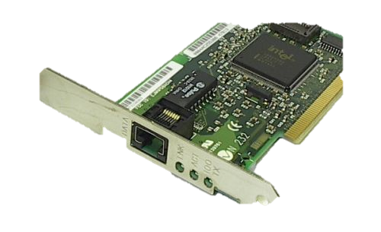
Performance Evaluation
P4C-XDP
UDP 14Mpps
Linux kernel
4.19-rc5
sender
16-core Intel Xeon
E5 2650 2.4GHz
32GB memory
Intel X540 10GbE
Ixgbe driver
Intel X540 10GbE
ixgbe driver with XDP
P4C-XDP binary
#./p4c-xdp --target xdp -o <output_file> <input p4>
Sample code at tests/xdp*.p4
Load to driver by: ip link set dev eth0 xdp obj xdp1.o
Measure packet rate in Mpps
Packet drop rate (XDP_DROP) and transmit rate (XDP_TX)

Slide 28
Sample P4 Program Performance
P4 Program | Performance (Mpps) | Possible Optimization
SimpleDrop | 14.4 | NA
xdp1 | 8.1 | 14
xdp3 | 7.1 | 13
xdp6 | 2.5 | 12
SimpleDrop: return XDP_DROP
xdp1.p4: parse Ethernet/IPv4 header, deparse it, and drop.
xdp3.p4: parse Ethernet/IPv4 header, lookup a MAC address in a map, deparse it, and drop.
xdp6.p4: parse Ethernet/IPv4 header, lookup and get a new TTL value from eBPF map, set to IPv4 header, deparse it, and drop.
Possible Optimization: avoid byte-order translation and unnecessary (de-)parsing

Slide 29

Limitations

Slide 30
Fundamental Limitations
Feature | P4 | XDP
Loops | Parsers | Tail call
Nested headers | Bounded depth | Bounded depth
Multicast/broadcast | External | No
Packet segmentation | No | No
Packet reassembly | No | No
Timers/timeouts/aging | No | No
Queues | No | No
Scheduling | No | No
State | Registers/counters | Maps
Linear scans | No | No

Slide 31

Limitations of XDP
No multi-/broadcast support
No ability to clone packets in XDP
The stack size is too small
Complex pipelines are rejected by the verifier
Generic XDP and TCP
TCP is ignored by the generic XDP driver
eBPF maps cannot be pinned in network namespaces

Slide 32
Conclusion
P4 is a language that defines data-path behavior
It generalizes to different architectures
Including the Linux kernel
P4 can express XDP
High-level abstraction to C code
Generated code is performant but not optimal
Many future optimizations are possible
P4 and XDP have similar limitations

