Slide 1
P4C-XDP: Programming the Linux Kernel Forwarding Plane using P4
Mihai Budiu, VMware Research
William Tu, VMware NSBU
{mbudiu,tuc}@vmware.com
June 5, 2018
P4 Workshop

Slide 2

What is eBPF / XDP ?
A virtual machine running in Linux kernel
A way to write a restricted C program and runs in Linux kernel
A set of hook points inside kernel to invoke/run the BPF program
Benefits
Safe
Extensible
Fast
User space
Kernel
space
socket
IP/routing
Bridge hook
tc
Your Program
driver
eBPF hook point
Hardware
Example of TC+eBPF

Slide 3
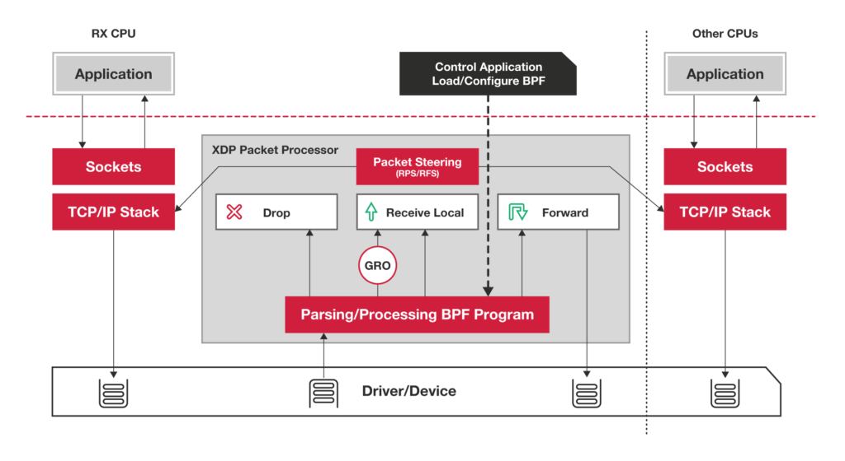
XDP: eXpress Data Path
https://www.iovisor.org/technology/xdp

Slide 4
P4₁₆-> C -> eBPF
p4c-xdp: back-end for the P4₁₆ reference compiler
Generate stylized C
No loops, all data on stack
eBPF tables for control/data-plane communication
Filtering, forwarding, encapsulation
Newer kernel supports XDP forwarding
eBPF verifier limitations
BPF 512 Byte maximum stack size
Registers having const_imm spills without tracking state

Slide 5
P4₁₆ Generic Data Plane Model
Programmable blocks
Data plane
P4
P4
P4
Fixed function

Slide 6
The XDP Switching Model
Control-plane API
Drop/tx/pass
Output port
Input port
Parser
Match+
Action
Deparser
EBPF tables
packet in
packet out
headers
headers
XDP Data Plane

Slide 7
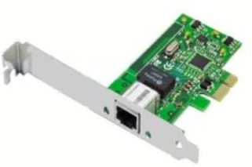
Flow
control-plane.c
app.p4
p4c-xdp
app.h
Control-plane API
app.c
Clang + LLVM
User space
BPF system call
Kernel space
app.o
Verifier
exe
Match-Action
tables
Data Plane XDP driver
Hardware

Slide 8
Simple Example
Parse Ethernet and IPv4 header
Lookup a table using Ethernet’s destination as key
Based on Ethernet’s destination address, execute two actions:
Drop the packet (XDP_DROP)
Pass the packet to network stack (XDP_PASS)
Parser
Match+
Action
Deparser

Slide 9
Protocol Header Definition
header Ethernet { bit<48> source;
bit<48> destination;
bit<16> protocol;
}
header IPv4{
bit<4> version;
bit<4> ihl;
bit<8> diffserv;
…
}
struct Headers { Ethernet ethernet; IPv4 ipv4;
}
C struct
xdp.h
struct Ethernet{ u8 source[6];
u8 destination[6];
u16 protocol;
u8 ebpf_valid;
}
C struct + valid bit

Slide 10
P4 Protocol Parser
﻿parser Parser(packet_in packet,
out Headers hd) {
state start {
packet.extract(hd.ethernet);
transition select(hd.ethernet.protocl) {
16w0x800: parse_ipv4;
default: accept;
}
}
state parse_ipv4 {
packet.extract(hd.ipv4);
transition accept;
} }
Code Block
Direct Pkt Access
Switch-case
goto
Code Block
Direct Pkt Access

Slide 11
Table Match and Action
﻿control Ingress (inout Headers hdr,
in xdp_input xin, out xdp_output xout) {
action Drop_action() {
xout.output_action = xdp_action.XDP_DROP; }
action Fallback_action() {
xout.output_action = xdp_action.XDP_PASS; }
table mactable {
key = {hdr.ethernet.destination : exact; }
actions = {
Fallback_action;
Drop_action;
}
implementation = hash_table(64);
}
Two action types
BPF HashMap
Key size of 6 byte
Value with enum type + parameter

Slide 12
P4-XDP: xdp1.c
﻿SEC(“prog”)
int ebpf_filter(struct xdp_md *skb) {
struct Headers hd = {};
…
/* parser */
if (end < start + header_size)
goto reject;
hd.ethernet.destination[0] = load_byte(…);
…
/* match+action*/
value = bpf_map_lookup_elem(key);
switch(value->action) {
case Drop_action:
…
/* deparser */
xdp_adjust_head();
// update packet header
return xout.xdp_output;
Parser:
Check packet access boundary.
Walk through the protocol graph.
Save in “struct Headers hd.”
Match+Action:
Extract key from struct Headers
Lookup BPF hash map
Execute the correponding action
Deparser
Convert headers back into a byte stream.
Only valid headers are emitted.

Slide 13
Generate Header for Control Plane
Generate: xpd1.h
User provide: user_xpd1.c
﻿struct mactable_key {
u8 field0[6];
}
enum mactable_actions {
Fallback_action,
Drop_action,
}
struct mactable_value {
enum mactable_actions action;
union {
struct {
} Fallback_action;
struct {
} Drop_action;
} u;
}
﻿#include ”xdp1.h”
int main () {
int fd = bpf_obj_get(MAP_PATH);
…
struct mactable_key key;
memcpy(key.field0, MACADDR, 6);
struct mactable_value value;
value.action = Fallback_action;
bpf_update_elem(fd, &key, &value, BPF_ANY);
}

Slide 14

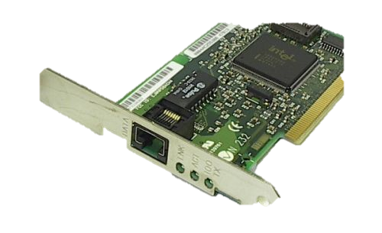
Setup and Installation
Run P4-XDP
sender
Linux kernel
4.10.0-rc7
IP: 2.2.2.9
16-core Intel Xeon
E5 2650 2.4GHz
32GB memory
Intel i40e driver
Intel X710 10GbE
Dual port i40e
Intel X710 10GbE
i40e driver with XDP patch
Dependencies:
P4 2016: https://github.com/p4lang/p4c
Linux >= 4.10.0-rc7: http://www.kernel.org/
iproute2 >= 4.8.0: https://www.kernel.org/pub/linux/utils/net/iproute2/
clang+LLVM >=3.7.1: http://llvm.org/releases
Source code at Github
Vagrant box / docker image available
P4C-XDP binary
#./p4c-xdp --target xdp -o <output_file> <input p4>

Slide 15
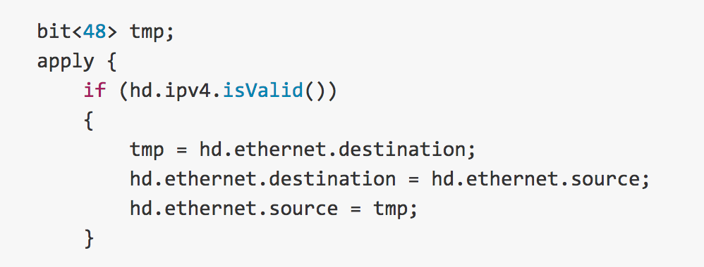
Demo1: Swap Ethernet (xdp11.p4)
Swap Ethernet source and destination
Send to the receiving interface (return XDP_TX)
https://youtu.be/On7hEJ6bPVU
https://github.com/vmware/p4c-xdp/blob/master/tests/xdp11.p4

Slide 16
Thank You
Questions?
https://github.com/vmware/p4c-xdp

Slide 17
BPF Verifier Pending Issues
BPF 512 Byte maximum stack size [#22]
Not necessarily due to the size of local variables
Enable certain deparser (lots of writes) hits max BPF stack size
Possible workarounds:
Bump up the maximum stack size in kernel
Enable more efficient use of stack in LLVM
Registers having const_imm spills without tracking state [#34]
BPF only has 10 registers, LLVM spills the register to stack when necessary
BPF verifier keeps the register states and restore after BPF_LOAD
Current version does not support spill const_imm

Slide 18
Demo2: ping4/6 and stats (xdp12.p4)
Parse IPv4/IPv6 ping
Drop ipv6 ping, and return XDP_DROP
Enable Control plane
Update ipv4 statistics, and return XDP_PASS
https://youtu.be/vlp1MzWVOc8
Notes:
# ip link set dev enp66s0f0 xdp obj xdp11.o verb
# ./xdp10

Slide 19
Deparser: Update the Packet
Example: VLAN pop
﻿control Deparser(in Headers hdrs,
packet_out packet) {
apply {
packet.emit(hdrs.ethernet);
packet.emit(hdrs.vlan_tag);
packet.emit(hdrs.ipv4);
} }
skb->data
ETH
VLAN
IPv4
payload
xdp_adjust_head() for 4 byte
skb->data
ETH
IPv4
payload
Users can push/pop headers by emitting more or skipping emit
Ex: vlan push/pop by add/remove packet.emit(hdrs.vlan_tag);
Need to adjust skb->data by adding xdp_adjust_head helper
The payload remains in the
same memory

Slide 20
xdp_model.p4
enum xdp_action {
XDP_ABORTED, // some fatal error occurred during processing;
XDP_DROP, // packet should be dropped
XDP_PASS, // packet should be passed to the Linux kernel
XDP_TX // packet resent out on the same interface
}
struct xdp_input {
bit<32> input_port;
}
struct xdp_output {
xdp_action output_action;
bit<32> output_port; // output port for packet
}
parser xdp_parse<H>(packet_in packet, out H headers);
control xdp_switch<H>(inout H hdrs, in xdp_input i, out xdp_output o);
control xdp_deparse<H>(in H headers, packet_out packet);
package xdp<H>(xdp_parse<H> p, xdp_switch<H> s, xdp_deparse<H> d);

Slide 21
Experiences with BPF Verifier
Typical packet access check: data + [off] <= data_end
where [off] can be either immediate or
coming from a tracked register that contains an immediate
Two patches related to direct packet access
bpf: enable verifier to better track const alu ops, commit 3fadc8011583
bpf: enable verifier to add 0 to packet ptr, commit 63dfef75ed753
R1=pkt(id=0,off=0,r=22) R2=pkt_end R3=imm144,min_value=144,max_value=144
30: (bf) r5 = r3
31: (07) r5 += 23
32: (77) r5 >>= 3
33: (bf) r6 = r1 // r6 == pkt
34: (0f) r6 += r5 // pkt += r5

