Slide 1
Compiling P4 to XDP
Mihai Budiu, VMware Research
William Tu, VMware NSBU
{mbudiu,tuc}@vmware.com
February 27, 2017
IOVisor summit

Slide 2
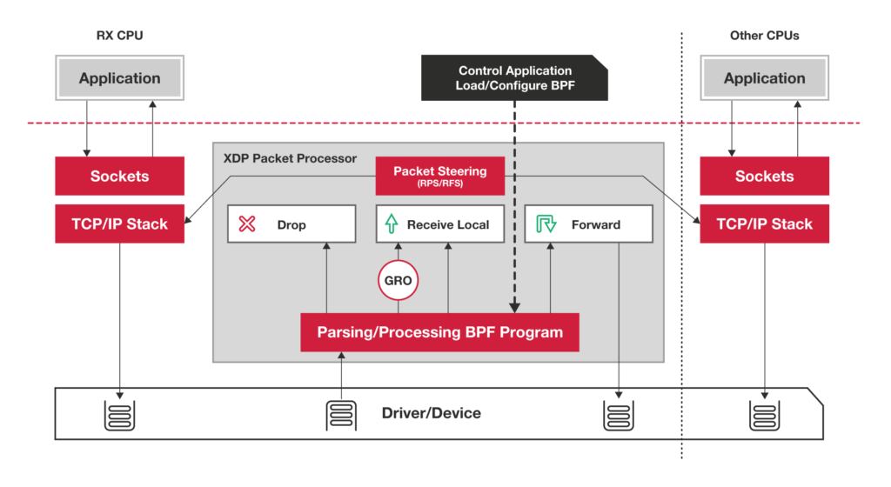
XDP
https://www.iovisor.org/technology/xdp

Slide 3

P4
P4: Programming Protocol-Independent Packet Processors
Pat Bosshart, Dan Daly, Glen Gibb, Martin Izzard, Nick McKeown, Jennifer Rexford, Cole Schlesinger, Dan Talayco, Amin Vahdat, George Varghese, David Walker ACM SIGCOMM Computer Communications Review (CCR). Volume 44, Issue #3 (July 2014)
Initially designed for programmable switches. P4₁₆ can support many kinds of packet processing devices.
http://P4.org

Slide 4



P4.org Consortium
Carriers, cloud operators, chip, networking, systems, universities,
start-ups

Slide 5
P4₁₆
C-like, strongly typed
Arbitrary length bitstrings
Match-action tables
Parser = state machine
No loops, no pointers, no memory allocation
Support for external, target-specific accelerators (e.g., checksum units, multicast, learning, etc.)

Slide 6
P4₁₆-> C -> EBPF
p4c-xdp: back-end for the P4₁₆ reference compiler
Generate stylized C
No loops, all data on stack
EBPF tables for control/data-plane communication
Filtering, forwarding, encapsulation
Currently use Linux TC subsystem for forwarding
https://github.com/williamtu/p4c-xdp

Slide 7
P4₁₆ generic data plane model
Programmable blocks
Data plane
P4
P4
P4
Fixed function

Slide 8
The XDP switching model
Control-plane API
Drop/tx/pass
Output port
Input port
Parser
Match+
Action
Deparser
EBPF tables
packet in
packet out
headers
headers
XDP Data Plane

Slide 9
xdp_model.p4
enum xdp_action {
XDP_ABORTED, // some fatal error occurred during processing;
XDP_DROP, // packet should be dropped
XDP_PASS, // packet should be passed to the Linux kernel
XDP_TX // packet resent out on the same interface
}
struct xdp_input {
bit<32> input_port;
}
struct xdp_output {
xdp_action output_action;
bit<32> output_port; // output port for packet
}
parser xdp_parse<H>(packet_in packet, out H headers);
control xdp_switch<H>(inout H hdrs, in xdp_input i, out xdp_output o);
control xdp_deparse<H>(in H headers, packet_out packet);
package xdp<H>(xdp_parse<H> p, xdp_switch<H> s, xdp_deparse<H> d);

Slide 10
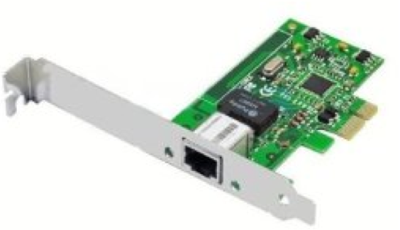
Flow
control-plane.c
app.p4
p4c-xdp
app.h
Control-plane API
app.c
Clang + LLVM
User space
BPF system call
Kernel space
app.o
Verifier
exe
Match-Action
tables
Data Plane XDP driver
Hardware

Slide 11
Simple Example
Parse Ethernet and IPv4 header
Lookup a table using Ethernet’s destination as key
Based on Ethernet’s destination address, execute one action:
Drop the packet (XDP_DROP)
Pass the packet to network stack (XDP_PASS)
Network stack
Parser
Match+
Action
Deparser
packet
Drop

Slide 12
P4 Protocol Header Definition
header Ethernet { bit<48> source;
bit<48> destination;
bit<16> protocol;
}
header IPv4{
bit<4> version;
bit<4> ihl;
bit<8> diffserv;
…
}
struct Headers { Ethernet ethernet; IPv4 ipv4;
}
C struct
xdp.h
P4c-xdp
struct Ethernet{ u8 source[6];
u8 destination[6];
u16 protocol;
u8 ebpf_valid;
}
…
C struct + valid bit

Slide 13
P4 Protocol Parser
﻿parser Parser(packet_in packet,
out Headers hd) {
state start {
packet.extract(hd.ethernet);
transition select(hd.ethernet.protocl) {
16w0x800: parse_ipv4;
default: accept;
}
}
state parse_ipv4 {
packet.extract(hd.ipv4);
transition accept;
} }
Code Block
BPF Direct Pkt Access
Switch-case
goto
Code Block
BPF Direct Pkt Access

Slide 14
Table Match and Action
﻿control Ingress (inout Headers hdr,
in xdp_input xin, out xdp_output xout) {
action Drop_action() {
xout.output_action = xdp_action.XDP_DROP; }
action Fallback_action() {
xout.output_action = xdp_action.XDP_PASS; }
table mactable {
key = {hdr.ethernet.destination : exact; }
actions = {
Fallback_action;
Drop_action;
}
implementation = hash_table(64);
Two action types
BPF HashMap
Key size of 6 byte
Value with enum type + parameter

Slide 15
Deparser: Update the Packet
Example: VLAN Push
﻿control Deparser(in Headers hdrs,
packet_out packet) {
apply {
packet.emit(hdrs.ethernet);
packet.emit(hdrs.vlan_tag);
packet.emit(hdrs.ipv4);
} }
skb->data
ETH
IPv4
payload
xdp_adjust_head() helper for extra 4 bytes
skb->data
ETH
VLAN
IPv4
payload
The payload remains in the
same memory
Parser saves results at ‘hdrs’
Users can push/pop headers by emitting more or skipping emit
Ex: vlan push/pop by add/remove packet.emit(hdrs.vlan_tag);
Need to adjust skb->data by adding xdp_adjust_head helper

Slide 16
P4-XDP: xdp1.c
﻿SEC(“prog”)
int ebpf_filter(struct xdp_md *skb) {
struct Headers hd = {};
…
/* parser */
if (end < start + header_size)
goto reject;
hd.ethernet.destination[0] = load_byte(…);
…
/* match+action*/
value = bpf_map_lookup_elem(key);
switch(value->action) {
case Drop_action:
…
/* deparser */
xdp_adjust_head();
// update packet header
return xout.xdp_output;
Parser:
Check packet access boundary.
Walk through the protocol graph.
Save in “struct Headers hd.”
Match+Action:
Extract key from struct Headers
Lookup BPF hash map
Execute the correponding action
Deparser
Convert headers back into a byte stream.
Only valid headers are emitted.

Slide 17
Generate Header for Control Plane
Generate: xpd1.h
User provide: user_xpd1.c
﻿struct mactable_key {
u8 field0[6];
}
enum mactable_actions {
Fallback_action,
Drop_action,
}
struct mactable_value {
enum mactable_actions action;
union {
struct {
} Fallback_action;
struct {
} Drop_action;
} u;
}
﻿#include ”xdp1.h”
int main () {
int fd = bpf_obj_get(MAP_PATH);
…
struct mactable_key key;
memcpy(key.field0, MACADDR, 6);
struct mactable_value value;
value.action = Fallback_action;
bpf_update_elem(fd, &key, &value, BPF_ANY);
}

Slide 18
Setup and Installation
Source code at Github
git clone https://github.com/williamtu/p4c-xdp/
Vagrant box / docker image available
Dependencies:
P4 2016: https://github.com/p4lang/p4c
Linux >= 4.10.0-rc7: http://www.kernel.org/
iproute2 >= 4.8.0: https://www.kernel.org/pub/linux/utils/net/iproute2/
clang+LLVM >=3.7.1: http://llvm.org/releases
P4C-XDP binary
#./p4c-xdp --target xdp -o <output_xdp.c> <input.p4>

Slide 19
Experiences with BPF Verifier
Typical packet access check: data + [off] <= data_end
where [off] can be either immediate or
coming from a tracked register that contains an immediate
Two patches related to direct packet access
bpf: enable verifier to better track const alu ops, commit 3fadc8011583
bpf: enable verifier to add 0 to packet ptr, commit 63dfef75ed753
R1=pkt(id=0,off=0,r=22) R2=pkt_end R3=imm144,min_value=144,max_value=144
30: (bf) r5 = r3
31: (07) r5 += 23
32: (77) r5 >>= 3
33: (bf) r6 = r1 // r6 == pkt
34: (0f) r6 += r5 // pkt += r5

Slide 20
Pending Issues
BPF 512 Byte maximum stack size [#22]
Not necessarily due to the size of local variables
LLVM allocates too many things into 8 byte registers
LLVM spills registers onto the stack
Possible workarounds:
Bump up the maximum stack size in kernel
Enable more efficient use of stack in LLVM
Registers having const_imm spills without tracking state [#34]
BPF only has 10 registers, LLVM spills the register to stack when necessary
BPF verifier keeps the register states and restore after BPF_LOAD
Current version does not support spill const_imm
Notes:
llvm, where it allocates too many things into wide registers and then it spills them onto the stack although they could be spilled into the original stack locations of the local variables. E.g. There are two locations for ethtype on the stack: One in our headers, and one in the spill location, the later being 64 bits. It would almost be better if there was no register allocation at all, and the data would just be manipulated directly on the stack.

Slide 21

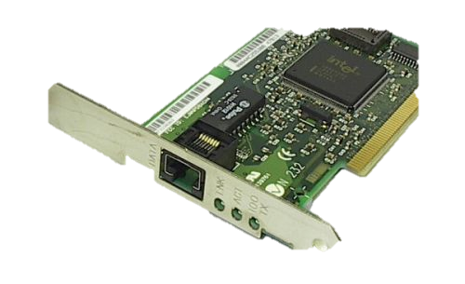
Demo Testbed
Run P4-XDP
Receiver 139
Sender 138
Linux kernel
4.10.0-rc7
IP: 2.2.2.9
16-core Intel Xeon
E5 2650 2.4GHz
32GB memory
Intel i40e driver
Intel X710 10GbE
Dual port i40e
Intel X710 10GbE
i40e driver with XDP patch
Linux kernel net-next 4.10.0-rc7
Due to two BPF verifier fixes
Plus our own 2 patches to increase BPF stack size to 4096
i40e XDP driver
V4 patch: http://patchwork.ozlabs.org/patch/706701/
Demo source code at, see demo*
https://github.com/williamtu/p4c-xdp/tree/master/tests/

Slide 22
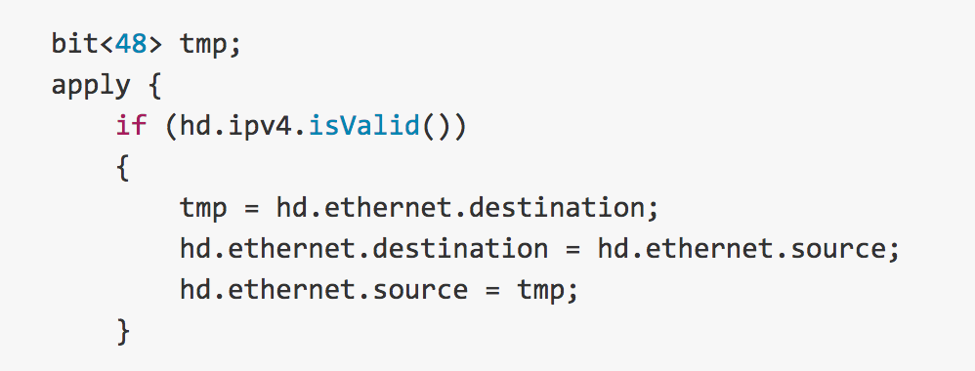
Demo1: Swap Ethernet (xdp11.p4)
Swap Ethernet source and destination
Send to the receiving interface (return XDP_TX)
Receiver
Swap Eth
Sender
XDP_TX
https://github.com/williamtu/p4c-xdp/blob/master/tests/xdp11.p4
https://youtu.be/On7hEJ6bPVU

Slide 23
Demo2: ping4/6 and stats (xdp12.p4)
Parse IPv4/IPv6 ICMP ping
Drop ipv6 ping, and return XDP_DROP
Demonstrate control plane
Update ipv4 statistics, and return XDP_PASS
https://github.com/williamtu/p4c-xdp/blob/master/tests/xdp12.p4
https://youtu.be/vlp1MzWVOc8
Notes:
# ip link set dev enp66s0f0 xdp obj xdp11.o verb
# ./xdp10

Slide 24
Demo3: Encapsulation (xdp16.p4)
Define a customized header
Insert the header in front of Ethernet (or any where you want)
header myhdr_t
{
bit<32> id;
bit<32> timestamp;
}
control Ingress(…) {
action TS_action()
{
hd.myhdr.ts = BPF_KTIME_GET_NS(); // BPF helper
hd.myhdr.id = 0xfefefefe;
xoutdrop = false; //XDP_PASS
}
ETH
IPv4
payload
Emit at deparser
my hdr
ETH
IPv4
payload
https://github.com/williamtu/p4c-xdp/blob/master/tests/xdp16.p4
https://youtu.be/TibGxCXPNVc
Notes:
action TS_action() {
hd.myhdr.ts = BPF_KTIME_GET_NS();
hd.myhdr.id = 0xfefefefe;
xoutdrop = false; }

Slide 25
Future Wok
Forward / broadcast /clone
Currently rely on TC (bpf_skb_clone_redirect)
XDP_FORWARD support in driver/kernel?
Recirculation
Add recirculation support in XDP driver
Return xdp_recirculate and tail call.
Use cases

Slide 26
Thank You
Questions?

