Slide 1
Interactive Parallel Data Visualization and Exploration
March 27, 2013
Mihai Budiu
Moises Goldszmidt
Jean-Philippe Martin
Mark Manasse
Alex Andoni
Gordon Plotkin
Qingzhuo Luo (intern 2012)

Slide 2
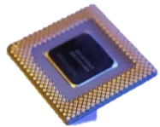



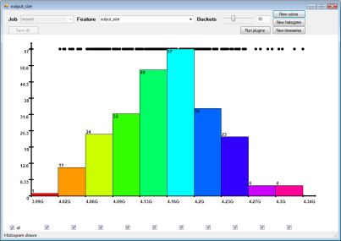
Cluster-Based Visualization
Data
RMI
Partial renderings
Rendering overlay
Client GUI
Multi-core
data extraction,
transformation rendering
Server workers

Slide 3
Data size
O(1)
RMI
Partial renderings
O(n)
Rendering overlay
O(1)
~1MPx = O(1)
Client GUI
Multi-core
data extraction,
transformation rendering
Server workers

Slide 4
Composable Interfaces
Client
IView
Cluster-level
parallelism
ParallelView
IView
IView
IView
ProxyView
ProxyView
LocalView
IView
IView
Multi-core-level
parallelism
ParallelView
ParallelView
IView
IView
IView
IView
IView
LocalView
LocalView
LocalView
LocalView
LocalView
Server 1
Server 2

Slide 5
Computing “Small” Results
Plot
Image
overlay
IDistribution
ParallelDistr
Plot
Image
Result size
independent
of the data size
IDistribution
Client
ProxyDistr
Plot
Image
overlay
Server
IDistribution
ParallelDistr
Image
Image
Plot
Plot
IDistribution
IDistribution
LocalDistr
LocalDistr

Slide 6
Computing “Big” Results
Filter
result
IDistribution
ParallelDistr
IDistribution
ParallelDistr
Filter
IDistribution
ProxyDistr
IDistribution
Data never moves
Client
ProxyDistr
Filter
Server
IDistribution
ParallelDistr
IDistribution
Filter
Filter
ParallelDistr
IDistribution
IDistribution
LocalDistr
LocalDistr
IDistribution
IDistribution
LocalDistr
LocalDistr

Slide 7
A Language of Linear Transformations
f : A → B, f(a + b) = f(a) + f(b)
Various + operations:
DB Tables, with union
Distributions, with union
Histograms, with pointwise addition
Transparent images with overlays
Timeseries, with union
Multisets, with pointwise addition
Top K values, with mergesort

Slide 8
Software Stack
client side
server side
Domain-specific App
Domain-specific
Data-structures
Plotting
Built-in structs (Distribution, View, Histogram, ScatterPlot, TimeSeries, ColorMap)
IView
IDistribution
IHistogram
IScatter
ITimeSeries
IColorMap
IPlot
X
ILocal
IParallel
IProxy
RMI
Object transport

Slide 9
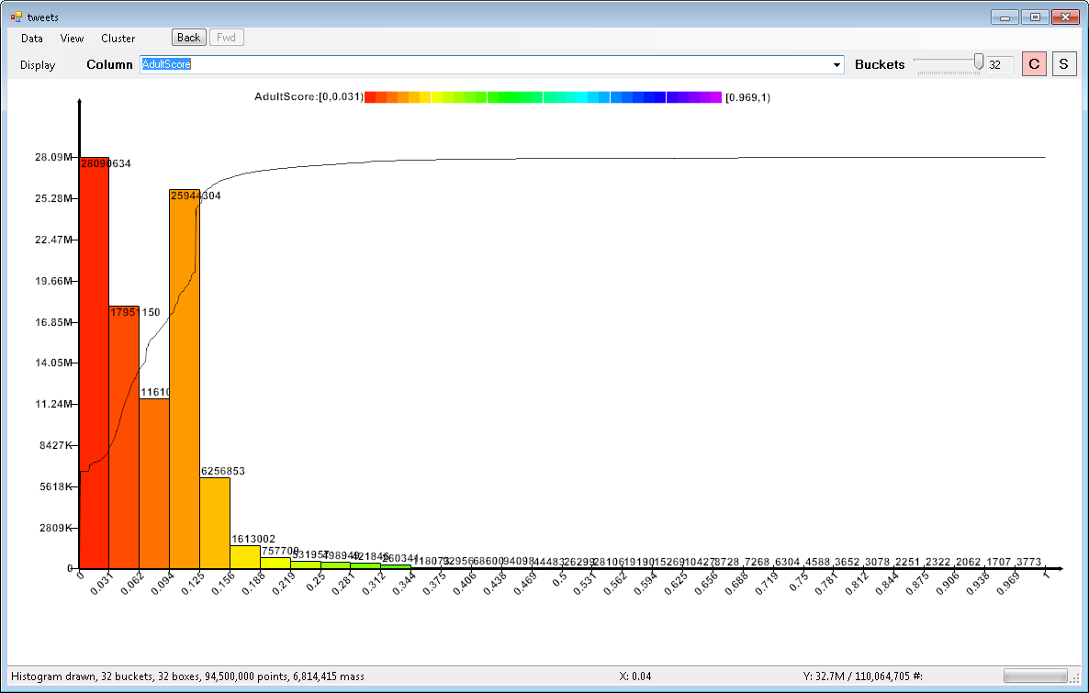
Running on 700 cores

Slide 10
