Slide 1




Spatial Computation
Mihai Budiu
CMU CS
Thesis committee:
Seth Goldstein
Peter Lee
Todd Mowry
Babak Falsafi
Nevin Heintze
Ph.D. Thesis defense, December 8, 2003
SCS
Notes:
sky image courtesy of NASA

Slide 2
Spatial Computation
A model of general-purpose computation
based on Application-Specific Hardware.
Thesis committee:
Seth Goldstein
Peter Lee
Todd Mowry
Babak Falsafi
Nevin Heintze
Ph.D. Thesis defense, December 8, 2003
SCS
Notes:
Definition of Spatial Computation.

Slide 3
Thesis Statement
Application-Specific Hardware (ASH):
can be synthesized by adapting software compilation for predicated architectures,
provides high-performance for programs with
high ILP, with very low power consumption,
is a more scalable and efficient computation substrate than monolithic processors.
not!

Slide 4

Outline
Introduction
Compiling for ASH
Media processing on ASH
ASH vs. superscalar processors
Conclusions
Notes:
Handshake image from www.247mail.com/why.html

Slide 5
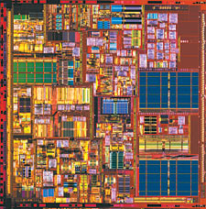
CPU Problems
Complexity
Power
Global Signals
Limited ILP
Notes:
This research addresses some limitations of the (superscalar) microprocessor structure.
Complexity = of design, verification, manufacturing.

Slide 6
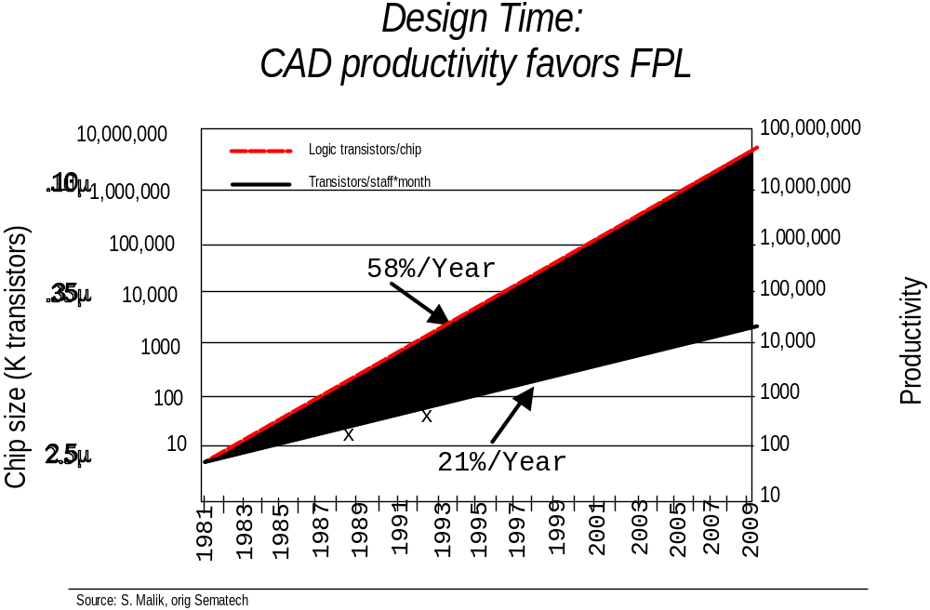
Design Complexity
from Michael Flynn’s FCRC 2003 talk
Notes:
Design complexity outpaces productivity increase. A slide from Michael Flynn’s FCRC plenary presentation.

Slide 7
Communication vs. Computation
gate
wire
5ps
20ps
Power consumption on wires is also dominant
Notes:
Gates are cheap and wires expensive at very high clock speeds.

Slide 8
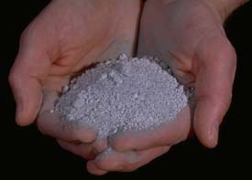
Our Approach: ASH
Application-Specific Hardware
Notes:
Volcanic ash Image from http://www.geology.sdsu.edu/how_volcanoes_work/Tephra.html

Slide 9
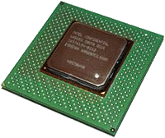
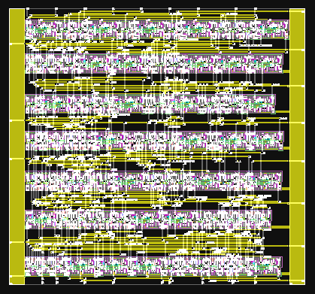
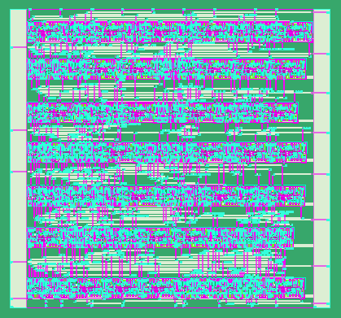
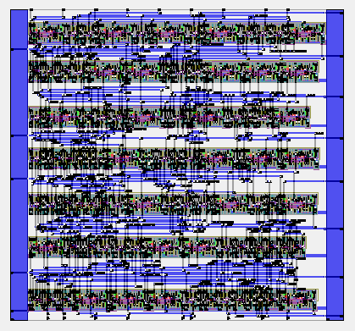
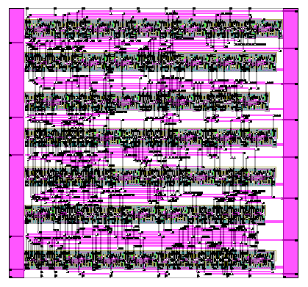
Resource Binding Time
1.
1.
Programs
2.
Programs
2.
CPU
ASH
Notes:
We take advantage of the fact that we create hardware *after* the program is known.

Slide 10

Hardware Interface
software
software
ISA
virtual ISA
gates
hardware
hardware
CPU
ASH
Notes:
We escape the “tyranny of the ISA”. This makes compilation more difficult.

Slide 11
Application-Specific Hardware
C program
Dataflow IR
Compiler
dataflow machine
Reconfigurable/custom hw
Notes:
The dataflow machine generated is very close semantically to the internal compiler representation.

Slide 12
Contributions
Computer
architecture
Embedded
systems
Reconfigurable
computing
Compilation
Asynchronous
circuits
High-level
synthesis
Nanotechnology
Dataflow
machines
systems
theory
Notes:
This research makes most contributions in the area of optimizing compilation, but brings new insights into other areas as well.

Slide 13

Outline
Introduction
CASH: Compiling for ASH
Media processing on ASH
ASH vs. superscalar processors
Conclusions

Slide 14
Computation = Dataflow
Programs
Circuits
a
7
x = a & 7;
...
y = x >> 2;
&
2
x
>>
Operations ) functional units
Variables ) wires
No interpretation
Notes:
We do not have the disadvantages of the traditional dataflow machine model, because we implement the machines directly in hardware.

Slide 15
Basic Operation
+
latch
data
ack
valid
Notes:
Both the internal representation and the synthesized circuit are built from such constructs.

Slide 16
Asynchronous Computation
+
+
+
+
data
ack
1
valid
2
3
4
+
+
+
+
latch
5
6
7
8
Notes:
Asynchronous computation is triggered by data availability; it is completely dynamically scheduled.

Slide 17
Distributed Control Logic
FSM
ack
rdy
+
-
short, local wires
asynchronous control
Notes:
There is no centralized FSM controlling the behavior of the circuit; each producer-consumer pair has some control logic for handshaking, and that is all.
(There is however also logic for memory access, which features some global structures and arbitration.)

Slide 18
Forward Branches
b
x
0
if (x > 0)
y = -x;
else
y = b*x;
*
-
>
!
y
Conditionals ) Speculation
critical path
Notes:
Conditionals are compiled into circuits executing simultaneously all branches.

Slide 19
Control Flow ) Data Flow
data
Merge (label)
data
data
predicate
Gateway
p
Split (branch)
!
Notes:
Note: in reality the merge operator is slightly more complicated than described here, since multiple merge operators sometimes need to cooperate in order to correctly execute the program.
The merge is also called “mu”, while the gateway is also called “eta”.

Slide 20
Loops
0
i
0
*
+1
int sum=0, i;
for (i=0; i < 100; i++)
sum += i*i;
return sum;
< 100
sum
+
return sum;
!
ret
Notes:
Loops can be built using merges and gateways as building blocks. Some gateways direct the data to the beginning of the loop while other direct the data out of the loop (red). They are controlled by complementary predicates.

Slide 21
Predication and Side-Effects
addr
token
sequencing
of side-effects
no speculation
Load
to
memory
pred
data
token
Notes:
Side-effect operations are predicated (never speculated).
The lack of a PC, i.e., program order, mandates the use of another mechanism to preserve correctness; this is the flow of tokens.
Tokens are both a compile-time and run-time construct. This is one instance where we do things an ISA would not allow.

Slide 22

Thesis Statement
Application-Specific Hardware:
can be synthesized by adapting software compilation for predicated architectures,
provides high-performance for programs with
high ILP, with very low power consumption,
is a more scalable and efficient computation substrate than monolithic processors.
not!

Slide 23
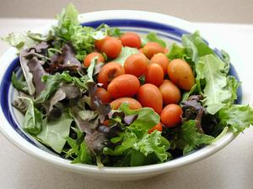
Outline
Introduction
CASH: Compiling for ASH
  An optimization on the SIDE
Media processing on ASH
ASH vs. superscalar processors
Conclusions
skip to
Notes:
Salad image from www.amgmedia.com/freephotos/salad.jpg

Slide 24
Availability Dataflow Analysis
y = a*b;
...
if (x) {
...
... = a*b;
}
y
Notes:
Replace expressions already computed with scalar values.

Slide 25
Dataflow Analysis Is Conservative
if (x) {
...
y = a*b;
}
...
... = a*b;
y?
Notes:
Conservativeness must assume that the expression is not available.

Slide 26
Static Instantiation,
Dynamic Evaluation
flag = false;
if (x) {
...
y = a*b;
flag = true;
}
...
... = flag ? y : a*b;
Notes:
Solution: maintain dynamically the availability state of an expression; predicate its re-computation.

Slide 27
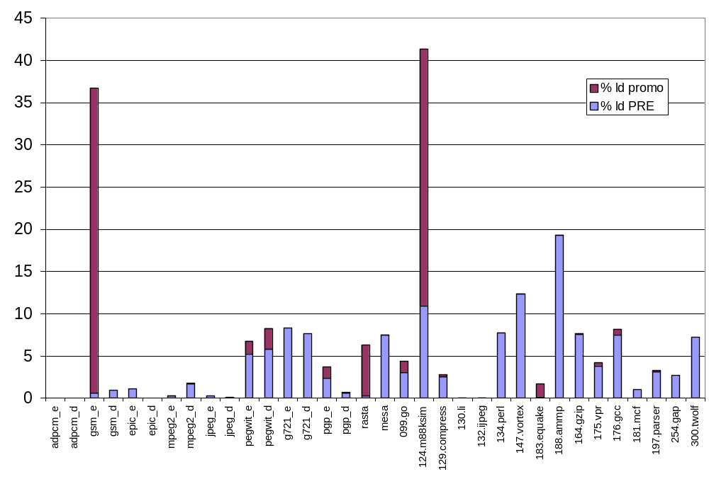
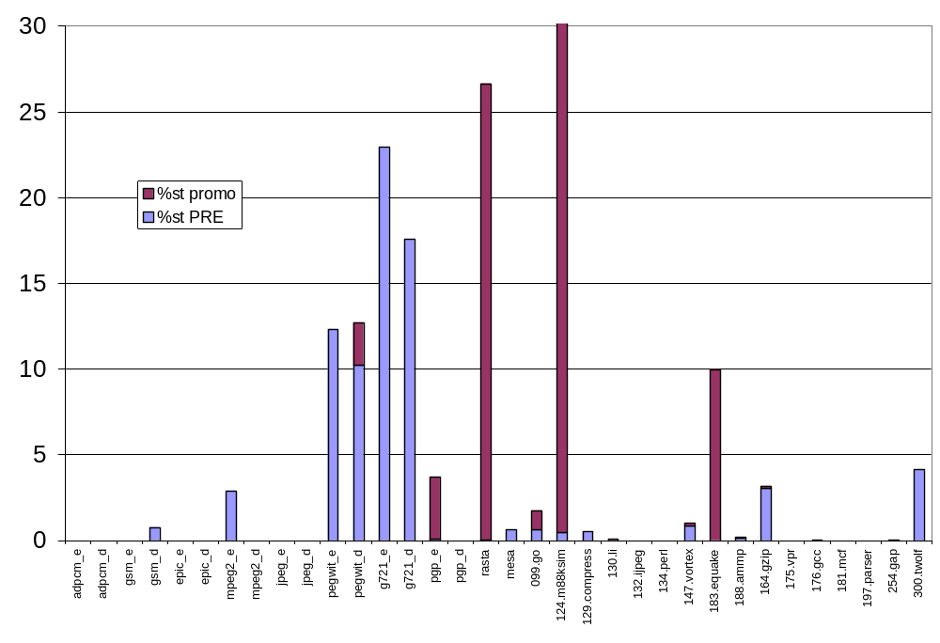
SIDE Register Promotion Impact
Loads
% reduction
Stores
Notes:
We applied SIDE to memory access removal through register promotion; it can be very effective.

Slide 28

Outline
Introduction
CASH: Compiling for ASH
Media processing on ASH
ASH vs. superscalar processors
Conclusions
Notes:
Photo taken and processed by me.

Slide 29
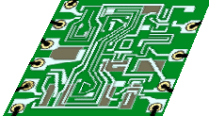
Performance Evaluation
Mem
L2
1/4M
ASH
L1
8K
LSQ
limited BW
CPU: 4-way OOO
Assumption: all operations have the same latency.
Notes:
We compare ASH and a 4-way superscalar by connecting them to the same memory hierarchy.
We also assume (for most of the evaluations) that the operation latencies are identical.
Ideally we’d like to compare ASH and a VLIW, but we didn’t have access handy to a VLIW simulator.

Slide 30
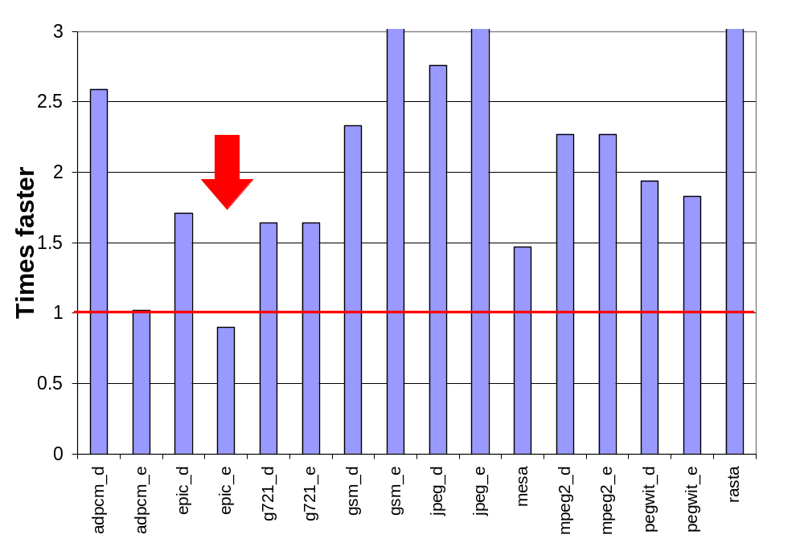
Media Kernels, vs 4-way OOO
Notes:
This data is just for the kernels.
Kernels were selected manually to be the hottest 1, 2, or 3 functions in each application.
See the thesis for details on these kernels.
Only one kernel exhibits a slowdown.

Slide 31
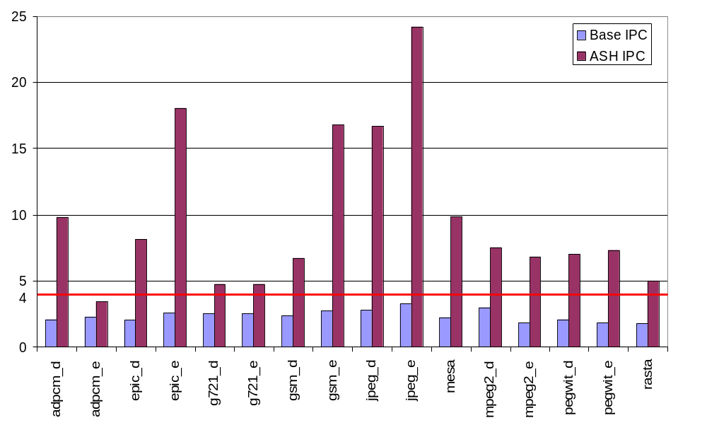
Media Kernels, IPC
Notes:
ASH can sustain very high parallelism for these kernels.

Slide 32
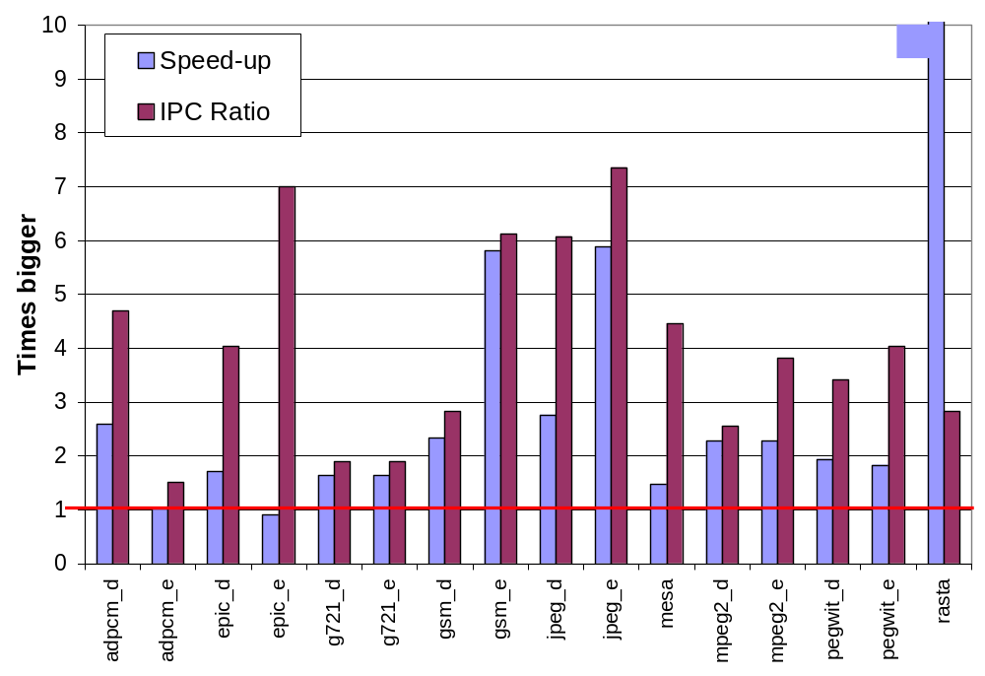
Speed-up / IPC Correlation
Notes:
This graph compares speed-up and parallelism increase; i.e., how much parallelism we waste for getting the speed-up.
Note that the parallelism includes speculative execution.
epic_e is a very bad case: lots of useless speculation.
rasta is a great case; it results from the register promotion generating much better code than for the processor.

Slide 33
Low-Level Evaluation
C
CASH
core
Results shown so far.
All results in thesis.
Verilog
back-end
Synopsys,
Cadence P/R
180nm std. cell library, 2V
~1999
technology
Results in the next two slides.
ASIC
Notes:
We compare the truly asynchronous circuits generated with a 600Mhz 4-way OOO superscalar based on SimpleScalar + Wattch.
This is preliminary data; this back-end is still under development.
The Verilog back-end was written entirely by Girish Venkataramani.

Slide 34
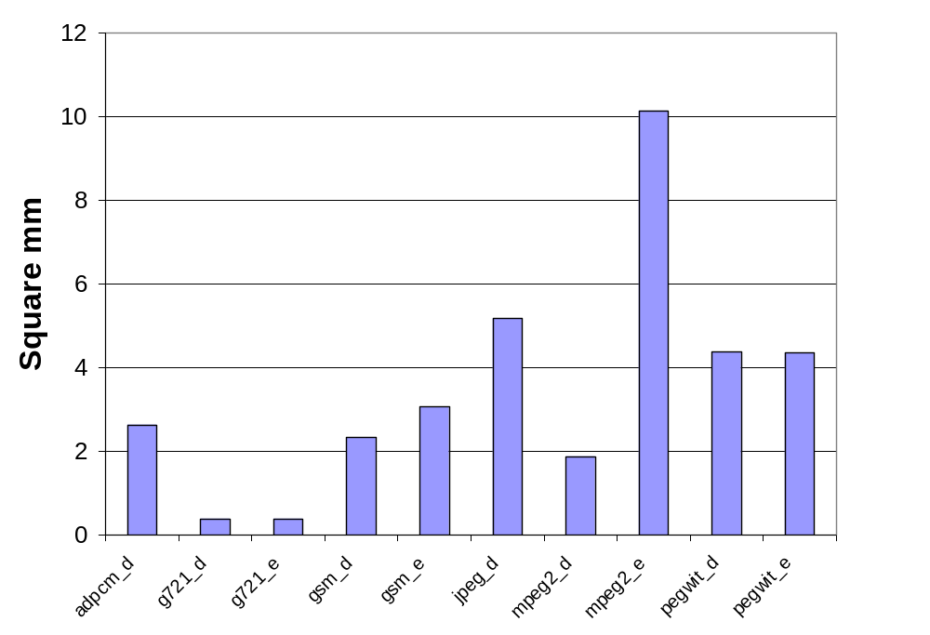
Area
Reference: P4 in 180nm has 217mm²
Notes:
These values are for slightly different kernels: for each program exactly one function was selected.
This data includes aggressive loop unrolling.

Slide 35
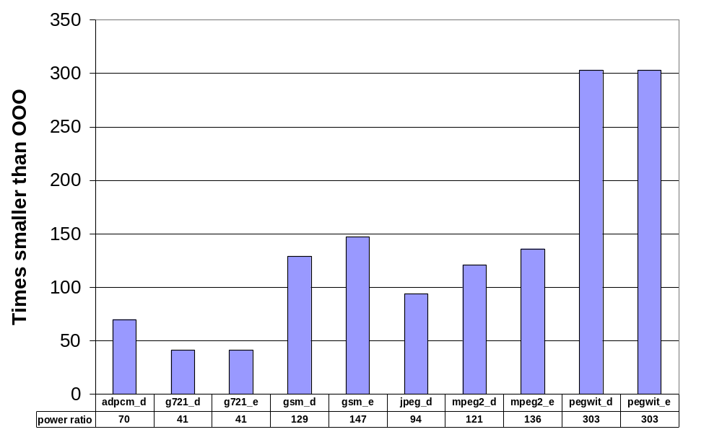
Power
vs 4-way OOO superscalar, 600 Mhz, with clock gating (Wattch), ~ 6W
Notes:
These values are not percents!
Bigger is better.

Slide 36
Thesis Statement
Application-Specific Hardware:
can be synthesized by adapting software compilation for predicated architectures,
provides high-performance for programs with
high ILP, with very low power consumption,
is a more scalable and efficient computation substrate than monolithic processors.
not!

Slide 37
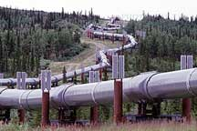
Outline
Introduction
CASH: Compiling for ASH
Media processing on ASH
  dataflow pipelining
ASH vs. superscalar processors
Conclusions
skip to
Notes:
What is the source of parallelism in ASH?
Pipeline image from www.bfi.org/Trimtab/winter02/ brittleTimes.htm

Slide 38
Pipelining
i
1
*
100
+
<=
pipelined
multiplier
(8 stages)
int sum=0, i;
for (i=0; i < 100; i++)
sum += i*i;
return sum;
sum
+
cycle=1
Notes:
Let us look how the sum-of-squares program behaves at run-time.

Slide 39
Pipelining
i
1
*
100
+
<=
sum
+
cycle=2

Slide 40
Pipelining
i
1
*
100
+
<=
sum
+
cycle=3

Slide 41
Pipelining
i
1
*
100
+
<=
sum
+
cycle=4

Slide 42
Pipelining
i
1
i=1
100
+
<=
i=0
sum
+
cycle=5
pipeline balancing
Notes:
Pipelining occurs naturally, due to the asynchronous nature of the computation.
This phenomenon was exploited by the dataflow machines

Slide 43
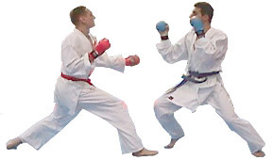
Outline
Introduction
CASH: Compiling for ASH
Media processing on ASH
ASH vs. superscalar processors
Conclusions
Notes:
Now we perform a limit-study to see the potential of ASH on whole-programs.
Karate fighters image from http://www.enighet.se/karate.htm

Slide 44
This Is Obvious!
wrong!
ASH runs at full dataflow speed,
so CPU cannot do any better
(if compilers equally good).
Notes:
There was already a hint in the epic_e kernel which was doing worse than a 4-way OOO.

Slide 45
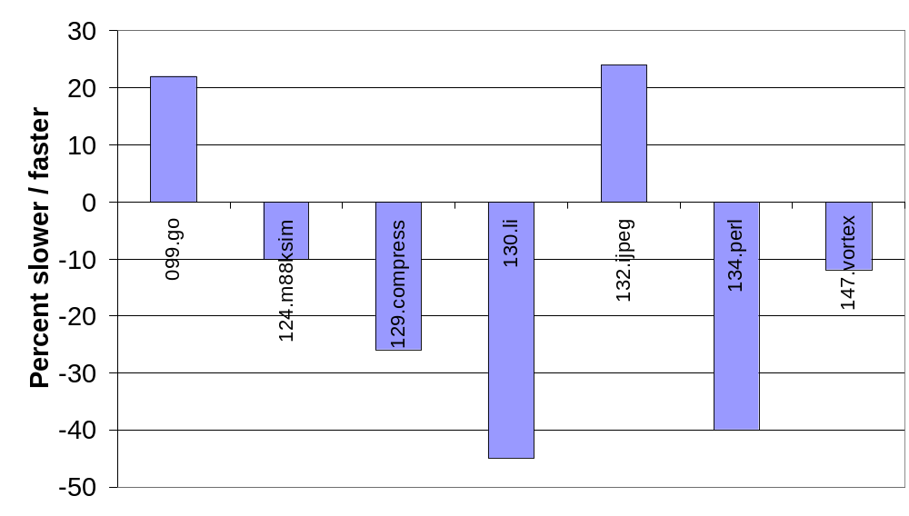
SpecInt95, ASH vs 4-way OOO
Notes:
For most of SpecInt95 ASH underperforms OOO.
This data is again with the high-level simulation model in which everything is assumed equal.

Slide 46
Branch Prediction
i
ASH crit path
1
CPU crit path
+
for (i=0; i < N; i++) {
...
if (exception) break;
}
<
exception
!
&
Predicted not taken
Effectively a noop for CPU!
Predicted taken.
result available before inputs
Notes:
(Successful) branch prediction in processor renders some computations irrelevant.
Since we transformed control-flow into dataflow, the gateway predicate is on the critical path for ASH, but not for processor!
In the thesis we suggest a way to add a limited form of branch-prediction to ASH without destroying its distributed structure.
The hard part is not prediction, but stopping runaway speculation which crosses hyperblock boundaries.

Slide 47
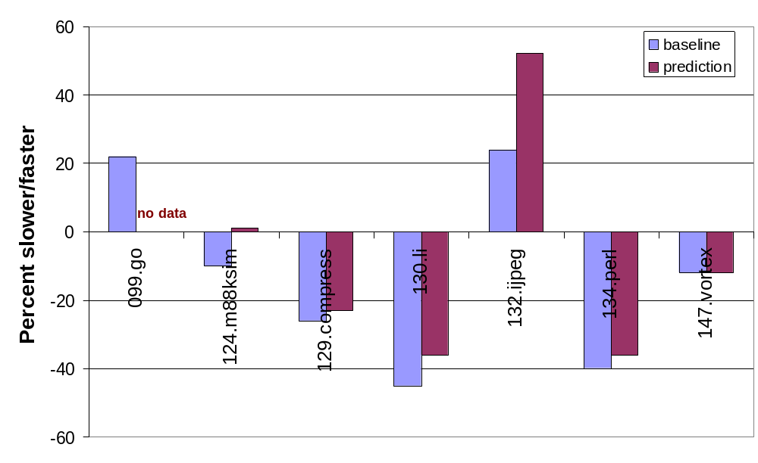
SpecInt95, perfect prediction
Notes:
Unfortunately even branch prediction does not redeem ASH.

Slide 48
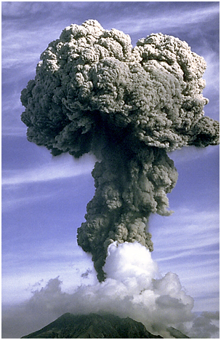
ASH Problems
Both branch and join not free
Static dataflow
(no re-issue of same instr)
Memory is “far”
Fully static
  No branch prediction
  No dynamic unrolling
  No register renaming
Calls/returns not lenient
...
Notes:
Photo of volcanic ash from http://photo2.si.edu/earthquakes/sakurajima.html
Other problems plague ASH. Some are inherent in the distributed structure, and some could be fixed with changes in the model/compiler.

Slide 49
Thesis Statement
Application-Specific Hardware:
can be synthesized by adapting software compilation for predicated architectures,
provides high-performance for programs with
high ILP, with very low power consumption,
is a more scalable and efficient computation substrate than monolithic processors.
not!

Slide 50
Outline
Introduction
CASH: Compiling for ASH
Media processing on ASH
ASH vs. superscalar processors
Conclusions

Slide 51
Strengths
low power
simple verification?
specialized to app.
unlimited ILP
simple hardware
no fixed window
economies of scale
highly optimized
branch prediction
control speculation
full-dataflow
global signals/decision

Slide 52
Conclusions
Compiling “around the ISA” is a fruitful research approach.
Distributed computation structures require more synchronization overhead.
Spatial Computation efficiently implements high-ILP computation with very low power.

Slide 53
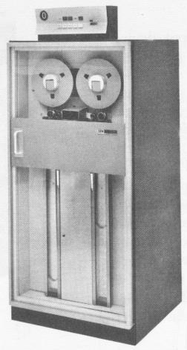
Backup Slides
Control logic
Pipeline balancing
Lenient execution
Dynamic Critical Path
Memory PRE
Critical path analysis
CPU + ASH

Slide 54
Control Logic
rdy_{in}
C
C
ack_{in}
Δ
ack_{out}
Δ
rdy_{out}
data_{in}
Reg
data_{out}
back
back to talk
Notes:
Typical micropipelines.
The rdy and ack signals may have fan-out/fan-in.

Slide 55
Last-Arrival Events
Event enabling the
generation of a result
May be an ack
Critical path=collection
of last-arrival edges
+
data
ack
valid

Slide 56
Dynamic Critical Path
Some edges may repeat
Trace back along
last-arrival edges
Start from last node
back
back to analysis
Notes:
See Fields & Bodik’s seminal ISCA 2001 paper.

Slide 57
Critical Paths
b
x
0
if (x > 0)
y = -x;
else
y = b*x;
*
-
>
!
y
Notes:
Speculation introduces the problem of long critical paths. The solution is on the next slide.

Slide 58
Lenient Operations
b
x
0
if (x > 0)
y = -x;
else
y = b*x;
*
-
>
!
y
Solve the problem of unbalanced paths
back
back to talk
Notes:
A lenient operation can generate the result before all of its inputs are known.
Leniency reduces the dynamic critical path.

Slide 59
Pipelining
i
1
*
100
+
i=1
<=
i=0
sum
+
cycle=6
Notes:
Pipelining may suffer from stalls due to unbalanced lengths of paths.
The thesis presents a general solution called “pipeline balancing”.

Slide 60
Pipelining
i
1
*
100
+
<=
i’s loop
Long
latency
pipe
predicate
sum
sum’s loop
+
cycle=7
Notes:
The i loop is coupled to the sum loop through the predicate. The acknowledgment
for the predicate prevents i’s loop from making progress.

Slide 61
Pipelining
i
1
*
100
+
critical path
<=
i’s loop
Predicate ack
edge is on the
critical path.
sum
sum’s loop
+
Notes:
The critical path of this circuit actually goes through an acknowledgment edge.

Slide 62
Pipelinine balancing
i
1
*
100
+
i’s loop
<=
decoupling
FIFO
sum
sum’s loop
+
cycle=7
Notes:
By inserting FIFO stages on the predicate path we can decouple the two loops.

Slide 63
Pipelinine balancing
i
1
*
100
+
i’s loop
critical path
<=
decoupling
FIFO
sum
sum’s loop
+
back
back to presentation
Notes:
The critical path is minimal for the resulting circuit, implying maximal performance.

Slide 64
Register Promotion
(p1)
*p=…
(p1)
*p=…
(p2)
(p2 Æ : p1)
…=*p
…=*p
φ
Load is executed only if store is not
Notes:
The load predicate is weakened.

Slide 65
Register Promotion (2)
(p1)
*p=…
(p1)
*p=…
(false)
…=*p
(p2)
…=*p
When p2 ) p1 the load becomes dead...
...i.e., when store dominates load in CFG
back
Notes:
As a particular case of the previous optimization, if whenever the load predicate is true the store predicate is as well, the load can be completely removed. It is removed by the dead-code optimization, since its predicate becomes false. This optimization can be generalized for the case of multiple stores preceding the load.

Slide 66
¼ PRE
(p1)
...=*p
(p2)
...=*p
(p1 Ç p2)
...=*p
This corresponds in the CFG to lifting the load
to a basic block dominating the original loads
Notes:
The same optimization can be applied to loads as well.
The code is basically the same as for common-subexpression elimination in an SSA form.
(Technicality: to enable this transformation no predicate must depend on the other operation. Easily checked with a reachability computation.)

Slide 67
Store-store (1)
(p1)
*p=…
(p1 Æ : p2)
*p=…
(p2)
*p=...
(p2)
*p=...
When p1 ) p2 the first store becomes dead...
...i.e., when second store post-dominates first in CFG
Notes:
In this case the predicate of the first store is weakened, so that it is never executed when the second one will overwrite it.

Slide 68
Store-store (2)
(p1)
*p=…
(p1 Æ : p2)
*p=…
(p2)
*p=...
(p2)
*p=...
Token edge eliminated, but...
...transitive closure of tokens preserved
back
Notes:
Since the two predicates are now disjoint, the two stores can never occur simultaneously, so there is no need for a token edge between them.
Notice that the removal of the token edge is not trivial.

Slide 69
A Code Fragment
for(i = 0; i < 64; i++) {
for (j = 0; X[j].r != 0xF; j++)
if (X[j].r == i)
break;
Y[i] = X[j].q;
}
SpecINT95:124.m88ksim:init_processor, stylized
Notes:
A sample analysis of bottlenecks in ASH.

Slide 70
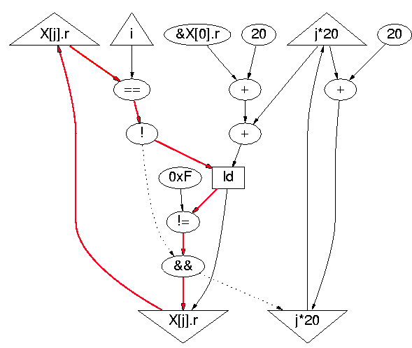
Dynamic Critical Path
definition
sizeof(X[j])
load predicate
loop predicate
for (j = 0; X[j].r != 0xF; j++)
if (X[j].r == i)
break;
Notes:
Critical path contains control-flow (i.e., eta) predicate.

Slide 71
MIPS gcc Code
LOOP:
L1: beq $v0,$a1,EXIT ; X[j].r == i
L2: addiu $v1,$v1,20 ; &X[j+1].r
L3: lw $v0,0($v1) ; X[j+1].r
L4: addiu $a0,$a0,1 ; j++
L5: bne $v0,$a3,LOOP ; X[j+1].r == 0xF
EXIT:
for (j = 0; X[j].r != 0xF; j++)
if (X[j].r == i)
break;
L1! L2 ! L3 ! L5 ! L1
4-instructions loop-carried dependence
Notes:
Processor critical path also spans two branches.

Slide 72
If Branch Prediction Correct
LOOP:
L1: beq $v0,$a1,EXIT ; X[j].r == i
L2: addiu $v1,$v1,20 ; &X[j+1].r
L3: lw $v0,0($v1) ; X[j+1].r
L4: addiu $a0,$a0,1 ; j++
L5: bne $v0,$a3,LOOP ; X[j+1].r == 0xF
EXIT:
for (j = 0; X[j].r != 0xF; j++)
if (X[j].r == i)
break;
L1! L2 ! L3 ! L5 ! L1
Superscalar is issue-limited!
2 cycles/iteration sustained
Notes:
But not if branch prediction guesses their outcome. If it does, the critical path is 1 instruction long!

Slide 73
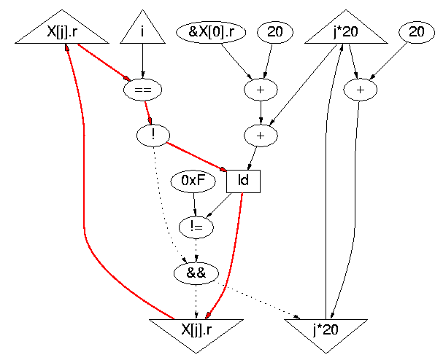
Critical Path with Prediction
Loads are not
speculative
for (j = 0; X[j].r != 0xF; j++)
if (X[j].r == i)
break;
Notes:
When predicting the load-controlling predicate is on the critical path.

Slide 74
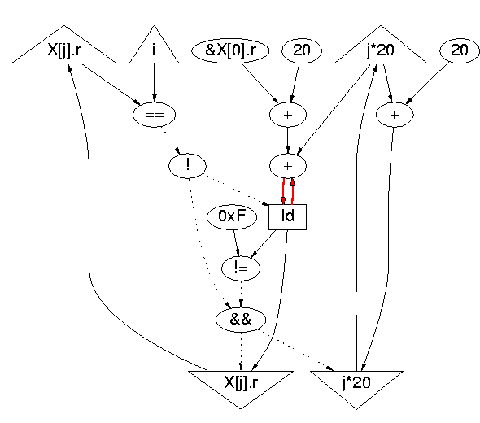
Prediction + Load Speculation
ack edge
~4 cycles!
Load not pipelined
(self-anti-dependence)
for (j = 0; X[j].r != 0xF; j++)
if (X[j].r == i)
break;
Notes:
When we allow loads to issue speculatively (as a processor also does), the critical path contains an ack edge, because the latency of the load is 3 cycles.
There is a dependence between the output register of the load in different iterations.

Slide 75
OOO Pipe Snapshot
LOOP:
L1: beq $v0,$a1,EXIT ; X[j].r == i
L2: addiu $v1,$v1,20 ; &X[j+1].r
L3: lw $v0,0($v1) ; X[j+1].r
L4: addiu $a0,$a0,1 ; j++
L5: bne $v0,$a3,LOOP ; X[j+1].r == 0xF
EXIT:
register
renaming
IF
DA
EX
WB
CT
L5
L1
L2
L1
L2
L3
L4
L1
L3
L5
L3
L2
L1
L3
L3
Notes:
A processor however can have multiple instances of the load simultaneously active, since each uses a different physical register, due to register renaming.

Slide 76

Unrolling?
for(i = 0; i < 64; i++) {
for (j = 0; X[j].r != 0xF; j+=2) {
if (X[j].r == i)
break;
if (X[j+1].r == 0xF)
break;
if (X[j+1].r == i)
break;
}
Y[i] = X[j].q;
}
when 1 iteration
back
back to talk
Notes:
Unrolling does not help when the number of iterations may be small.
Overhead projector image from staples.com

Slide 77
Ideal Architecture
CPU
ASH
Low ILP computation
+ OS
+ VM
High-ILP
computation
Memory
back
Notes:
CPUs are very convenient; they will probably be around forever, but they will not evolve as fast as in the past.
We can envision delegating to them “fringe” jobs, while we run the core computation on the ASH fabrics.

