Slide 1
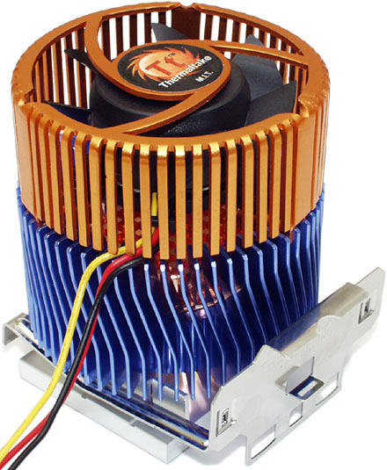
On The Energy Efficiency of Computation
Mihai Budiu
CMU CS
CALCM Seminar
Feb 17, 2004
Note: this version fixes some errors in the ASH performance graphs shown
Notes:
CPU cooler picture from http://www.dansdata.com/images/coolercomp/dragorb440.jpg

Slide 2
Presentation Setup
main( )
{
signal(SIGINT, welcome);
while (slides( ) && time( )) {
talk( );
}
}
Notes:
I welcome interruptions.

Slide 3
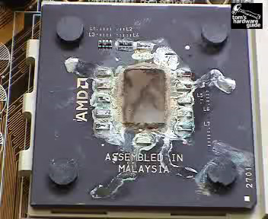
Why Do We Care?
Toasted CPU: about 2 sec after removing cooler.
(Tom’s Hardware Guide)
Notes:
http://www6.tomshardware.com/cpu/20010917/heatvideo-05.html

Slide 4
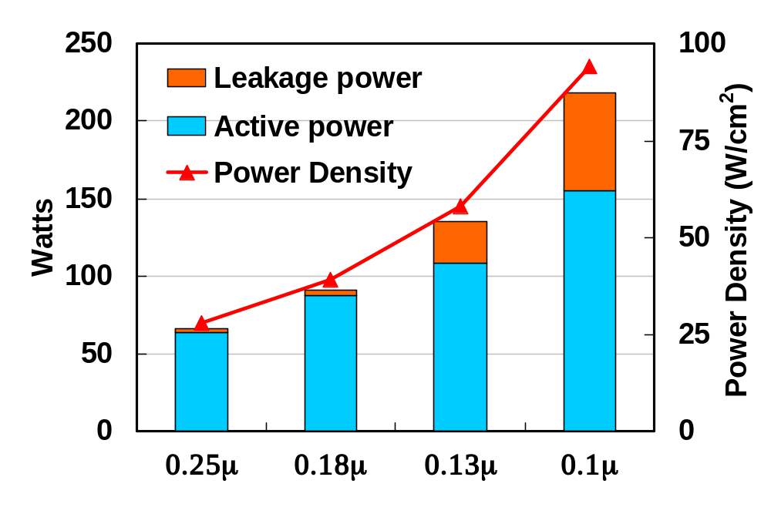
Power and Power Density
Assuming constant die size, no power management
Data from Fred Polack, Intel, MICRO 32

Slide 5
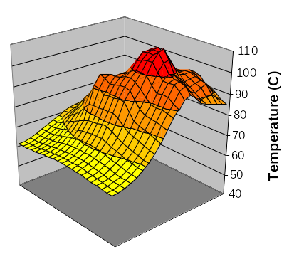
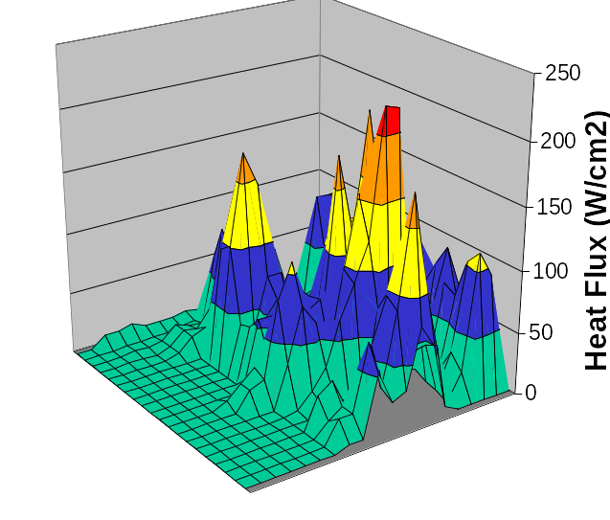
Power Density Distribution
Chip surface
Data from Fred Polack, Intel, MICRO 32

Slide 6
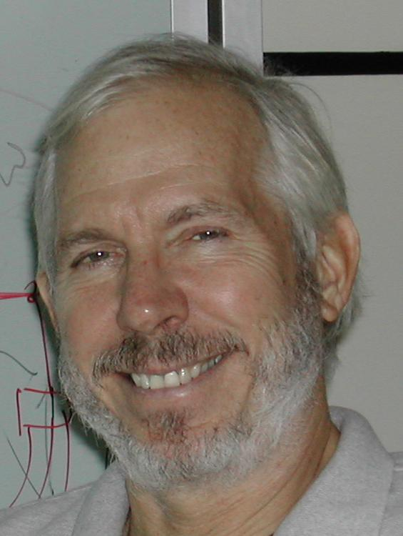
Outline
Introduction
Power and Energy Efficiency
  data from Bob Brodersen,
  Berkeley wireless group
Synchronous Hardware Efficiency
Asynchronous Hardware Efficiency
ASH Efficiency
Conclusions
Notes:
Zhang & Brodersen paper is available at http://bwrc.eecs.berkeley.edu/Classes/EE225C/Papers/arch_design.doc

Slide 7
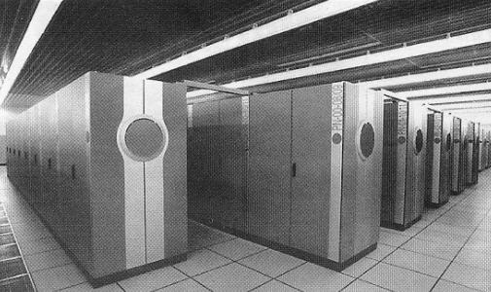

Energy Efficiency Metric
How much computing
can we can do...
...with a finite energy source?
Notes:
Supercomputer image from http://www.meteoestremo.com/sito/articoli/images/2/supercomputer.jpg
Battery image from http://www.allelectronics.com/images/gold/full/NCB-AAA.jpg

Slide 8
Some Arithmetic

Slide 9
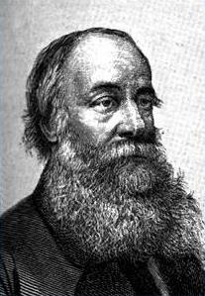
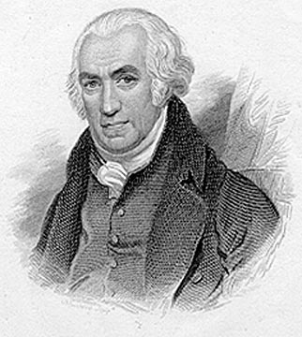
Energy and Power Efficiency
OP/nJ = MOPS/mW
Joule
Watt
The energy efficiency metric for energy constrained applications (OP/nJ) =
thermal (power) considerations when maximizing throughput (MOPS/mW).
Notes:
James Joule Prescott image from www.sciencetrek.net/joule.htm
James Watt Image from http://www.thesciencebookstore.com/links.asp

Slide 10
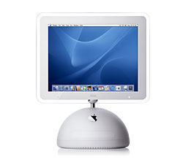
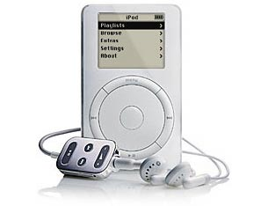

ISSCC Chips (.18μm-.25μm)
Microprocessors
DSP’s
Dedicated
#
Year
Description
#
Year
Description
#
Year
Description
1
1997
S/390
9
1998
StrongArm
16
2001
Encryption Processor
2
2000
PPC (SOI)
10
2000
Comm
17
2000
Hearing Aid Processor
3
1999
G5
11
1998
Graphics
18
2000
FIR for Disk Read Head
4
2000
G6
12
1998
Multimedia
19
1998
MPEG Encoder
5
2000
Alpha
13
2000
Multimedia
20
2002
802.11a Baseband
6
1998
P6
14
2002
Mpg decoder
7
1998
Alpha
15
1998
Multimedia
8
1999
PPC
Notes:
Device images from apple.com

Slide 11
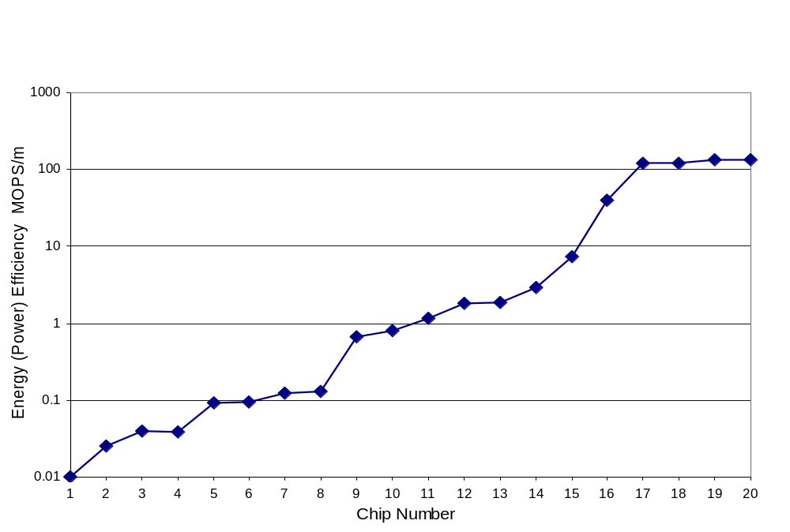
Energy Efficiency (MOPS/mW or OP/nJ)
3 orders of
magnitude!

Slide 12
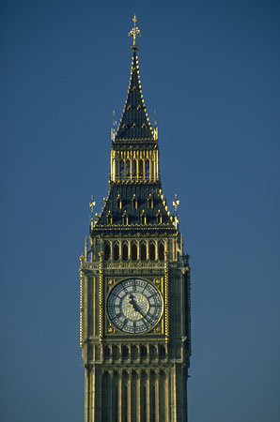
Outline
Introduction
Power and Energy Efficiency
Synchronous Hardware Efficiency
Asynchronous Hardware Efficiency
ASH Efficiency
Conclusions

Slide 13
Explaining the Difference
Operations per second:
MOPS = f_{clk} £ N _{op}
Operations per clock
Power:
P_{chip} = A_{chip} £ C_{sw} £ V_{dd}² £ f_{clk}
Normalized switched capacitance
Efficiency:
MOPS/P_{chip}= (f_{clk} £ N_{op} )/ (A_{chip} £ C_{sw} £ V_{dd}² £ f_{clk} )
=1/(A_{op} £ C_{sw} £ V_{dd}²)
Chip area per operation

Slide 14
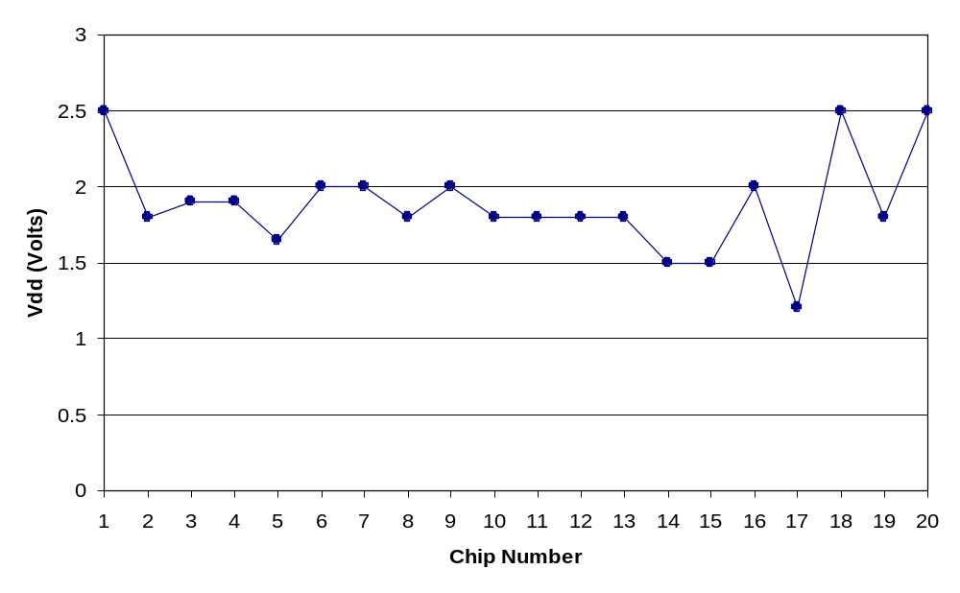
Supply Voltage, V_{dd}
MOPS/P_{chip} =1/(A_{op} £ C_{sw} £ V_{dd}²)

Slide 15
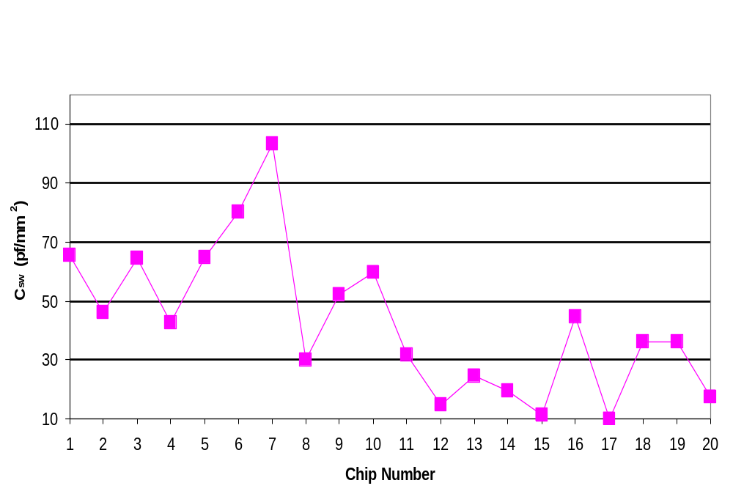
Normalized Switched Capacitance, C_{sw}
3x
MOPS/P_{chip} =1/(A_{op} £ C_{sw} £ V_{dd}²)

Slide 16
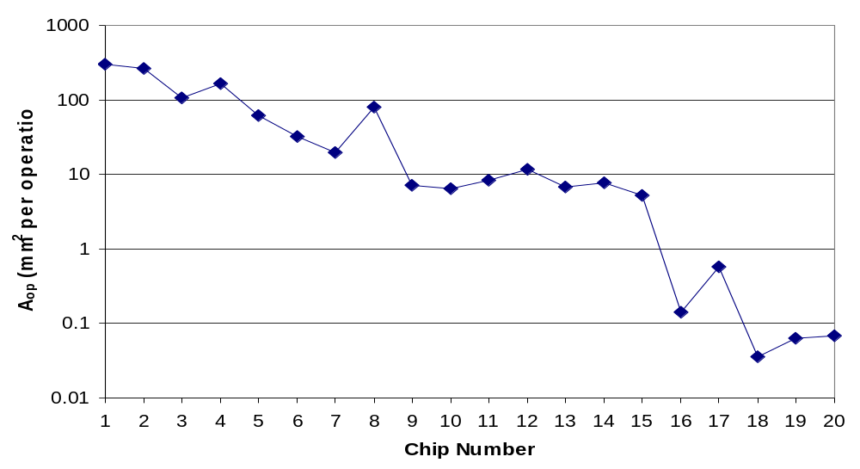
Area per operation, A_{op}
AHA!
MOPS/P_{chip} =1/(A_{op} £ C_{sw} £ V_{dd}²)
A_{op} = A_{chip}/N_{op}

Slide 17
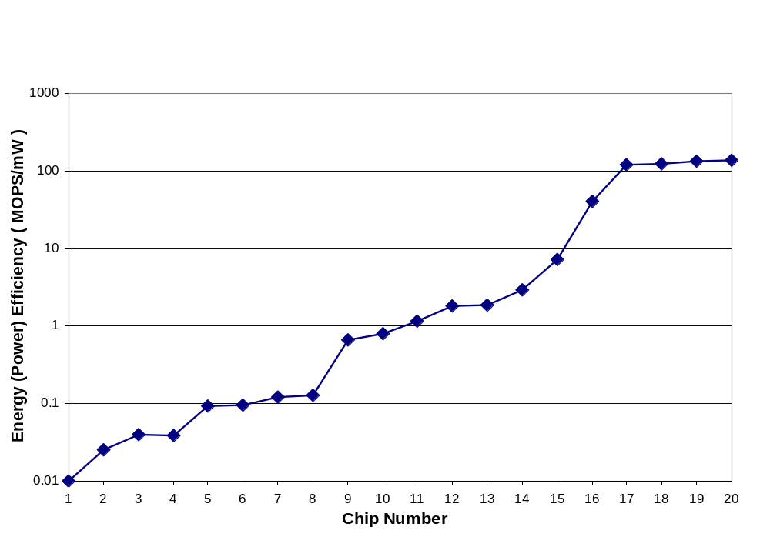
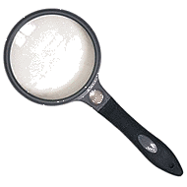
Focusing In
802.11a
NEC
DSP
PPC
Notes:
Magnifying glass image source unrecorded

Slide 18
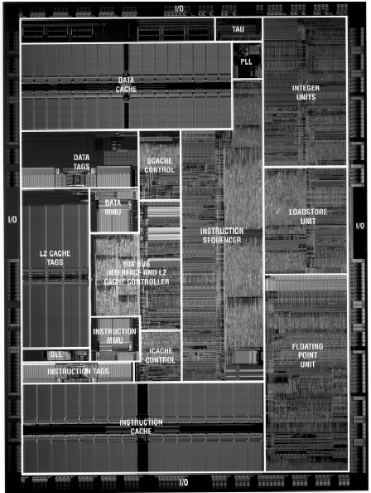
μP: MOPS/mW=.13
Useful arithmetic
N_{op} = 2 (two ways)
f_{clock} = 450 MHz
) 900 MIPS
A_{op} = A_{chip}/2= 42mm²
Power = 7 Watts
Notes:
Image from Bob Brodersen

Slide 19
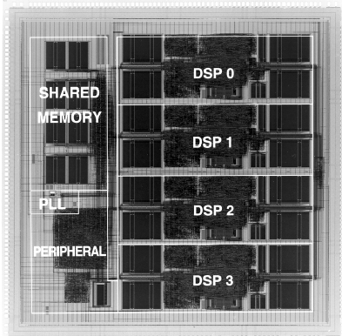
DSP: MOPS/mW=7
4 processors £ 4 ops each
N_{op} = 16
f_{clock} = 50 MHz
) 800 MOPS
A_{op} = A_{chip}/16= 5.3mm²
Power = 110 mW
Notes:
Image from Bob Brodersen

Slide 20
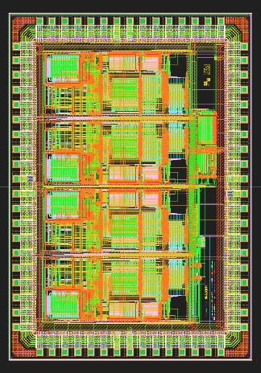
Dedicated Design: MOPS/mW=200
Complex MAC = 8 ops
N_{op} = 96
f_{clock} = 25 MHz
) 2400 MOPS
A_{op} = 5.4 mm²/96 =.15 mm²
Power = 12 mW
Fully parallel mapping of adaptive correlator algorithm.
Notes:
Image from Bob Brodersen

Slide 21
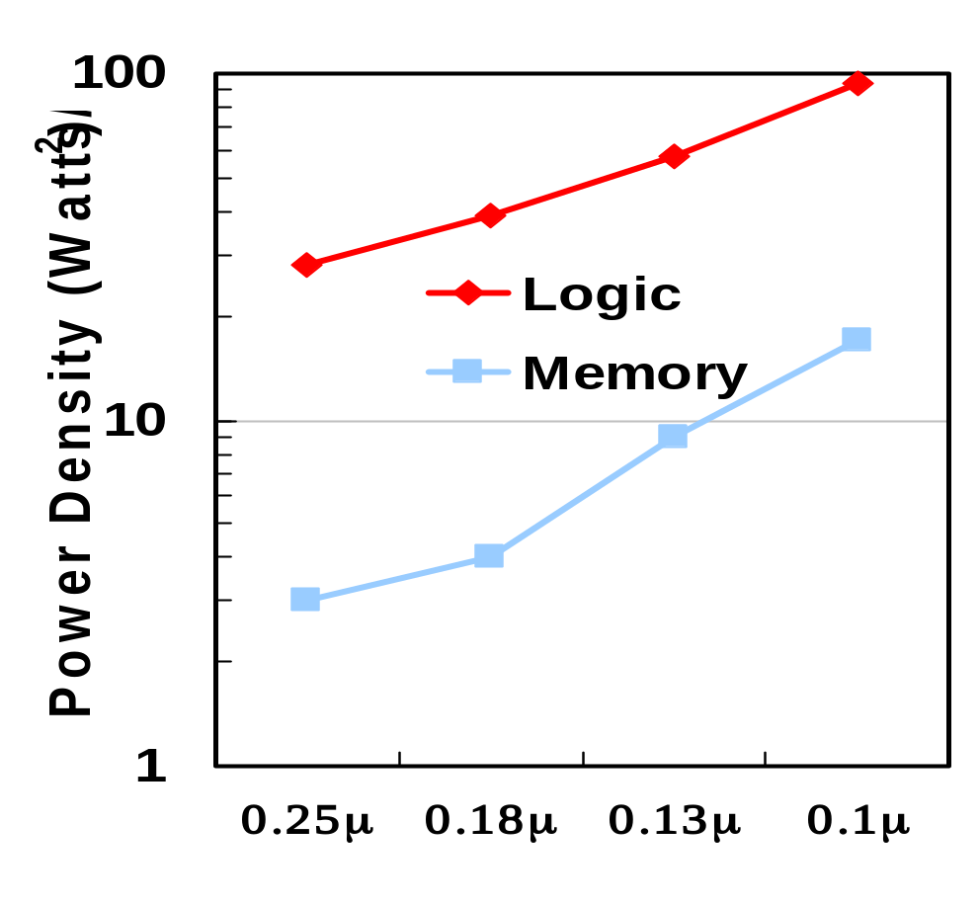
Memory is More Power-Efficient
Hint: use on-chip caches
Notes:
Data from Fred Polack

Slide 22
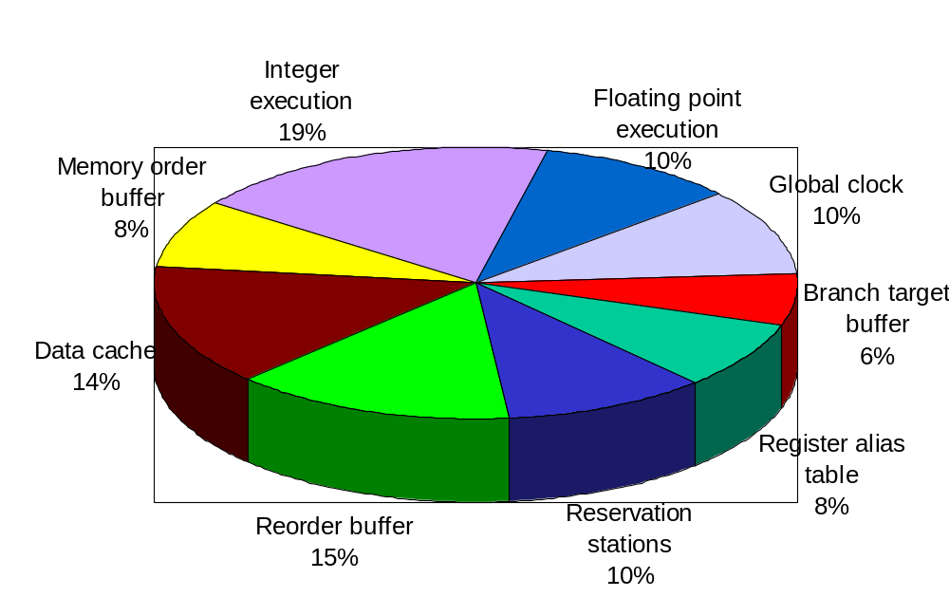
Energy Distribution in μP
“useful” (includes local clock)

Slide 23
Efficiency and Performance
V_{dd} + ! f_{clock} +, MOPS +
Power +
MOPS/mW *
Better metric: Energy £ delay
  Roughly independent of V_{dd}

Slide 24
Efficiency and Technology
MOPS / mW
[T. Claasen, ISSCC 1999]
1000
100
10
hardwired
1
DSP
0.1
microprocessors
0.01
0.001
2
1
0.5
0.25
0.13
0.1
0.07
feature size [µ]
Notes:
Slide adapted from Reiner Hartenstein.

Slide 25
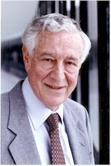
How Low Can You Go?
Energy required to compute is ZERO
If computation is quasistatic...
...and no information is destroyed (reversible)
Ops/nJ ! 1
Rolf Landauer

Slide 26
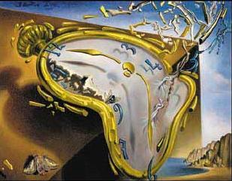
Outline
Introduction
Power and Energy Efficiency
Synchronous Hardware Efficiency
Asynchronous Hardware Efficiency
ASH Efficiency
Conclusions

Slide 27

Lutonium Performance
Asynchronous microcontroller
Designed and implemented at Caltech
0.18 μm technology
1.8V supply, 0.4V/0.5V th
200 MIPS
1.8 ops/nJ
DSP-like
Alain Martin

Slide 28
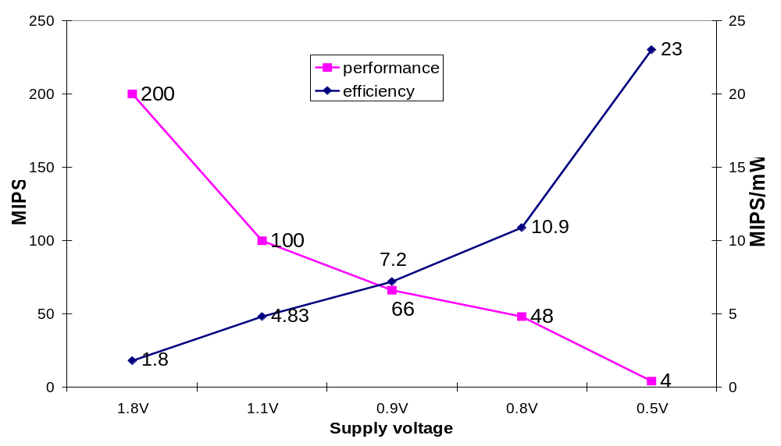
Efficiency and Supply Voltage

Slide 29
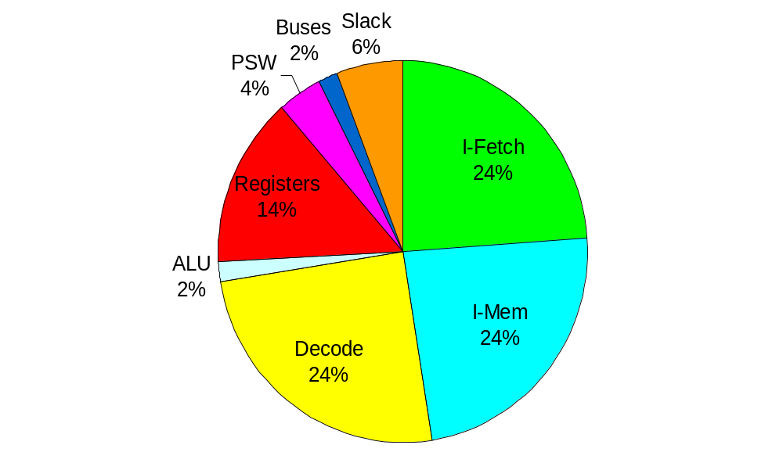
Async Processor Breakdown
“useful”

Slide 30
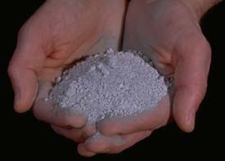
Outline
Introduction
Power and Energy Efficiency
Synchronous Hardware Efficiency
Asynchronous Hardware Efficiency
ASH Efficiency
Conclusions

Slide 31
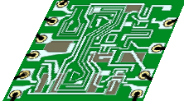
Application-Specific Hardware
C code
Compiler for
Application
Specific
Hardware
Memory
Asynchronous Circuits

Slide 32
Tool-Flow
C
Mediabench kernels
(1 hot function/benchmark)
CASH
core
Verilog
back-end
Synopsys,
Cadence P/R
180nm std. cell library, 2V
~1999
technology
Memory
ASIC

Slide 33
Caveat
Memory
we model this part
accurately
optimistic speed model,
no power accounting

Slide 34
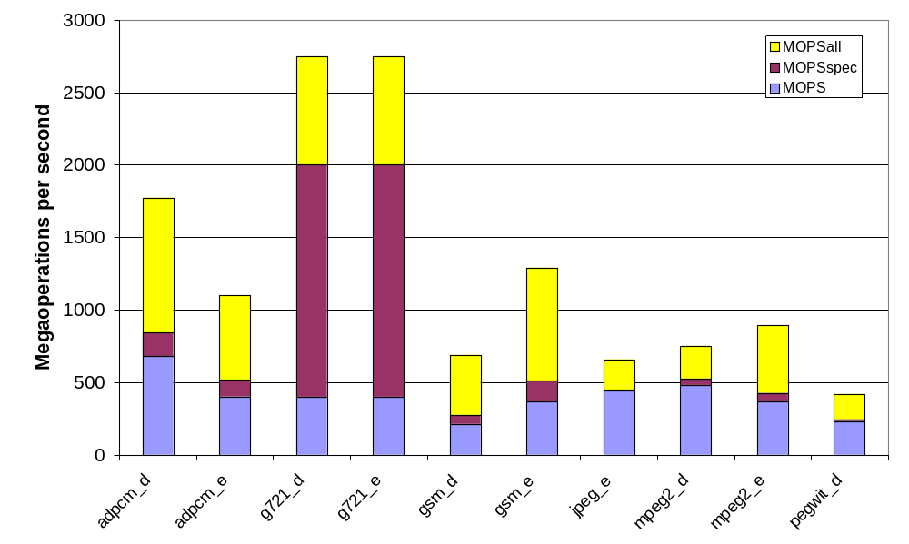
ASH Performance

Slide 35
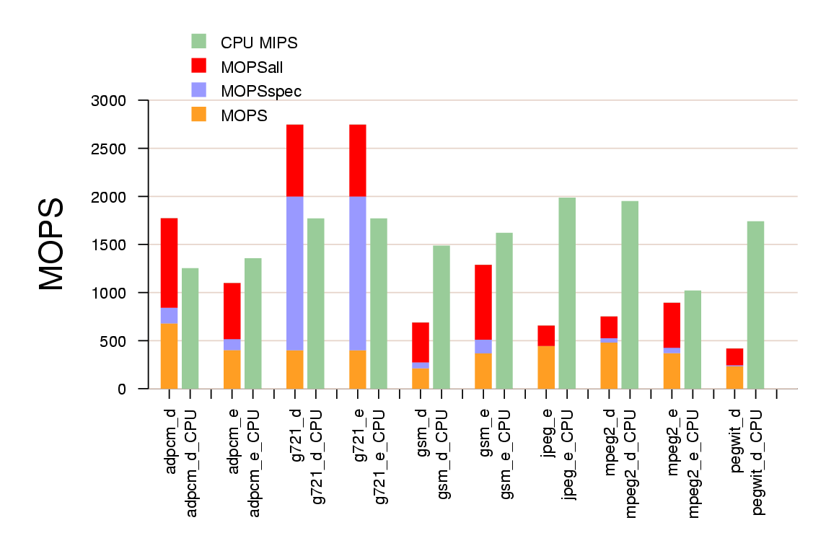
ASH vs 600MHz CPU

Slide 36
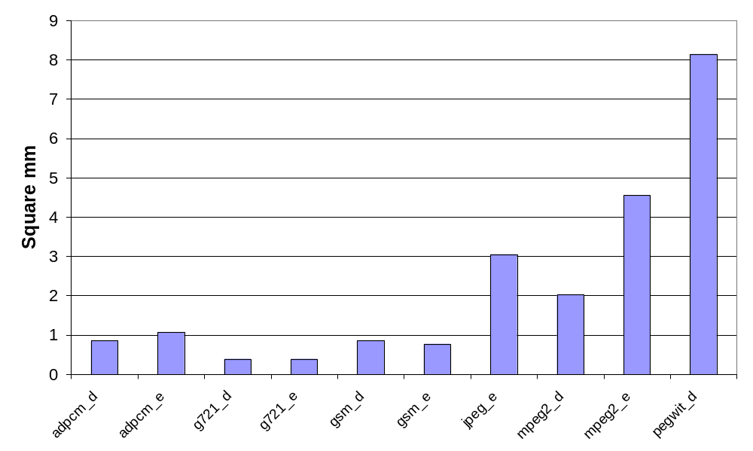
ASH Area
minimal RISC core

Slide 37
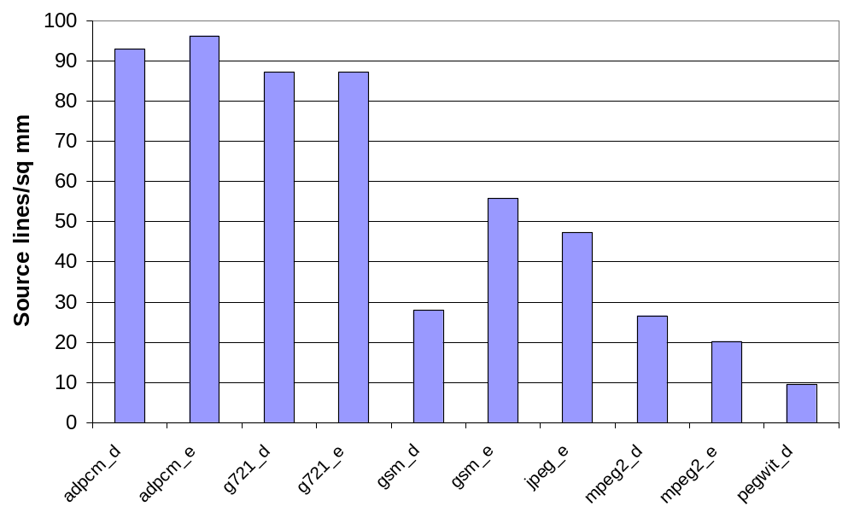
Normalized Area
many C
macros

Slide 38
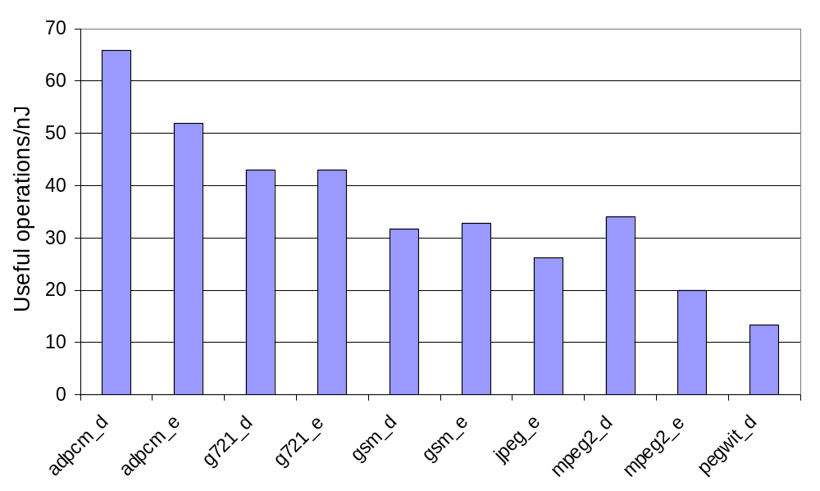
ASH Energy Efficiency

Slide 39
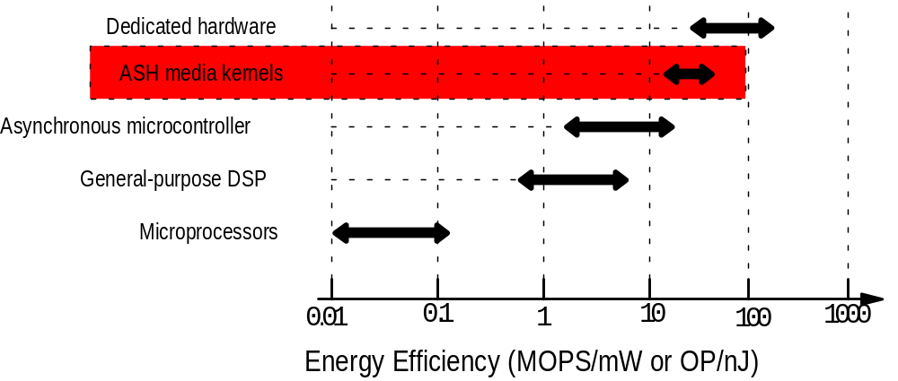
All Together Now

Slide 40
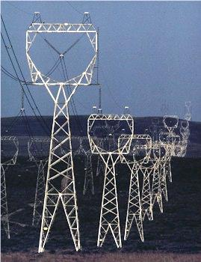
Conclusions
Performance comes at a price
Energy efficiency is expressed in ops/nJ or MOPS/mW
Dedicated hardware is more power-efficient than microprocessors
ASH efficiency competitive
with dedicated hardware
Notes:
Powerline image from http://www.pnl.gov/energytechdev/POWER.stm

