Slide 1
TUNING SOC’S USING
THE DYNAMIC CRITICAL PATH
Hari Kannan!, Mihai Budiu#, John Davis#,
Girish Venkataramani^
!Stanford University
#Microsoft Research-SVC
^Mathworks

Slide 2
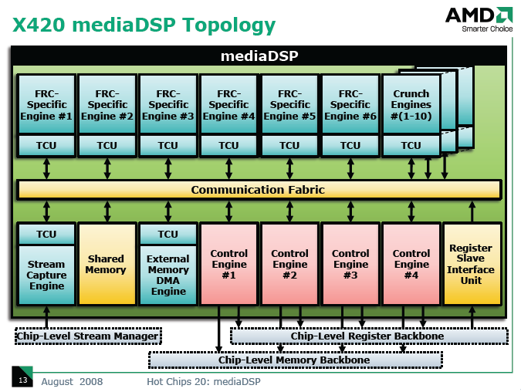
Motivation
High degrees of integration among blocks in SoCs
Obtaining optimal configuration for SoC very hard
  Exponential search-space of possible configurations

Slide 3
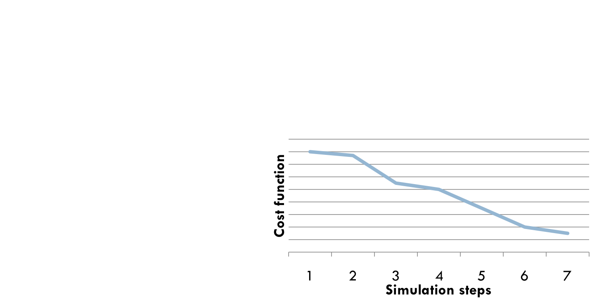
Search space optimization
Possible Configurations
Optimizing the search space
M1 – 10
M2 – 10
…
Mn – 10
----------------
Space – 10^{n}
1 2 3 … ~O(n)
M1
M2
M3…Mn
50
15
30
…
10
40
20
30
…
10
35
20
30
…
15
30
25
30
…
25
…
Need analysis to drive optimizations

Slide 4
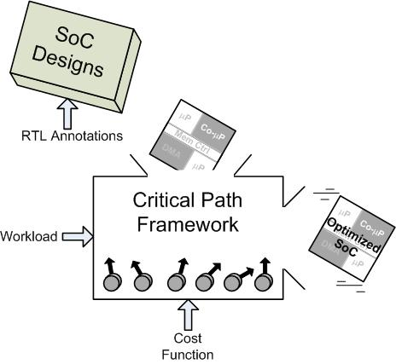
Global Critical Path (GCP) Analysis
Approach that addresses
the complexity barrier
Dynamic performance
profile of the system
  Track transition of key
  control signals
  Path of execution
  identifies modules
  “gating” progress
  Directs optimization efforts
Notes:
Put a picture here that shows the critical path (John’s pic)

Slide 5
Last Arrival Events
Simulate program execution on SoC
At runtime,
  Last-arriving input = critical input
  For each block, trace last input enabling output
Input Arrival Time:
Output Generation Time:
10
Processing
Block
Adder (+)
4
11
7
2

Slide 6
Computing the Critical Path
1
5. Criticality Measure =
(edge-freq)/(max-freq)
4. Maintain freq histogram
3. Some edges may repeat
2. Trace back along
last-arrival edges
1. Start from last node
2
2
1
2
1
Notes:
Put pic from Mihai’s website (look through the presentations)

Slide 7
Outline
Motivation & Critical Path overview
Applying the Critical Path analysis to real SoCs
Evaluation
Conclusions and Future Work
Notes:
Need some beautification
Get from Dan the slide on mem corruptions vs high level bugs

Slide 8
Critical path for synchronous systems
Easy to analyze for asynchronous systems
  Signal transitions (handshakes) are explicit
Synchronous systems have
  implicit transitions
  no handshakes
Producers and consumers do not need a handshake
  e.g. A pipeline stage feeding data to the next stage
  Need to add virtual “req” and “ack” signals
Notes:
Mention that there are other things, not in this talk. Refer to TR draft ☺

Slide 9
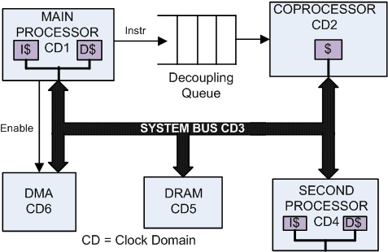
Evaluation System
  Stats:
    Increase in simulation time: None observed
    Percentage of critical control signals: 0.2% (of all signals in SoC)
    Number of lines of code added: 1%
Notes:
Talk about the system: (Leon + interesting stuff). Say what we added, what changes we had to make etc.

Slide 10


Evaluation
Define Power-Delay (Performance) as cost function
Power-Delay = Delay * ∑CV²f
Critical path provides optimization hints
  Directs the search; converges quickly to optimal config
Freq A | Freq B | Power-Delay
50 | 70 | 1100
Freq A | Freq B | Power-Delay
55 | 65 | 1000
Exhaustive Search
Critical Path Optimization
Notes:
A determined to be critical, so move to B

Slide 11
Algorithm for GCP
Initial parameters
Simulate workload
New Perf < Old Perf ?
Search
Converged?
Stop
YES
NO
Speed up bottleneck IP
Slow down IP outside GCP
Use GCP, find bottleneck IP
Optimize bottleneck IP
Iterate

Slide 12
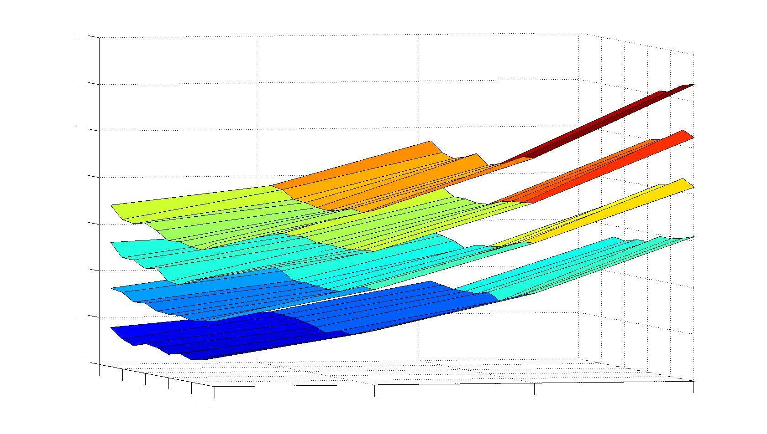
Parameter space (legal)
80
75
60
70
50
2nd CPU Freq (MHz)
65
40
Power-Delay
60
30
65
50
45
70
80
90
110
55
40
100
50
45
DRAM Freq (MHz)
120
Coprocessor Freq (MHz)
Notes:
First show exhaustive space, then show trajectory (animate paths maybe)

Slide 13
Paring down the parameter space
Optimize parameters for the bottleneck IP block (coprocessor), at expense of another block outside the critical path (DRAM)
Select initial configuration parameters for different IP blocks such that cost function is satisfied
Using GCP analysis, identify bottlenecks (coprocessor)
80
Perform simulation of workload
Iterate
75
60
70
50
2nd CPU Freq (MHz)
65
40
Power-Delay
60
30
65
50
45
70
80
90
110
55
40
100
50
45
DRAM Freq (MHz)
120
Coprocessor Freq (MHz)
Notes:
First show exhaustive space, then show trajectory (animate paths maybe)

Slide 14

Parameter space (directed search)
80
75
60
Directed Search
70
50
2nd CPU Freq (MHz)
65
40
Power-Delay
60
30
65
50
45
70
80
90
110
55
40
100
50
45
DRAM Freq (MHz)
120
Coprocessor Freq (MHz)
Notes:
First show exhaustive space, then show trajectory (animate paths maybe)

Slide 15
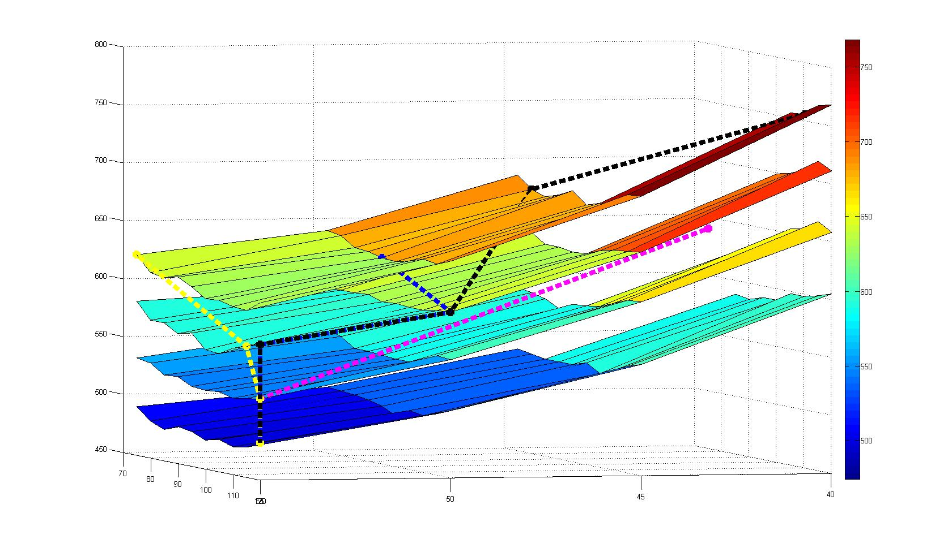
Parameter space (directed search)
80
75
60
Directed Search
70
50
2nd CPU Freq (MHz)
65
40
Power-Delay
60
30
65
50
Simulation steps reduced by 2 orders
of magnitude
45
70
80
90
110
55
40
100
50
45
DRAM Freq (MHz)
120
Coprocessor Freq (MHz)
Notes:
First show exhaustive space, then show trajectory (animate paths maybe)

Slide 16
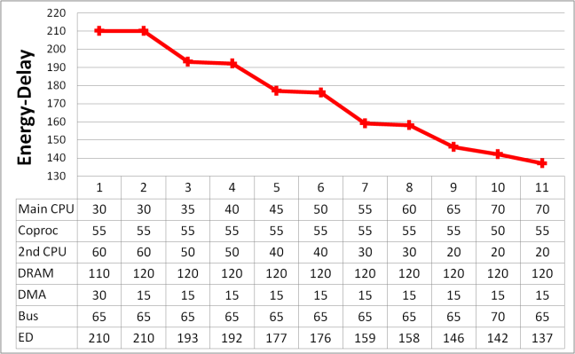
Evaluation (higher-dimension)
Simulation steps reduced by 3 orders
of magnitude
Power-Delay
PD

Slide 17
Abstracting Modules
Advantageous to treat modules as black-boxes
  Third-party IP blocks are often closed-source
  Saves designer effort by reducing annotation
Analyze critical path using block interface
How does abstraction affect the critical path?
?
Notes:
Show pics

Slide 18
Abstraction Evaluation
Performed experiment abstracting processor
  Compared critical path with & w/o abstraction
  Same edges identified as critical
  3% difference in the critical edge count
Critical path still provides reliable optimization hints!
Accuracy of Path
Speed of Simulation
Software Simulation
Functional Simulation
TLM
Partial RTL
RTL
Notes:
Mention that it was due to the Leon’s data cache

Slide 19
Conclusions
SoC designs becoming very complex
  Contain many tens of cores, third-party IP
  Performance pathologies hard to diagnose
Critical path analysis provides useful insights
  Identifies system-wide bottlenecks
Helps designer obtain optimal configurations
  Obviates need for simulating entire search-space
    Reduces exponential search time significantly
Notes:
Say that we like to think it might even be linear, but no formal proof

Slide 20
Thank You!

Slide 21
More on critical path for SoC’s
Concurrent events
  Multiple control signals may transition in the same cycle
    Could refine this with timing information
  Vastly different critical paths could be obtained
  Rely on designer intuition to resolve ties
Finite State Machines
  FSMs produce outputs while in certain states
  State transitions do not require control signals to change
  Back-track until an external input causes a transition
Pure sources and sinks
  Modules that do not require req/ack signals
    e.g. A register file in a simple processor (sink)

Slide 22
Algorithm for GCP
Step 1: Select initial configuration parameters
Step 2: Simulate workload
Step 3: Performance worse than previous performance, STOP, else proceed
Step 4: Using GCP analysis, identify bottlenecks
Step 5: Optimize parameters for the bottleneck IP block
  Make block on critical path faster,
  Make block outside the critical path slower
Step 6: Go to Step 2 (iterate)

Slide 23
Last Arrival Events
Simulate program execution on SoC
At runtime,
  Last-arriving input = critical input
  For each block, trace last input enabling output
  FIFO example: when consumer is slow and FIFO is full
Producer
Enqueue
!(fifo_empty)
Consumer
FIFO
!(fifo_full)
Dequeue

Slide 24
Last Arrival Events
Simulate program execution on SoC
At runtime,
  Last-arriving input = critical input
  For each block, trace last input enabling output
  FIFO example: when consumer is slow and FIFO is full
Producer
Enqueue
!(fifo_empty)
Consumer
FIFO
!(fifo_full)
Dequeue

Slide 25
Critical Path Analysis
Event: signal from (f1, t₁) to (f2, t₃)
Analyzed system
f1
f1
f2
f2
f2
t₀
t₁
t₂
t₃
Dynamic Critical Path = longest path in Timed Graph
Notes:
Talk more about the critical path analysis here. Mention that it is basically a “finding longest path” problem

Slide 26
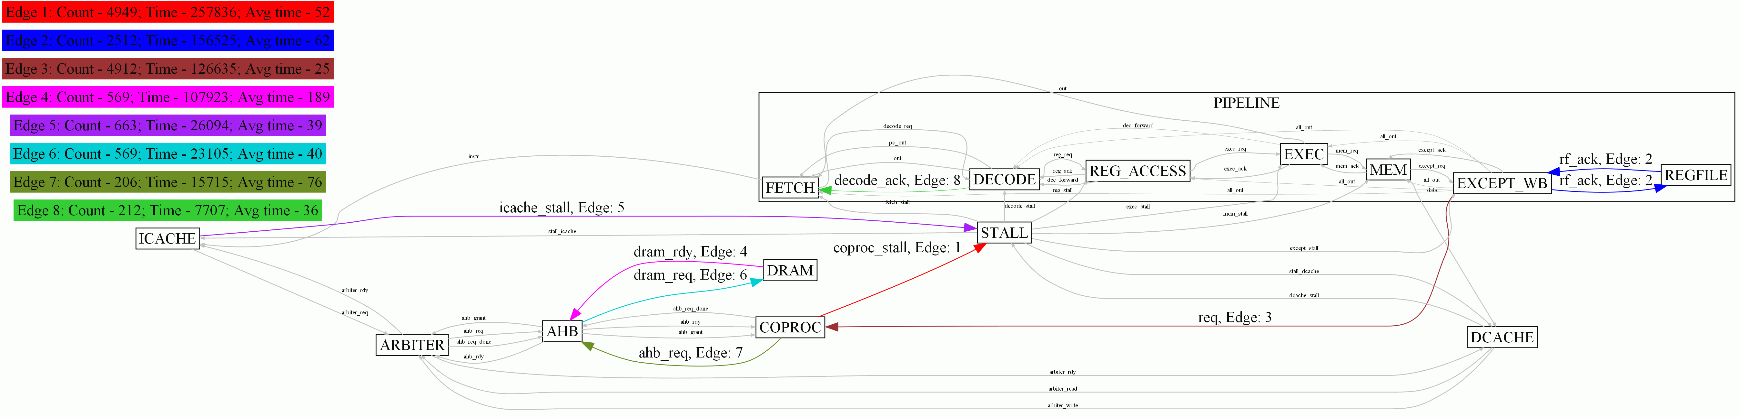
What does the critical path look like?
Notes:
Beautify some more. Ugh!

Slide 27
Abstraction Evaluation
Performed experiment abstracting processor
  Compared critical path with & w/o abstraction
  Same edges identified as critical
    DRAM -> Bus -> Processor found to be most critical
  3% difference in the critical edge count
Difference due to blocking vs. non-blocking signals
  Context of signal matters
Critical path still provides reliable optimization hints!
Notes:
Mention that it was due to the Leon’s data cache

Slide 28
Future Work
Automate design annotation
  Possible to automatically infer control signals
    Easiest when dealing with abstracted interfaces
Infer context from black-boxes
  Distinguish between blocking/non-blocking signals
    Will refine the critical path analysis further
Expose results of analysis to software
  Can be used to fine-tune applications for performance

