Slide 1
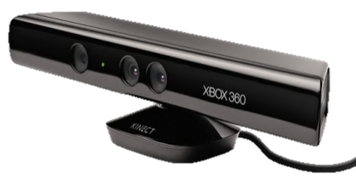
Training Kinect
Mihai Budiu
Microsoft Research, Silicon Valley
UCSD CNS 2012 RESEARCH REVIEW February 8, 2012

Slide 2
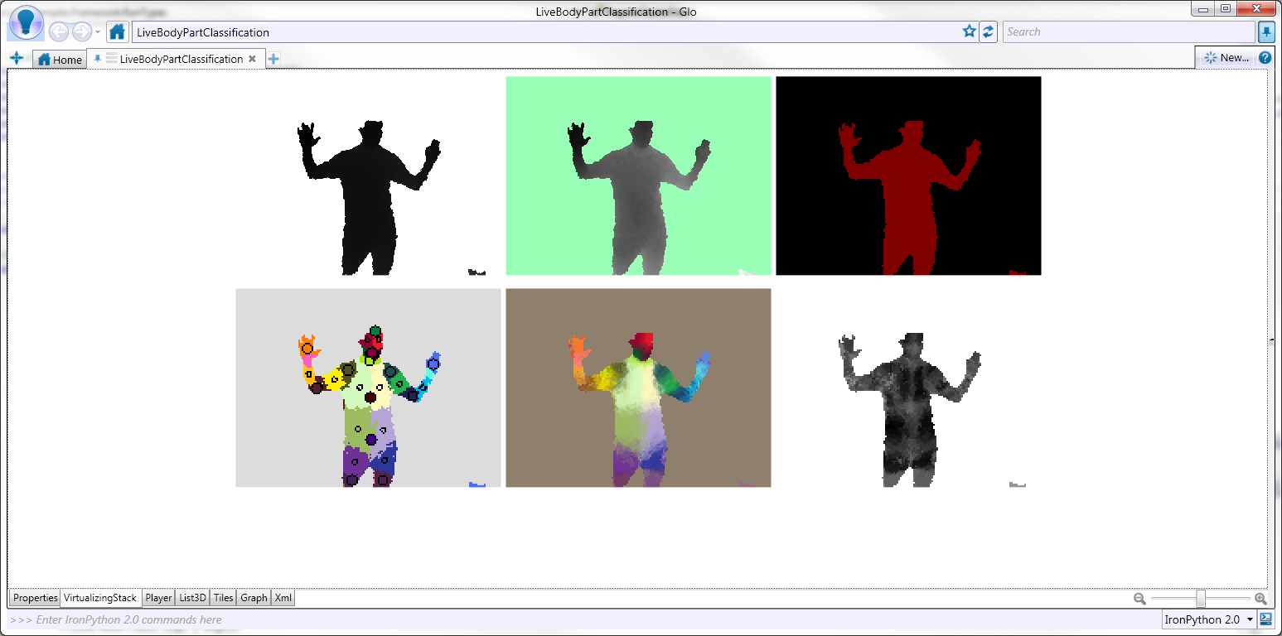
Label body parts in depth map
Parallelizing the Training of the Kinect Body Parts Labeling Algorithm Mihai Budiu, Jamie Shotton, Derek G. Murray, and Mark Finocchio Big Learning: Algorithms, Systems and Tools for Learning at Scale, Sierra Nevada, Spain, December 16-17, 2011

Slide 3
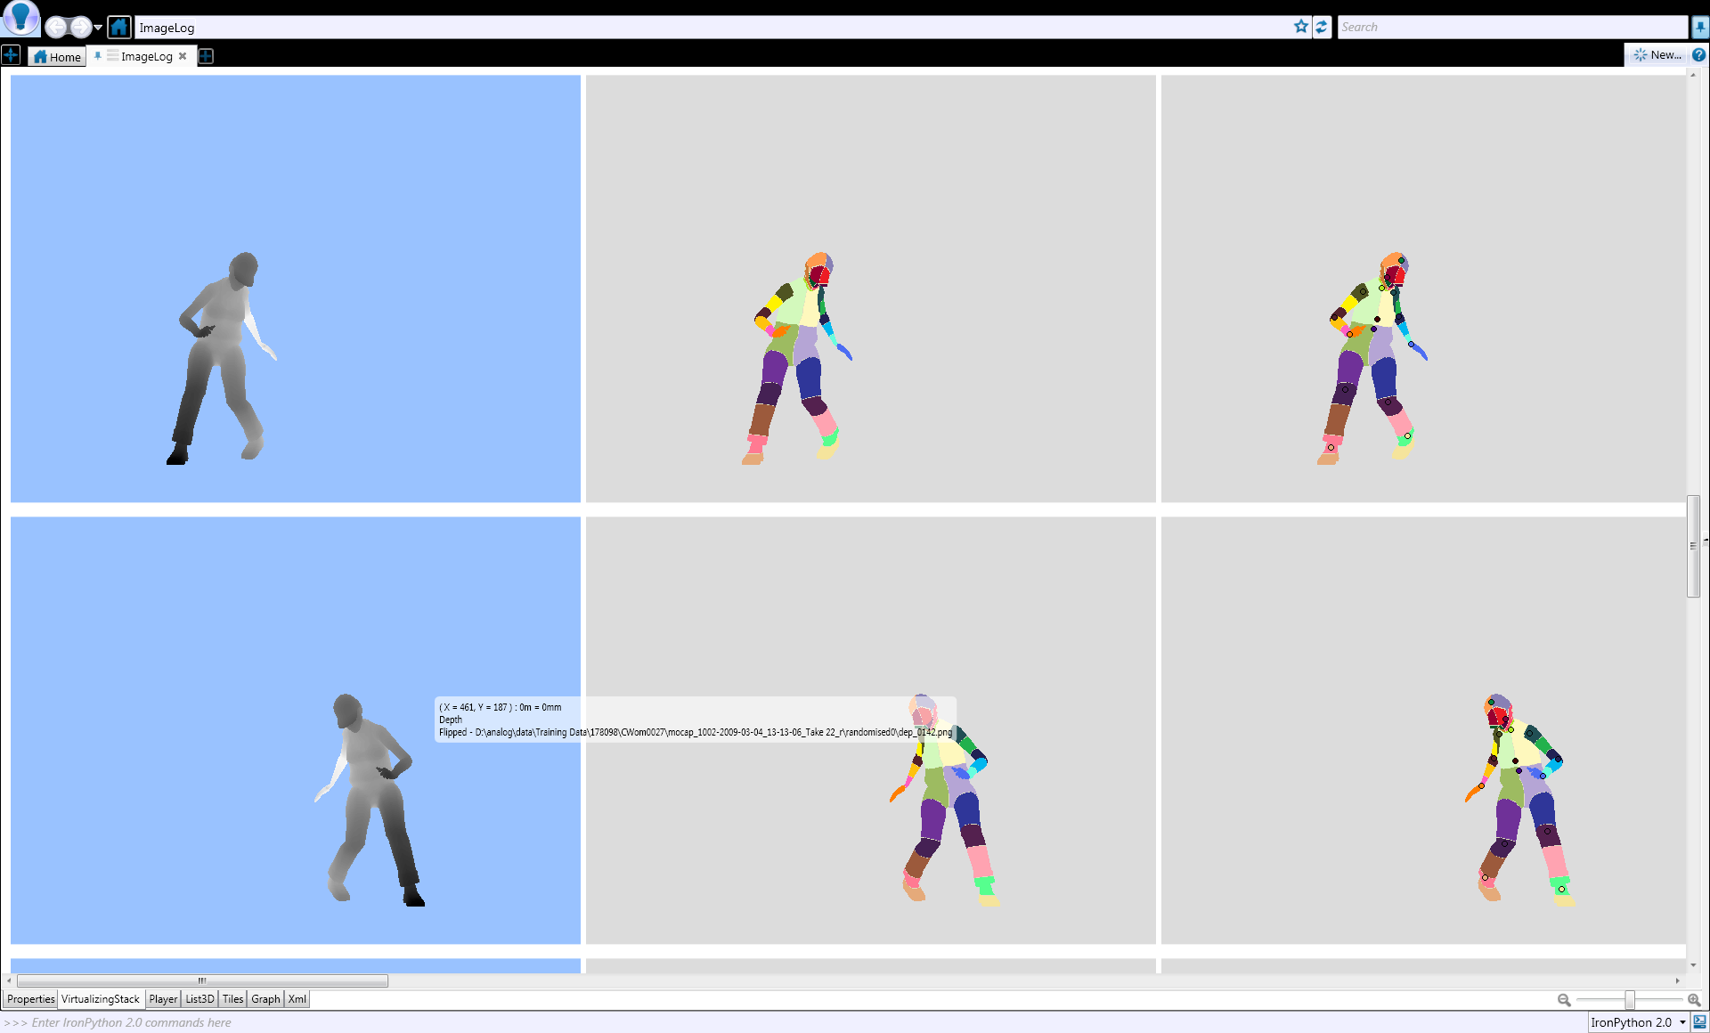

Solution: Learn from Data
Training examples
Machine learning
Classifier

Slide 4

Big data
Classifier
Decision forest inference
1M Training examples
300,000 pixels/image
100,000 features
<2²⁰ tree nodes/tree
31 body parts
3 trees
DryadLINQ
Dryad

Slide 5
Data-Parallel Computation
Application
SQL
Sawzall, Java
≈SQL
LINQ
Parallel Databases
Sawzall,FlumeJava
Pig, Hive
DryadLINQ
Language
Map-Reduce
Hadoop
Dryad
Execution
GFS BigTable
HDFS
S3
Cosmos
Azure
HPC
Storage

Slide 6

Dryad = 2-D Piping
Unix Pipes: 1-D
grep | sed | sort | awk | perl
Dryad: 2-D
grep¹⁰⁰⁰ | sed⁵⁰⁰ | sort¹⁰⁰⁰ | awk⁵⁰⁰ | perl⁵⁰
Notes:
Dryad is a generalization of the Unix piping mechanism: instead of uni-dimensional (chain) pipelines, it provides two-dimensional pipelines. The unit is still a process connected by a point-to-point channel, but the processes are replicated.

Slide 7
Virtualized 2-D Pipelines
Notes:
This is a possible schedule of a Dryad job using 2 machines.

Slide 8


Virtualized 2-D Pipelines

Slide 9

Virtualized 2-D Pipelines

Slide 10
Virtualized 2-D Pipelines

Slide 11
Virtualized 2-D Pipelines
2D DAG
multi-machine
virtualized
Notes:
The Unix pipeline is generalized 3-ways:
2D instead of 1D
spans multiple machines
resources are virtualized: you can run the same large job on many or few machines

Slide 12



Fault Tolerance
Notes:
Vertex failures and channel failures are handled differently.

Slide 13

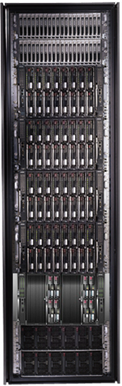
LINQ
=> DryadLINQ
Dryad
Notes:
DryadLINQ adds a wealth of features on top of plain Dryad.

Slide 14
LINQ = .Net+ Queries
Collection<T> collection;
bool IsLegal(Key);
string Hash(Key);
var results = from c in collection where IsLegal(c.key) select new { Hash(c.key), c.value};
Notes:
Language Integrated Query is an extension of .Net which allows one to write declarative computations on collections (green part).

Slide 15

DryadLINQ Data Model
.Net objects
Partition
Collection

Slide 16

DryadLINQ = LINQ + Dryad
Collection<T> collection;
bool IsLegal(Key k);
string Hash(Key);
var results = from c in collection where IsLegal(c.key) select new { Hash(c.key), c.value};
Vertex code
Query plan
(Dryad job)
Data
collection
C#
C#
C#
C#
results
Notes:
DryadLINQ translates LINQ programs into Dryad computations:
- C# and LINQ data objects become distributed partitioned files.
- LINQ queries become distributed Dryad jobs.
- C# methods become code running on the vertices of a Dryad job.

Slide 17
Kinect Training Pipeline
Upload Data
Preprocessing
Train one tree level
Distribute
Replicate
Inject noise
Add background
Overlay players
Normalization
Compute histograms
20x

Slide 18
Query plan for one tree layer
Features
Partial tree
Images
split
Parallelize on:
Features
Images
Tree nodes
New partial tree

Slide 19
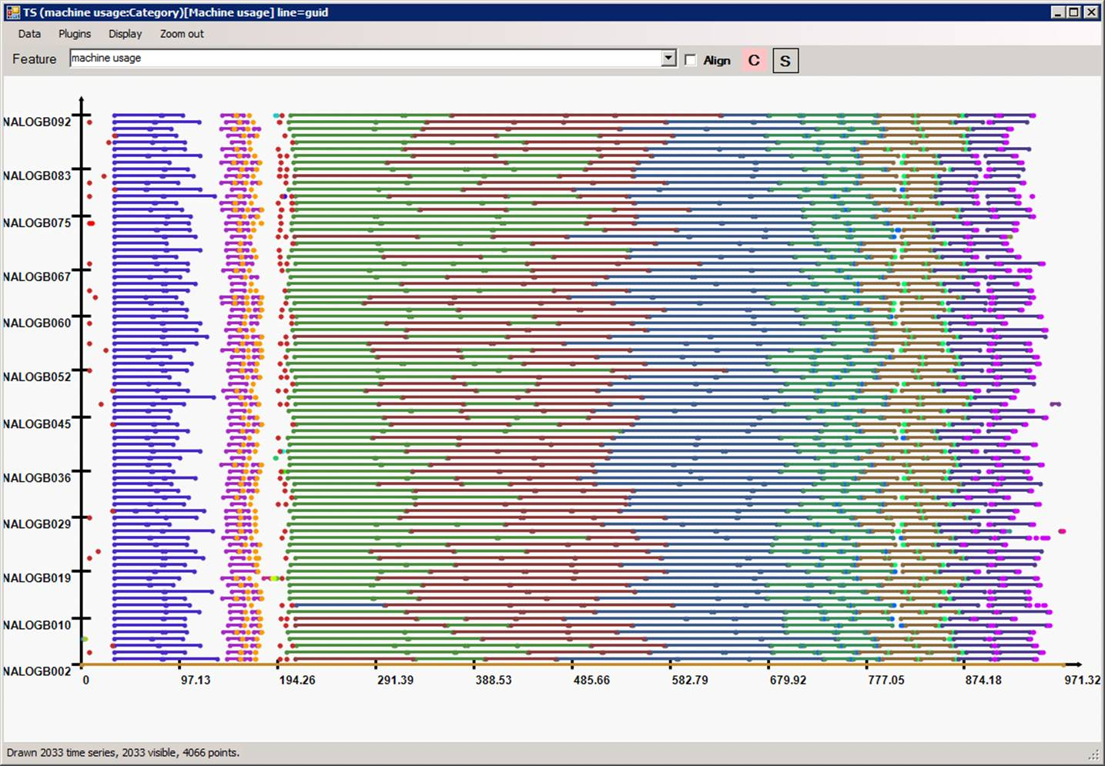
High cluster utilization
Machine
Time

Slide 20
Conclusions

Slide 21
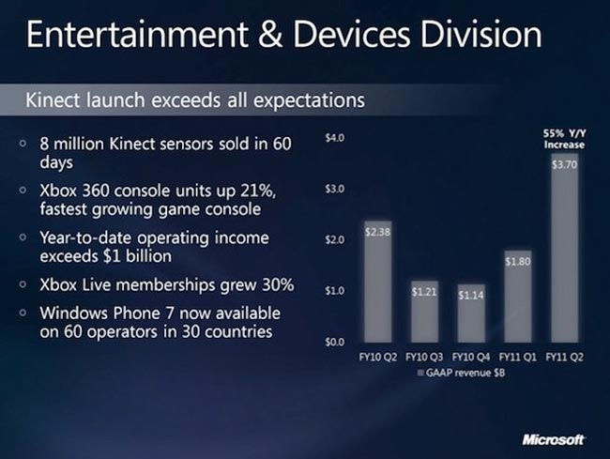
Huge Commercial Success

Slide 22
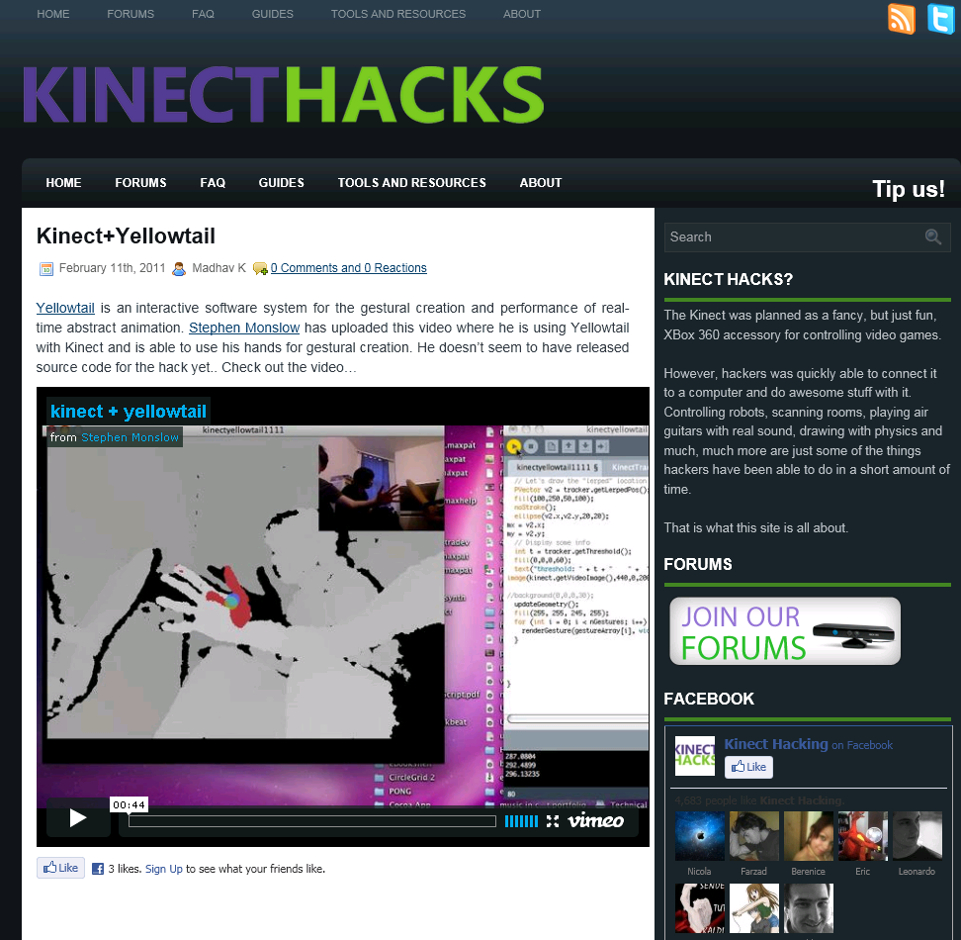
Tremendous Interest from Developers

Slide 23
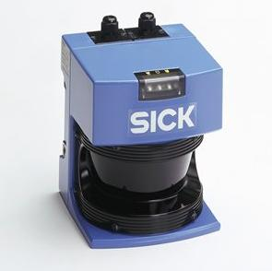

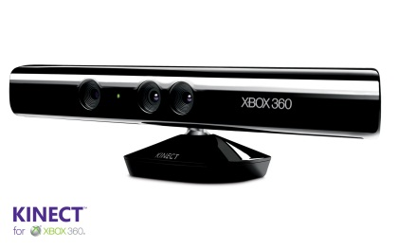
Consumer Technologies Push The Envelope
Price: 6000$
Price: 150$

Slide 24

Unique Opportunity for Technology Transfer

Slide 25
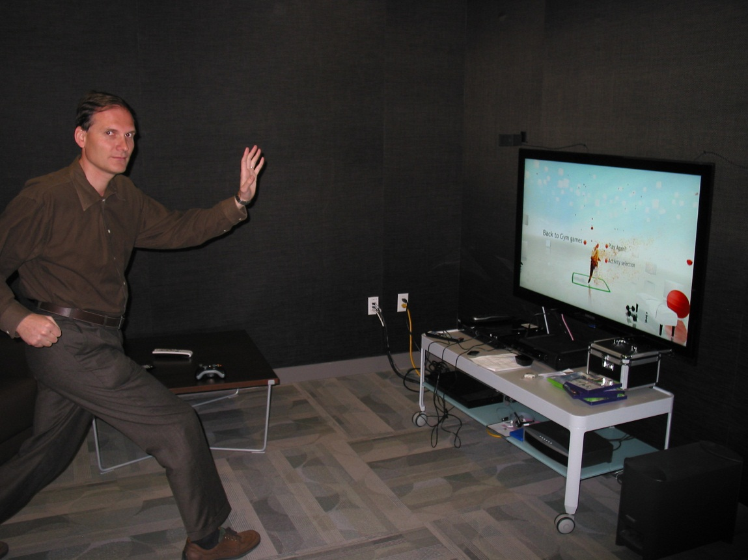
I can finally explain to my son what I do for a living…

Slide 26
Backup slides

Slide 27
Training efficiency

Slide 28
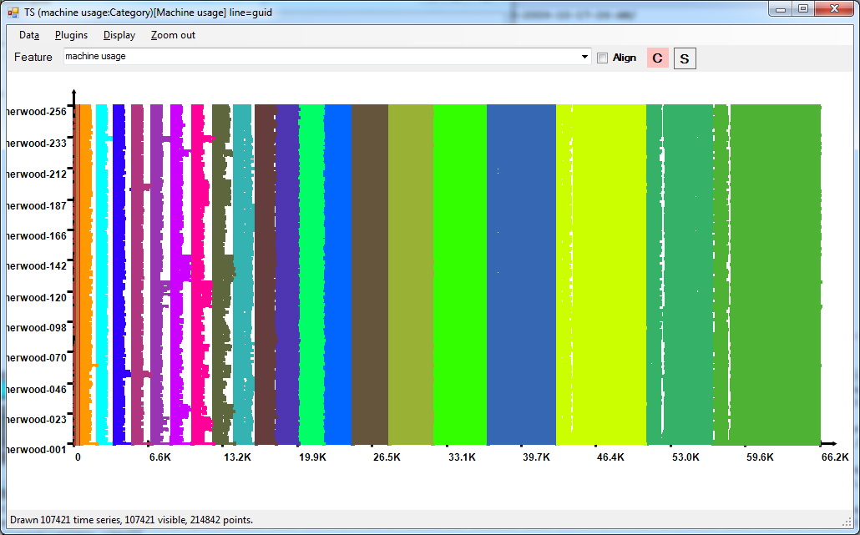
Cluster usage for one tree
Preprocess
1
2
3
4
5
6
7
8
9
10
11
12
13
14
15
16
17
18
19 (failed)
19
Normalize
Tree
Machine
(235)
14400 processes
Time (s)
18.3 hours, 137.2 CPU days, 107421 processes, 29.56 TB data, average parallelism=140

Slide 29
DryadLINQ Language Summary
Where
Select
GroupBy
OrderBy
Aggregate
Join

