Slide 1




Artemis
Distributed system
Hunting for Bugs with Artemis
Dryad Overview
Logs
System Architecture
Data Collection
Data collection
Database
View
GUI
Plug-ins
GUI
Plug-ins
Conclusions

Slide 2
Hunting for Bugs with Artemis
pptPlex Section Divider
The slides after this divider will be grouped into a section and given the label you type above. Feel free to move this slide to any position in the deck.

Slide 3

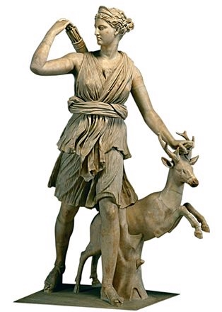
Hunting for Bugs with Artemis
Gabriela F. Creţu-Ciocârlie
Mihai Budiu
Moises Goldszmidt
Microsoft Research, Silicon Valley
WASL 2008
This presentation is built and should be viewed with pptPlex: http://www.officelabs.com/projects/pptPlex/Pages

Slide 4
Artemis Goal
One-stop shop for performance analysis of distributed systems

Slide 5

Principles
1) Modular: Separate generic from application specific parts
2) Extensible: add new analyses via plug-ins
3) Interactive: human expert part of the analysis loop

Slide 6
System Architecture
pptPlex Section Divider
The slides after this divider will be grouped into a section and given the label you type above. Feel free to move this slide to any position in the deck.

Slide 7
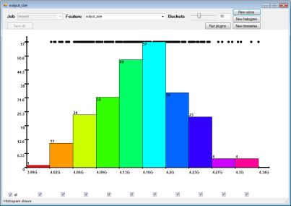
Distributed system
Distributed
Logs
Data collection
Database
Local
View
GUI
Plug-ins

Slide 8
Distributed system
Application- Specific
Logs
Data collection
Generic
Database
View
GUI
Plug-ins

Slide 9
Dryad Overview
pptPlex Section Divider
The slides after this divider will be grouped into a section and given the label you type above. Feel free to move this slide to any position in the deck.

Slide 10
Dryad Application Structure
Input files
Channels
Stage
Output files
grep
sort
awk
sed
perl
grep
sort
sed
awk
grep
sort
Vertices
Notes:
This is the basic Dryad terminology.

Slide 11

Dryad System Architecture
data plane
job schedule
V
V
V
Serv
Serv
Serv
Job manager
cluster
control plane
Notes:
The brain of a Dryad job is a centralized Job Manager, which maintains a complete state of the job.
The JM controls the processes running on a cluster, but never exchanges data with them.
(The data plane is completely separated from the control plane.)

Slide 12
Data Collection
pptPlex Section Divider
The slides after this divider will be grouped into a section and given the label you type above. Feel free to move this slide to any position in the deck.

Slide 13
Text
Binary
XML
Perfmon
Data
Text
Binary
XML
Perfmon
Text
Binary
XML
Perfmon
10GB-1TB
Copy
Persisted data
DryadLINQ
application
Parse
Filter
Aggregate
100MB-1GB

Slide 14
GUI
pptPlex Section Divider
The slides after this divider will be grouped into a section and given the label you type above. Feel free to move this slide to any position in the deck.

Slide 15


Slide 16
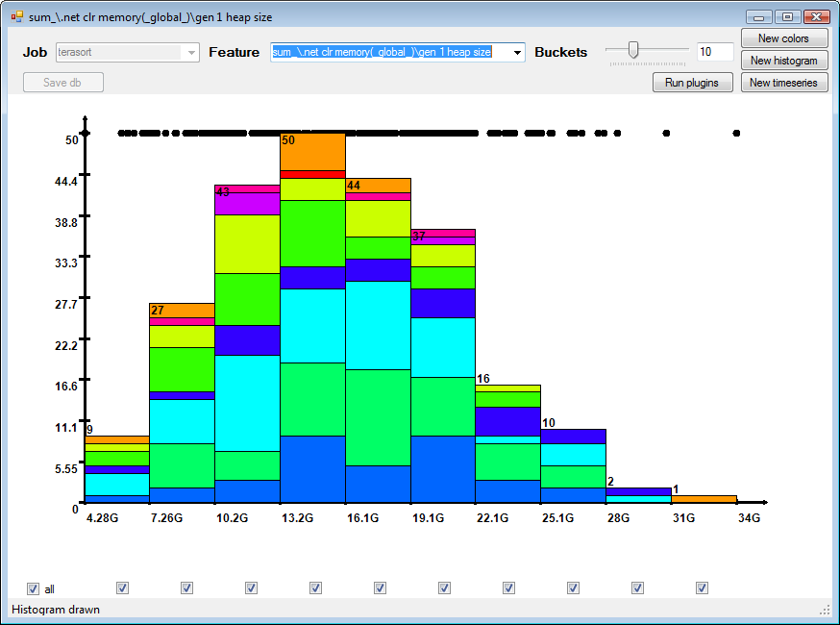

Slide 17
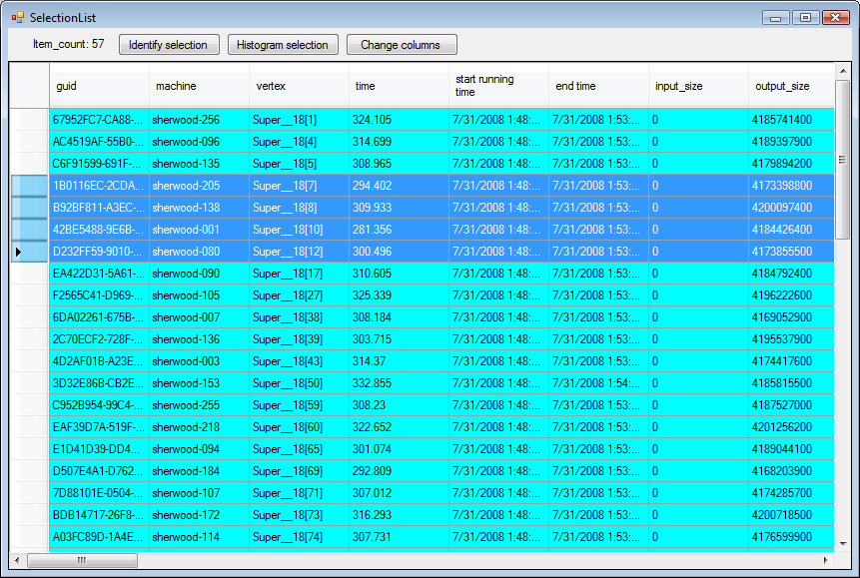

Slide 18
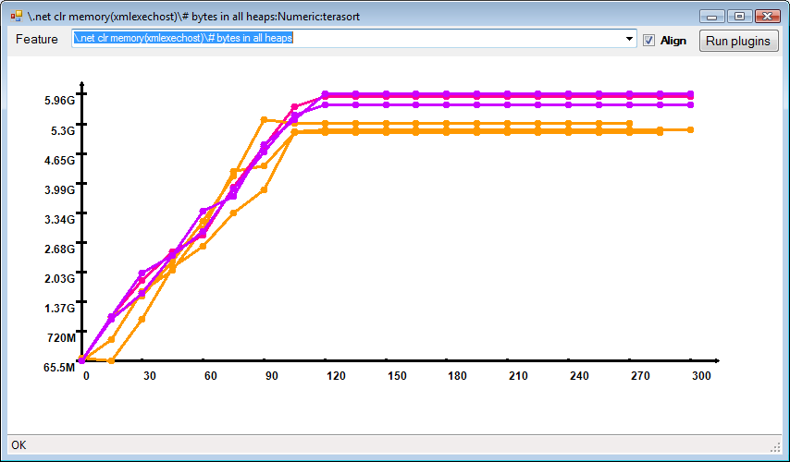

Slide 19
Plug-ins
pptPlex Section Divider
The slides after this divider will be grouped into a section and given the label you type above. Feel free to move this slide to any position in the deck.

Slide 20
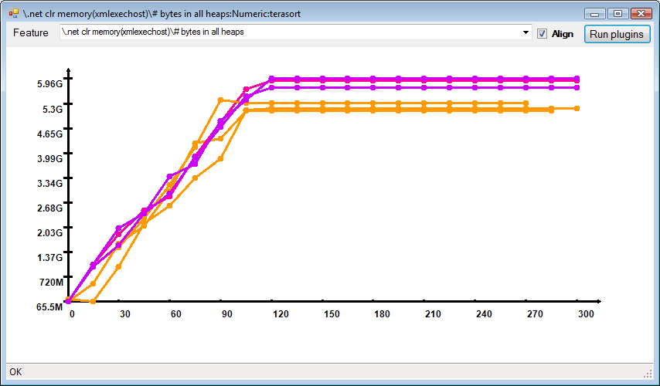
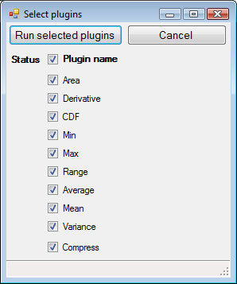

Slide 21
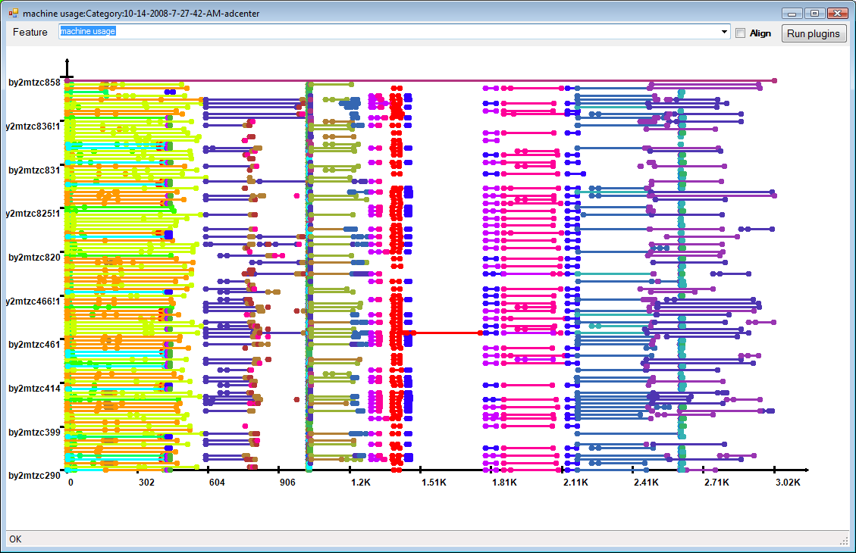
Machine Utilization Plug-in

Slide 22

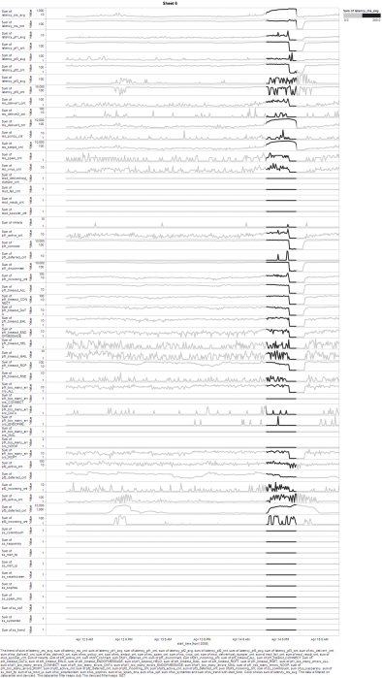
Complex statistics: HiLighter plug-in
Key Performance Indicator
Binary search over logistic regression with
L1 regularization
Metrics
Correlated metrics

Slide 23

Interactive Analysis
KPI Selection
Feature Computation
Visualization
Hilighter
Notes:
Using Artemis and HiLighter as plugin we were able to analyze performance crises in MSFT Enterprise Data Center and provide recommendation on changes of placement of alarms.

Slide 24
Conclusions
pptPlex Section Divider
The slides after this divider will be grouped into a section and given the label you type above. Feel free to move this slide to any position in the deck.

Slide 25
Conclusions
Automatic diagnosis
Goal
Statistical analyses
Feature extraction
Artemis today
Summarization
Raw data
Distributed system

