Slide 1
Alice £200
Bob 20 shares of A
Alice buys 10 shares of A from Bob (£10/share)
Alice £100, 10 shares of A
Bob £100, 10 shares of A

Slide 2
Initiation and delivery
Matching and trade conversion
Affirmation and confirmation
Clearing and settlement
Risk management and routing

Slide 3
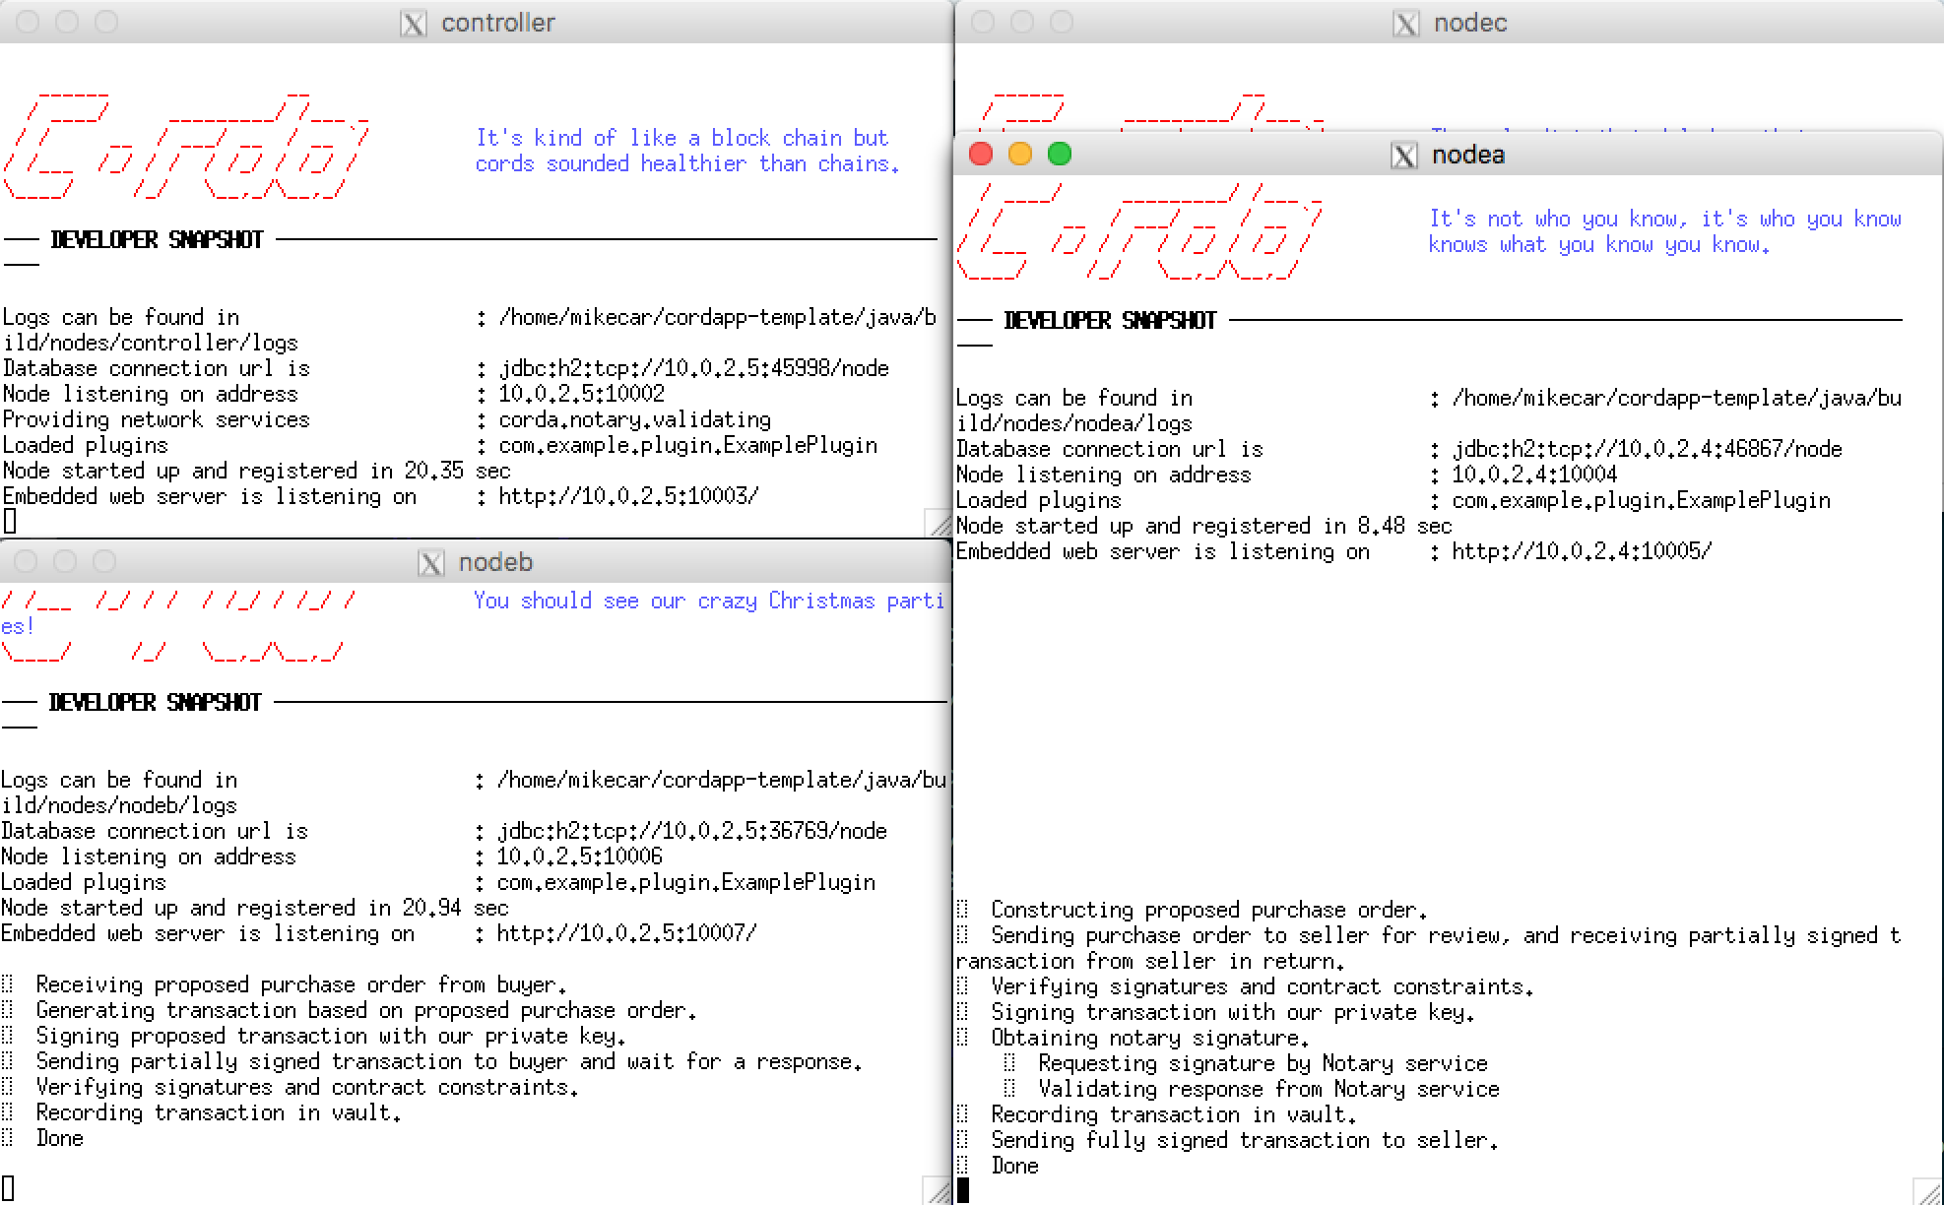

Slide 4
