Slide 1


NOn LINEAR ARX IDENTIFICATION
Students: Durus Mihai-Valer
Group: Nicoara Toma-Stefan Project indexes: 14/15
30331 Dioane Radu-Alexandru

Slide 2
TABLE OF CONTENTS
Introduction to Nonlinear ARX………………………………………………………………………………...3
Algorithm Design….………………………………………………………………….……………………….5
Prediction&Simulation……………………………………………………………………….………………...7
Tuning results.………………………………...………………………………………………………………10
Conclusions……………………………………………………………………………………..…………….13

Slide 3
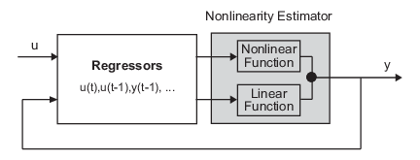

InTRoDUCTION TO NONLINEAR ARX
y(t) + $a_{1}$y(t-1)+ $a_{2}$y(t-2)+ $a_{3}$y(t-3)+…+ $a_{na}$y(t-na)= $b_{1}$u(t)+ $b_{2}$u(t-1)+… $b_{nb}$u(t-nb+1)+e(t);
Where u, y and e are input, output and disturbance.
$y_{p}$(t)=[- $a_{1, }−a_{1}$, …, $−a_{na}$, $b_{1}$, $b_{2},…,b_{nb}$]*${\text{[}\text{y}\text{(}\text{t}\text{−1), }\text{y}\text{(}\text{t}\text{−2),…,}\text{y}\text{(}\text{t}\text{−}\text{na}\text{), }\text{u}\text{(}\text{t}\text{),}\text{u}\text{(}\text{t}\text{−1),…,}\text{u}\text{(}\text{t}\text{−}\text{nb}\text{−1)]}}^{T}$
This structure implies that the current output y(t) is predicted as a weighted sum of past output values and past input values.

Slide 4
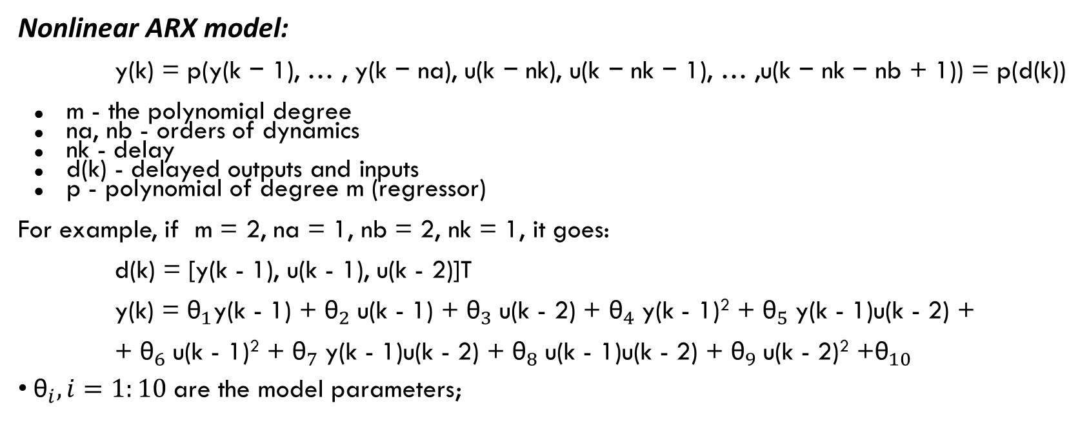
Model Structure
Nonlinear ARX model:
y(k) = p(y(k − 1), … , y(k − na), u(k − nk), u(k − nk − 1), … ,u(k − nk − nb + 1)) = p(d(k))
m - the polynomial degree
na, nb - orders of dynamics
nk - delay
d(k) - delayed outputs and inputs
p - polynomial of degree m (regressor)
For example, if m = 2, na = 1, nb = 2, nk = 1, it goes:
d(k) = [y(k - 1), u(k - 1), u(k - 2)]T
y(k) = ${\text{θ}}_{1}$y(k - 1) + ${\text{θ}}_{2}$u(k - 1) + ${\text{θ}}_{3}$u(k - 2) + ${\text{θ}}_{4}$y(k - 1)² + ${\text{θ}}_{5}$y(k - 1)u(k - 2) +
+ ${\text{θ}}_{6}$u(k - 1)² + ${\text{θ}}_{7}$y(k - 1)u(k - 2) + ${\text{θ}}_{8}$u(k - 1)u(k - 2) + ${\text{θ}}_{9}$u(k - 2)² +${\text{θ}}_{10}$
${\text{θ}}_{i}, i=1:10$are the model parameters;

Slide 5
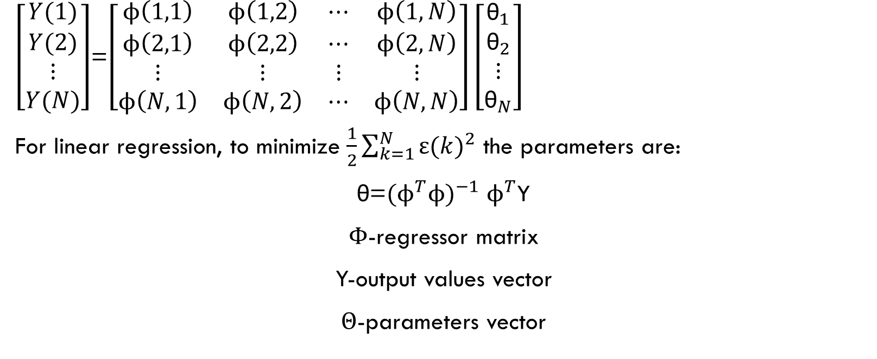
Applying linear regression
$\left[\begin{aligned}Y(1) \\ Y(2) \\ ⋮ \\ Y(N)\end{aligned}\right]$=$\left[\begin{matrix}ϕ\left(1,1\right) & ϕ\left(1,2\right) & ⋯ & ϕ\left(1,N\right) \\ ϕ\left(2,1\right) & ϕ\left(2,2\right) & ⋯ & ϕ\left(2,N\right) \\ ⋮ & ⋮ & ⋮ & ⋮ \\ ϕ\left(N,1\right) & ϕ\left(N,2\right) & ⋯ & ϕ\left(N,N\right)\end{matrix}\right]\left[\begin{aligned}{\text{θ}}_{1} \\ {\text{θ}}_{2} \\ ⋮ \\ {\text{θ}}_{N}\end{aligned}\right]$
For linear regression, to minimize $\frac{1}{2}\sum_{k=1}^{N}{{ε(k)}^{2}}$ the parameters are:
$\text{θ}\text{=}{{(ϕ}^{T}ϕ)}^{−1}$ $ϕ^{T}$Y
$Φ$-regressor matrix
Y-output values vector
$Θ$-parameters vector

Slide 6
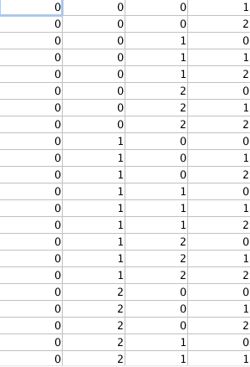
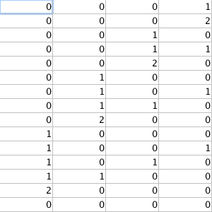
Regressor Computation
Let’s take na=nb=2, nk=1 and
m=2. The designed algorithm
for the regressor will contain all
possible combinations of powers
of input/output variables.

Slide 7
Prediction and simulation
Prediction → determining the next output of the system based on previous ones
y(k) = p(y(k - 1), … , y(k - na), u(k - 1), … , u(k - nb))
Simulation → the true outputs are unknown, previously simulated outputs must be used
yhat(k) = p(yhat(k - 1), … , yhat(k - na), u(k - 1), … , u(k - nb))
Usually the prediction is more accurate than the simulation.

Slide 8
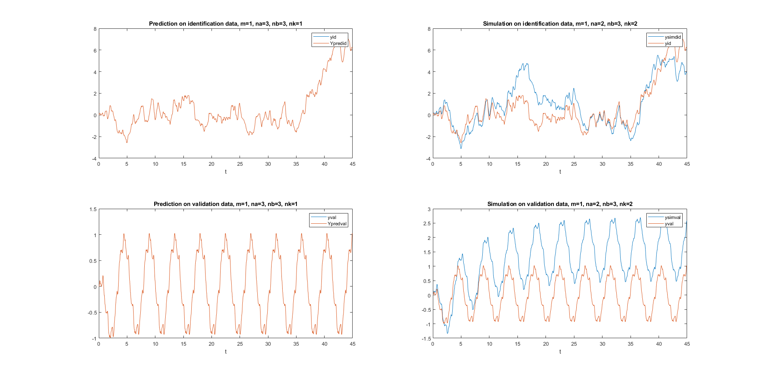
P&S for different values of the system degree
These plots are made for the best parameters with respect to that degree.

Slide 9
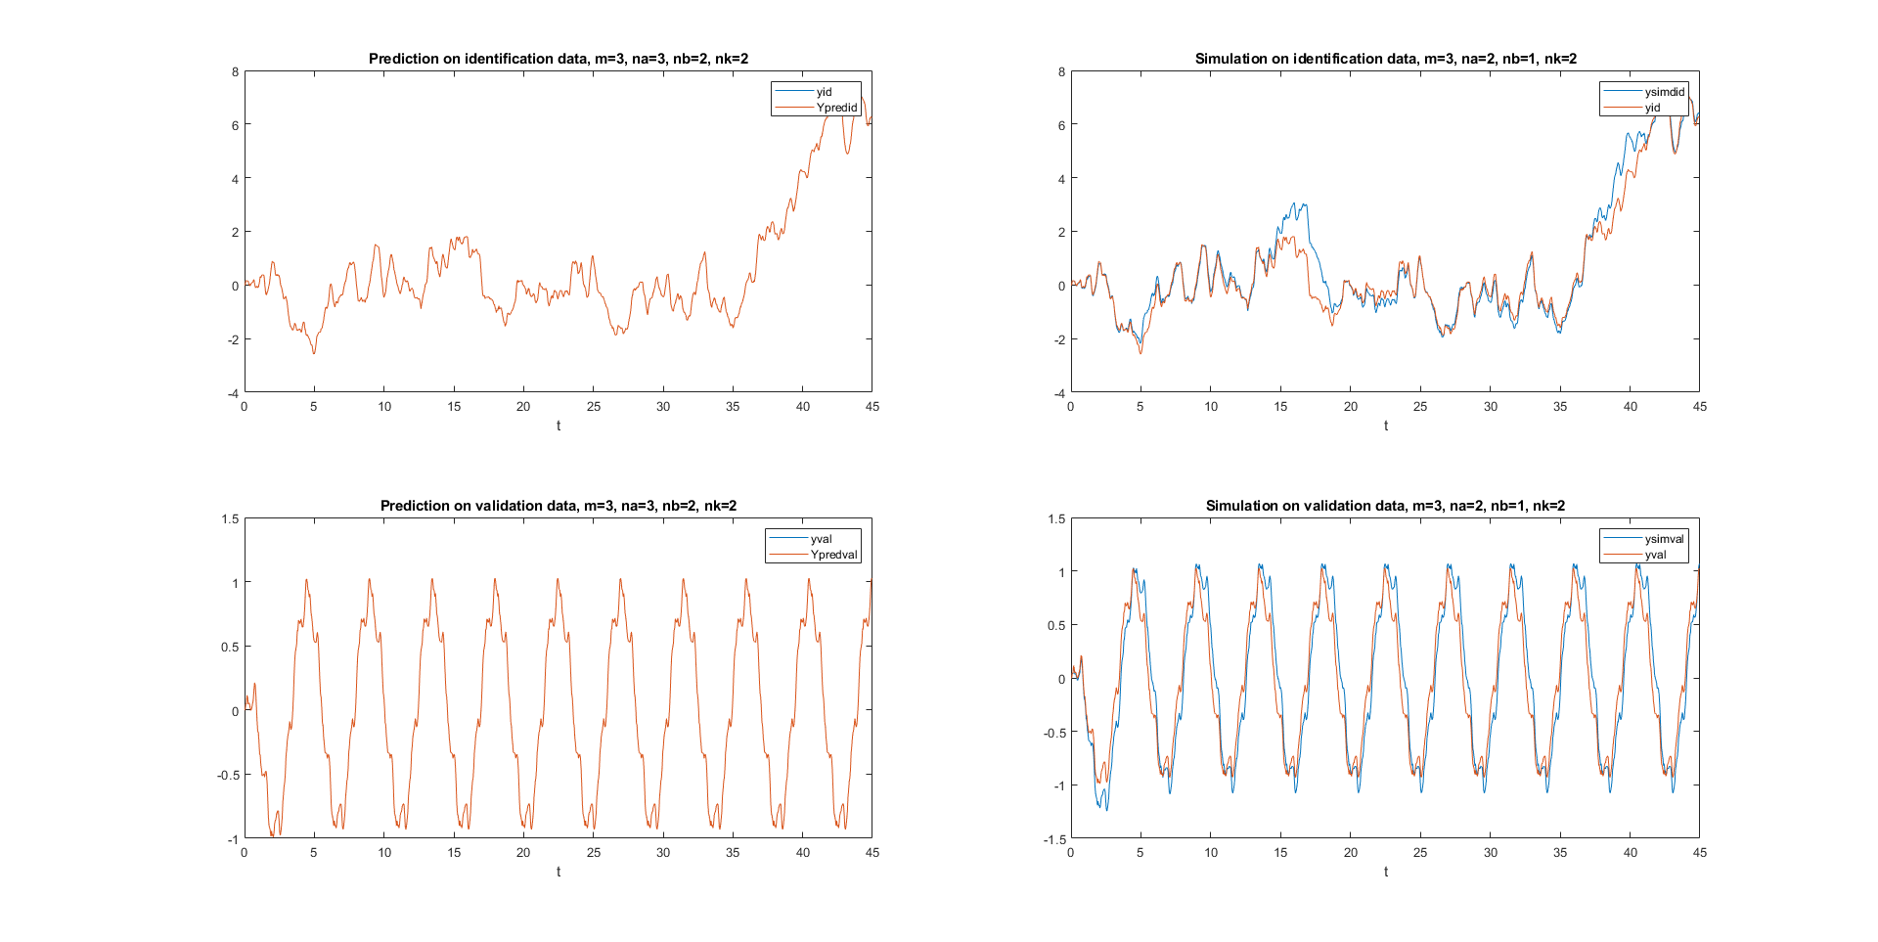
P&S for different values of the system degree

Slide 10
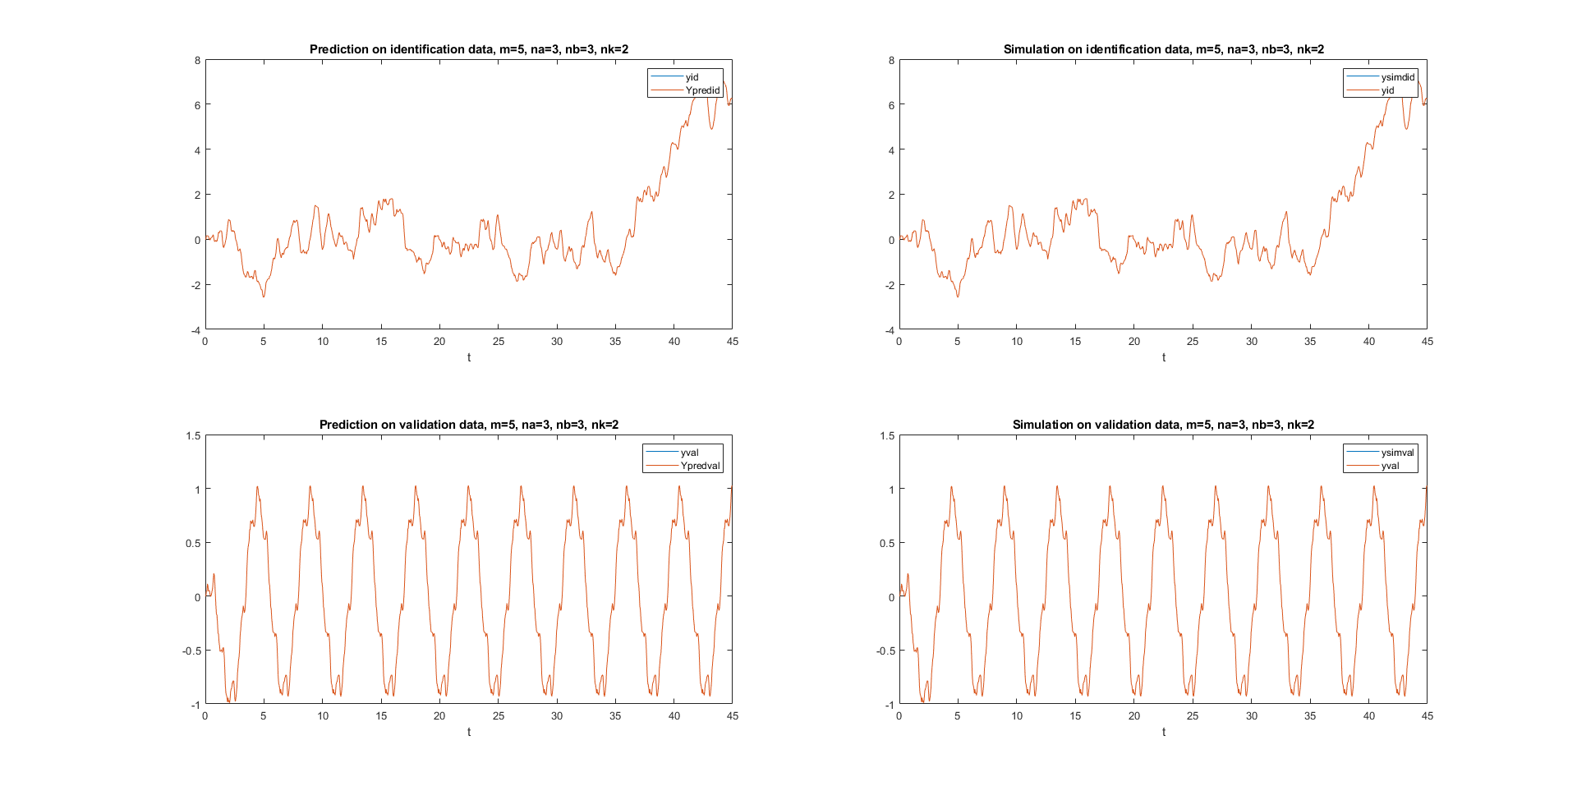
BEST MODEL
Definitely increasing the order of the system on the best parameters gives better results,
until overfitting occurs (m ≥ 6).

Slide 11
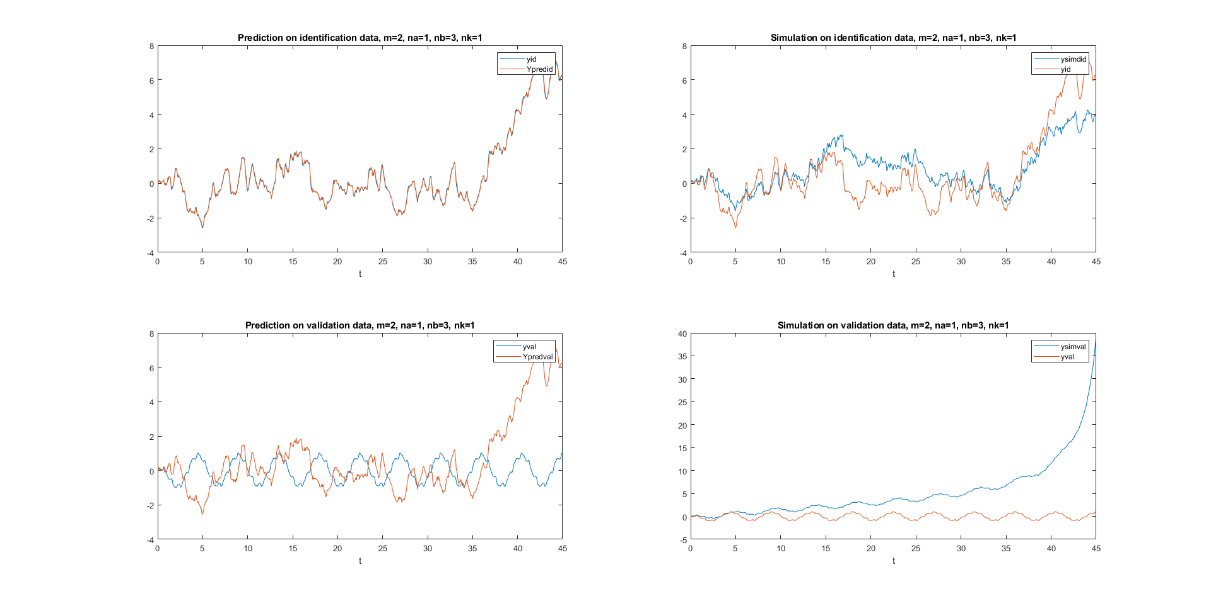
Results can get quite bad…
For different values of na, nb and nk other than the best ones the results get a bigger error even when predicting, on the simulation part the impact is even clearer.

Slide 12
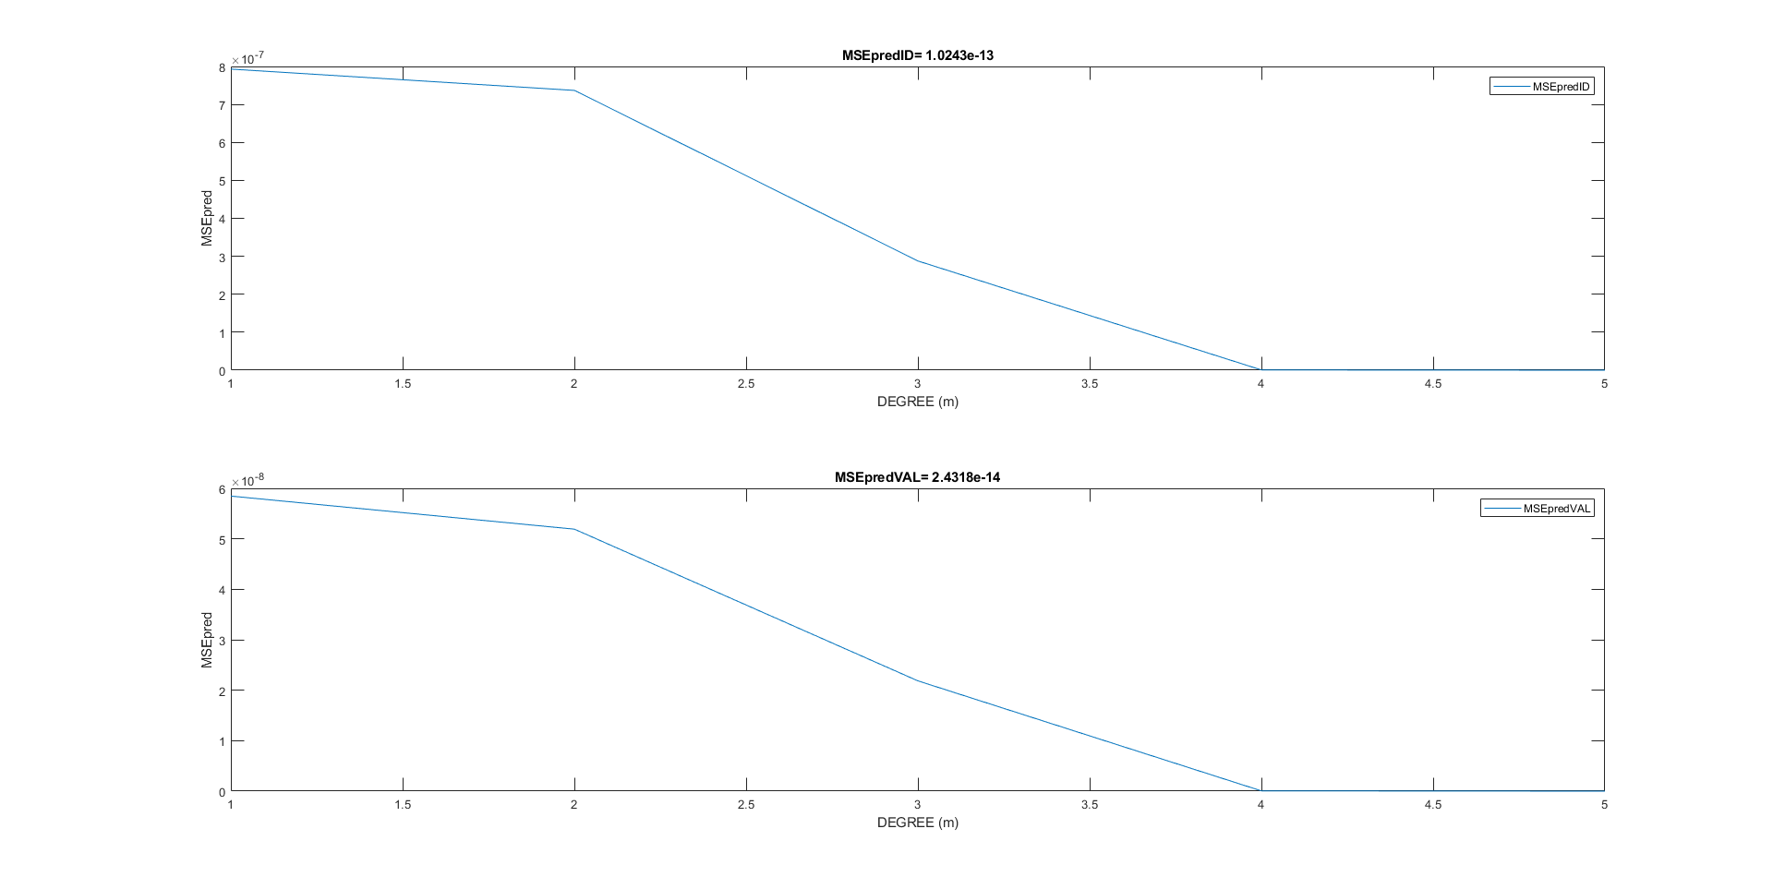
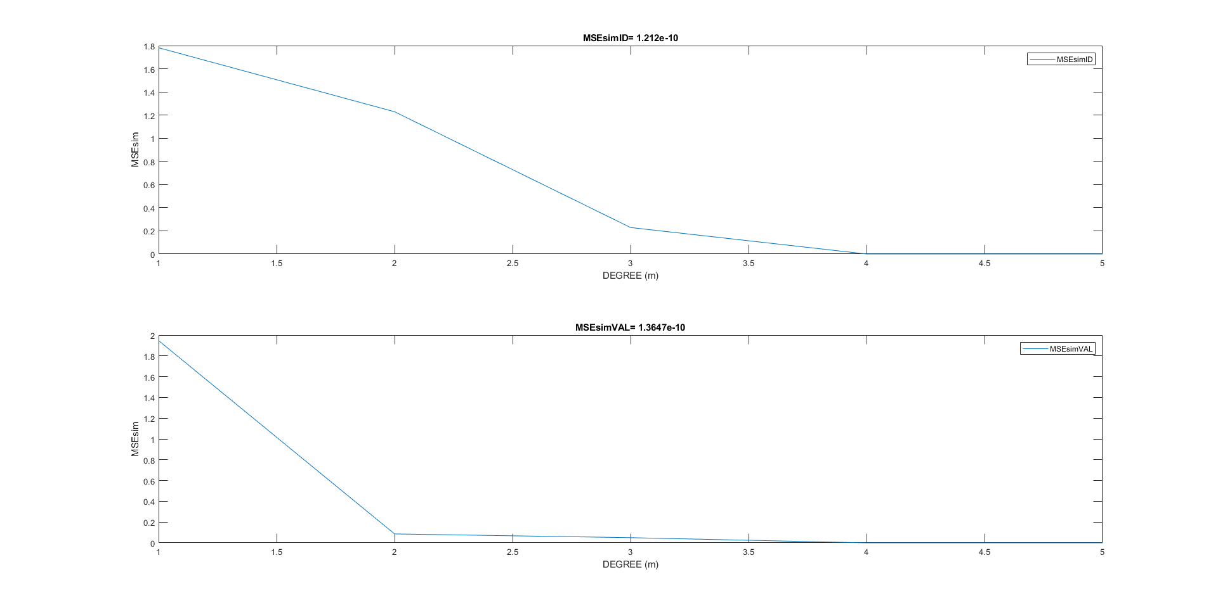
ERROR VS DEGREE

Slide 13
Conclusions
The results are highly dependent on the values of the specific parameters of the system (na, nb, nk and m), so choosing them wisely will lead to good performances on both set of data.
Increasing the order of the system too much causes overfitting which highly decreases the results accuracy.
Nonlinear ARX gives better prediction and simulation performances than standard ARX structure due to it’s nonlinearity.

Slide 14



