Slide 1
Implementarea arhitecturii {
introducere.v
top.v
[MIPS în Verilog]
Prezentat de
< Crăciun Mihai, Summer Practice Student >
}
Advanced Micro Devices Inc.

Slide 2
‘Cuprins’ {
01
02
03
introducere.v
top.v
Schema arhitecturii MIPS
< Se va prezenta o schemă simplă a microprocesorului >
Implementarea în Verilog
< Se vor explora modulele implementate în Verilog și strategiile de eficientizare >
Probleme și concluzii
< Se vor enumera problemele întâmpinate, rezolvarea acestora și experiențele dobândite >
}
Advanced Micro Devices Inc.

Slide 3
01 {
[Schema arhitecturii MIPS]
top.v
introducere.v
< Microprocesorul MIPS este o arhitectură RISC caracterizată printr-un set redus de instrucțiuni, 32 de registre generale de 32 de biți, format fix de instrucțiuni de 32 de biți și o eficiență crescută. >
}
Advanced Micro Devices Inc.

Slide 4
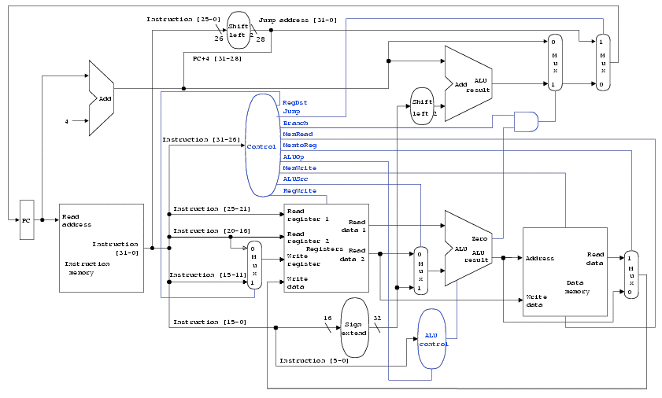
Schema Arhitecturii{ MIPS
}

Slide 5
02 {
[Implementarea în Verilog]
top.v
introducere.v
< Implementarea microprocesorului MIPS în Verilog implică crearea de module pentru unități precum unitatea de control, ALU, unitatea de registru și memoria, utilizând strategii de eficientizare cum ar fi optimizarea utilizării resurselor hardware. >
}
Advanced Micro Devices Inc.

Slide 6
Conținutul modulului ‘ALU’;
introducere.v
top.v
module ALU #(parameter DATA_WIDTH = 32)(
input [DATA_WIDTH - 1:0] A,
input [DATA_WIDTH - 1:0] B,
input [3:0] OP,
output reg ERR_RESERVED,
output reg OF, // overflow / underflow bit : if set such error happened
output reg ZERO, // returns 1 if logical expression is true
output reg [DATA_WIDTH - 1:0] O
);
always@(A or B or OP)
case(OP)
4'b0000: begin
{OF, O} = A + B;
ZERO = 1'b0;
ERR_RESERVED = 1'b0;
end
4'b0001: begin
{OF, O} = A + (~B + 1); // A - B
ZERO = 1'b0;
ERR_RESERVED = 1'b0;
end
4'b0011: begin
O = A & B; // A and B
ZERO = 1'b0;
ERR_RESERVED = 1'b0;
end
4'b0100: begin
O = A | B; // A or B
ZERO = 1'b0;
ERR_RESERVED = 1'b0;
end
4'b0101: begin
ZERO = (A < B) ? 1'b1 : 1'b0; // SLT - set less than
O = {{31{1'b0}}, ZERO};
ERR_RESERVED = 1'b0;
end
4'b0110: begin
ZERO = (A == B) ? 1'b1 : 1'b0; // SEQ - set if equal
O = {{31{1'b0}}, ZERO};
ERR_RESERVED = 1'b0;
end
4'b0111: begin
ZERO = (A != B) ? 1'b1 : 1'b0; // SNE - set if not equal
O = {{31{1'b0}}, ZERO};
ERR_RESERVED = 1'b0;
end
4'b1000: begin
ZERO = 1'b0;
{OF, O} = A << B; // SHL - shift left
ERR_RESERVED = 1'b0;
end
4'b1001: begin
ZERO = 1'b0;
O = A >> B; // SHR - shift right
ERR_RESERVED = 1'b0;
end
default: begin
ERR_RESERVED = 1'b1;
ZERO = 1'b0;
OF = 1'b0;
O = {DATA_WIDTH{1'b0}};
end
endcase
endmodule
Advanced Micro Devices Inc.

Slide 7
Conținutul modulului ‘Control’;
introducere.v
top.v
module control(
input [5:0] OPCODE,
input [5:0] FUNCT,
input ZERO,
output reg REGDST,
output reg REGWRITE,
output reg EXTOP,
output reg ALUSRC,
output reg [3:0] ALUOP,
output reg MEMWRITE,
output reg MEM2REG,
output reg PCSRC,
output reg PCLOAD
);
always@(OPCODE or FUNCT or ZERO)
casex({OPCODE, FUNCT})
// ADD
12'b000000_100000:
{REGDST, REGWRITE, EXTOP, ALUSRC, ALUOP, MEMWRITE, MEM2REG, PCSRC, PCLOAD} = 12'b1_1_0_0_0000_0_1_0_0;
// SUB
12'b000000_100010:
{REGDST, REGWRITE, EXTOP, ALUSRC, ALUOP, MEMWRITE, MEM2REG, PCSRC, PCLOAD} = 12'b1_1_0_0_0001_0_1_0_0;
// AND
12'b000000_100100:
{REGDST, REGWRITE, EXTOP, ALUSRC, ALUOP, MEMWRITE, MEM2REG, PCSRC, PCLOAD} = 12'b1_1_0_0_0011_0_1_0_0;
// OR
12'b000000_100101:
{REGDST, REGWRITE, EXTOP, ALUSRC, ALUOP, MEMWRITE, MEM2REG, PCSRC, PCLOAD} = 12'b1_1_0_0_0100_0_1_0_0;
// SLT
12'b000000_101010:
{REGDST, REGWRITE, EXTOP, ALUSRC, ALUOP, MEMWRITE, MEM2REG, PCSRC, PCLOAD} = 12'b1_1_0_0_0101_0_1_0_0;
// ADDI - we take imm from instruction so we need extension.
12'b001000_xxxxxx:
{REGDST, REGWRITE, EXTOP, ALUSRC, ALUOP, MEMWRITE, MEM2REG, PCSRC, PCLOAD} = 12'b0_1_1_1_0000_0_1_0_0;
// SW instruction: SW $source register's address, offset($destination register's address).
12'b101011_xxxxxx:
{REGDST, REGWRITE, EXTOP, ALUSRC, ALUOP, MEMWRITE, MEM2REG, PCSRC, PCLOAD} = 12'b0_0_0_1_0000_1_0_0_0;
// LW instruction: LW $destination register's address, offset($source register's address).
12'b100011_xxxxxx:
{REGDST, REGWRITE, EXTOP, ALUSRC, ALUOP, MEMWRITE, MEM2REG, PCSRC, PCLOAD} = 12'b0_1_0_1_0000_0_0_0_0;
// BEQ instruction: BEQ $first source register's address, $second source register's address, branch value.
12'b000100_xxxxxx:
{REGDST, REGWRITE, EXTOP, ALUSRC, ALUOP, MEMWRITE, MEM2REG, PCSRC, PCLOAD} = {10'b0_0_1_0_0110_0_1, ZERO, 1'b0};
// J instruction: J address. (26 bits)
12'b000010_xxxxxx:
{REGDST, REGWRITE, EXTOP, ALUSRC, ALUOP, MEMWRITE, MEM2REG, PCSRC, PCLOAD} = 12'b0_0_0_0_0000_0_0_0_1;
default:
{REGDST, REGWRITE, EXTOP, ALUSRC, ALUOP, MEMWRITE, MEM2REG, PCSRC, PCLOAD} = 12'b0_0_0_0_0000_0_0_0_0;
endcase
endmodule
Advanced Micro Devices Inc.

Slide 8
Conținutul modulului ‘REGBank’;
introducere.v
top.v
module REG_BANK(
input clk,
input REGWRITE,
input [4:0] RA1, // rs1
input [4:0] RA2, // rs2
input [4:0] WA, // rd (write address, in this case addr of reg)
input [31:0] WD, // write data (what we take from memory)
output [31:0] RD1, // output of RD1
output [31:0] RD2 // output of RD2
);
reg [31:0] REGCONTENT[31:0]; // 32 registers
initial begin ... // (we initialize each register with 0)
always@(posedge clk)
if(WA >= 5'b00001 && REGWRITE)
REGCONTENT[WA] <= WD;
assign RD1 = REGCONTENT[RA1];
assign RD2 = REGCONTENT[RA2];
endmodule
REGCONTENT[0] = 0; // zero
REGCONTENT[1] = 0; // at
REGCONTENT[2] = 0; // v0
REGCONTENT[3] = 0; // v1
REGCONTENT[4] = 0; // a0
REGCONTENT[5] = 0; // a1
REGCONTENT[6] = 0; // a2
REGCONTENT[7] = 0; // a3
REGCONTENT[8] = 0; // t0
REGCONTENT[9] = 0; // t1
REGCONTENT[10] = 0; // t2
REGCONTENT[11] = 0; // t3
REGCONTENT[12] = 0; // t4
REGCONTENT[13] = 0; // t5
REGCONTENT[14] = 0; // t6
REGCONTENT[15] = 0; // t7
REGCONTENT[16] = 0; // t8
REGCONTENT[17] = 0; // t9
REGCONTENT[18] = 0; // s0
REGCONTENT[19] = 0; // s1
REGCONTENT[20] = 0; // s2
REGCONTENT[21] = 0; // s3
REGCONTENT[22] = 0; // s4
REGCONTENT[23] = 0; // s5
REGCONTENT[24] = 0; // s6
REGCONTENT[25] = 0; // s7
REGCONTENT[26] = 0; // k0
REGCONTENT[27] = 0; // k1
REGCONTENT[28] = 0; // gp
REGCONTENT[29] = 0; // sp
REGCONTENT[30] = 0; // fp
REGCONTENT[31] = 0; // ra
Advanced Micro Devices Inc.

Slide 9
Conținutul modulului ‘IM’;
introducere.v
top.v
// instruction memory (ROM)
module im(
input clk,
input [31:0] ADDR,
output reg [31:0] INSTRUCTION
);
reg [31:0] rom_content [255:0];
initial begin
$readmemb ("rom_content.mem", rom_content);
end
// to actually index rom content by multiples of 4
// we must divide PC by 4, so we ignore bit 1 and 0
// this way we can index via multiples of 4.
always@(posedge clk)
if(ADDR[31:2] <= 255) // maximum of 255 instructions
INSTRUCTION <= rom_content[ADDR[31:2]];
else
INSTRUCTION <= 32'hffff;
endmodule
Advanced Micro Devices Inc.

Slide 10
Conținutul modulului ‘DM’;
introducere.v
top.v
// data memory
module dm(
input clk,
input [31:0] WD,
input [31:0] ADDR,
input [11:0] SW_LADDR_WD, // will act as last address data in. -> STDIN
input MEMWRITE, // WRITE ENABLE (WE)
output [31:0] RD,
output [11:0] RD_LADDR, // will output last 12 bits of the content at the last address in memory. -> STDOUT
output [31:0] VMEMORY_CONTENT // will output RAM[253] mapped as "video memory"
);
reg [31:0] ram_content [255:0]; // ONE-HOT lines.
initial begin ... // we initialize each ram address content with 0
always@(posedge clk) begin
if(MEMWRITE) begin
ram_content[ADDR] <= WD;
end
ram_content[254] <= {20'b0, SW_LADDR_WD}; // IO -> STDIN (FD0)
end
assign RD = (MEMWRITE <= 1'b0) ? ram_content[ADDR] : {32{1'bx}};
assign RD_LADDR = ram_content[255][11:0]; // IO -> STDOUT (FD1)
assign VMEMORY_CONTENT = ram_content[253][11:0]; // IO -> VMEM
endmodule
// we write in offsets of 32 bits, so
// we ignore bits 0 and 1 (division by 4)
// we can also store with byte-offset using this instruction.
// basically, RAM[OFFSET/4 << 8*OFFSET%4] = value.
// {ram_content[ADDR[31:2] + 1], ram_content[ADDR[31:2]]} <= ((WD << (8 * ADDR[1:0])));
// however, we will keep the design simple and efficient for our needs.
// we can also load with offset using this.
// wire [63:0] auxreg_lwoffset;
// assign auxreg_lwoffset = (({ram_content[ADDR[31:2] + 1], ram_content[ADDR[31:2]]} >> (8 * ADDR[1:0]));
Advanced Micro Devices Inc.

Slide 11
Conținutul modulului ‘MIPS_PROC’;
introducere.v
top.v
module MIPS_PROC(
input clk,
input [11:0] SW_VALUES,
output [11:0] RD_LADDR,
output [31:0] VMEM
);
wire ... // declare signals used by each module instantiation
// PROGRAM COUNTER LOGIC
reg [31:0] PC;
reg RESET_SYS = 1'b0;
always@(posedge clk) begin
if(RESET_SYS <= 1'b0) begin
PC = 0;
RESET_SYS = 1'b1;
end
else begin
if(PCSRC >= 1'b1)
PC = PC + 4 + (sign_ext_imm << 2);
else if (PCLOAD >= 1'b1)
PC = {PC[31:28], {IM_CONTENT[25:0] << 2}};
else
PC = PC + 4;
end
end
// END PROGRAM COUNTER LOGIC
im im_inst( ... );
control MAIN_CONTROL_inst( ... );
assign REGBNK_RA1 = IM_CONTENT[25:21];
assign REGBNK_RA2 = IM_CONTENT[20:16];
assign REGBNK_WA_IN = (REGDST == 1'b0) ? IM_CONTENT[20:16] : IM_CONTENT[15:11];
assign REGBNK_WD = (MEM2REG == 1'b0) ? DM_OUT : ALU_OUT;
REG_BANK REG_BANK_inst( ... );
// SIGN EXTENDER LOGIC
assign sign_ext_imm = (EXTOP == 1'b1) ? {{16{IM_CONTENT[15]}}, IM_CONTENT[15:0]} : {{16{1'b0}}, IM_CONTENT[15:0]};
assign ALU_B_IN = (ALUSRC == 1'b0) ? REGBNK_RD2 : sign_ext_imm;
ALU ALU_inst( ... );
dm dm_inst( ... );
endmodule
Advanced Micro Devices Inc.

Slide 12
Conținutul modululelor ‘Display’;
introducere.v
top.v
module clk_divider(
input clk,
input [31:0] di,
output reg clk_out
);
reg [31:0] counter;
initial begin
clk_out = 0;
counter = 0;
end
always@(posedge clk)
begin
if (counter >= di - 1) begin
counter <= 0;
clk_out <= ~clk_out; // toggle clk_out every di clock cycles
end else begin
counter <= counter + 1;
end
end
endmodule
// this module codificates the anodes of each display digit as a whole.
module dec2_4(
input [1:0] ain,
output reg [3:0] aout
);
always@(ain)
begin
case(ain)
2'b00: aout = 4'b0001;
2'b01: aout = 4'b0010;
2'b10: aout = 4'b0100;
2'b11: aout = 4'b1000;
endcase
aout = ~aout;
end
endmodule
module cnt2(
input clk,
output reg [1:0] do
);
always@(posedge clk)
begin
if(do <= 2'b11)
do <= do + 1;
else
do <= 2'b00;
end
endmodule
Advanced Micro Devices Inc.

Slide 13
Conținutul modululelor ‘Display’;
introducere.v
top.v
module dig_dec(
input [3:0] di,
output reg a,
output reg b,
output reg c,
output reg d,
output reg e,
output reg f,
output reg g
);
// we code the led display (from left to right)
// __ a
// | | f and b
// -- g
// | | e and c
// __ d
always@(di)
begin
casex(di) //abcdefg
4'b0000: {a, b, c, d, e, f, g} = 7'b1111110; // 0 -> a, b, c, d, e, f
4'b0001: {a, b, c, d, e, f, g} = 7'b0110000; // 1 -> b, c
4'b0010: {a, b, c, d, e, f, g} = 7'b1101101; // 2 -> a, b, d, e, g
4'b0011: {a, b, c, d, e, f, g} = 7'b1111001; // 3 -> a, b, c, d, g
4'b0100: {a, b, c, d, e, f, g} = 7'b0110011; // 4 -> b, c, f, g
4'b0101: {a, b, c, d, e, f, g} = 7'b1011011; // 5 -> a, c, d, f, g
4'b0110: {a, b, c, d, e, f, g} = 7'b1011111; // 6 -> a, f, g, c, d, e
4'b0111: {a, b, c, d, e, f, g} = 7'b1110000; // 7 -> a, b, c
4'b1000: {a, b, c, d, e, f, g} = 7'b1111111; // 8 -> a, b, c, d, e, f, g
4'b1001: {a, b, c, d, e, f, g} = 7'b1111011; // 9 -> a, b, c, d, f, g
4'b1010: {a, b, c, d, e, f, g} = 7'b1110111; // 10 (A) -> a, b, c, e, f, g
4'b1011: {a, b, c, d, e, f, g} = 7'b0011111; // 11 (b) -> f, g, c, d, e
4'b1100: {a, b, c, d, e, f, g} = 7'b0001101; // 12 (c) -> d, e, g
4'b1101: {a, b, c, d, e, f, g} = 7'b0111101; // 13 (d) -> b, c, d, e, g
4'b1110: {a, b, c, d, e, f, g} = 7'b1001111; // 14 (E) -> a, d, e, f, g
4'b1111: {a, b, c, d, e, f, g} = 7'b1000111; // 15 (F) -> a, e, f, g
default: {a, b, c, d, e, f, g} = 7'b0000001; // - (err) -> g
endcase
{a, b, c, d, e, f, g} = ~{a, b, c, d, e, f, g};
end
endmodule
Advanced Micro Devices Inc.

Slide 14
Conținutul modululelor ‘Display’;
introducere.v
top.v
module display_top(
input clk,
input [31:0] di,
output a,
output b,
output c,
output d,
output e,
output f,
output g,
output A1,
output A2,
output A3,
output A4
);
reg [31:0] rot_reg; // this will be the value to be displayed, but we will rotate it continuously.
reg [2:0] rotation_counter; // this will be the counter at which the the register will be updated with di.
wire [3:0] dig_dec_in; // this will be the input to the digital decoder for the display.
// this sets the active segments of the 7-segment display digit.
wire [1:0] cnt2_out; // this will be the output of the 2 bit counter.
// this cycles through the selected display segment to be updated.
wire clk_div_display; // this will determine the refresh rate of the display.
wire clk_div_rotate; // this will determine the rotation speed of the display, since we can only display 16 bits at a time.
wire [15:0] din_main; // this will be the input to the leds at the current posedge of the divided clock.
// we want 60hz, if board internal clock is 33.33MHz we divide this value by 60 * 4 to reduce flicker
localparam disp_div_amount = 138875; // 33.33 MHz * 1 second -> faster: divide this value -> currently about 240hz - SIM WITH 1 or so.
// the display will be rotated at about 60hz.
localparam rot_div_amount = 555500; // 4 times slower than the display refresh rate : SIMULATE WITH 4x disp_div_amount
initial
rotation_counter = 0;
clk_divider clkdiv_disp( ... );
clk_divider clkdiv_rot( ... );
cnt2 cnt( ... );
dig_dec digdec( ... );
dec2_4 dec( ... );
always@(posedge clk_div_rotate) begin
if (rotation_counter <= 3'd0) begin
rotation_counter <= 3'd4; // Reset counter after full rotation cycle
rot_reg <= di; // update with new input data - only after rotation is complete
end else begin
rotation_counter <= rotation_counter - 1; // decrement counter
rot_reg <= {rot_reg[3:0], rot_reg[31:4]}; // rotate right by 4 bits
end
end
assign din_main = rot_reg[15:0]; // this is the current display value.
assign dig_dec_in = (cnt2_out == 2'b00) ? din_main[3:0] :
(cnt2_out == 2'b01) ? din_main[7:4] :
(cnt2_out == 2'b10) ? din_main[11:8] :
(cnt2_out == 2'b11) ? din_main[15:12] : 4'bxxxx;
endmodule
Advanced Micro Devices Inc.

Slide 15
Conținutul modulului ‘Top’;
introducere.v
top.v
module main_top(
input clk,
input STEP_BTN, // we use a button as a step instruction debug for the MIPS processor
input [11:0] SW_IN, // this is the input from the switches, also known as IO(FD0 - IN)
output [11:0] IO_LED_OUT, // this is the output to LEDs, also known as IO(FD1 - OUT)
output a, // a, b, c, d, e, f, g will set the segment display.
output b,
output c,
output d,
output e,
output f,
output g,
output A1, // the anodes of each display digit.
output A2,
output A3,
output A4
);
wire [31:0] DISPLAY_IN;
wire STEP;
one_period op(
.clk(clk),
.in(STEP_BTN),
.out(STEP)
);
MIPS_PROC MIPS_PROC_dut(
.clk(clk & STEP),
.SW_VALUES(SW_IN),
.RD_LADDR(IO_LED_OUT),
.VMEM(DISPLAY_IN)
);
display_top display_inst( ... );
endmodule
module one_period(
input clk,
input in,
output out
);
reg [1:0] cs = 2'b0;
reg [1:0] ns;
always@(posedge clk)
cs <= ns;
always@(cs or in)
case({cs, in}) // we treat the case in which the clock is very fast.
3'b00_0 : ns = 2'b00; // state 0: button is not pressed
3'b00_1 : ns = 2'b01; // we press the button, we enter the state in which we should execute
3'b01_0 : ns = 2'b00; // if we release, we return in state 0
3'b01_1 : ns = 2'b10; // if we hold, we enter the hold state
3'b10_0 : ns = 2'b00; // if we release, we exit hold state
3'b10_1 : ns = 2'b10; // if we hold the button, we stay here
endcase
assign out = (cs == 2'b01) ? 1'b1 : 1'b0;
endmodule
Advanced Micro Devices Inc.

Slide 16
Conținutul ‘rom_content.mem’;
introducere.v
top.v
100011_00000_00001_0000000011111110 // lw $at, 254($zero) -> will read from ram[254] in register 1 <- STDIN
101011_00000_00001_0000000011111111 // sw $at, 255($zero) -> will write at ram[255] -> STDOUT
001000_00010_00010_0000000100000001 // addi $v0, $v0, 513 - we keep adding for testing video memory.
101011_00000_00010_0000000011111101 // sw $v0, 253($zero) -> will write at ram[253] -> VIDEO MEMORY
000010_00000000000000000000000000 // j 0 -> loop main program
Advanced Micro Devices Inc.

Slide 17
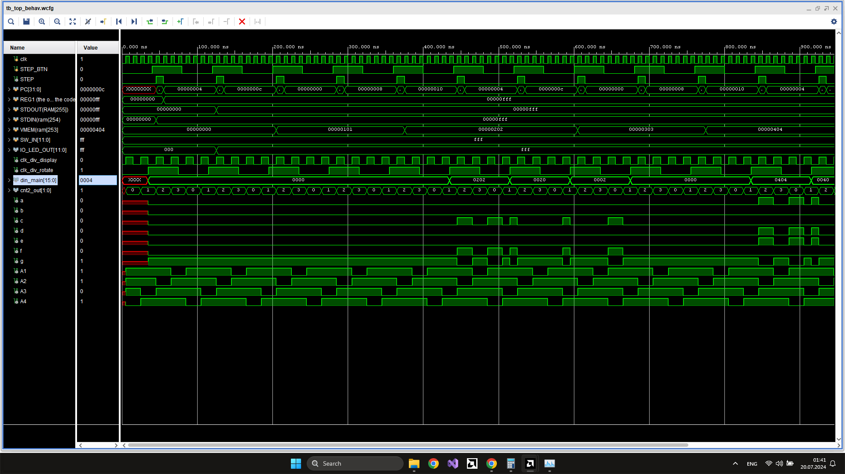
Simulare Vivado

Slide 18
03 {
[Probleme și concluzii]
top.v
introducere.v
}
Advanced Micro Devices Inc.

Slide 19
Probleme întâmpinate {
< /probleme >
< /soluții >
introducere.v
top.v
< Ca și în cadrul unui mediu de dezvoltare obișnuit, au apărut o serie de probleme și au fost identificate soluții adecvate. >
Eficiență redusă ALU.
Nu se poate citi și scrie simultan în bancul de registre.
Apăsarea butonului de step duce la executarea a multiple instrucțiuni.
Definirea scăderii drept adunare cu complementul față de 2.
Implementarea bancului de registre similară cu un modul RAM.
Introducerea unui modul one-period.
}
Advanced Micro Devices Inc.

Slide 20
Experiențe dobândite {
introducere.v
top.v
Lucru în echipă
Sinteză și verificare
Am colaborat cu trainerii și colegii la unele probleme întâmpinate
Testarea modulelor Verilog și sinteza pe hardware real
Arhitectura microprocesoarelor
Optimizare de performanță
Detalii despre funcționarea internă a microprocesoarelor
Experimentarea cu strategii de eficientizare
Design hardware
FPGA
Utilizarea limbajului Verilog
Utilizarea FGPA pentru testare: AMD Xilinx Zynq-7000 xc7z007sclg400-1
}
Advanced Micro Devices Inc.

Slide 21
Mulțumesc { pentru atenție!
top.v
introducere.v
}
Advanced Micro Devices Inc.

