Slide 1
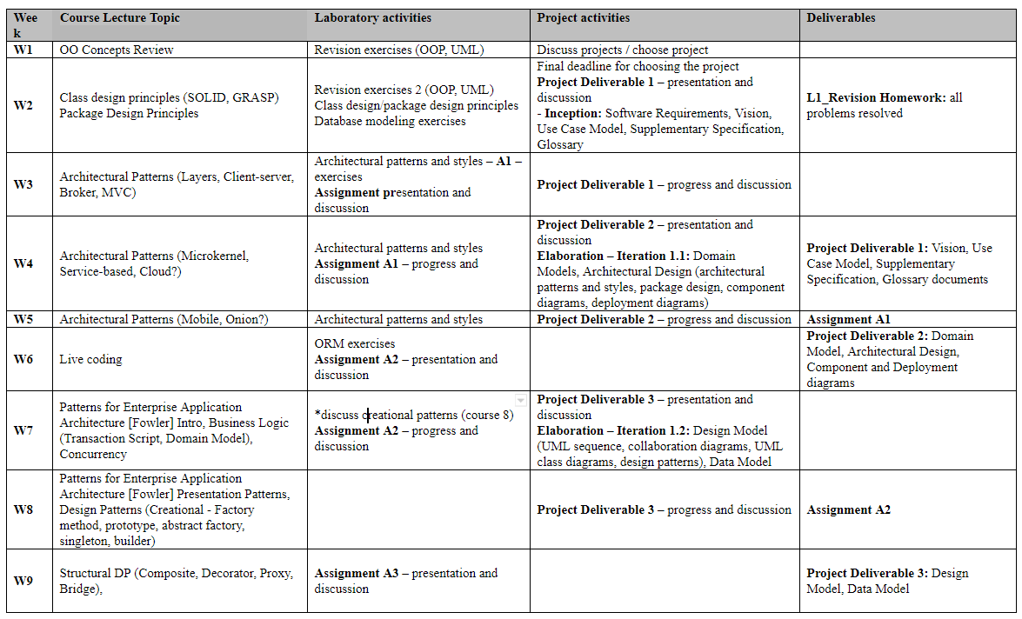
Schedule

Slide 2
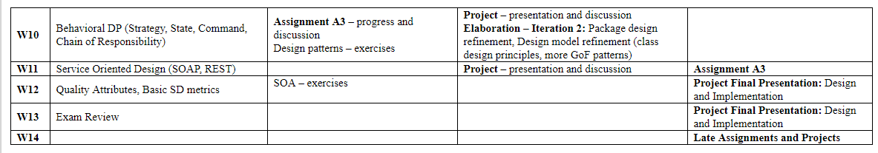

Slide 3
Grading
Assignment grading = 0.4 * Documentation_grade + 0.6 * Implementation_grade
Project grading = 0.1*Deliverable1 + 0.1*Deliverable2 + 0.1*Deliverable3 + 0.3*Final Design + 0.4*Implementation
Extra points/ penalties can be given each lab

