Slide 1
Project session 2
Proiectare Software 2018

Slide 2
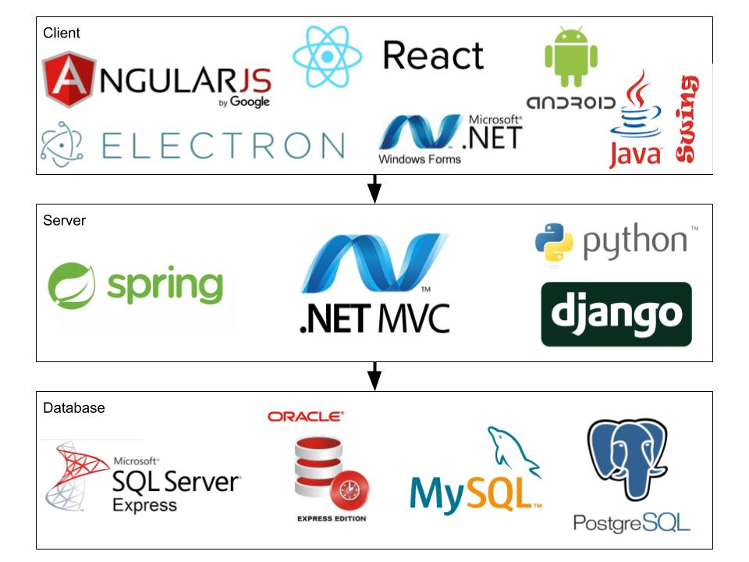
Choosing the technology

Slide 3
Project Deliverable 1 - Deadline: 15.03.2021
Vision
Use Case Model
Supplementary Specification
Glossary – will be updated later on

Slide 4
Project Deliverable 1 - Vision
Introduction - explain the purpose of this document
Positioning
What problem does the system solve?
Position/need in the marketplace this system will fill
Stakeholder and user descriptions
Stakeholders (Sponsors, Backoffice guys, Admins, Owner of the system)
Users (end users)
Product Requirements
High level functional requirements

Slide 5
Project Deliverable 1 - Use Case Model
Describe the three most important use cases
Description + UML diagram
https://yuml.me/diagram/scruffy/usecase/draw

Slide 6
Project Deliverable 1 - Supplementary Specification
Non-functional requirements
Availability
Performance
Response time (Certain page must load in < 500ms)
Can work fine under high load (100 requests/second)
Security
Authentication and Authorization
Https only
Store password hashes
Prevent SQL injection
Keep sensitive information encrypted
Testability
Easy to automate
Unit tests
Logging
Usability
How easy it is for certain users to do certain things
Usually a trade-off with other requirements
Design constraints (imagination)
Non-functionals (Quality Attributes) drive architecture decisions

Slide 7
Project Deliverable 1 - Glossary
* Specific terms from documentation that have to be defined.

Slide 8
Project Deliverable 1 - Deadline: 15.03.2018
Diagram Tools
https://draw.io
https://yuml.me/

