Slide 1

cost-Benefit Analysis
Evaluating Alternatives for Sustainable Decision-Making

Slide 2
Contents
Introduction
Estimating Benefits
What are benefits?
Methods of estimating benefits
Problems in benefit estimation
Estimating Costs
What are costs?
General considerations in cost estimation
Types of costs
Literature

Slide 3
Introduction
What is Cost-Benefit Analysis?
Compare estimated costs and benefits
Decide whether a project is viable
Decide which course of action is the best
Plan | Total Costs | Total Benefits | Benefit-Cost Ratio
Plan A | 10 | 20 | 2
Plan B | 20 | 45 | 2.25
Pros
Data-Driven approach
Makes decisions less complex
Uncovers hidden costs and benefits
Cons
Incorrect data can skew results
Might abstract away too many factors
Might ignore important factors (e.g., enforcement costs)

Slide 4
Cost-Benefit Analysis: Estimating Benefits
Benefit: Something that improves a person’s position.
How do you provide a benefit?
By giving a person something they value
How do we know a person values something?
They are willing to sacrifice something / willing to pay for it
⇒ We can determine benefits by using supply/demand curves!
Example - Estimating Benefits with Demand Curves
Common Problems:
Hard to quantify in environmental topics
Demand curves are also affected by the ability to pay
Knowledge levels about goods can affect demand

Slide 5
Methods of Estimating Benefits: Direct Damage
The value of the benefits of an environmental quality improvement = The value of the reduced damages that would otherwise take place
Method:
Measure emissions
Determine the resulting pollution levels
Estimate the resulting human exposure for these levels
Estimate the physical impacts of the exposure
Determine the (monetary) values associated with these impacts
All other risk factors must be isolated / accounted for!

Slide 6
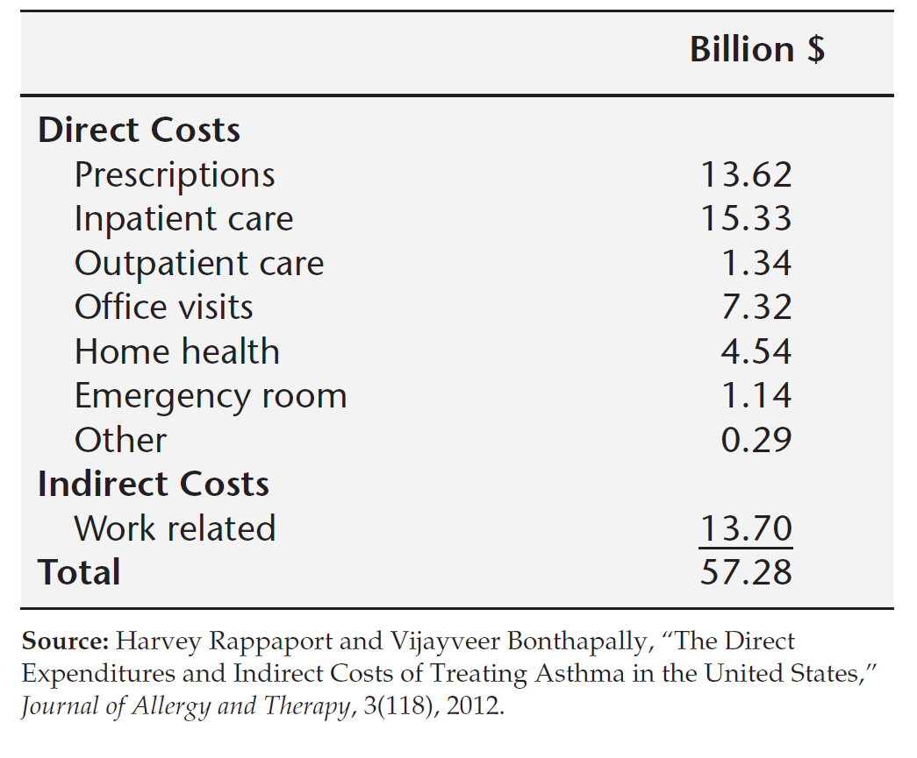
The Damage Function: Health Costs
Health costs – impacts on human health
Cost of Illness (COI) Approach:
Estimate the increased costs from a pollution related illness
Direct Costs
Hospital Visits
Medication Costs
Indirect Costs
Lost work time
Lost school days
Lost economic productivity due to deaths by the illness

Slide 7
The Damage Function: Production Costs
Production costs – impacts on the production of goods and services
Air pollution – yields of crops / amounts of timber
Water pollution – water for domestic uses / fishing industries
Workplace pollution – effectiveness of workers / deterioration of machines
Example - Benefits from Reduced Production Costs
Measure the value of the increased output
Value = Increase in Quantity * Price
Problem: Production costs may have also changed
Measure the change in net income
Value = Total Value of Output – Production Costs
Problem: Supply curves may not be known
Solution: Increased land values in the area = added net incomes

Slide 8
The Damage Function: Materials Damage
Materials damage – costs from damage on exposed surfaces, machinery, buildings, etc.
Method:
Estimate damages
Total damages = Total amount of exposed materials * rate of deterioration
Estimate increased cost of maintenance
Problem: This approach underestimates the true damages from a willingness-to-pay perspective

Slide 9
What are some other problems of Direct Damage Approaches?

Slide 10
Methods of Estimating Benefits: Willingness to Pay
WTP: Averting Costs (Revealed Preferences)
Expenditures made by the affected people to combat the problem.
Market values of the goods bought = Value of the environmental change
Value of Human Health
Expenditures people make to avoid environmentally induced symptoms
Respiratory symptoms (LA Study, 1986)
Cooking with electricity instead of gas
Air conditioning at home / in the car
$0.97 for shortness of breath
$23.87 for chest tightness
Can be used to deduce the value of a statistical life

Slide 11
Methods of Estimating Benefits: Willingness to Pay
WTP: Averting Costs (Revealed Preferences)
2. Value of Human Life
Value of a Statistical Life (VSL) – average value from a group of people to save a random individuals life
Group of 100,000 people
Average person is willing to pay $20
VSL based on WTP = 100,000 * $20 = $2,000,000 Done for adults only
3. Children’s health (Liu et.al, 2000)
Mother’s WTP for child’s health is greater than for their own

Slide 12
Methods of Estimating Benefits: Willingness to Pay
WTP: Market prices of goods (Revealed Preferences)
Variation in price of goods affected by environmental characteristics = WTP for these environmental characteristics
Industrial Wage Rates
Measure wages in two similar industries
Only difference is the risk factor (e.g., air quality)
Wage-rate differentials = value people place on removal of risk factor
Travel Costs
Sample data from multiple sites with different characteristics
House Prices
Can also measure implied VSL

Slide 13
Methods of Estimating Benefits: Willingness to Pay
WTP: Conduct surveys (Stated Preferences)
Contingent Valuation – Ask people how much they would be willing to pay in a contingent situation.
Valuing an Environmental Amenity
Clear definition of the feature / amenity
Set of questions about relevant features of the respondent
WTP Elicitation: reveal the maximum amount they would pay rather than go without the amenity
Directly asking / Bidding games / Range of Values
Valuing Health Outcomes
WTP to avoid premature mortality (similar to estimating VSL)
WTP to achieve reductions in morbidity

Slide 14
Methods of Estimating Benefits: Problems in estimation
Discounting
Tendency to undervalue future problems
Necessary to properly prioritize issues
Must not lead to a reduction in long-term environmental capital
Optimally combined with the idea of sustainability
Willingness-To-Pay vs Willingness-To-Accept
Theoretically there should be (almost) no difference
Discrepancies in studies – WTA > WTP
Responses are contingent on phrasing / framing
Estimating Nouse Values
Environmental factors don’t have use values

Slide 15
Cost-Benefit Analysis: Estimating Costs
Cost: Expenditure of resources / inputs to produce a good or service
Importance of accurately measuring costs
Under-/Overestimating costs is as detrimental as over-/underestimating benefits
Total costs should always reflect the least costs necessary to achieve the goal.

Slide 16
Estimating Costs: General Considerations
Multiple levels of analysis
Costs to a single community
Costs to an industry / region
Costs to an entire economy
With/Without Principle
Compare costs with/without the new regulations, not before/after
Costs can increase due to other future factors
True Added Costs = Costs with regulation – Costs without regulation
Private and Social Costs
Private Costs – Costs experienced by the deciding party
Social Costs – All costs of the action (incl. private + external costs)
Distribution of Costs
How are the costs distributed among different groups in society

Slide 17
Estimating Costs: Types of Costs
Opportunity Costs
The maximum value of other outputs that could have been otherwise produced
Negative externalities must be evaluated and included
Viewpoint matters (e.g., Taxes – costs for firm, but not for society)
Transfer payments are excluded
Polluting firms pay emission taxes, that go to beneficiaries
Environmental Costs
Environmental protection programs can result in further environmental costs (in another medium)
Reducing solid waste => increase in air pollution (due to incineration)
Recycling taxes => ‘midnight dumping’ (illegal disposal)
Mitigation can be planned – results in mitigation costs

Slide 18
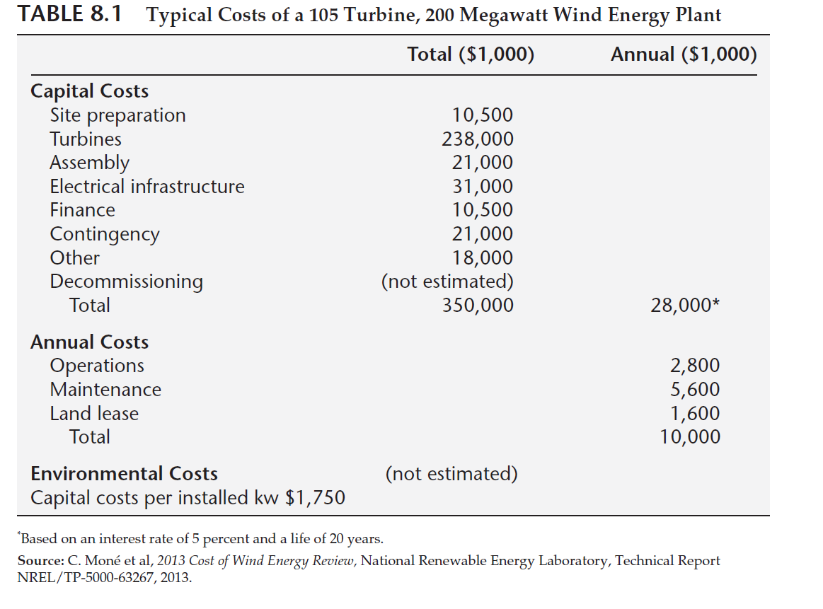
Estimating Costs: Types of Costs
Enforcement Costs
Resources for audits, monitoring, and sanctions
Opportunity costs due to reallocating resources
Costs of Single Facilities
Up-Front + Capital + Annual
Environmental Costs (optional)
Vary greatly from site to site
Hard to accurately model
Costs of Local Regulation
If regulation affects only one firm and employment is high
Small social costs
Community perspective: High costs

Slide 19
Estimating Costs: Types of Costs
Costs of Regulating an Industry
Opposite outcome from local regulation => true social opportunity costs
Estimate costs to predict how the affected firms will react
Use Cost Surveys to gather data about one firm and extrapolate it
The Effect of Output Adjustments on Costs
Example - Output Adjustments
When regulating a whole industry, market adjustments must be included
Inelastic Demand ⇒ small reduction in produced quantity
Burden on society ≈ increased cost of current output level
Little adjustment for output in industry; consumers share burden
More Elastic Demand ⇒ larger reduction in produced quantity
Burden on society ≈ increased cost of new projected output
Larger adjustment in output; burden falls on industry

Slide 20
Estimating Costs: Types of Costs
Costs at the National level
Costs = Loss in value of marketed output resulting from regulation
Bottom-up approach
Economy-wide surveys to estimate expenditures
Inter-industry effects of policies
Top-down approach
Macroeconomic mathematical models
Run on historical data
Rerun without regulation expenditures
Compare effects on GDP, employment, etc.
Future Costs and Technological Change
Short term
Long term (10+ years) – difficult to estimate

Slide 21
Literaturverzeichnis
Field, B. C. & Field, M. K. (2022). Environmental Economics. An Introduction. 7th edition. McGraw Hill.
Perman, P.; Ma, Y.; Common, M.; Maddison, D. & McGilvray, J. (2012). Natural Resource and Environmental Economics. 3rd edition. Addison Wesley.

