Slide 1
Team Number: 07 You Shall (Not) Pass Smart Door
Mihailo Rajacic, Mirzet Brkic, 15.12.2017.

Slide 2
Contents
Main idea & Features
Hardware, Architecture, Use scenario
Potential problems
Thank you!

Slide 3
Main idea & Features
Controlled access system – (im)polite way of telling people that they are (not) welcome
Features
- Detection of persons in front of the door
- Face detection and recognition using external web service
- Opening/closing door according to the face in the photo
- Adding new faces and changing the status of a face (approved/denied)
- Log of all door actions
- “You shall (not) pass”

Slide 4
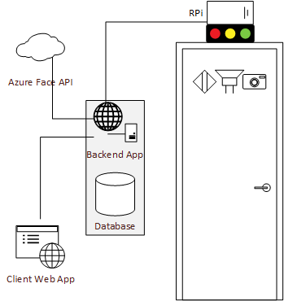
Hardware, Architecture, Use scenario
Hardware
- Raspberry Pi
- Ultrasonic Distance Sensor
- Pi Camera
- LED indication
- Servo motor
- Speakers
Software
- NodeRED app
- Backend App & Database
- Client Web App
- Azure Face API
Roles
- Host
- Guest

Slide 5
Potential problems
Picture instead of a live face
Face recognition gone wrong / relying on external service
‘The usual suspects’:
- Hardware issues
- Scalability / Deployment
- Database attacks…
Vielen Dank!
Q&A

