Slide 1
2022 ODOT Technology Conference
Notes:
Welcome and intro

Slide 2
Show of Hands
How many of you can write code?
How many of you are familiar with AI/ML/Deep Learning?
How many of you think using video to count cars or identify potholes is an easy problem?
ODOT Technology Conference 2022 TOGETHER TOWARDS TOMORROW

Slide 3
Goals
Learn how to solve Computer Vision problems
Use provided toolkit to experiment and …
Apply what you learned to solve your own problems
ODOT Technology Conference 2022 TOGETHER TOWARDS TOMORROW

Slide 4
Classical programming vs ML
ODOT Technology Conference 2022 TOGETHER TOWARDS TOMORROW

Slide 5
AI vs ML vs DL
ODOT Technology Conference 2022 TOGETHER TOWARDS TOMORROW

Slide 6
QuizZ: Deep Learning, ML, AI or Traditional Programming?
Lane Detection
https://youtu.be/OV1l5xFHiwQ?t=16
Path Planning
https://youtu.be/t7P4au6bT1Q?t=23
Vehicle Detection
https://youtu.be/kZViHcQgGYU?t=37
Behavioral Cloning
https://youtu.be/vXzgXb1rkjw?t=24

Slide 7
Biggest Challenge
Images/video represent unstructured data that is hard to analyze and interpret automatically
What can be done about it?
How can we turn unstructured information into structured?
ODOT Technology Conference 2022 TOGETHER TOWARDS TOMORROW

Slide 8
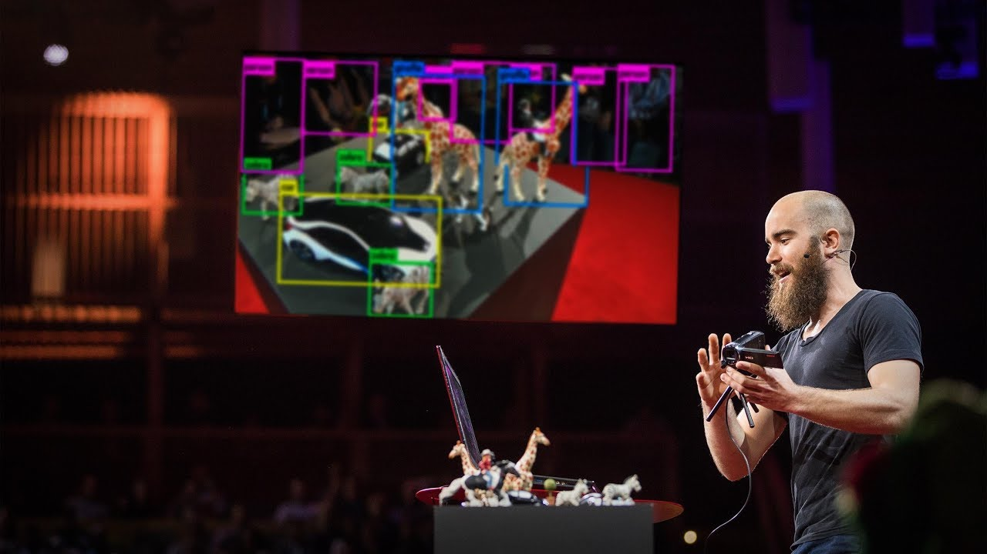
How computers learn to recognize objects
ODOT Technology Conference 2022 TOGETHER TOWARDS TOMORROW

Slide 9
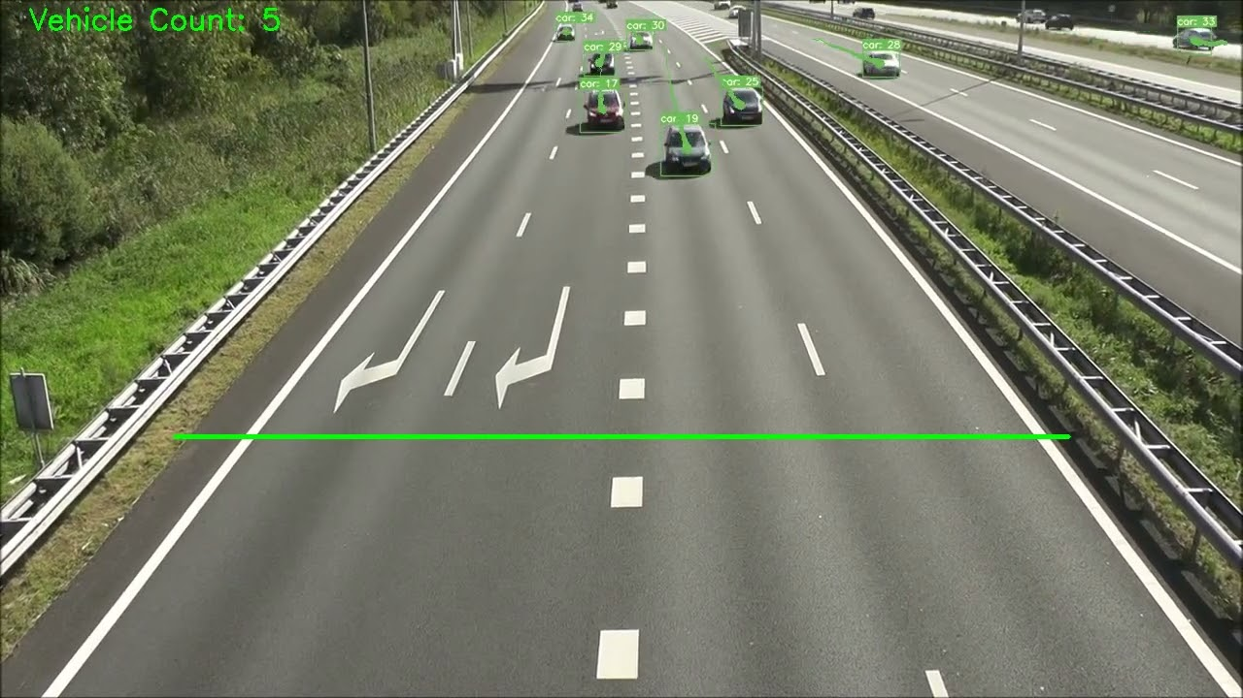
Our End Product
ODOT Technology Conference 2022 TOGETHER TOWARDS TOMORROW

Slide 10
Our End Product
YOLO
basic intro to YOLO
how it works
ODOT Technology Conference 2022 TOGETHER TOWARDS TOMORROW
ODOT Technology Conference 2022 TOGETHER TOWARDS TOMORROW

Slide 11
Let’s do some coding
ODOT Technology Conference 2022 TOGETHER TOWARDS TOMORROW

Slide 12
Custom Model
Start with an existing training data set if you can find one
Train the model
Evaluate it
ODOT Technology Conference 2022 TOGETHER TOWARDS TOMORROW

Slide 13
Custom Model
Annotate your own data
Image annotations
Data format
ODOT Technology Conference 2022 TOGETHER TOWARDS TOMORROW

Slide 14
Active Learning
improve model over time
adapt to changes
ODOT Technology Conference 2022 TOGETHER TOWARDS TOMORROW

Slide 15
Some recent advances
Stable Diffusion
https://twitter.com/xsteenbrugge/status/1558508866463219712
https://github.com/CompVis/stable-diffusion
Whisper
https://openai.com/blog/whisper/
ODOT Technology Conference 2022 TOGETHER TOWARDS TOMORROW

Slide 16
Questions
?
Last updated 8/4/2022
ODOT Technology Conference 2022 TOGETHER TOWARDS TOMORROW

