Slide 1
AI/ML for computer vision workshop
Notes:
Welcome and intro

Slide 2
Show of Hands
How many of you can write code?
How many of you are familiar with AI/ML/Deep Learning?
How many of you think using video to count cars or identify potholes is an easy problem?
ODOT Technology Conference 2022 TOGETHER TOWARDS TOMORROW

Slide 3
Goals
Learn how to solve Computer Vision problems
Use provided toolkit to experiment and …
Apply what you learned to solve your own problems
ODOT Technology Conference 2022 TOGETHER TOWARDS TOMORROW

Slide 4


Classical programming vs Ml
Rules
Classical
Computer
Answer
Data
Answer
Machine Learning
Model
Data
ML
Model
Computer
Answer
New Data

Slide 5
AI vs ML vs DL
1950’s
1980’s
2010’s
ODOT Technology Conference 2022 TOGETHER TOWARDS TOMORROW

Slide 6
QuizZ: Deep Learning, ML, AI or Traditional Programming?
Lane Detection
https://youtu.be/OV1l5xFHiwQ?t=16
Path Planning
https://youtu.be/t7P4au6bT1Q?t=23
Vehicle Detection
https://youtu.be/kZViHcQgGYU?t=37
Behavioral Cloning
https://youtu.be/vXzgXb1rkjw?t=24

Slide 7
The Challenge
Images/video represent unstructured data that is hard to analyze and interpret automatically
How can we extract meaningful information from images/video?
ODOT Technology Conference 2022 TOGETHER TOWARDS TOMORROW

Slide 8
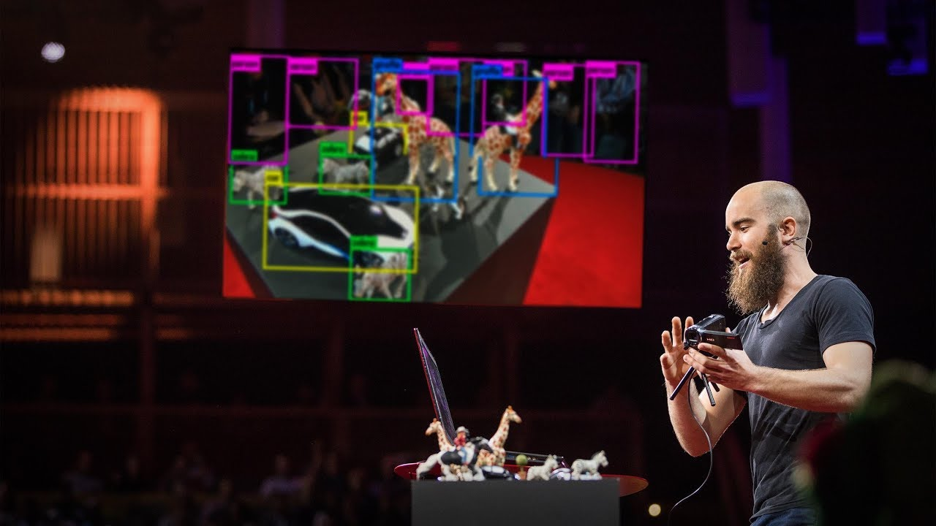
How computers learn to recognize objects
ODOT Technology Conference 2022 TOGETHER TOWARDS TOMORROW

Slide 9
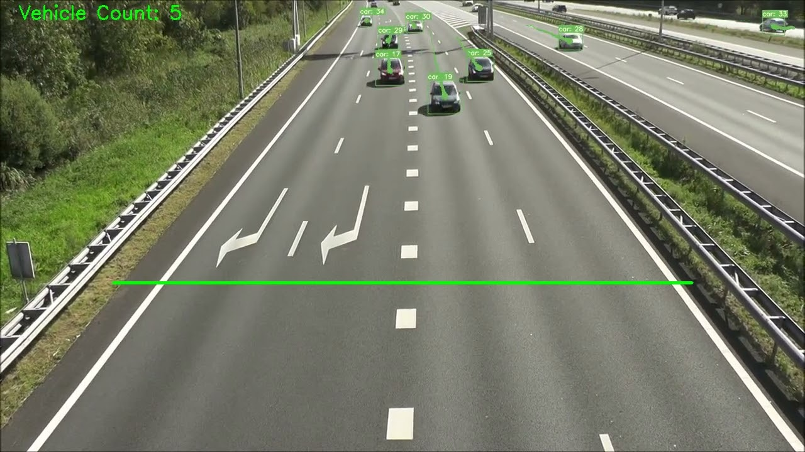
Our End Product
ODOT Technology Conference 2022 TOGETHER TOWARDS TOMORROW

Slide 10
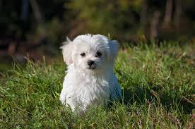
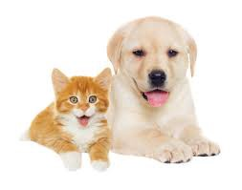
Our End Product
YOLO
Image Classification
Image Localization
Object Detection
Dog + Bounding Box
Cat
Dog
Dog
+ Bounding Boxes
ODOT Technology Conference 2022 TOGETHER TOWARDS TOMORROW
10
ODOT Technology Conference 2022 TOGETHER TOWARDS TOMORROW

Slide 11
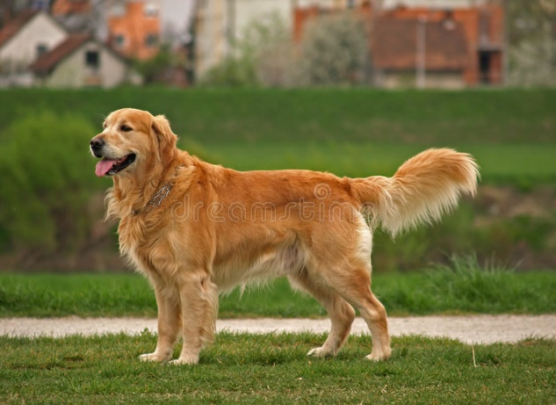
YOLO
Pc
Bx
By
Bw
CNN
Trained Model
Bh
C1
C2
Many such Images
1
12
23
Trained Model
20
25
1
0
New Dog Image

Slide 12
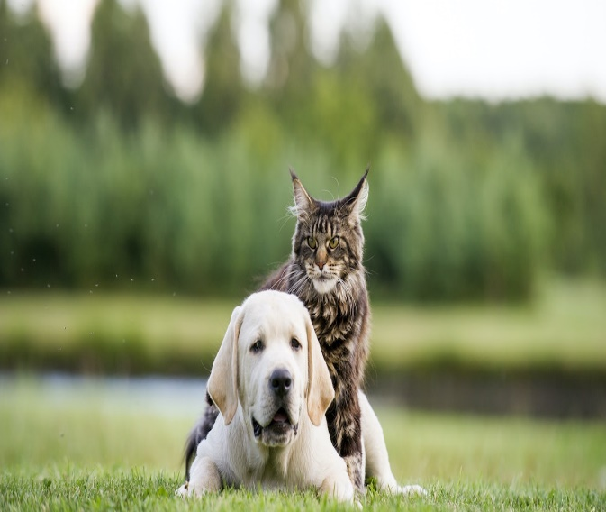

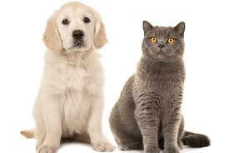
YOLO
Bw
CNN
Trained Model
Bh
4 x 4 x 7
Trained Model
4 x 4 x 7 Vector

Slide 13
Let’s do some coding
Go to Google Colab and let’s have some fun
ODOT Technology Conference 2022 TOGETHER TOWARDS TOMORROW

Slide 14
Some recent advances
Whisper
https://openai.com/blog/whisper
ODOT Technology Conference 2022 TOGETHER TOWARDS TOMORROW

Slide 15
Some recent advances
Stable Diffusion
https://github.com/CompVis/stable-diffusion
ODOT Technology Conference 2022 TOGETHER TOWARDS TOMORROW

Slide 16
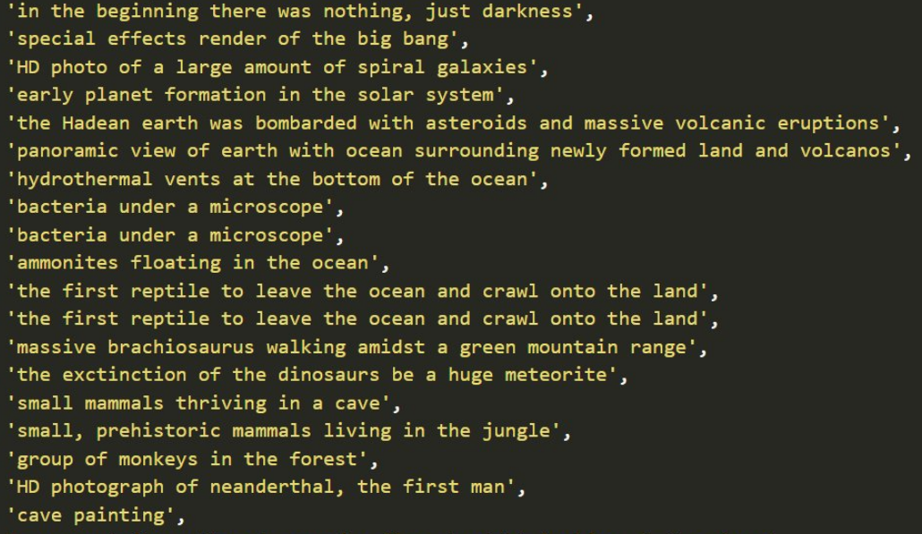
Stable diffusion
https://twitter.com/xsteenbrugge/status/1558508866463219712
ODOT Technology Conference 2022 TOGETHER TOWARDS TOMORROW

Slide 17
Questions
?
Last updated 8/4/2022
ODOT Technology Conference 2022 TOGETHER TOWARDS TOMORROW

