Slide 1

Meta-cognition evaluation
Maruseac Mihai
Neață Sofia
https://github.com/mihaimaruseac/nlp

Slide 2

Metacognition
Thinking about knowing
Learning about thinking
Control of learning

Slide 3
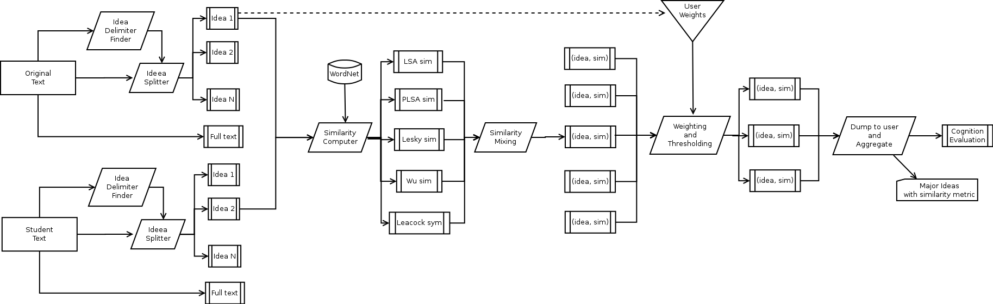
Overview

Slide 4
Beta Stage
Pre-alpha
POS tagging
One similarity measure
Multiple problems

Slide 5
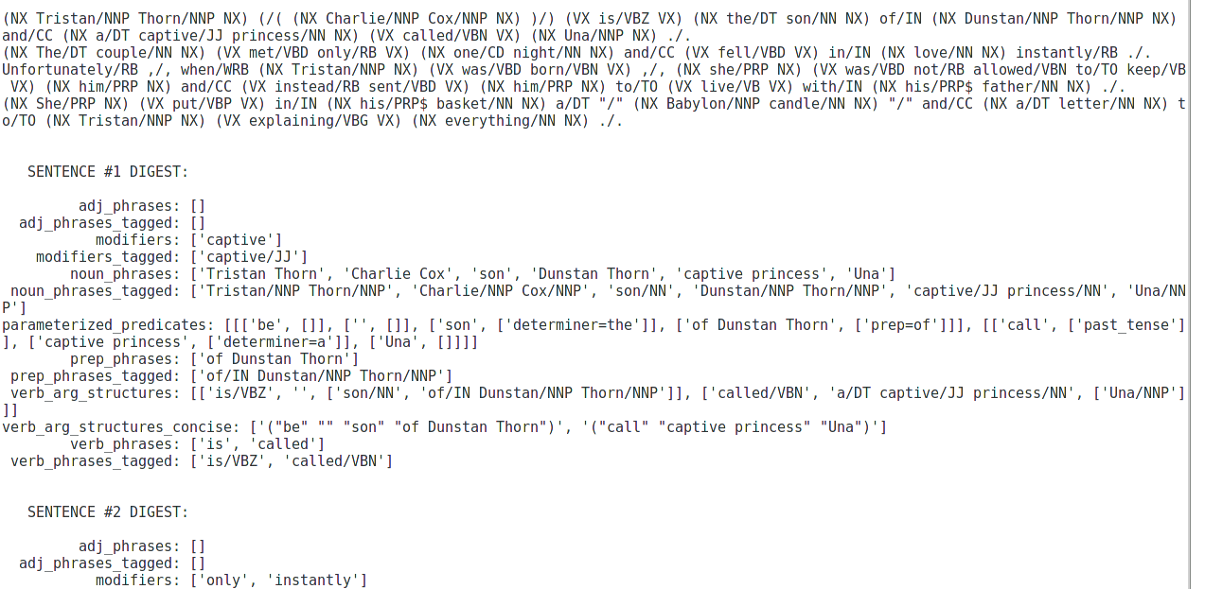
MontyLingua

Slide 6
Language
French in original data set
MontyLingua supports only English
Fallback to IMDB data
Switch to other NLP toolchain

Slide 7
OpenNLP vs MontiLingua vs GATE
MontiLingua
Python, a collection of libraries
Use what you need
No training required
Enriched with common sense knowledge
Less vulnerable to NLP errors
Only English???

Slide 8
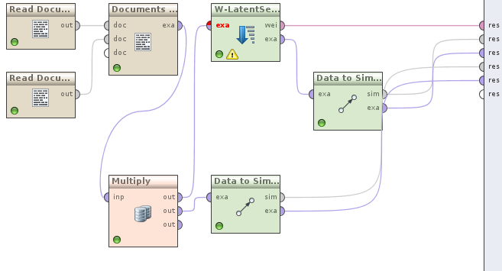
Rapid Miner

Slide 9
RapidMiner
All components are premade
No tutorial, hard to understand what each of them does
How to convert a document to a wordlist?

Slide 10
RapidMiner vs WEKA
RapidMiner
More text analysis tools
Command line interface – usable from our application only when needed
Multilayered-data-view concept mapping closely to our pipeline idea
Still a good decision (after understanding how it works)

Slide 11
Results
We have some results
Distance: 200028.57
Something must be wrong
Need tweaking and debugging

Slide 12

Thanks

