Slide 1

Meta-cognition evaluation
Maruseac Mihai
Neață Sofia
https://github.com/mihaimaruseac/nlp

Slide 2

Metacognition
Thinking about knowing
Learning about thinking
Control of learning

Slide 3
Metacognition Evaluation :: Plan
set of student works
measure the similarity between it and initial text
Criteria:
  lexical similarity based on lexical chains
  semantic similarity (LSA, LDA)
  cue phrases

Slide 4
Metacognition Evaluation :: Done
IMDB movie synopsis and reviews
measure the similarity between reviews and synopsis
prevent spoilers, increase quality of reviews

Slide 5
Procedure
Cue phrases => Main ideas
LSA/PLSA/DSA + Lexical Chains
  Higher dimensional vector of words
Same treatment for original
  Or presplit and precomputed

Slide 6
Evaluation
For each idea: cosine similarity
Average over all ideas with weights depending on idea's importance
Score is given by this mean

Slide 7
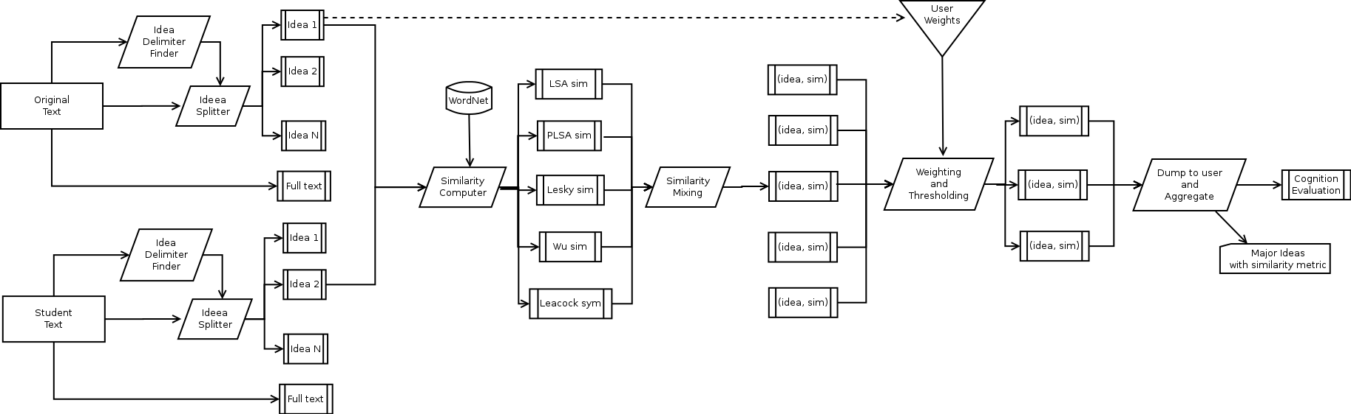
Overview

Slide 8
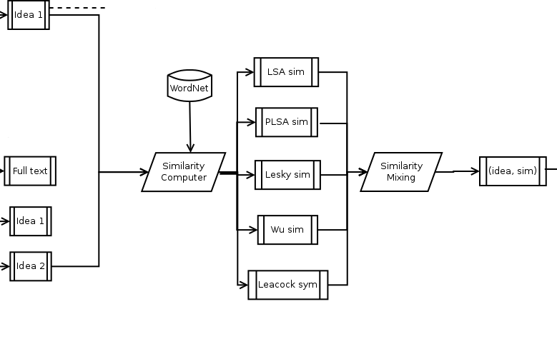
Overview :: Details

Slide 9
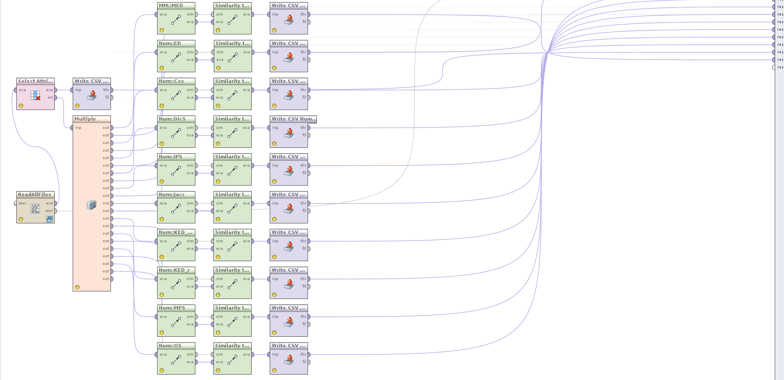
Architecture

Slide 10
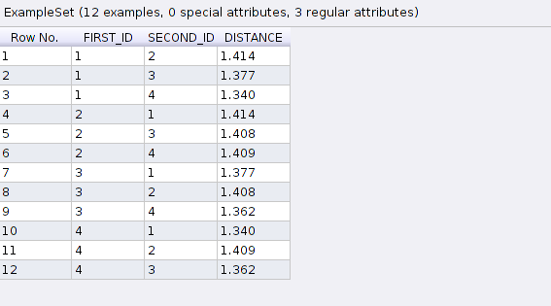
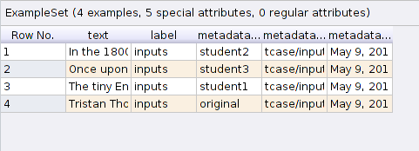
Results

Slide 11
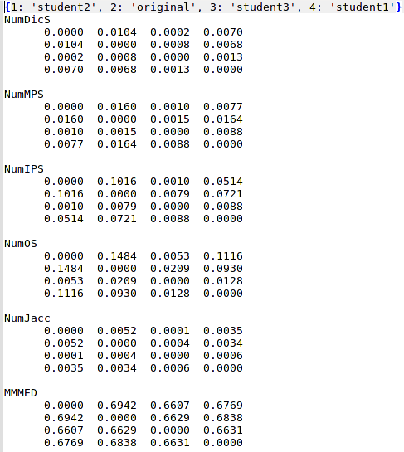
Results (2)

Slide 12
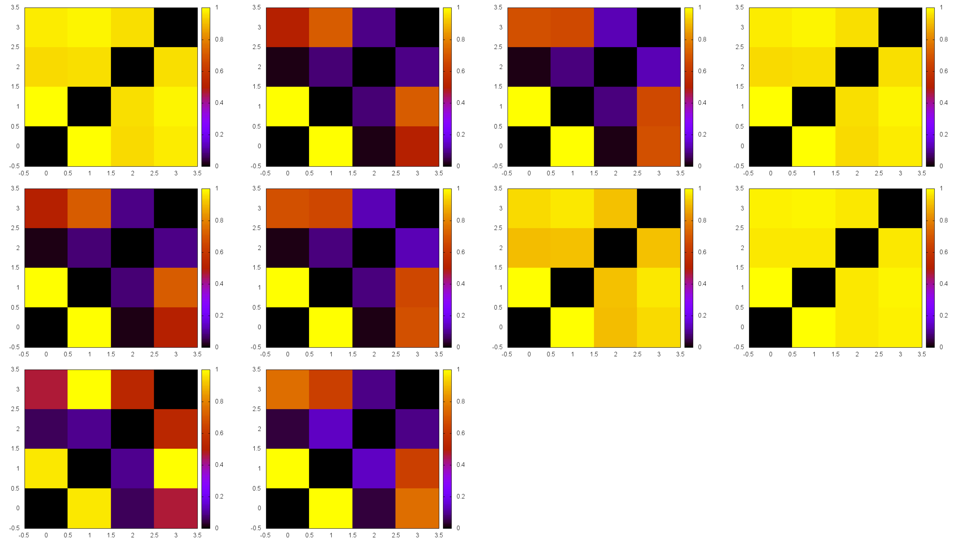
Results (3)

Slide 13
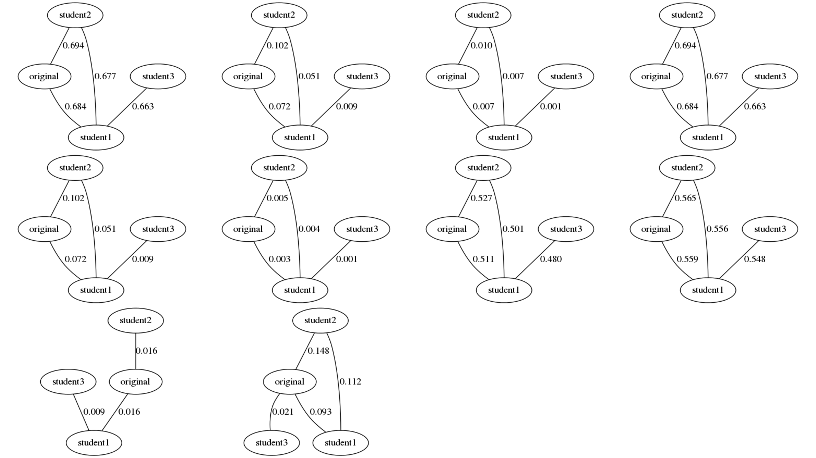
Results (4)

Slide 14
TODO
More metrics
Split by ideas
Aggregate data
Define metacognition value
GUI

Slide 15

Thanks

