Slide 1

Meta-cognition evaluation
Maruseac Mihai
Neață Sofia
https://github.com/mihaimaruseac/nlp

Slide 2
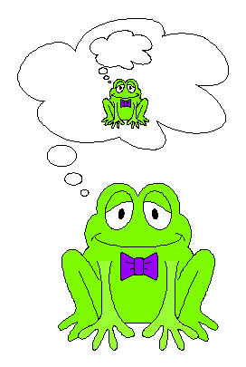
Metacognition
Thinking about knowing
Learning about thinking
Control of learning

Slide 3
Metacognition Evaluation
set of student works
measure the similarity between it and initial text
Criteria:
  lexical similarity based on lexical chains
  semantic similarity (LSA, LDA)
  cue phrases

Slide 4
Motivation
Reviews
No spoilers
Review the significant parts
Don't be too close to original
Lecture comprehension

Slide 5
Tools
WEKA
RapidMiner
libSVM
Shogun
OpenNLP
MontyLingua
GATE
  WEKA, libSVM
  Romanian

Slide 6

Thanks

