Slide 1

Meta-cognition evaluation
Maruseac Mihai
Neață Sofia
https://github.com/mihaimaruseac/nlp

Slide 2

Metacognition
Thinking about knowing
Learning about thinking
Control of learning

Slide 3
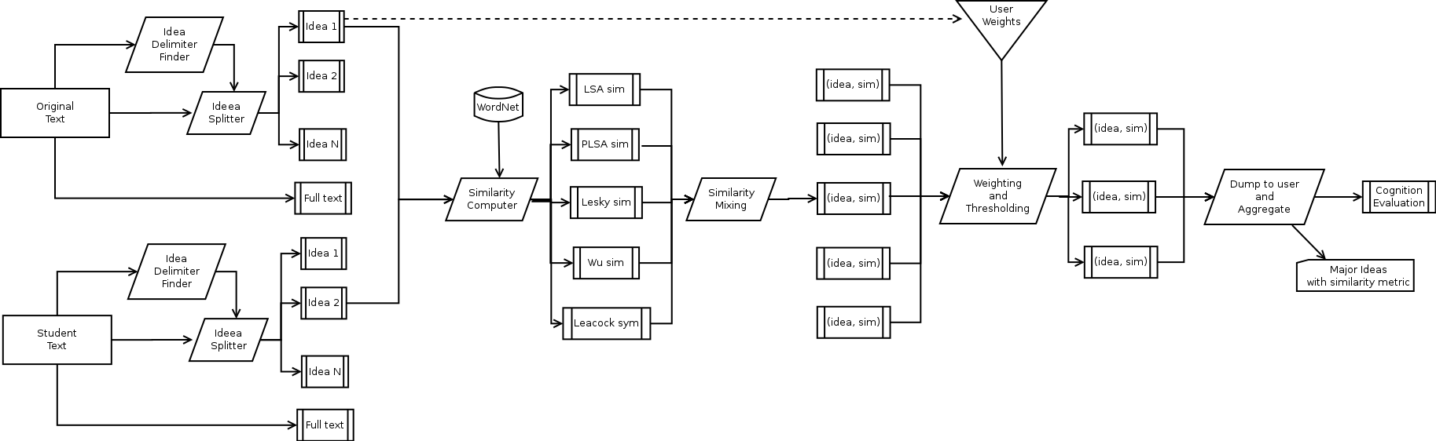
Overview

Slide 4
Overview
Pipeline architecture
Easily parallelisable
Map-Reduce

Slide 5
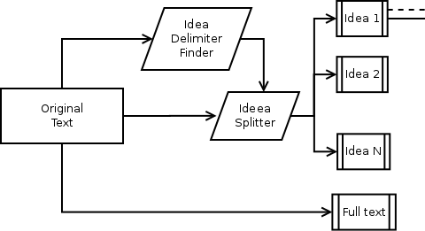
Stage 1

Slide 6
Stage 1
Increase capabilities
Weights to filter more important ideas
Keep full text as well
Split on paragraphs vs split on connectors
Both for original and student's work

Slide 7
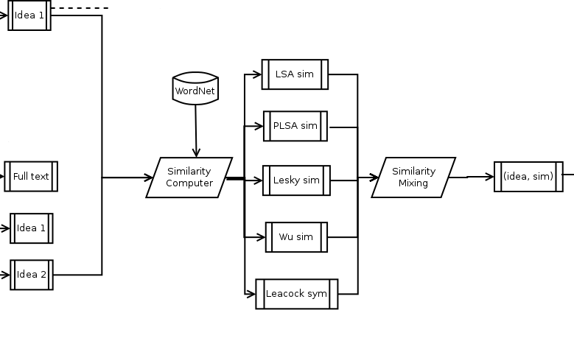
Stage 2

Slide 8
Stage 2
Pair ideas: one from original, one from student's work
Use multiple similarities metrics
Mix them before output
LSA, PLSA
WordNet (3)

Slide 9


Stage 2 :: WordNet
Lesky, 1986: overlap between dictionary entries
Wu, 1994:
Leacock, 1998:

Slide 10
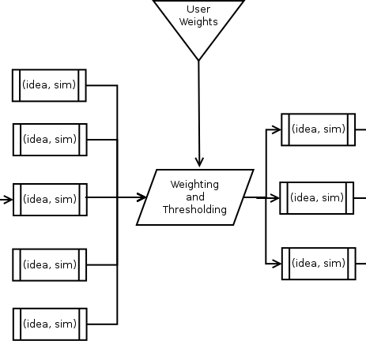
Stage 3

Slide 11
Stage 3
Keep only the relevant pairs
Tweakable by user prefferences towards some ideas
Use thresholds
Filter pairs

Slide 12
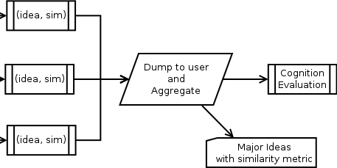
Stage 4

Slide 13
Stage 4
Output each relevant pair
Aggregate pairs to compute a single metric
Let user decide what to use from them.

Slide 14
RapidMiner vs WEKA
RapidMiner
More text analysis tools
Command line interface – usable from our application only when needed
Multilayered-data-view concept mapping closely to our pipeline idea

Slide 15
OpenNLP vs MontiLingua vs GATE
MontiLingua
Python, a collection of libraries
Use what you need
No training required
Enriched with common sense knowledge
Less vulnerable to NLP errors

Slide 16

Thanks

