Slide 1
Computational Science II
-
FS15 Project / Daniel Studer
Improving the computation time

Slide 2
Algorithm of force.f90
First Algorithm
Formula:
Loading: - density_project.data → ρ [256,128]
- r_project.data → r' [128]
- theta_project.data → Θ' [256]
Calculating: - dr, dΘ
- r [129]
- Θ [257]
Loop: for 129*257 points 128*256 times
Required Time ~ 125.73 s

Slide 3
Algorithm of force.f90
Second Algorithm
Formula:
Loading: - density_project.data → ρ [256,128]
- r_project.data → r' [128]
- theta_project.data → Θ' [256]
Calculating: - dr, dΘ
- r [129]
- Θ [257]
- cos(Θ-Θ') → cosdΘ [257,256]
- sin(Θ-Θ') → sindΘ [257,256]
Loop: for 129*257 points 128*256 times
Required Time ~ 40.77 s

Slide 4
Algorithm of force.f90
Third Algorithm
Formula:
Loading: - density_project.data → ρ [256,128]
- r_project.data → r' [128]
- theta_project.data → Θ' [256]
Calculating: - dr, dΘ
- r [129]
- Θ [257]
- cos(Θ-Θ') → cosdΘ [257,256]
- sin(Θ-Θ') → sindΘ [257,256]
Substitution: - R = r/r' → R [129,128]
- dR= -r/r'² dr' → dR[129,128]

Slide 5
Algorithm of force.f90
Third Algorithm
Formula:
Loading: - density_project.data → ρ [256,128]
- r_project.data → r' [128]
- theta_project.data → Θ' [256]
Calculating: - dr, dΘ
- r [129]
- Θ [257]
- cos(Θ-Θ') → cosdΘ [257,256]
- sin(Θ-Θ') → sindΘ [257,256]
Substitution: - R = r/r' → R [129,128]
- dR= -r/r'² dr' → dR[129,128]
Loop: for 129*257 points 128*256 times

Slide 6
Source Code force.f90
program forcefield
implicit none
! initialize variables and grids ____________________________________
integer::dim_r,dim_theta
integer::dim_r1,dim_theta1
integer::i,j,k,l
real::t_start,t_end,t
real::var0,var1,var2,var3,var4,var5,var6
real::G
real::dr,dtheta
real::dforce_r,dforce_theta
real,dimension(256+1,256)::cos_dtheta
real,dimension(256+1,256)::sin_dtheta
real,dimension(128+1,128)::r_sub
real,dimension(128+1,128)::dr_sub
real,dimension(128)::r
real,dimension(256)::theta
real,dimension(128+1)::r1
real,dimension(256+1)::theta1
real,dimension(128,256)::density
real,dimension(128+1,256+1,2)::force
G=1
dim_theta=256
dim_r=128
dim_theta1=dim_theta+1
dim_r1=dim_r+1
!_______________________________________________________________

Slide 7
Source Code force.f90
! load data from Computational_Science_II/Data/ ______________________
open(unit=1,file="Data/r_project.data")
do i=1,dim_r
read(1,'(e20.10)') r(i)
end do
close(1)
open(unit=2,file="Data/theta_project.data")
do i=1,dim_theta
read(2,'(e20.10)') theta(i)
end do
close(2)
open(unit=3,file="Data/density_project.data")
do i=1,dim_r
do k=1,dim_theta
read(3,'(e20.10)') density(i,k)
end do
end do
Close(3)
!_______________________________________________________________

Slide 8
Source Code force.f90
! build theta1, cos_dtheta and sin_dtheta grid ___________________________
dtheta=theta(2)-theta(1)
do j=1,dim_theta
theta1(j)=theta(j)-dtheta*0.5
end do
theta1(dim_theta1)=theta(dim_theta)+dtheta*0.5
do j=1,dim_theta1
do l=1,dim_theta
var0=theta1(j)-theta(l)
cos_dtheta(j,l)=cos(var0)
sin_dtheta(j,l)=sin(var0)
end do
end do
!_______________________________________________________________

Slide 9
Source Code force.f90
! build r1, r_sub and dr_sub grid ____________________________________
dr=r(2)-r(1)
do i=1,dim_r
r1(i)=r(i)-dr*0.5
end do
r1(dim_r1)=r(dim_r)+dr*0.5
do i=1,dim_r1
do k=1,dim_r
var1=r(k)
r_sub(i,k)=r1(i)/var1
dr_sub(i,k)=-r_sub(i,k)/var1*dr
end do
end do
!_______________________________________________________________

Slide 10
Source Code force.f90
call CPU_Time(t_start)
! calculate force __________________________________________________
do j=1,dim_theta1
do i=1,dim_r1
dforce_r=0.0
dforce_theta=0.0
do l=1,dim_theta
var2=cos_dtheta(j,l)
var3=sin_dtheta(j,l)
do k=1,dim_r
var4=r_sub(i,k)
var5=1+var4*var4-2*var4*var2
var5=var5*sqrt(var5)*var4
var6=density(k,l)*dr_sub(i,k)
var6=var6/var5
dforce_r=dforce_r+(var4-var2)*var6
dforce_theta=dforce_theta+var3*var6
end do
end do
force(i,j,1)=dforce_r*dtheta*G
force(i,j,2)=dforce_theta*dtheta*G
end do
end do
!_______________________________________________________________
call CPU_Time(t_end)
t=t_end-t_start
write(*,*) "required time:"
write(*,*) t

Slide 11
Source Code force.f90~
call CPU_Time(t_start)
! calculate force __________________________________________________
do j=1,dim_theta1
do i=1,dim_r1
dforce_r=0.0
dforce_theta=0.0
do l=1,dim_theta/2
var2=cos_dtheta(j,l)
var3=sin_dtheta(j,l)
do k=1,dim_r
var4=r_sub(i,k)
var5=1+var4*var4-2*var4*var2
var5=var5*sqrt(var5)*var4
var6=density(k,l)*dr_sub(i,k)
var6=var6/var5
dforce_r=dforce_r+(var4-var2)*var6
dforce_theta=dforce_theta+var3*var6
end do
end do
force(i,j,1)=dforce_r*dtheta*G
force(i,j,2)=dforce_theta*dtheta*G
end do
end do
!_______________________________________________________________
call CPU_Time(t_end)
t=t_end-t_start
write(*,*) "required time:"
write(*,*) t

Slide 12
Source Code force.f90~
call CPU_Time(t_start)
! calculate force __________________________________________________
do j=1,dim_theta1
do i=1,dim_r1
dforce_r=0.0
dforce_theta=0.0
do l=1,dim_theta/2
var2=cos_dtheta(j,l)
var2s=-cos_dtheta(j,l)
var3=sin_dtheta(j,l)
do k=1,dim_r
var4=r_sub(i,k)
var5=1+var4*var4-2*var4*var2
var5=var5*sqrt(var5)*var4
var6=density(k,l)*dr_sub(i,k)
var6=var6/var5
dforce_r=dforce_r+(var4-var2)*var6
dforce_theta=dforce_theta+var3*var6
end do
end do
force(i,j,1)=dforce_r*dtheta*G
force(i,j,2)=dforce_theta*dtheta*G
end do
end do
!_______________________________________________________________
call CPU_Time(t_end)
t=t_end-t_start
write(*,*) "required time:"
write(*,*) t

Slide 13
Source Code force.f90~
call CPU_Time(t_start)
! calculate force __________________________________________________
do j=1,dim_theta1
do i=1,dim_r1
dforce_r=0.0
dforce_theta=0.0
do l=1,dim_theta/2
var2=cos_dtheta(j,l)
var2s=-cos_dtheta(j,l)
var3=sin_dtheta(j,l)
var3s=-sin_dtheta(j,dim_theta-l)
do k=1,dim_r
var4=r_sub(i,k)
var5=1+var4*var4-2*var4*var2
var5=var5*sqrt(var5)*var4
var6=density(k,l)*dr_sub(i,k)
var6=var6/var5
dforce_r=dforce_r+(var4-var2)*var6
dforce_theta=dforce_theta+var3*var6
end do
end do
force(i,j,1)=dforce_r*dtheta*G
force(i,j,2)=dforce_theta*dtheta*G
end do
end do
!_______________________________________________________________
call CPU_Time(t_end)
t=t_end-t_start
write(*,*) "required time:"
write(*,*) t

Slide 14
Source Code force.f90~
call CPU_Time(t_start)
! calculate force __________________________________________________
do j=1,dim_theta1
do i=1,dim_r1
dforce_r=0.0
dforce_theta=0.0
do l=1,dim_theta/2
var2=cos_dtheta(j,l)
var2s=-cos_dtheta(j,l)
var3=sin_dtheta(j,l)
var3s=-sin_dtheta(j,dim_theta-l)
do k=1,dim_r
var4=r_sub(i,k)
var5=1+var4*var4-2*var4*var2
var5s=1+var4*var4-2*var4*var2s
var5=var5*sqrt(var5)*var4
var6=density(k,l)*dr_sub(i,k)
var6=var6/var5
dforce_r=dforce_r+(var4-var2)*var6
dforce_theta=dforce_theta+var3*var6
end do
end do
force(i,j,1)=dforce_r*dtheta*G
force(i,j,2)=dforce_theta*dtheta*G
end do
end do
!_______________________________________________________________

Slide 15
Source Code force.f90~
call CPU_Time(t_start)
! calculate force __________________________________________________
do j=1,dim_theta1
do i=1,dim_r1
dforce_r=0.0
dforce_theta=0.0
do l=1,dim_theta/2
var2=cos_dtheta(j,l)
var2s=-cos_dtheta(j,l)
var3=sin_dtheta(j,l)
var3s=-sin_dtheta(j,dim_theta-l)
do k=1,dim_r
var4=r_sub(i,k)
var5=1+var4*var4-2*var4*var2
var5s=1+var4*var4-2*var4*var2s
var5=var5*sqrt(var5)*var4
var5s=var5s*sqrt(var5s)*var4
var6=density(k,l)*dr_sub(i,k)
var6=var6/var5
dforce_r=dforce_r+(var4-var2)*var6
dforce_theta=dforce_theta+var3*var6
end do
end do
force(i,j,1)=dforce_r*dtheta*G
force(i,j,2)=dforce_theta*dtheta*G
end do
end do
!_______________________________________________________________

Slide 16
Source Code force.f90~
call CPU_Time(t_start)
! calculate force __________________________________________________
do j=1,dim_theta1
do i=1,dim_r1
dforce_r=0.0
dforce_theta=0.0
do l=1,dim_theta/2
var2=cos_dtheta(j,l)
var2s=-cos_dtheta(j,l)
var3=sin_dtheta(j,l)
var3s=-sin_dtheta(j,dim_theta-l)
do k=1,dim_r
var4=r_sub(i,k)
var5=1+var4*var4-2*var4*var2
var5s=1+var4*var4-2*var4*var2s
var5=var5*sqrt(var5)*var4
var5s=var5s*sqrt(var5s)*var4
var6=density(k,l)*dr_sub(i,k)
var6s=density(k,l+dim_theta/2)*dr_sub(i,k)
var6=var6/var5
dforce_r=dforce_r+(var4-var2)*var6
dforce_theta=dforce_theta+var3*var6
end do
end do
force(i,j,1)=dforce_r*dtheta*G
force(i,j,2)=dforce_theta*dtheta*G
end do
end do
!_______________________________________________________________

Slide 17
Source Code force.f90~
call CPU_Time(t_start)
! calculate force __________________________________________________
do j=1,dim_theta1
do i=1,dim_r1
dforce_r=0.0
dforce_theta=0.0
do l=1,dim_theta/2
var2=cos_dtheta(j,l)
var2s=-cos_dtheta(j,l)
var3=sin_dtheta(j,l)
var3s=-sin_dtheta(j,dim_theta-l)
do k=1,dim_r
var4=r_sub(i,k)
var5=1+var4*var4-2*var4*var2
var5s=1+var4*var4-2*var4*var2s
var5=var5*sqrt(var5)*var4
var5s=var5s*sqrt(var5s)*var4
var6=density(k,l)*dr_sub(i,k)
var6s=density(k,l+dim_theta/2)*dr_sub(i,k)
var6=var6/var5
var6s=var6s/var5s
dforce_r=dforce_r+(var4-var2)*var6
dforce_theta=dforce_theta+var3*var6
end do
end do
force(i,j,1)=dforce_r*dtheta*G
force(i,j,2)=dforce_theta*dtheta*G
end do
end do
!_______________________________________________________________

Slide 18
Source Code force.f90~
call CPU_Time(t_start)
! calculate force __________________________________________________
do j=1,dim_theta1
do i=1,dim_r1
dforce_r=0.0
dforce_theta=0.0
do l=1,dim_theta/2
var2=cos_dtheta(j,l)
var2s=-cos_dtheta(j,l)
var3=sin_dtheta(j,l)
var3s=-sin_dtheta(j,dim_theta-l)
do k=1,dim_r
var4=r_sub(i,k)
var5=1+var4*var4-2*var4*var2
var5s=1+var4*var4-2*var4*var2s
var5=var5*sqrt(var5)*var4
var5s=var5s*sqrt(var5s)*var4
var6=density(k,l)*dr_sub(i,k)
var6s=density(k,l+dim_theta/2)*dr_sub(i,k)
var6=var6/var5
var6s=var6s/var5s
dforce_r=dforce_r+(var4-var2)*var6+(var4-var2s)*var6s
dforce_theta=dforce_theta+var3*var6
end do
end do
force(i,j,1)=dforce_r*dtheta*G
force(i,j,2)=dforce_theta*dtheta*G
end do
end do
!_______________________________________________________________

Slide 19
Source Code force.f90~
call CPU_Time(t_start)
! calculate force __________________________________________________
do j=1,dim_theta1
do i=1,dim_r1
dforce_r=0.0
dforce_theta=0.0
do l=1,dim_theta/2
var2=cos_dtheta(j,l)
var2s=-cos_dtheta(j,l)
var3=sin_dtheta(j,l)
var3s=-sin_dtheta(j,dim_theta-l)
do k=1,dim_r
var4=r_sub(i,k)
var5=1+var4*var4-2*var4*var2
var5s=1+var4*var4-2*var4*var2s
var5=var5*sqrt(var5)*var4
var5s=var5s*sqrt(var5s)*var4
var6=density(k,l)*dr_sub(i,k)
var6s=density(k,l+dim_theta/2)*dr_sub(i,k)
var6=var6/var5
var6s=var6s/var5s
dforce_r=dforce_r+(var4-var2)*var6+(var4-var2s)*var6s
dforce_theta=dforce_theta+var3*var6+var3s*var6s
end do
end do
force(i,j,1)=dforce_r*dtheta*G
force(i,j,2)=dforce_theta*dtheta*G
end do
end do
!_______________________________________________________________

Slide 20
Source Code force.f90~
call CPU_Time(t_start)
! calculate force __________________________________________________
do j=1,dim_theta1
do i=1,dim_r1
dforce_r=0.0
dforce_theta=0.0
do l=1,dim_theta/2
var2=cos_dtheta(j,l)
var2s=-cos_dtheta(j,l)
var3=sin_dtheta(j,l)
var3s=-sin_dtheta(j,dim_theta-l)
do k=1,dim_r
var4=r_sub(i,k)
var5=1+var4*var4-2*var4*var2
var5s=1+var4*var4-2*var4*var2s
var5=var5*sqrt(var5)*var4
var5s=var5s*sqrt(var5s)*var4
var6=density(k,l)*dr_sub(i,k)
var6s=density(k,l+dim_theta/2)*dr_sub(i,k)
var6=var6/var5
var6s=var6s/var5s
dforce_r=dforce_r+(var4-var2)*var6+(var4-var2s)*var6s
dforce_theta=dforce_theta+var3*var6+var3s*var6s
end do
end do
force(i,j,1)=dforce_r*dtheta*G
force(i,j,2)=dforce_theta*dtheta*G
end do
end do
!_______________________________________________________________

Slide 21
Source Code force.f90/~
call CPU_Time(t_end)
t=t_end-t_start
write(*,*) "required time:"
write(*,*) t
! save force_project.data _________________________________________
open(unit=4,file="Results/force_project.data")
do i=1,dim_r
do j=1,dim_theta
write(4,'(2e20.10)') force(i,j,1) , force(i,j,2)
end do
end do
close(4)
!_______________________________________________________________
end program
Source Code force.f90
Source Code force.f90~
Required Time ~ 36.79 s
Required Time ~ 30.75 s

Slide 22
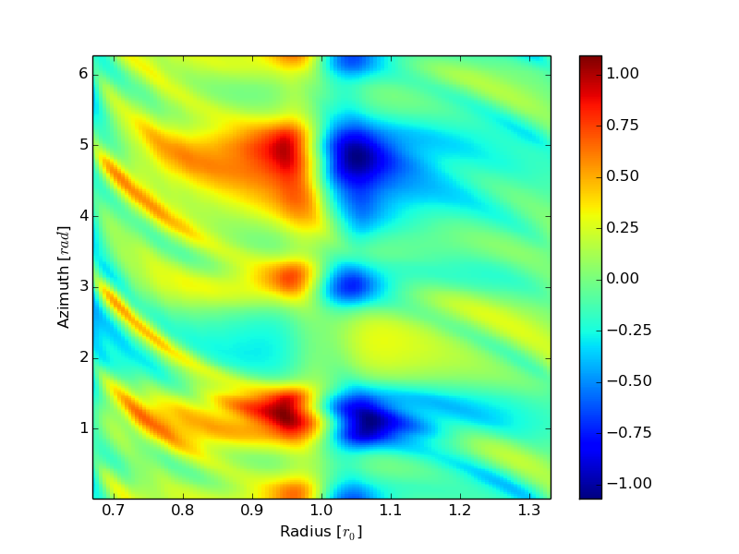
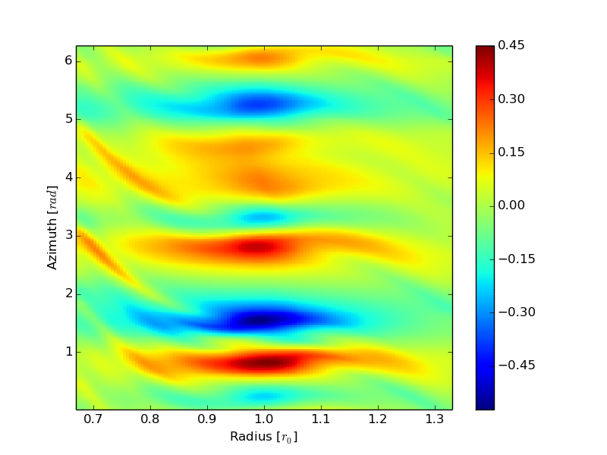
Results
r_force.project.data theta_force.project.data

