Slide 1
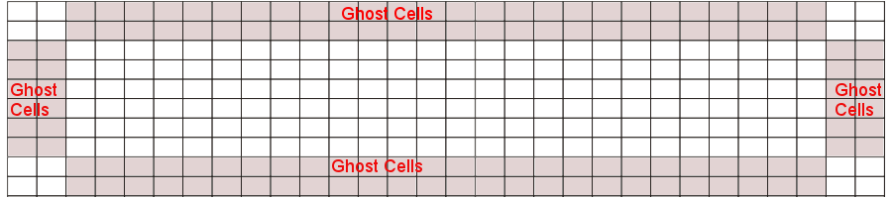
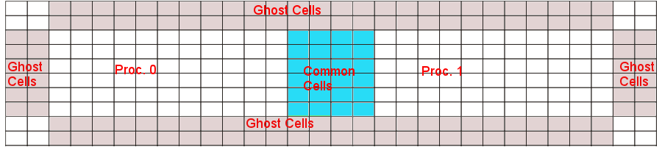
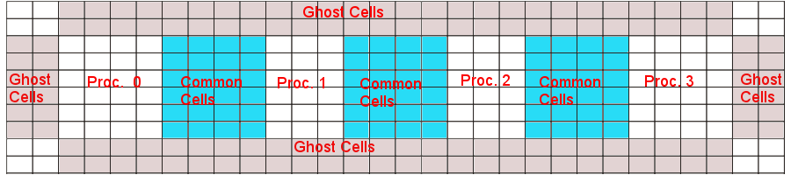
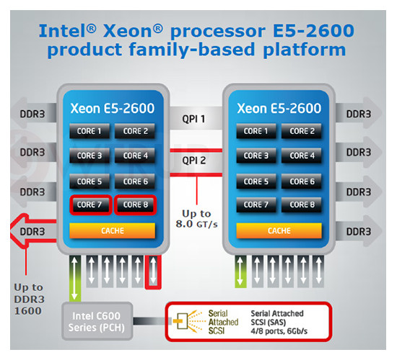
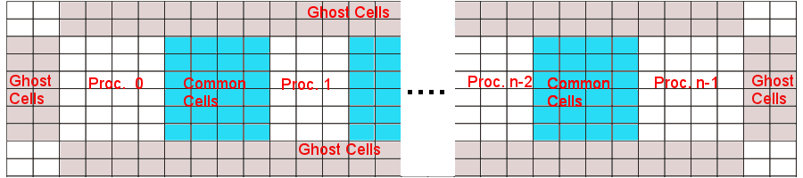
Introduction
Parallelization of a 2D Hydro code using MPI
Course: ESC401 - HPC1b: Parallel Computing
Authors: Rafael Küng, Christian Reinhardt and Mihai Tomozeiu
The task was the parallelization of a 2D Hydro code using MPI
The original code simulates an explosion in the lower left corner (right images) of a 2D wind tunnel using a single process
Number of individual proper cells nx (rows)* ny(columns) and 2* (nx +ny) ghost cells for reflective boundaries
Approach: slicing the domain along the x axis
Domain ditributiion in right figures panels: 2nd - 2 proc, 3rd – 4 proc, 4th – n proc
Each neighbouring processes need to communicate the closest two columns of proper cells to each other
Minimum timestep found among processes will become the timestep of al processesl
The simulations were run on the local zbox4
Intel Xeon E5-2660 (family platform sketch in the left image)
8 cores per socket
2 sockets per node
Internode communication with QDR Infiniband

