Slide 1
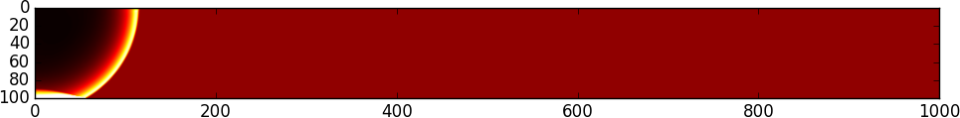
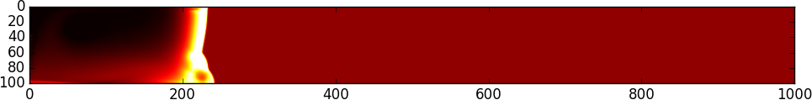
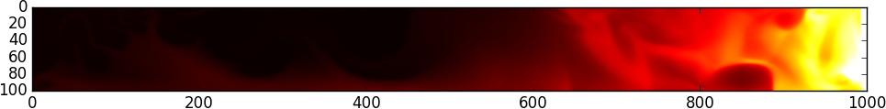
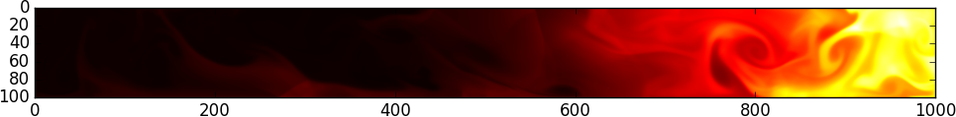
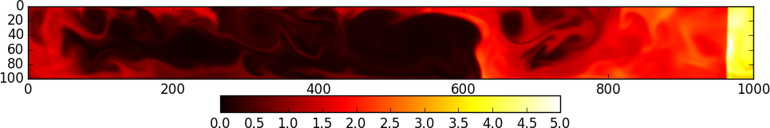
Example of a run (1000x100 grid): An initial overpressure in the top left cell causes a blast wave to propagate trough the
computational domain. The walls are reflecting so the shock bounces back at the domain boundaries and interferes with the
original wave. This causes an oscillating bulk motion with beautiful and quite complexe wave patterns in the inner part of
the domain. The colors represent the fluid density where black is zero and white is at least five.

