Slide 1
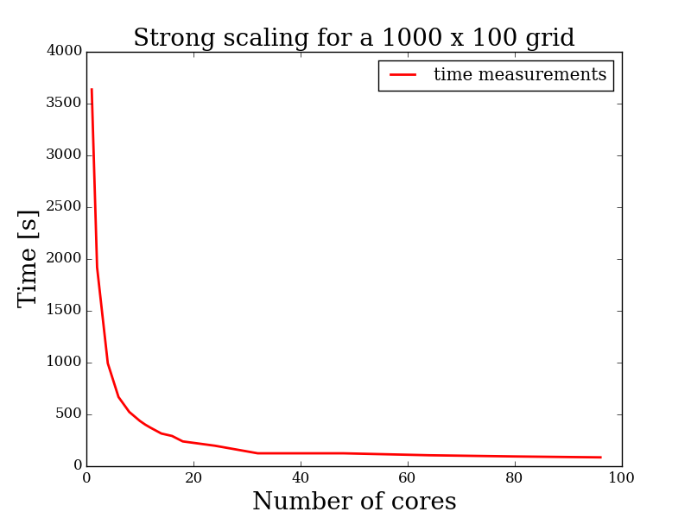
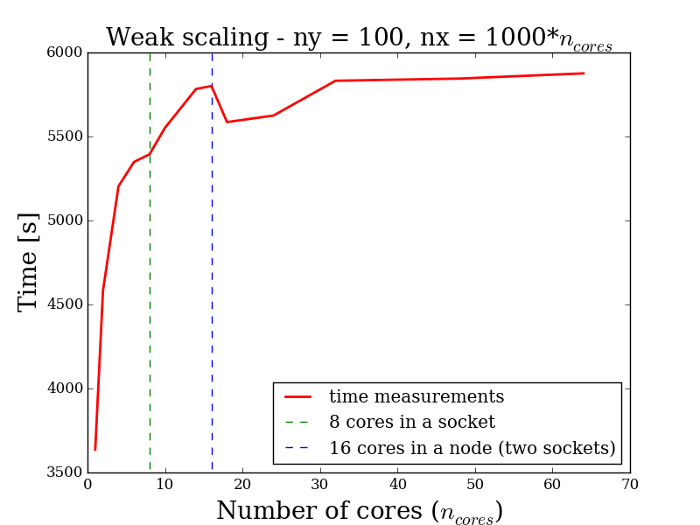
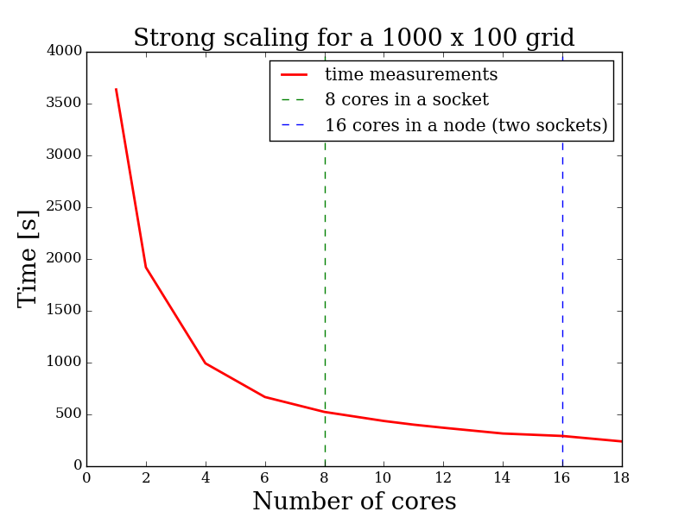
Time scaling
Strong scaling was performed on a 1000x100 (nx*ny) grid
Left upper figure contains results from 1 core to 96 cores
Left lower figure contains a zoom for 1 core to 18 cores
range
In the weak scaling ny was constant and nx scaled with the number of cores
The 16 cores point marks the transition to internode communication
showing a core performance worsening
After 4 cores and no

