Slide 1

Unity Container
Dependency injection using Unity
Radu Lacatus, Agile developer
May 19, 2016

Slide 2
Unity Container
The Unity Container (Unity) is a lightweight, extensible dependency injection container with optional support for instance and type interception.

Slide 3

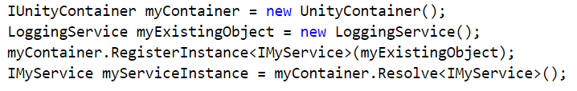
Basic registration
Registration with existing instances

Slide 4
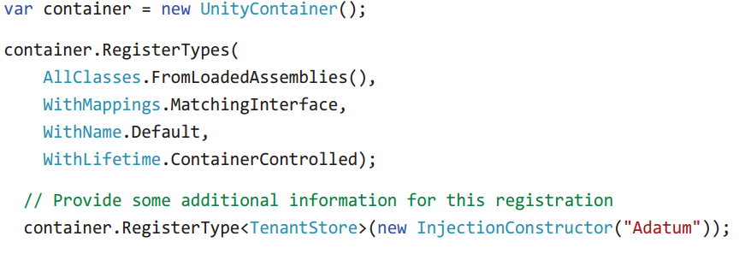
Registration by convention

Slide 5
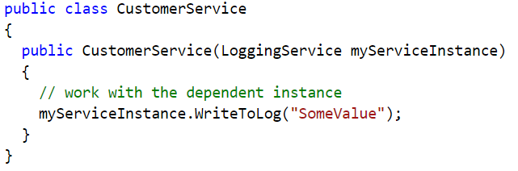
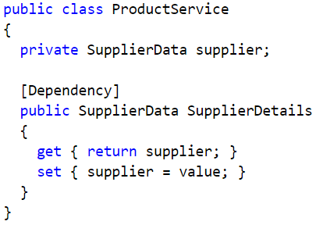
Constructor injection
Property (Setter) injection

Slide 6
Lifetime managers
TransientLifetimeManager – each call to Resolve creates a new instance
ContainerControlledLifetimeManager – same instance every time (Singleton)
HierarchicalLifetimeManager – similar to ContainerControlledLifetimeManager, but if there is a hierarchy of containers (parent > child) the child does not share instances with the parent
PerResolveLifetimeManager – similar to TransientLifetimeManager but in the case of circular dependencies (object graph) the types registered with this lifetime manager use the singleton approach, while the ones that use TransientLifetimeManager will have multiple instances.
PerThreadLifetimeManager – singleton behavior per thread
ExternallyControlledLifetimeManager – this allows other code to maintain the object in memory or dispose it and enables you to maintain control of the lifetime of existing objects or allow some other mechanism to control the lifetime.
More info: https://msdn.microsoft.com/en-us/library/ff660872(v=pandp.20).aspx

Slide 7
DEMO

Slide 8
Developer's Guide to Dependency Injection Using Unity https://msdn.microsoft.com/en-us/library/dn223671(v=pandp.30).aspx
Intro
Dependency injection in general
Dependency injection using Unity
Book: Dependency Injection with Unity - Dominic Betts, Grigori Melnik, Fernando Simonazzi, Mani Subramanian
Code sample
MSDN documentation: https://msdn.microsoft.com/en-us/library/ff647202.aspx

