Slide 1
INItiere in dezvoltarea aplicatiilor web si mobile
Mihaita Tinta

Slide 2



Mihaita Tinta
2004-2008 elev la CNMV
2008-2012 ETTI – CTI
2012-2014 FILS – SE
2010 – Programator
Prezent – Technical leader
mihaitatinta.tumblr.com
@mihaitatinta
mihaita-tinta

Slide 3
Cuprins
Programarea procedural sau programarea obiect-orientate
Arhitectura client-server
Tehnologii disponibile
Mediu de dezvoltare
Creare chat
Demo
Securizarea aplicatiei – Q&A

Slide 4
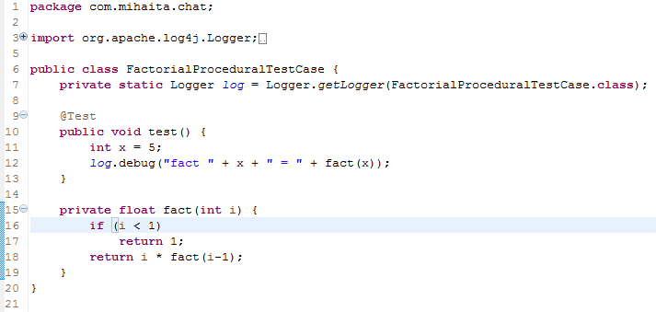
Programare procedurala

Slide 5
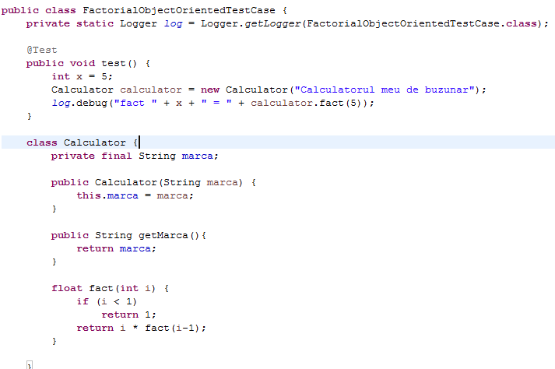
OOP

Slide 6
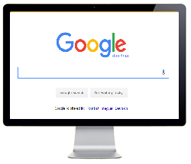
Arhitectura client-server
Request
Web Server
Database
Response

Slide 7
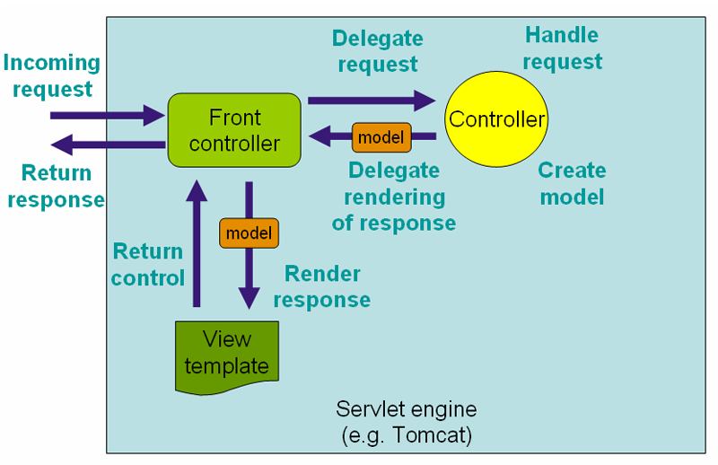
Arhitectura client-server MVC
http://docs.spring.io/spring/docs/current/spring-framework-reference/html/mvc.html

Slide 8

Unelte

Slide 9
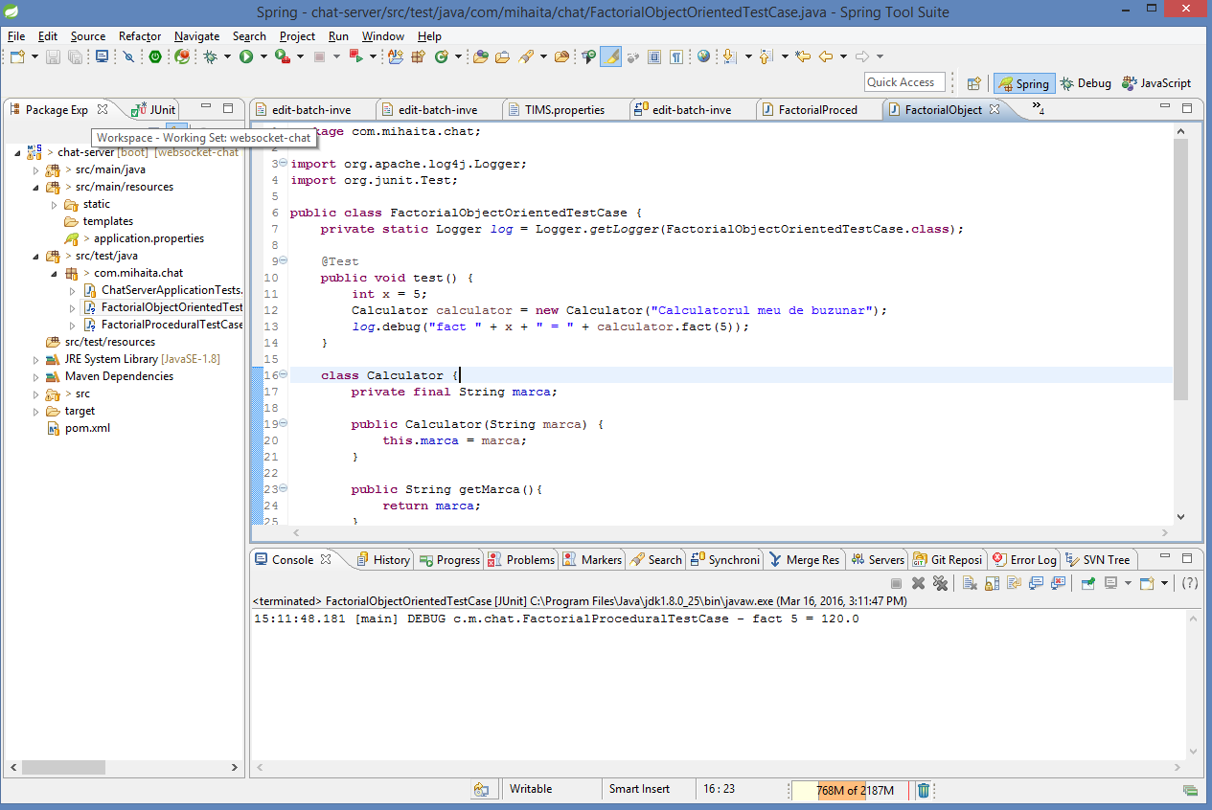
Springsource tool suite (eclipse)
https://spring.io/tools/sts/all

Slide 10
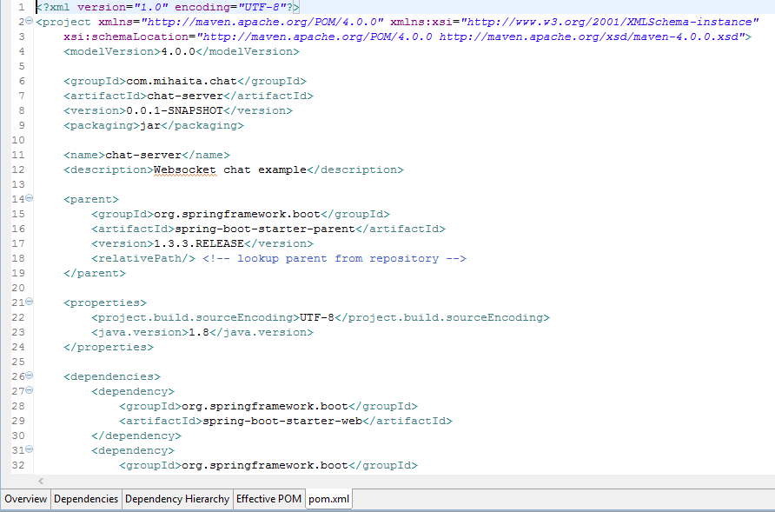
Apache Maven
http://maven.apache.org/

Slide 11
Baze de date
Mysql
Postgresql
H2
ORACLE
SQLite
DERBY
Mongo db

Slide 12
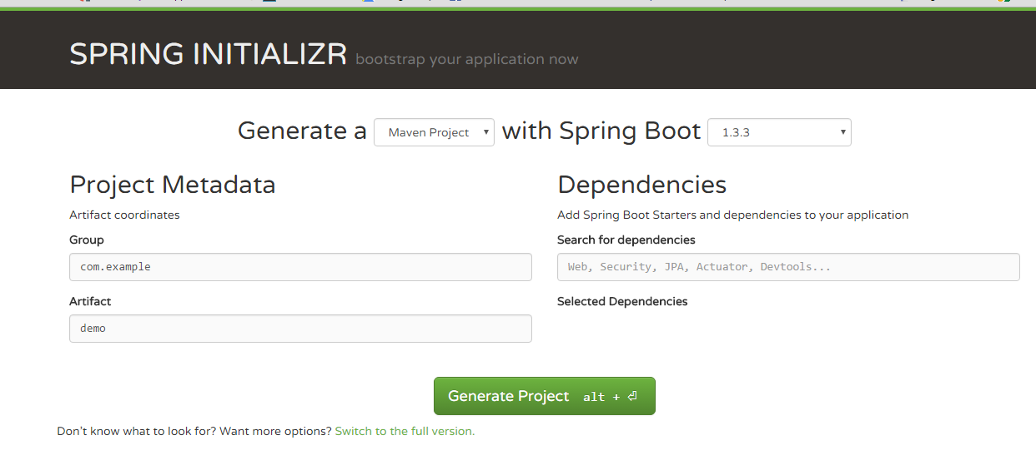
Spring boot
http://start.spring.io/

Slide 13
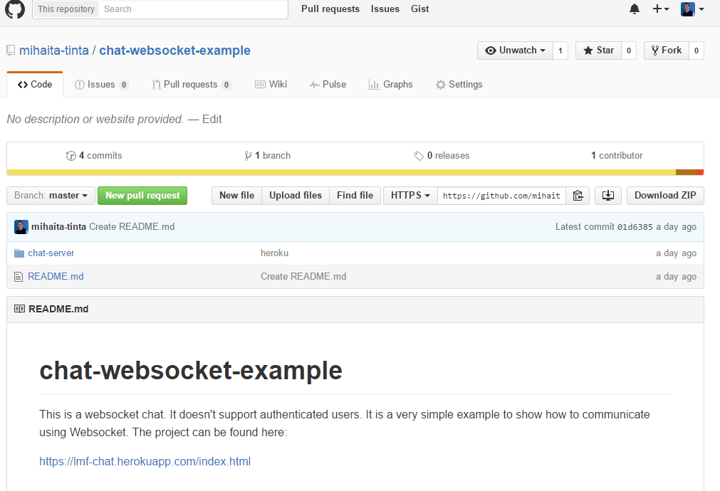
Github sau svn server
Git sau svn

Slide 14
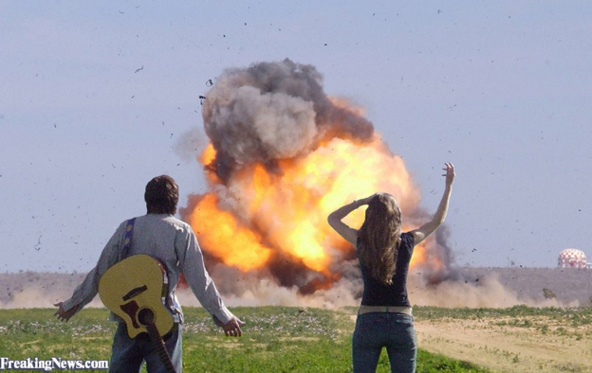
Coding

