Slide 1
HOW TO CREATE a chat using Websocket and angular js
Mihaita Tinta

Slide 2



Mihaita Tinta
2008-2012 ETTI – CTI
2012-2014 FILS – SE
2010 – Programator
Prezent – Technical leader
mihaitatinta.tumblr.com
@mihaitatinta
mihaita-tinta

Slide 3
Contents
Overview CLIENT - Server architecture and WEBSOCKETs
Available technologies to create a chat: Spring boot, Angular js
Live CODINg
DEPLOY to HEROKU
LIVE DEMO
Go mobile
Q&A

Slide 4
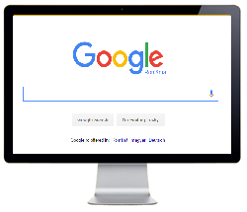
CLIENT – SERVER architecture
Request
Web Server
Database
Response

Slide 5
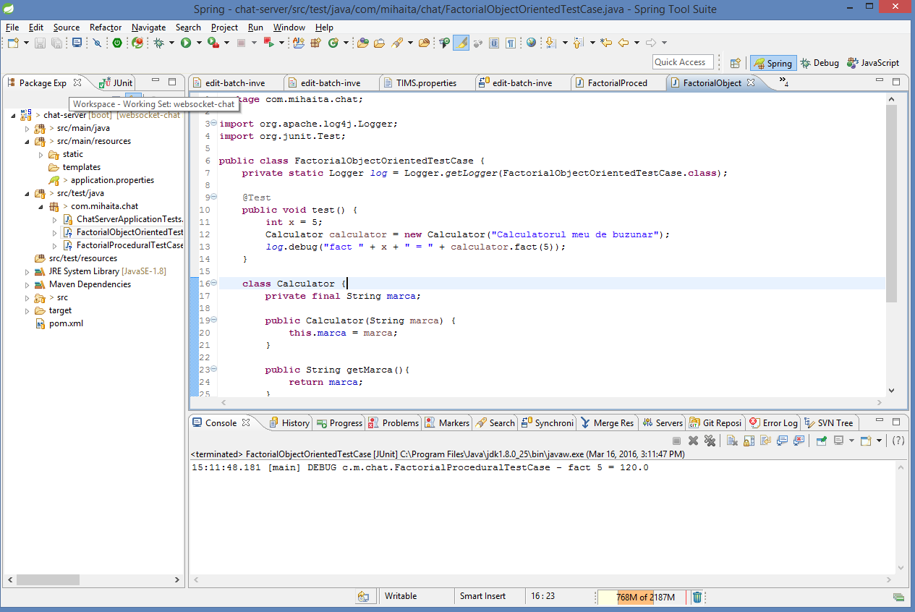
Springsource tool suite (eclipse)
https://spring.io/tools/sts/all

Slide 6
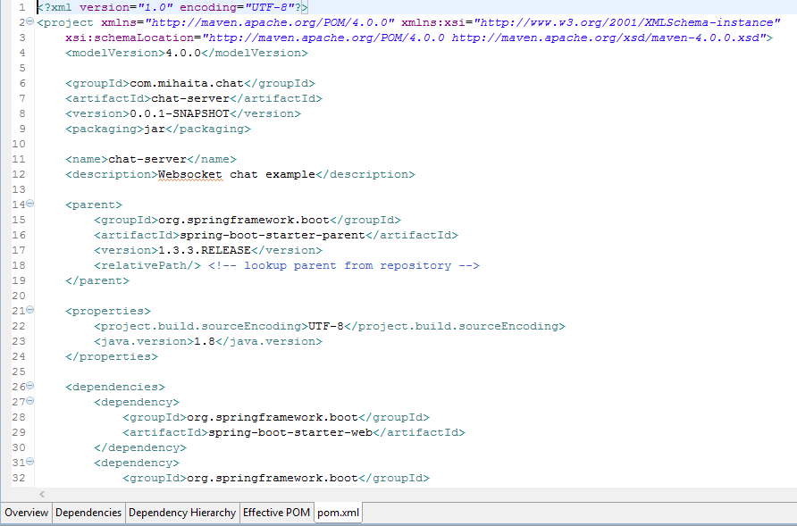
Apache Maven
http://maven.apache.org/

Slide 7
Persistent storage
Mysql
Postgresql
H2
ORACLE
SQLite
DERBY
Mongo db

Slide 8
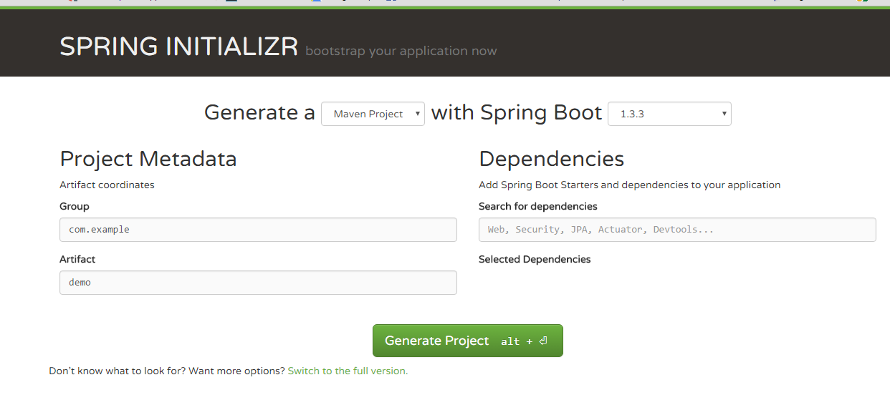
Spring boot
http://start.spring.io/

Slide 9
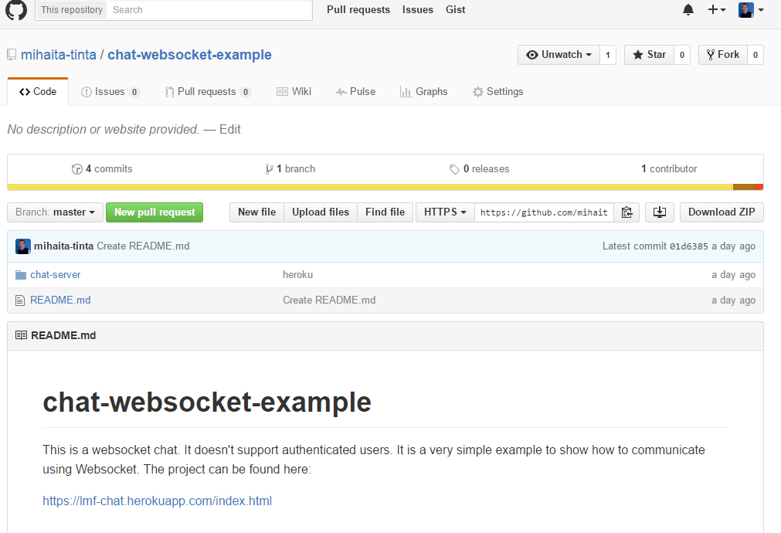
Github or svn server
Git or svn

Slide 10

Coding

