Slide 1


Data Processing at Scale with Knative and Benthos
Mihai Todor
Principal Software Engineer @ Optum
Murugappan Sevugan Chetty
Staff Software Engineer @ Box
May 17th, 2022, Valencia, Spain

Slide 2
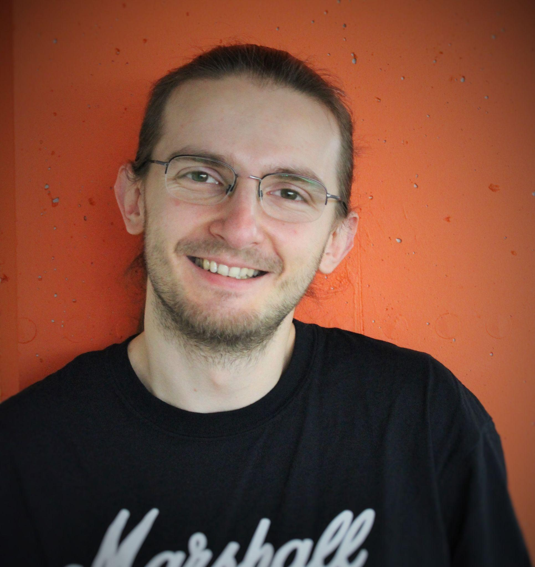
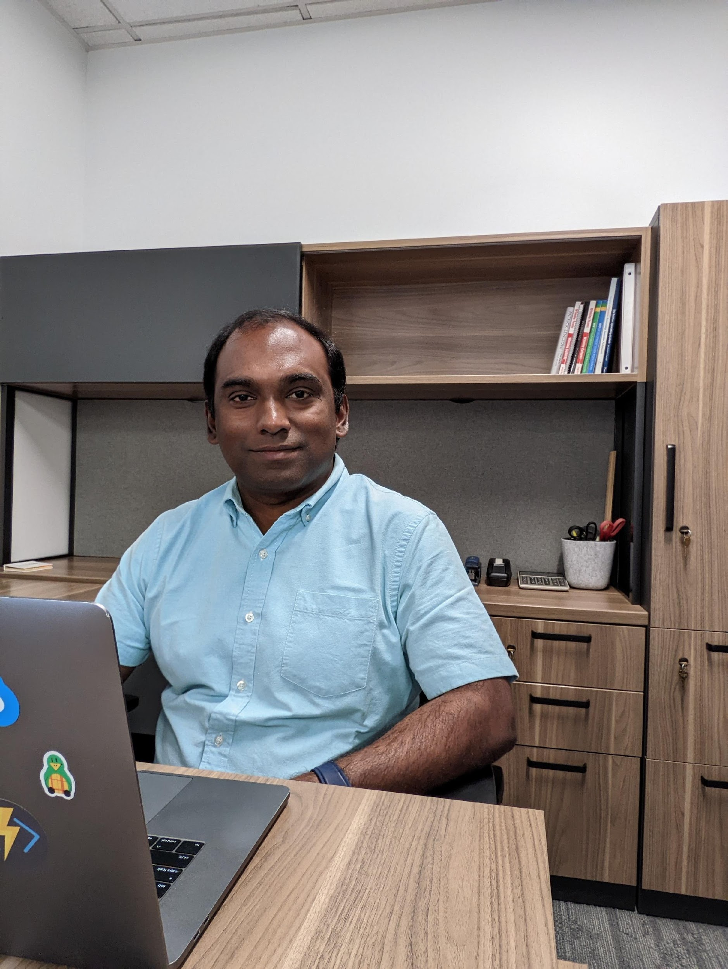
About Us
Mihai Todor
Principal SWE @ Optum
Data Streaming
Benthos contributor: https://www.benthos.dev/
GitHub: https://github.com/mihaitodor
Murugappan Chetty
Staff SWE @ Box
Container platforms
Open source contributor
Knative steering committee member representing end users
https://itsmurugappan.github.io

Slide 3
Agenda
Knative Autoscaling
Benthos
Benthos + Knative
Demo

Slide 4
Knative Autoscaling
Murugappan Sevugan Chetty

Slide 5
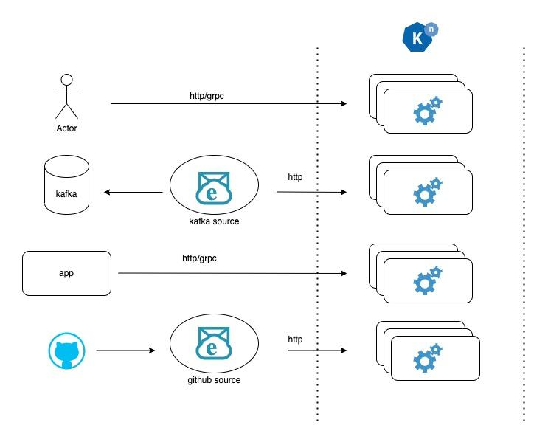
Knative Autoscaling
Push Based
RPS/Concurrency

Slide 6
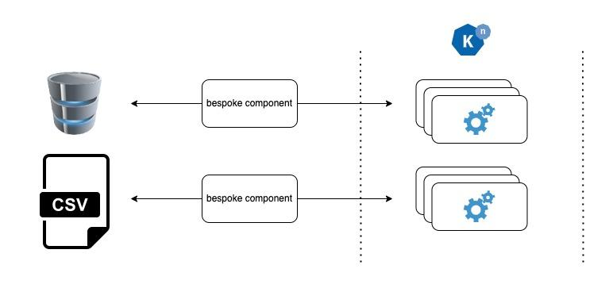
Knative Autoscaling
Pull Based
Requires bespoke components

Slide 7
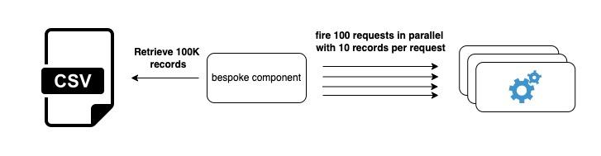
Bespoke Component

Slide 8
Component that we need
Configurable
Integrates with commonly used data sources
HTTP/gRPC sink option
Scalable
Resilient
Observable

Slide 9
Benthos
Mihai Todor

Slide 10
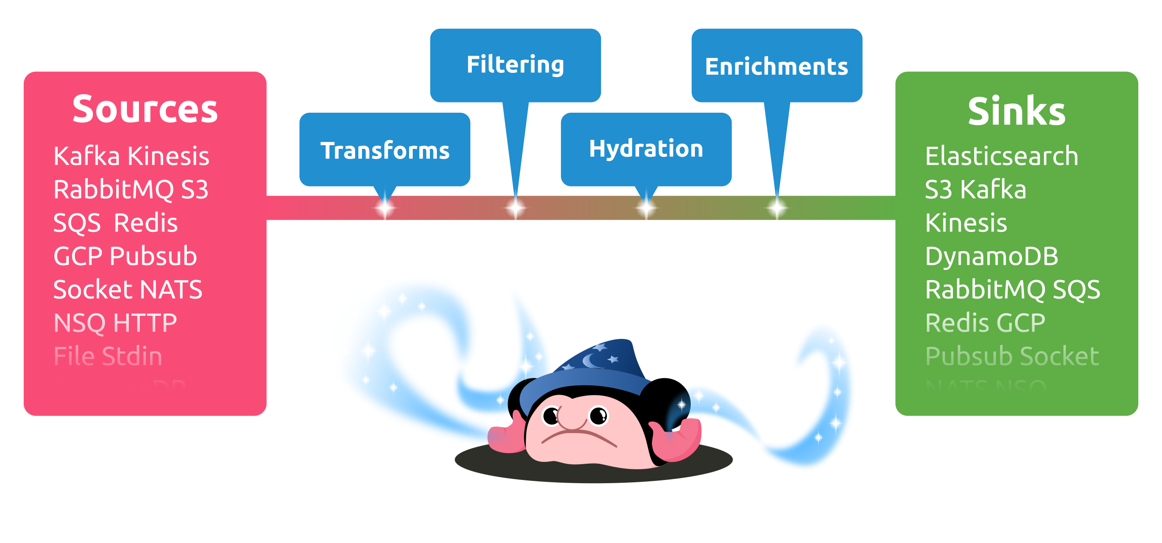
What is Benthos?
"Fancy stream processing made operationally mundane"
Ashley Jeffs, Benthos creator

Slide 11

Why Benthos?
Performant and simple
YAML / CUE configs
Stateless
Extendable

Slide 12



Let’s combine them!

Slide 13
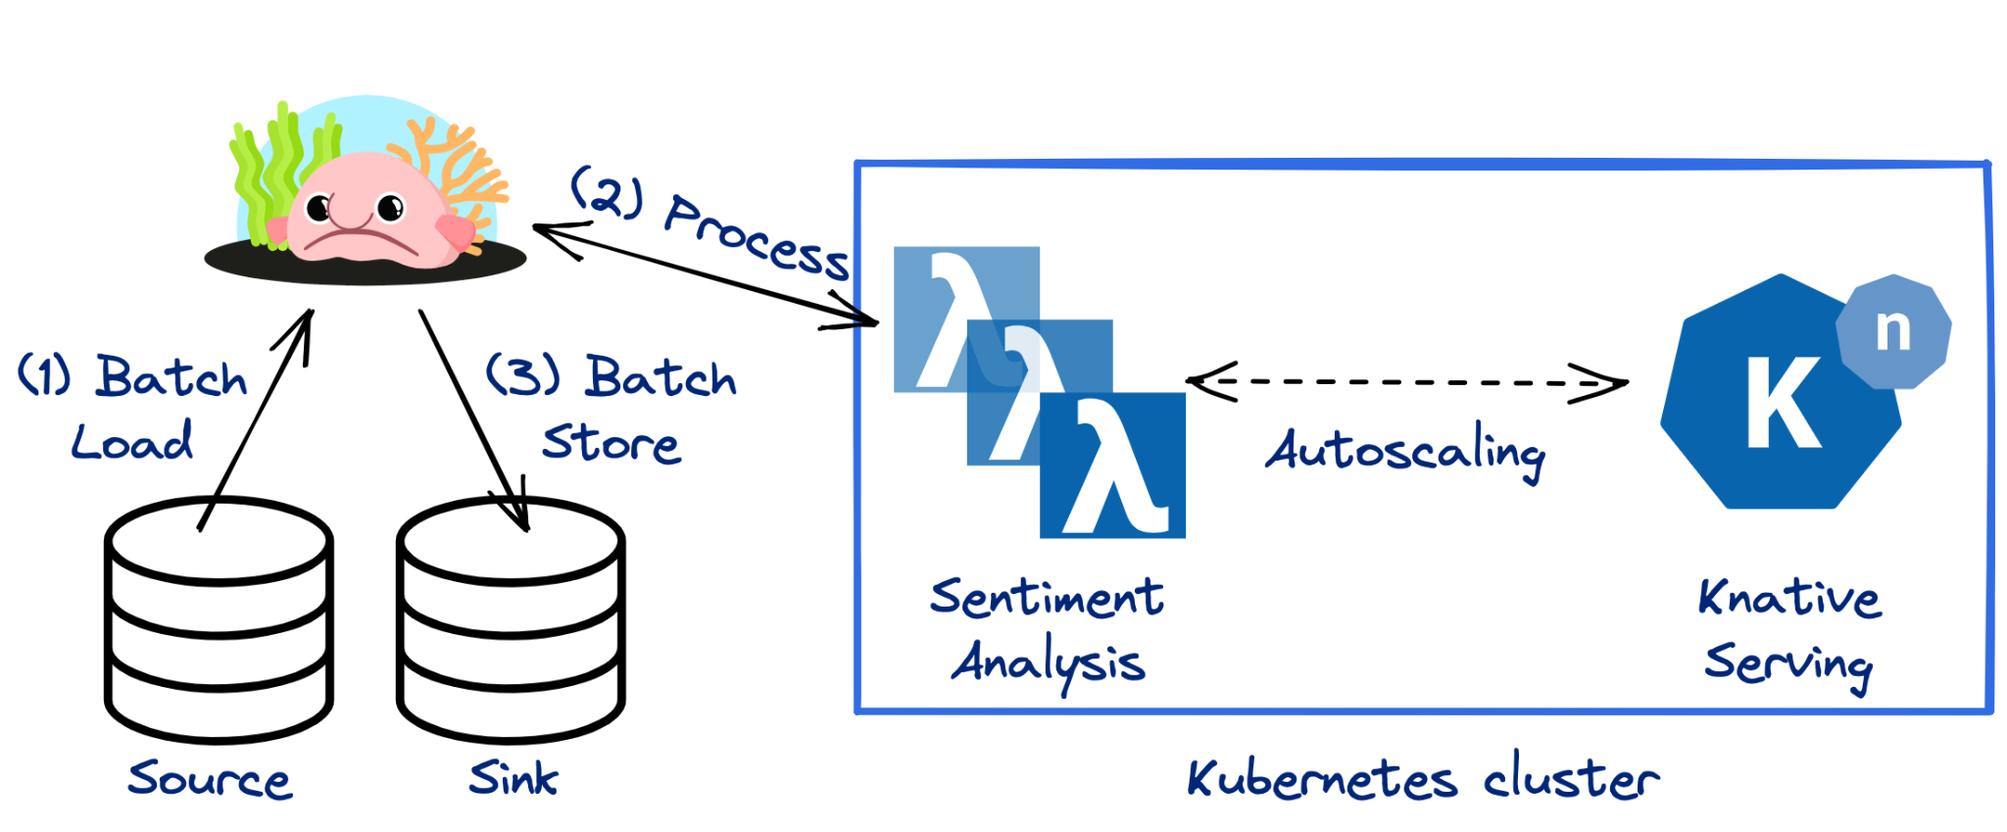
Demo Architecture

Slide 14
Demo
Scalable sentiment analysis on Twitter data
Mihai Todor

Slide 15
Summary
Knative supports push based autoscaling
Pull based autoscaling requires bespoke components
Benthos provides a configurable way to leverage Knative autoscaling

Slide 16
Thank you!
Reach out to us
Mihai: https://www.linkedin.com/in/mtodor/
Muru: https://www.linkedin.com/in/murugappan-chetty/
https://benthos.dev

