Slide 1


DEBRINET
S.S.J.D.D.
Small Space Junk Disposal Device

Slide 2
TABLE OF CONTENTS
01
04
02
05
03
06
THE VISION
IMPACT
DESCRIPTION
OUR BUSINESS IDEA
BENEFITS
OPERATIONS&GROWTH

Slide 3
THE VISION
We aim to protect space through an innovative, nature-inspired solution that tackles the growing threat of orbital debris.
Our concept: a flexible “space blanket” made from Dyneema and Kevlar, designed to collect and secure debris of various sizes in orbit.
This intelligent net can deploy autonomously, capture debris, and prepare it for controlled deorbiting or recycling.
By combining aerospace technology with sustainability, we offer a scalable solution to combat space pollution.
Our mission is to promote a safe, clean, and sustainable orbital environment, ensuring the future of space exploration for generations to come.

Slide 4

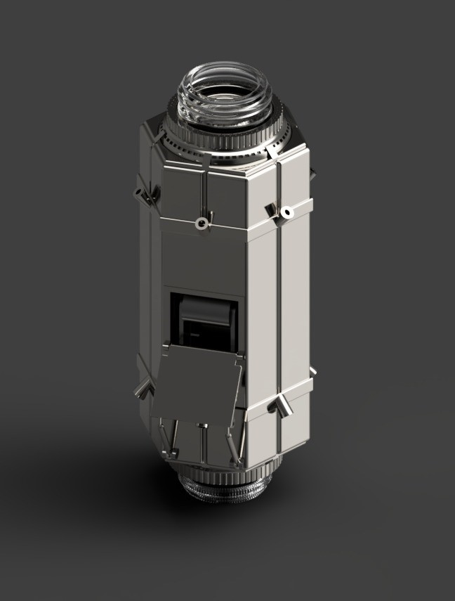

Our Thrust Pod

Slide 5
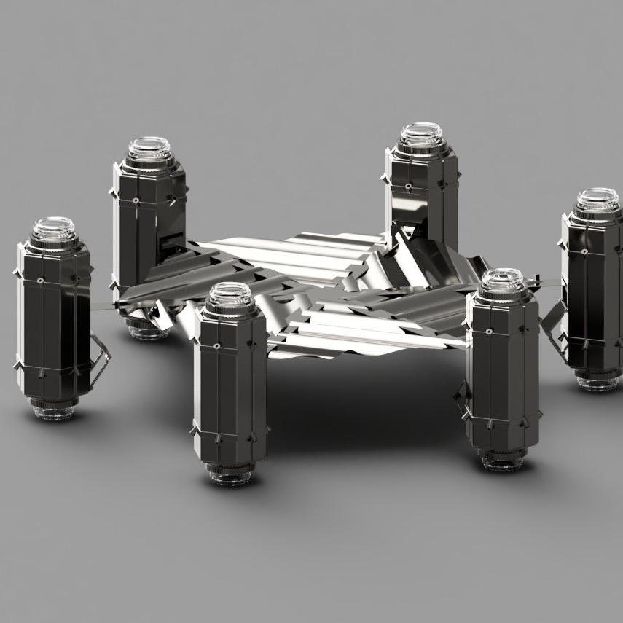
Description
Our product’s primary goal is the removal of space debris, such as fragments from destroyed satellites, non-functional satellites, and satellites that have exceeded their operational lifespan.
The net is made of three layers: Dyneema for strength, EVA foam for flexibility, and Kevlar for impact resistance. This combination makes the net lightweight but very durable in the harsh conditions of space.This net serves as the primary tool for redirecting debris toward destruction, gradually approaching target objects and slowly guiding them into Earth’s atmosphere.
To control the net, we designed it with six thrusters placed around the hexagon. These thrusters allow the system to keep its orientation stable and adjust its path while approaching debris targets.
The satellite uses cameras and sensors (LiDAR) to identify debris and navigate safely, relying on orbital data (TLEs from sources like Space-Track, NASA, and ESA) to avoid collisions with active satellites.
Render of our product

Slide 6


BENEFITS
1. Supports Scientific Research and Space Exploration A safer orbital environment allows scientific missions to operate longer and with fewer risks, opening new opportunities for innovation and discovery.
2. Creates New Economic Opportunities Reducing space debris fosters the growth of new industries focused on space maintenance, recycling, and sustainable exploration.
3. Reduces the Risk of Space Collisions Over 100 million uncontrolled objects orbit Earth today. Capturing debris helps prevent damage to active satellites, space stations, and crewed missions.

Slide 7



IMPACT
4. Protects Communication and GPS Infrastructure Cleaner orbits ensure the reliability of global communication, navigation, and data networks that depend on satellite systems.
5. Prevents the Kessler Syndrome This theory warns that debris collisions could trigger a chain reaction, making Earth’s orbit unusable for decades. Acting now helps prevent irreversible orbital pollution.
6. Enables Future Recycling Opportunities Captured debris could be analyzed, reused, or recycled in orbital factories, turning waste into valuable resources.
7. Lowers the Cost of Orbital Accidents Repairing or replacing damaged satellites costs hundreds of millions of dollars — prevention is far cheaper and more sustainable.

Slide 8

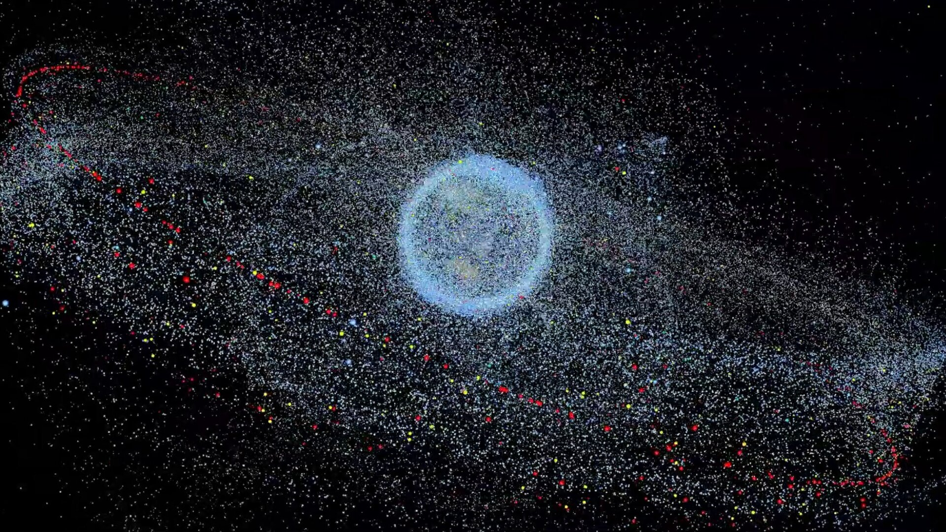
POZA
Representation of the space debris

Slide 9

BUSINESS IDEA
Our initiative proposes an innovative solution to reduce the risks caused by space debris through the development of an advanced orbital capture system — a flexible “blanket” made from ultra-resistant materials such as Dyneema.
The system is designed to capture debris of various sizes and shapes, ensuring safety, adaptability, and durability in the extreme conditions of outer space.
Development will take place in a specialized technology center equipped for testing, simulation, and prototype assembly, focused on maximizing system efficiency and reliability.

Slide 10
Target Market Overview
National Space Agencies (NASA, ESA, JAXA, ISRO)
Active in LEO (ISS, research satellites)
Responsible for orbital sustainability regulations
Already funding debris removal projects (ESA ClearSpace-1)
Needs: Direct contracts for orbital cleaning prototypes
Motivation: Protect investments & maintain global leadership
Major Commercial Constellation Operators (SpaceX, Amazon Kuiper)
Thousands of satellites in LEO → high collision risk
Single collision could destroy satellites worth tens of millions
Needs: “Debris removal as a service” or deorbiting contracts
Motivation: Protect assets & ensure uninterrupted services

Slide 11
Supporting Stakeholders & Conclusion
Space Insurance Companies (Lloyd’s, AXA XL, etc.)
Cover financial losses from orbital accidents
Safer space → lower premiums & stable profits
Needs: Co-financing or partnerships for LEO cleaning included in policies
Motivation: Reduce catastrophic risks & set insurance + prevention precedent
International Organizations & Governments (UN, EU, US Space Command)
Strategic/geopolitical interest: uncontrolled debris = potential military risk
Developing regulations & global programs for orbital cleaning
Needs: Fund demonstration missions & multinational initiatives
Motivation: Global cooperation & conflict prevention

Slide 12
OUR BUDGET
Components | Estimated Cost for 478kg
Layer 1 (exterior) — Dyneema 3 mm | 30.000$
Layer 2 (intermediate) — EVA foam 3 cm | 1.920$
Layer 3 (interior) — Kevlar + lightweight composite | 3.000$
Frame/structure — Foldable aluminum/composite | 3.000$
Deployment system — Springs/guidance | 2.000$
CubeSat 6U | 800.000$
6 Thruster Pods | 270.000$ (aprox. 45k each)
Testing
Impact test | 50.000$
Vacuum chamber | 70.000$
Numerical simulation | 25.000$
Design
3D design, structural analysis | 2.000$
Algorithms | 1.900$
Launch
SpaceX rideshare | 3.5mil$
TOTAL COST | 4.488.000$

Slide 13
OPERATIONS & GROWTH
Dedicated digital platform will connect space agencies, research institutions, and private companies, offering:
Custom technical solutions
Real-time project tracking
Access to specialized consulting
The initiative also includes pilot-scale implementations within space missions, with the goal of scaling globally as part of future orbital debris management strategies.
By tackling a critical global issue, this project creates new business opportunities in a high-growth, sustainable space technology sector.

Slide 14
BIBLOGRAPHY/SITEOGRAPHY
Dyneema® by DSM: https://www.dsm.com/dyneema
Gottifredi Maffioli – Bio-based Dyneema: https://www.gottifredimaffioli.com/en/about-bio-based-dyneema/v
OTS Offshore – Dyneema Technology: https://www.otsas.no/fiber-technology/dyneema/
Cosplay Craft EVA Sheets: https://cosplaycraft.pl/en/menu/eva-foam-193.html
Cosplayxlife EVA Foam: https://www.cosplayxlife.com/EVA-FOAM-100cmx200cm-sp5mm
Kevlar® by DuPont: https://www.dupont.com/brands/kevlar.html
Research paper: Mechanical Properties of CNT Reinforced Titanium Matrix Composites : https://doi.org/10.1016/j.matdes.2014.10.037
SpaceX Rideshare Program – Estimated Cost for LEO https://www.spacex.com/rideshare/
Momentus Space – Orbital Transfer Services https://momentus.space/
ANSYS & LS-DYNA for impact simulation https://www.ansys.com/products/structures/ansys-ls-dyna
NASA SBIR/STTR Open Proposals (for funding ): https://sbir.nasa.gov/
ESA : https://www.esa.int/
NASA – Orbital Debris Program Office https://orbitaldebris.jsc.nasa.gov/
NASA – Small Sats/ CubeSats: https://www.nasa.gov/what-are-smallsats-and-cubesats/
ESA PICTURES: https://www.esa.int/ESA_Multimedia/Videos/2019/02/Distribution_of_space_debris_in_orbit_around_Earth

