Slide 1
THE SECRET LIFE
OF A MAUI PAGE
Managed Page
Handler
What actually happens between new MyPage() and the garbage collector?
Native View
Navigation
GC
Mihajlo Mladenov

Slide 2
Dedicated to my wife, our daughter and the two little ones on the way!
You are my biggest motivation, and the reason everything outside this screen matters the most.

Slide 3

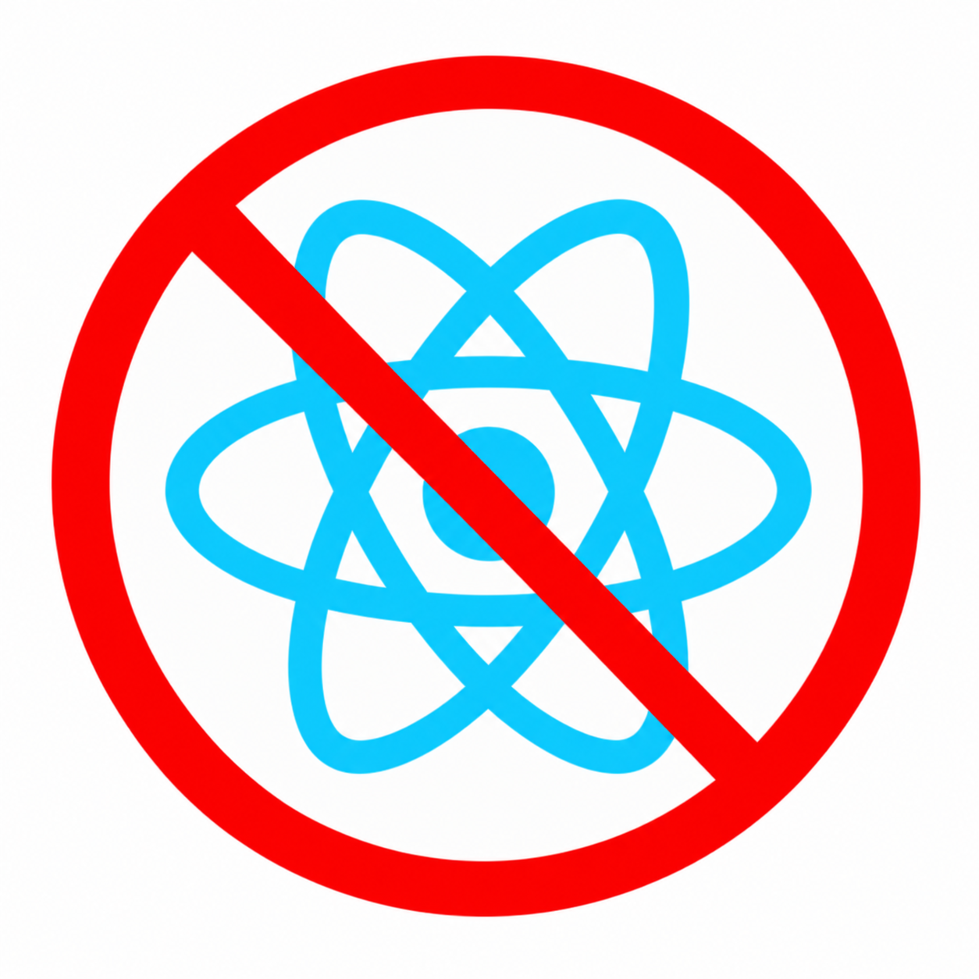
MAUI Day rules
No F-word
No N-word

Slide 4
THE MYSTERY
The page disappeared. Why is it still alive?
This is the question that turns lifecycle knowledge into useful debugging.
await Shell.Current.GoToAsync("details?id=42");
// user taps Back
await Shell.Current.GoToAsync("..");
What you see
DetailsPage is gone from the screen.
What may still exist
The page, its ViewModel, handlers, native views, event subscriptions, tasks...
Visibility is a UI state. Lifetime is an ownership problem.

Slide 5
MENTAL MODEL
One page, five phases
We only need enough internals to understand ownership at each phase.
1 Construct
2 Connect
3 Show
4 Navigate away
5 Collect
C# + XAML
managed tree
Handler +
native tree
Appearing /
interaction
Stack changes /
cleanup
Only when
unreachable
We will keep asking one thing:
Who owns the page now?

Slide 6
PHASE 1
Construction creates a managed object graph
InitializeComponent() gives you much more than a page object - but still no native control.
public DetailsPage(DetailsViewModel vm)
{
InitializeComponent();
BindingContext = vm;
}
Created now
Not guaranteed yet
ContentPage
XAML children
Bindings + resources
BindingContext references
Handler
PlatformView
Native visual tree
On-screen state
Constructor ≠ screen. Managed tree first; platform tree later.

Slide 7
PHASE 2
The handler is the bridge, not the page
It links a cross-platform control to its platform implementation.
ContentPage / View
Handler
PlatformView
VirtualView
mapper + lifecycle
UIView / Android View / WinUI
protected override void OnHandlerChanged()
{
base.OnHandlerChanged();
Debug.WriteLine(Handler?.PlatformView?.GetType().Name);
}
OnHandlerChanged is the moment your managed control has a platform counterpart.

Slide 8
UNDER THE HOOD
A page can live in two trees at once
The managed visual tree and the platform-native tree are related, but they are not the same object graph.
Managed tree
Native tree
ContentPage
UIViewController / Fragment
Handlers
Grid
ViewGroup
create
connect
map
disconnect
Entry
UITextField / EditText
Button
UIButton / MaterialButton
Native event subscriptions cross the boundary - and must be disconnected somewhere.

Slide 9
PHASE 3
Appearing and disappearing are visibility signals
Useful lifecycle hooks - but they are not object lifetime boundaries.
Constructor
HandlerChanged
OnAppearing
OnDisappearing
GC
Object exists
Native side ready
About to be shown
About to stop being visible
Only if unreachable
Common mistake: “OnDisappearing fired, therefore the page is finished.”
Disappearing tells you about visibility. The GC cares about reachability.

Slide 10
PHASE 4
Navigation is ownership
If a page is still in a navigation stack, it is supposed to remain alive.
Navigation stack
After Pop / ".."
RootPage
Expected owner removed
ListPage
Now any remaining strong reference is worth investigating.
DetailsPage
A page surviving while it is in the stack is normal. Surviving after removal may not be.

Slide 11
PHASE 5
Garbage collection follows reference paths
The collector does not know what “closed page” means. It only knows reachable vs unreachable.
GC root
static event
delegate
DetailsPage
ViewModel
var weak = new WeakReference(page);
page = null;
GC.Collect();
GC.WaitForPendingFinalizers();
GC.Collect();
Debug.WriteLine(weak.IsAlive);
A memory leak is usually just an unexpected reference path.

Slide 12
LEAK PATTERNS
Three ways “harmless” code keeps a page alive
1 Long-lived event
2 Native / handler event
3 Work outlives the page
AppEvents.Changed += OnChanged;
The publisher outlives the page, so the delegate can keep the page reachable.
Fix: unsubscribe or use a lifetime-aware pattern.
Handler.PlatformView.SomeEvent += ...
Now a platform object participates in the reference chain.
Fix: pair connect with disconnect / cleanup.
Timer, callback, task, subscription, cached ViewModel...
The page is gone visually, but something still has work tied to it.
Fix: cancellation + explicit ownership.
Don’t memorize leak types. Follow the owner → reference → page path.

Slide 13
DEBUGGING
A five-step recipe that works better than guessing
1
Give each page instance an ID
Know which instance you are actually looking at.
2
Log lifecycle + handler changes
Constructor, HandlerChanged, Appearing, Disappearing.
3
Verify navigation ownership
Is it still in a stack, modal, tab, cache, route?
4
Track with WeakReference
After expected removal, test whether it can be collected.
5
Find the retaining path
Static/service/native event? Task? timer? cache? ViewModel?
Prove ownership first. Prove collection second. Then inspect the retaining path.

Slide 14
LIVE DEMO
Page Lifecycle Lab
We’ll watch one page go through the whole journey, then break it on purpose.
A
Create + navigate
Watch ctor, handler, native view, appearing.
B
Navigate back
See disappearing and navigation ownership end.
C
Prove collection
WeakReference becomes dead after controlled GC.
D
Introduce one leak
Static event keeps the page alive.
E
Fix it
Remove the retaining reference and collect again.
~15 minutes

Slide 15
PRODUCTION PERSPECTIVE
Why this mental model matters at scale
Internals become useful when telemetry tells you what happened, but not why.
Crash / ANR
Performance
Memory
A native stack may start far below your XAML. Knowing the handler/platform boundary narrows the search.
Repeated page creation, handler churn, retained trees, and duplicate subscriptions show up as real cost.
“Page disappeared” is not evidence. Reference paths and collection are.

Slide 16
TAKEAWAYS
Three things to remember
A page is more than a page
Managed tree + handler + native tree + owners.
1
Disappearing is not dying
Navigation and visibility are different from reachability.
2
Debug ownership, not symptoms
Ask who holds the reference and where that ownership should end.
3
When something feels “random” in MAUI, draw the ownership graph.

