Slide 1


Java 8: Stream API - Parallel Streams
Divide and conquer
APRIL 24, 2017

Slide 2
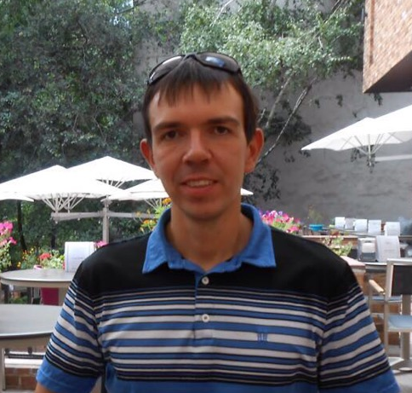
About me
My name: Mikhail Kantserov
My Mail: mikhail_kantserov@epam.com
My Skype: mihsankan

Slide 3
Agenda
Stream basics
Parallel stream basics
Some parallel stream code
Parallel streams under the hood
Measuring stream productivity
Common mistakes
QA

Slide 4
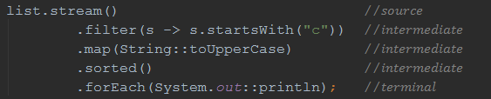
Stream basics
Abstraction that lets you process multiplicity of values in a declarative way
Execution postponed till terminal operation
Can be infinite
Source NOT mutated
Executable ONCE
Can run in a parallel way

Slide 5


Parallel stream basics
Streams can leverage multi-core architectures without you having to write a single line of multithread code

Slide 6
Streams in code
Lets see some code!
Notes:
prerequisites: ivy.jar copied to ant libraries
info: organization; module; status [integration/milestone/release]; revision; publication [autogenerated]

Slide 7
Stream under the hood
…

Slide 8
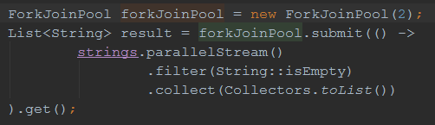
Custom parallel stream

Slide 9
Performance tests
Lets see some more code!

Slide 10
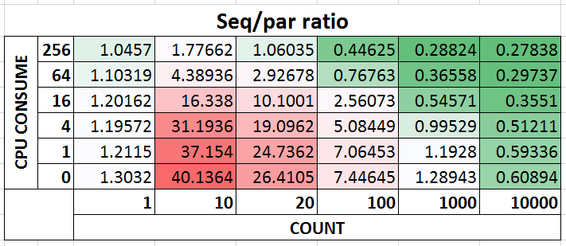
Test results

Slide 11
Common mistakes
Lets see some error prone code!

Slide 12

QA

Slide 13
Sources
Stream Parallel Guidance - Doug Lea: http://gee.cs.oswego.edu/dl/html/StreamParallelGuidance.html
Shipilëv blog: https://shipilev.net/
Talk samples: https://github.com/mihakz/streamTalk

Slide 14
Thank you!

