Slide 1


Java 8: Stream API - Parallel Streams
Divide and conquer
APRIL 24, 2017

Slide 2

About me
My name: Mikhail Kantserov
My Mail: mikhail_kantserov@epam.com
My Skype: mihsankan

Slide 3
Agenda
Stream basics
Parallel stream basics
Some parallel stream code
Parallel streams under the hood
Measuring stream productivity
Common mistakes
QA

Slide 4
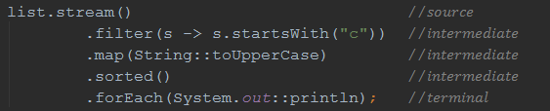
Stream basics
Abstraction that lets you process multiplicity of values in a declarative way
Execution postponed till terminal operation
Can be infinite
Source NOT mutated
Executable ONCE
Can run in a parallel way

Slide 5


Parallel stream basics
Streams can leverage multi-core architectures without you having to write a single line of multithread code

Slide 6
Streams in code
Lets see some code!
Notes:
prerequisites: ivy.jar copied to ant libraries
info: organization; module; status [integration/milestone/release]; revision; publication [autogenerated]

Slide 7
Stream under the hood
…

Slide 8
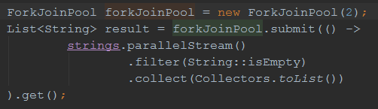
Custom parallel stream

Slide 9
Performance tests
Lets see some more code!

Slide 10
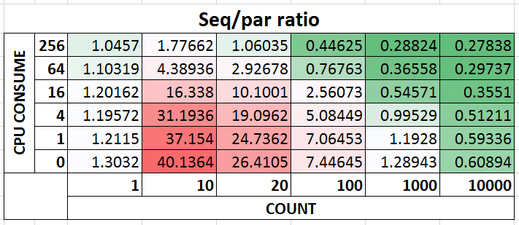
Test results

Slide 11
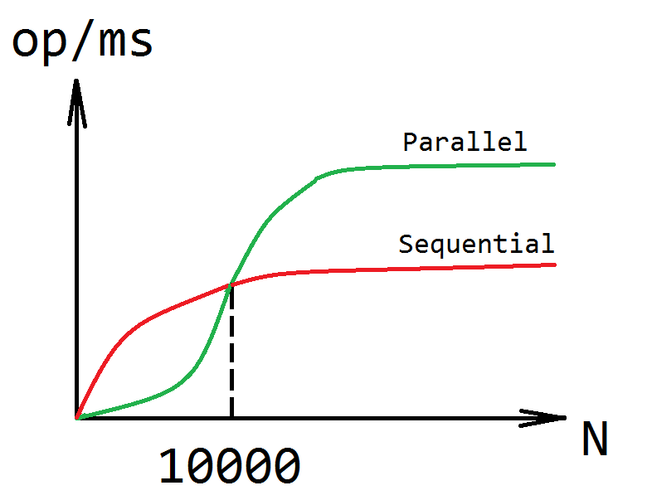
From other point of view

Slide 12
Sequential or parallel
Criteria | Parallel | Sequential
Stream scale factor | Large collection High cost per element | Small collection Low cost per element
Source of stream | ArrayList Plain array HashMap | LinkedList BlockingQueue IO based source
Independence | Independent Stateless | Impact on other Stateful
CPU cores | >1 core | 1 core

Slide 13
Common mistakes
Lets see some error prone code!

Slide 14
Some enterprise concerns
Not managed? Probably, not the case
Application server is already multithreaded
Not sure? Don’t use!!!

Slide 15

QA

Slide 16
Sources
Stream Parallel Guidance - Doug Lea: http://gee.cs.oswego.edu/dl/html/StreamParallelGuidance.html
Shipilëv blog: https://shipilev.net/
Talk samples: https://github.com/mihakz/streamTalk

Slide 17
Thank you!

